Slide 1

ICSC Italian Research Center on High-Performance Computing, Big Data and Quantum Computing
Missione 4 • Istruzione e Ricerca

Slide 2

G2Q Computing - A Compressed Hybrid Quantum Optimizer
Michele Cattelan Senior Quantum Algorithm Developer
ICSC Italian Research Center on High-Performance Computing, Big Data and Quantum Computing
Missione 4 • Istruzione e Ricerca

Slide 3




G2Q: Advanced Scientific Computing
G2Q develops and researches advanced computational methods, including quantum computing, to create innovative software solutions that optimize costs, time, and business performance.
We deliver:
Industrial scale Variational Quantum Distributed Optimization: by simulating quantum properties we can break up an optimization problem without loosing essential correlations thus allowing faster convergence to optimal solutions
Compressed Machine Learning algorithms with improved accuracy: by using quantum correlations we reduce training times and increase accuracy
HPC Class infrastructure to solve industrial scale problems: reduce costs and increase speed of computation by efficiently and precisely executing in parallel large sets of related classical and quantum computing tasks
ICSC Italian Research Center on High-Performance Computing, Big Data and Quantum Computing
Missione 4 • Istruzione e Ricerca

Slide 4
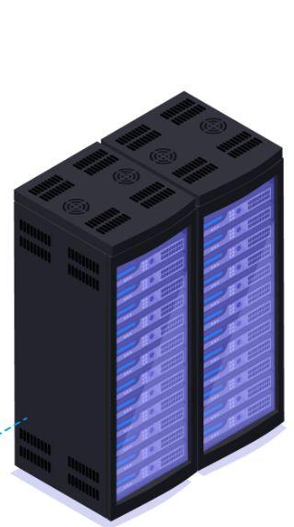
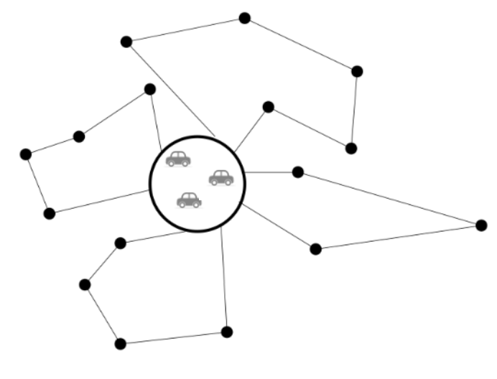
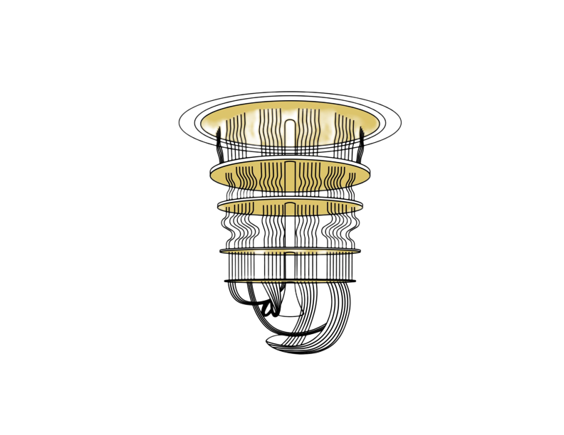
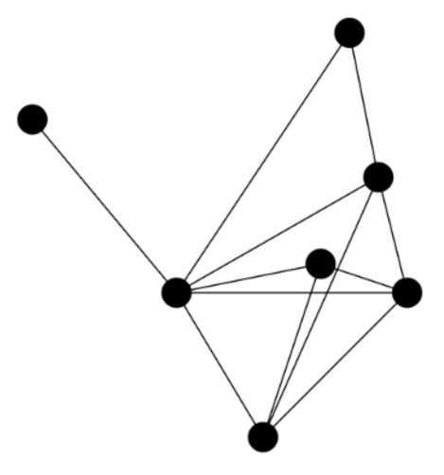
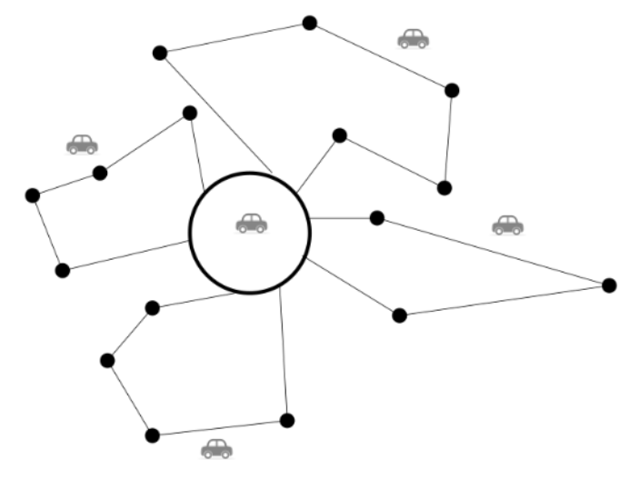
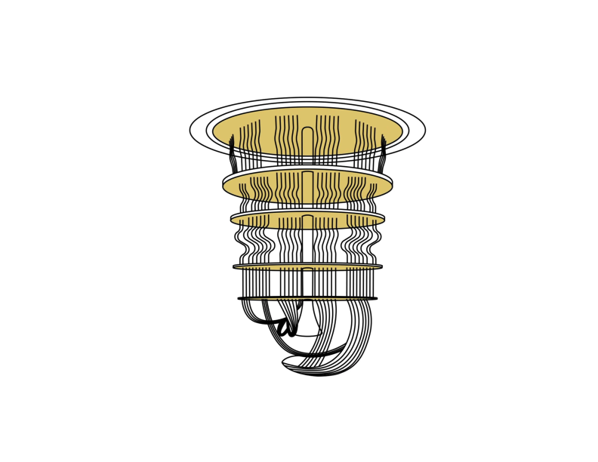
Quantum Distributed Optimizer (QDO)
Our tool distributes and solves large-scale, constrained optimization problems
Quantum-ready: supports both Classical and Quantum execution. For the Fully Classical execution the software simulates quantum mechanics on Classical computers
Generates samples from smaller circuits (simulated in parallel) and supports larger circuits on quantum hardware using our native noise-reduction techniques
Why is our solution different?
G2Q solution
Competitor Solutions
We use the QC as a distribution generator based on global properties of the problem
Encode and divide the problem in disconnected subproblems
We collect the samples from the distributions that already give the solution restricted to the subgraph of interest
The original problem is obtained using methods to “cut and paste” the subproblem solutions.
ICSC Italian Research Center on High-Performance Computing, Big Data and Quantum Computing
Missione 4 • Istruzione e Ricerca

Slide 5


High Quality Liquid Asset (HQLA) problem
Assets must be located to different portfolios.
Each asset has a miximum number of assignations.
The goal is to maximize the profit of the portfolio, while keeping the risk below some threshold.
ICSC Italian Research Center on High-Performance Computing, Big Data and Quantum Computing
Missione 4 • Istruzione e Ricerca

Slide 6


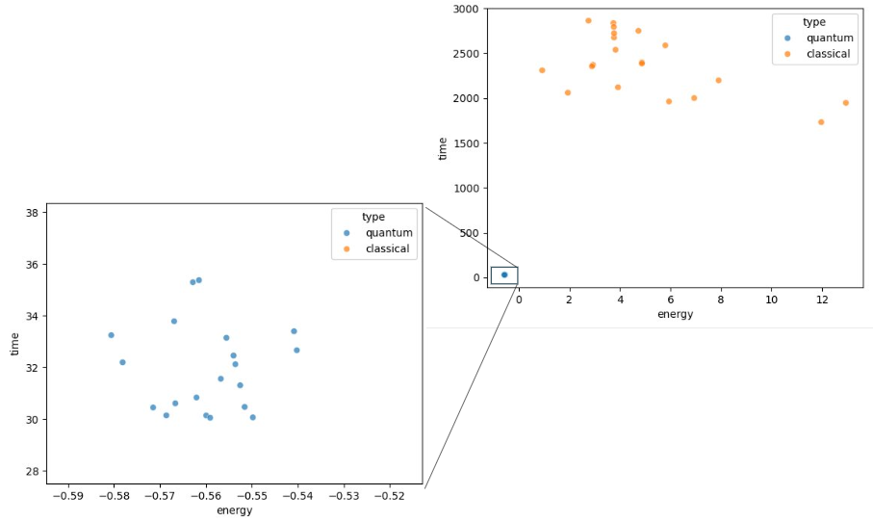
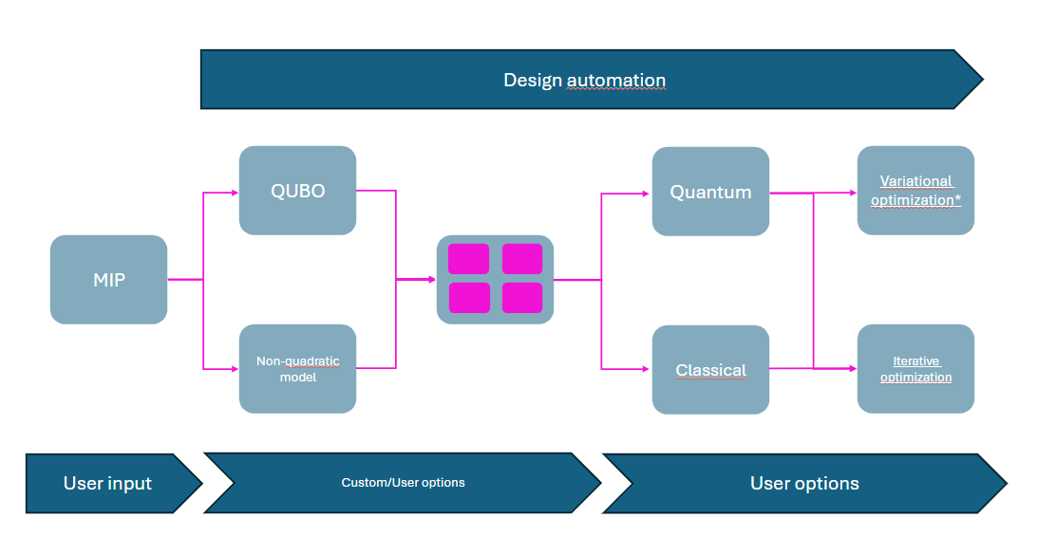
Quantum Distributed Optimizer (QDO)
Benchmarking (simulation)
Highly customizable: The user can select between simulation and hardware execution
Here we illustrate the architecture of the software and compare the results of our QDO (using simulated circuits of at most 15 qubits) with SA’s performance on HQLA problem instances with 5 accounts and 500 cashflow.
ICSC Italian Research Center on High-Performance Computing, Big Data and Quantum Computing
Missione 4 • Istruzione e Ricerca

Slide 7
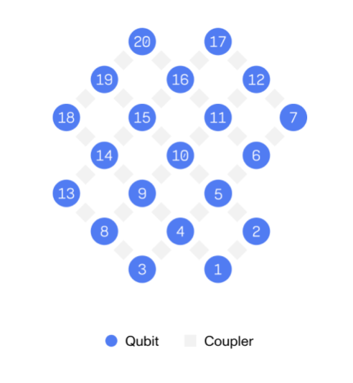
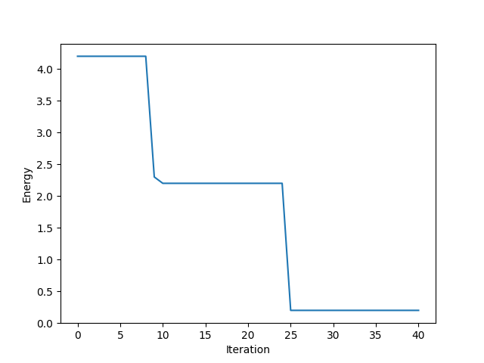
Quantum Distributed Optimizer (QDO)
Benchmarking (quantum hardware – superconducting qubits)
Quantum Assembly compatibility.
Phisical-parameters tuning.
Hardware connectivity.
ICSC Italian Research Center on High-Performance Computing, Big Data and Quantum Computing
Missione 4 • Istruzione e Ricerca

Slide 8

Grazie
per
l’attenzione
ICSC Italian Research Center on High-Performance Computing, Big Data and Quantum Computing
Missione 4 • Istruzione e Ricerca

