Slide 1

ICSC Italian Research Center on High-Performance Computing, Big Data and Quantum Computing
Missione 4 • Istruzione e Ricerca

Slide 2

SDDS - Secure Dynamic Data Sharing
DocSpace srl, Genoa, Italy
Links SpA, Lecce, Italy
Massimo Marasca
ICSC Italian Research Center on High-Performance Computing, Big Data and Quantum Computing
Missione 4 • Istruzione e Ricerca

Slide 3

The problem
Satellites operate in hostile, fragmented and bandwidth-limited communication environments.
Different operators maintains isolated data, preventing mutual benefit from shared anomaly patterns.
Failures are costly and often irreversible.
Anomalies are rare but mission-critical: even a single detection can save efforts and resources.
ICSC Italian Research Center on High-Performance Computing, Big Data and Quantum Computing
Missione 4 • Istruzione e Ricerca

Slide 4
The solution
An experiment on Federated Learning for satellite Anomaly Detection
Focus on the infrastructure, not on the application.
Requirements:
Data protection (Intel SGX) ,
Confidential Networking (DocSpace)
Disruption-Tolerant Networking (DocSpace)
ICSC Italian Research Center on High-Performance Computing, Big Data and Quantum Computing
Missione 4 • Istruzione e Ricerca

Slide 5

??
Federated Learning
Confidential Computing
Intel SGX
Disruption Tolerant Network
DocSpace
ICSC Italian Research Center on High-Performance Computing, Big Data and Quantum Computing
Missione 4 • Istruzione e Ricerca

Slide 6
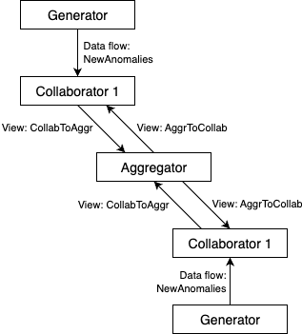
Federated Learning Model
ICSC Italian Research Center on High-Performance Computing, Big Data and Quantum Computing
Missione 4 • Istruzione e Ricerca

Slide 7
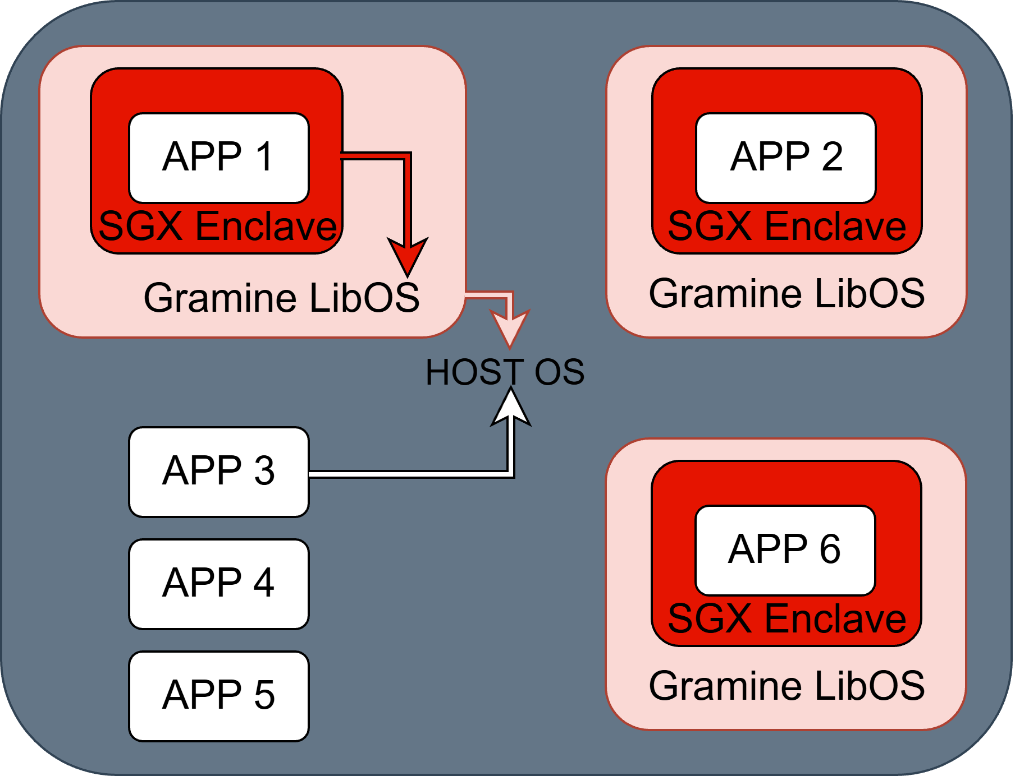
Confidential Computing – Intel SGX
ICSC Italian Research Center on High-Performance Computing, Big Data and Quantum Computing
Missione 4 • Istruzione e Ricerca

Slide 8
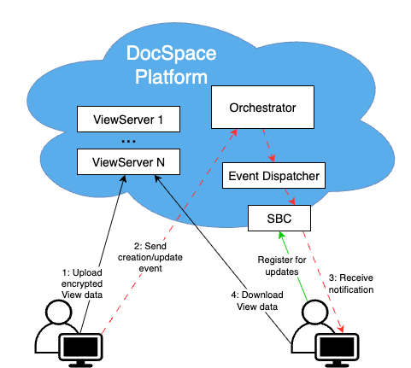
Disruption Tolerant Network – DocSpace
Control Plane (Connection):
Asymmetry,
Multicast,
Third Party Control.
Data Plane:
End-to-end encryption,
Persistence,
Delayed Synchronization.
Management Plane:
Logging and Monitoring,
History,
Graphical Visualization.
ICSC Italian Research Center on High-Performance Computing, Big Data and Quantum Computing
Missione 4 • Istruzione e Ricerca

Slide 9
Case studies
Using European Space Agency dataset with 56 different telemetry channels.
Linear classifier based on Support Vector Machine.
Input: 56 binary indicators.
Output: anomaly class.
Using FedAvg aggregation.
Using a synthetic version of OPSSAT-AD dataset, simulating heterogeneous local environments.
Each node trained a local Fully Connected Neural Network.
Input: 18 features.
Output: anomaly class.
Using FedAvg aggregation.
ICSC Italian Research Center on High-Performance Computing, Big Data and Quantum Computing
Missione 4 • Istruzione e Ricerca

Slide 10
Results
Collective experience and intelligence maintaining confidentiality.
Superior generalization thanks to complementary knowledge.
Global model > locally trained ones,
despite noise-induced heterogeneity.
ICSC Italian Research Center on High-Performance Computing, Big Data and Quantum Computing
Missione 4 • Istruzione e Ricerca

Slide 11
Conclusions
An experimental application for Anomaly Detection in the satellite domain.
Focus on infrastructure, not on the application.
Requirements:
Confidentiality → Gramine (Intel SGX),
Disruption-Tolerance Network → DocSpace.
A Disruption-Tolerant Distributed Confidential Infrastructure.
2 case studies validate the application.
ICSC Italian Research Center on High-Performance Computing, Big Data and Quantum Computing
Missione 4 • Istruzione e Ricerca

Slide 12

Grazie
per
l’attenzione
ICSC Italian Research Center on High-Performance Computing, Big Data and Quantum Computing
Missione 4 • Istruzione e Ricerca

