Slide 1

ICSC Italian Research Center on High-Performance Computing, Big Data and Quantum Computing
Missione 4 • Istruzione e Ricerca

Slide 2


NEBULA
Payload ottico event based con processore neuromorfico per Space-Based Space Situational Awareness
Daniele Sirigu
Sebastiano Felice Mereu
Alessandro Urru
Andrea Porru
Michele Arduini
Salvatore Dario dell'Aquila
Giovanni Bolognese
Simone Calabrese
ICSC Italian Research Center on High-Performance Computing, Big Data and Quantum Computing
Missione 4 • Istruzione e Ricerca

Slide 3


PROJECT GOAL
to test, in a Hardware-In-the-Loop setup,
the combination of an Event-Based Camera
and a Neuromorphic Processor
to assess advanced AI algorithms
for real-time SSA,
focusing on the detection and tracking of RSOs
ICSC Italian Research Center on High-Performance Computing, Big Data and Quantum Computing
Missione 4 • Istruzione e Ricerca

Slide 4
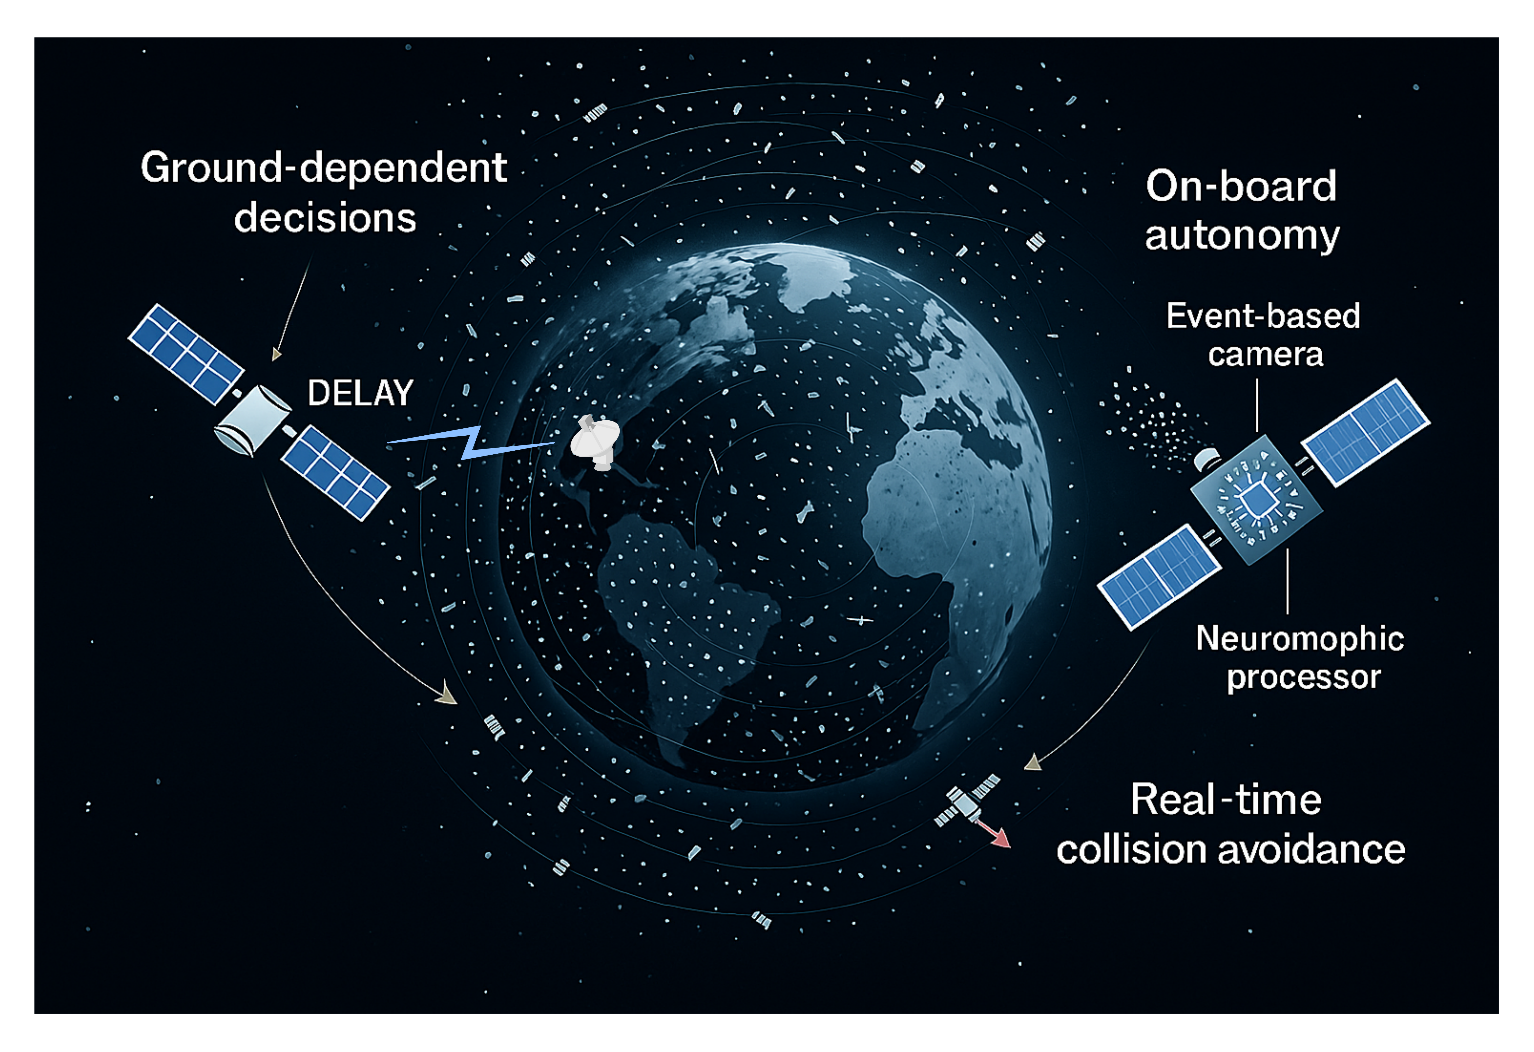
WHY NEBULA?
Increasing number of RSOs
Growing need for systems capable of making rapid decisions directly in orbit
Main challenge is to efficiently manage the limited power budget available in orbit
ICSC Italian Research Center on High-Performance Computing, Big Data and Quantum Computing
Missione 4 • Istruzione e Ricerca

Slide 5


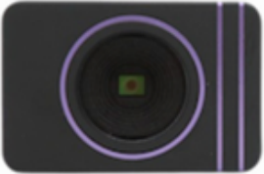
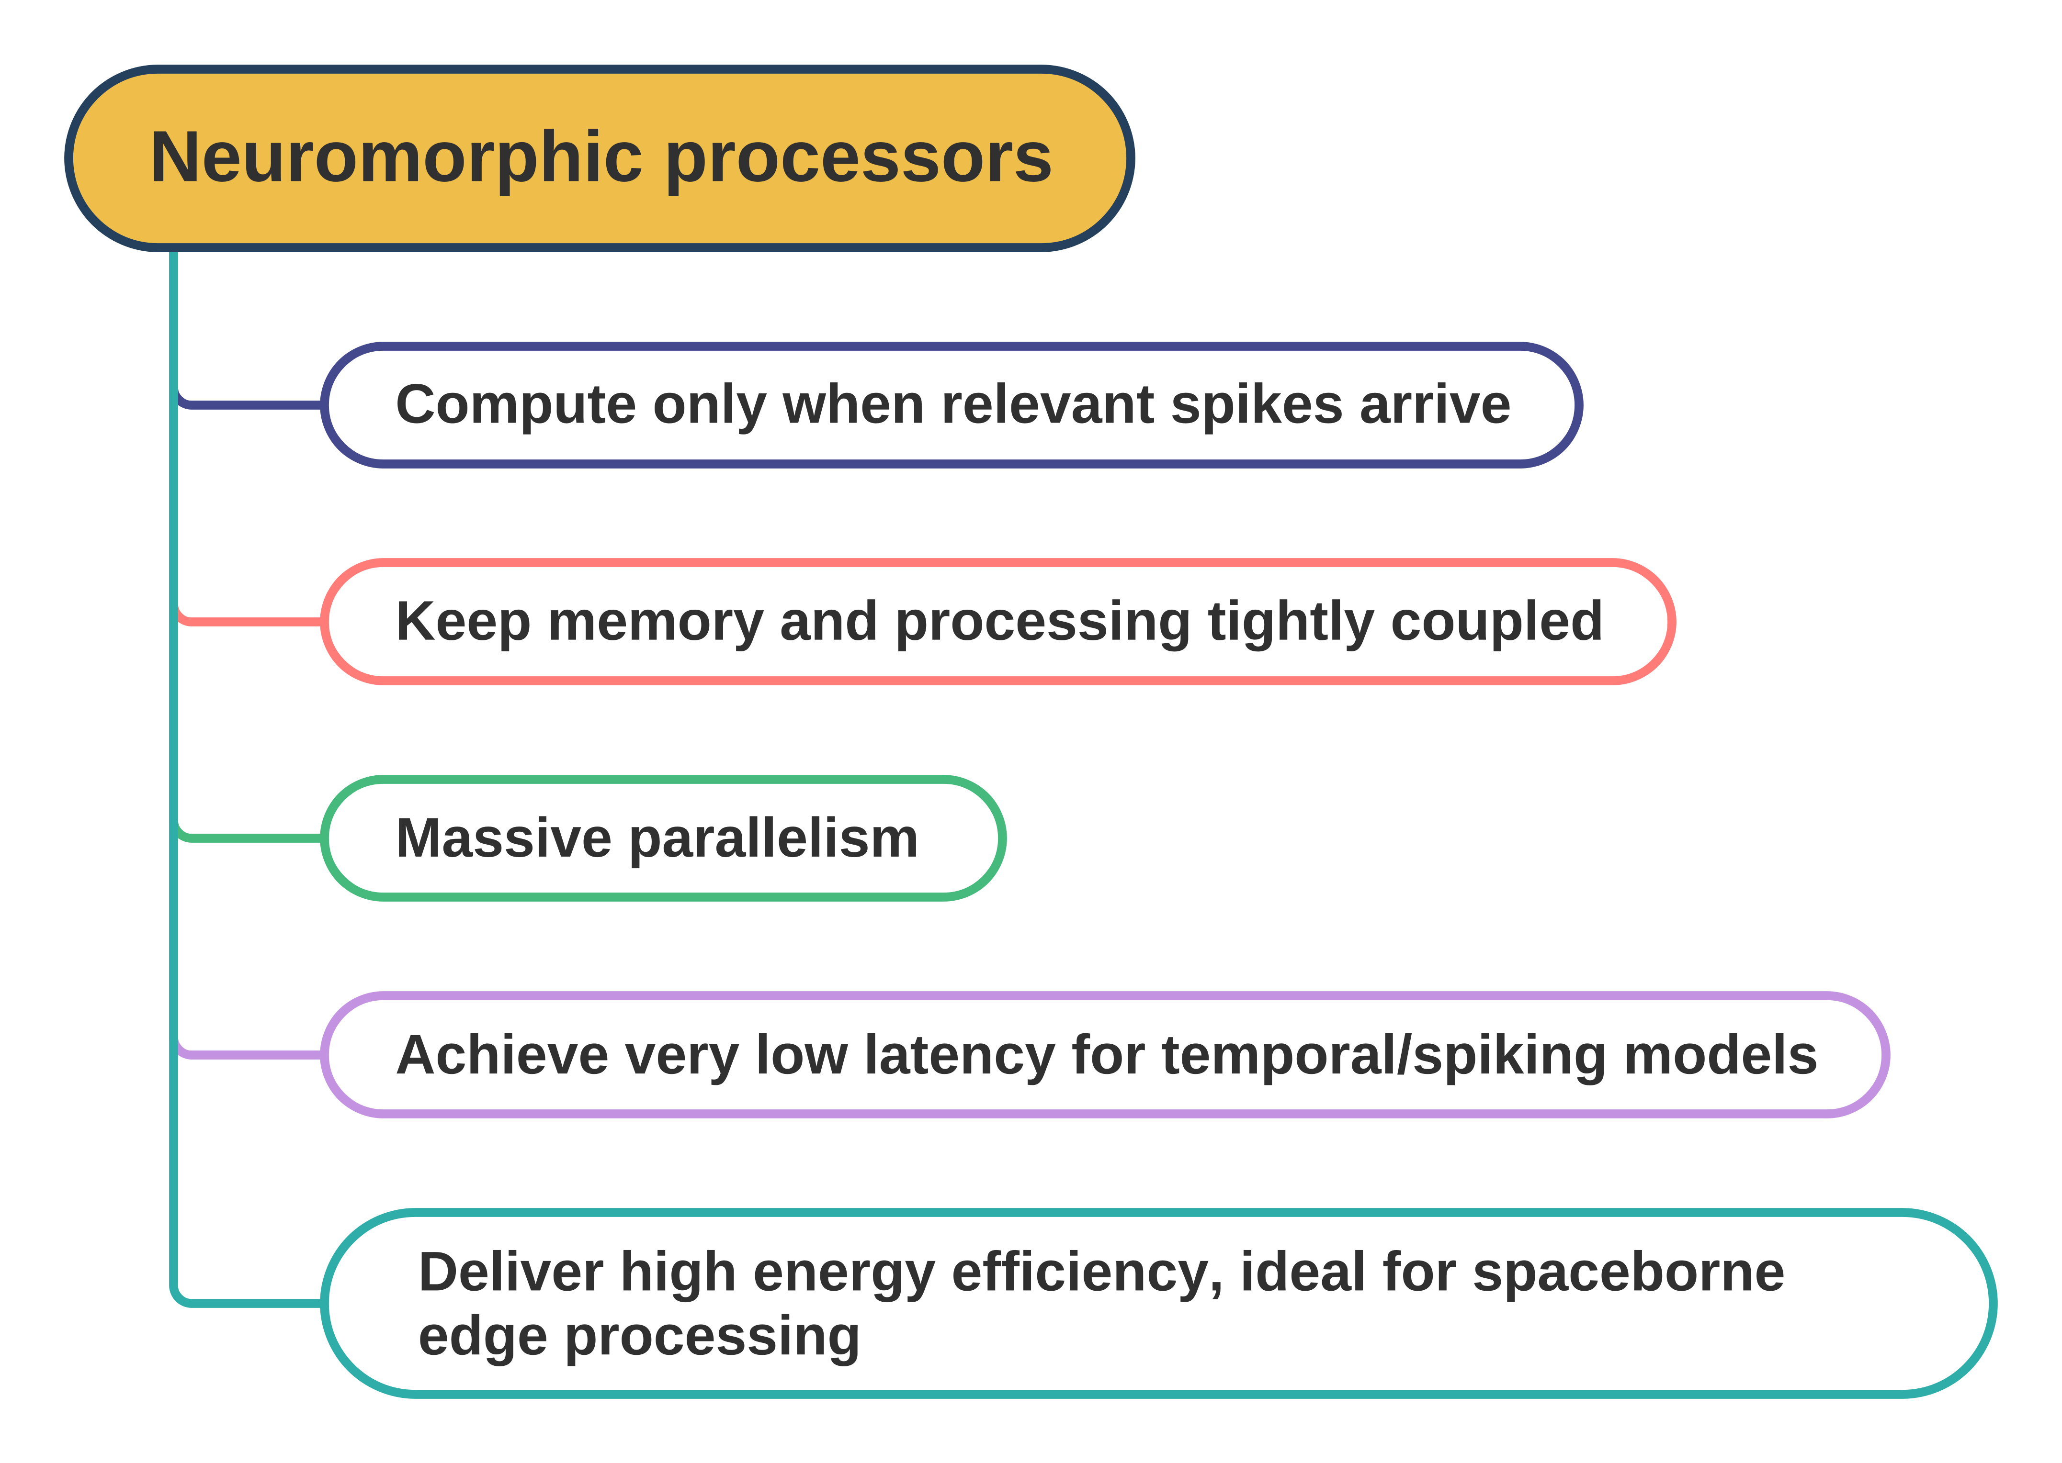
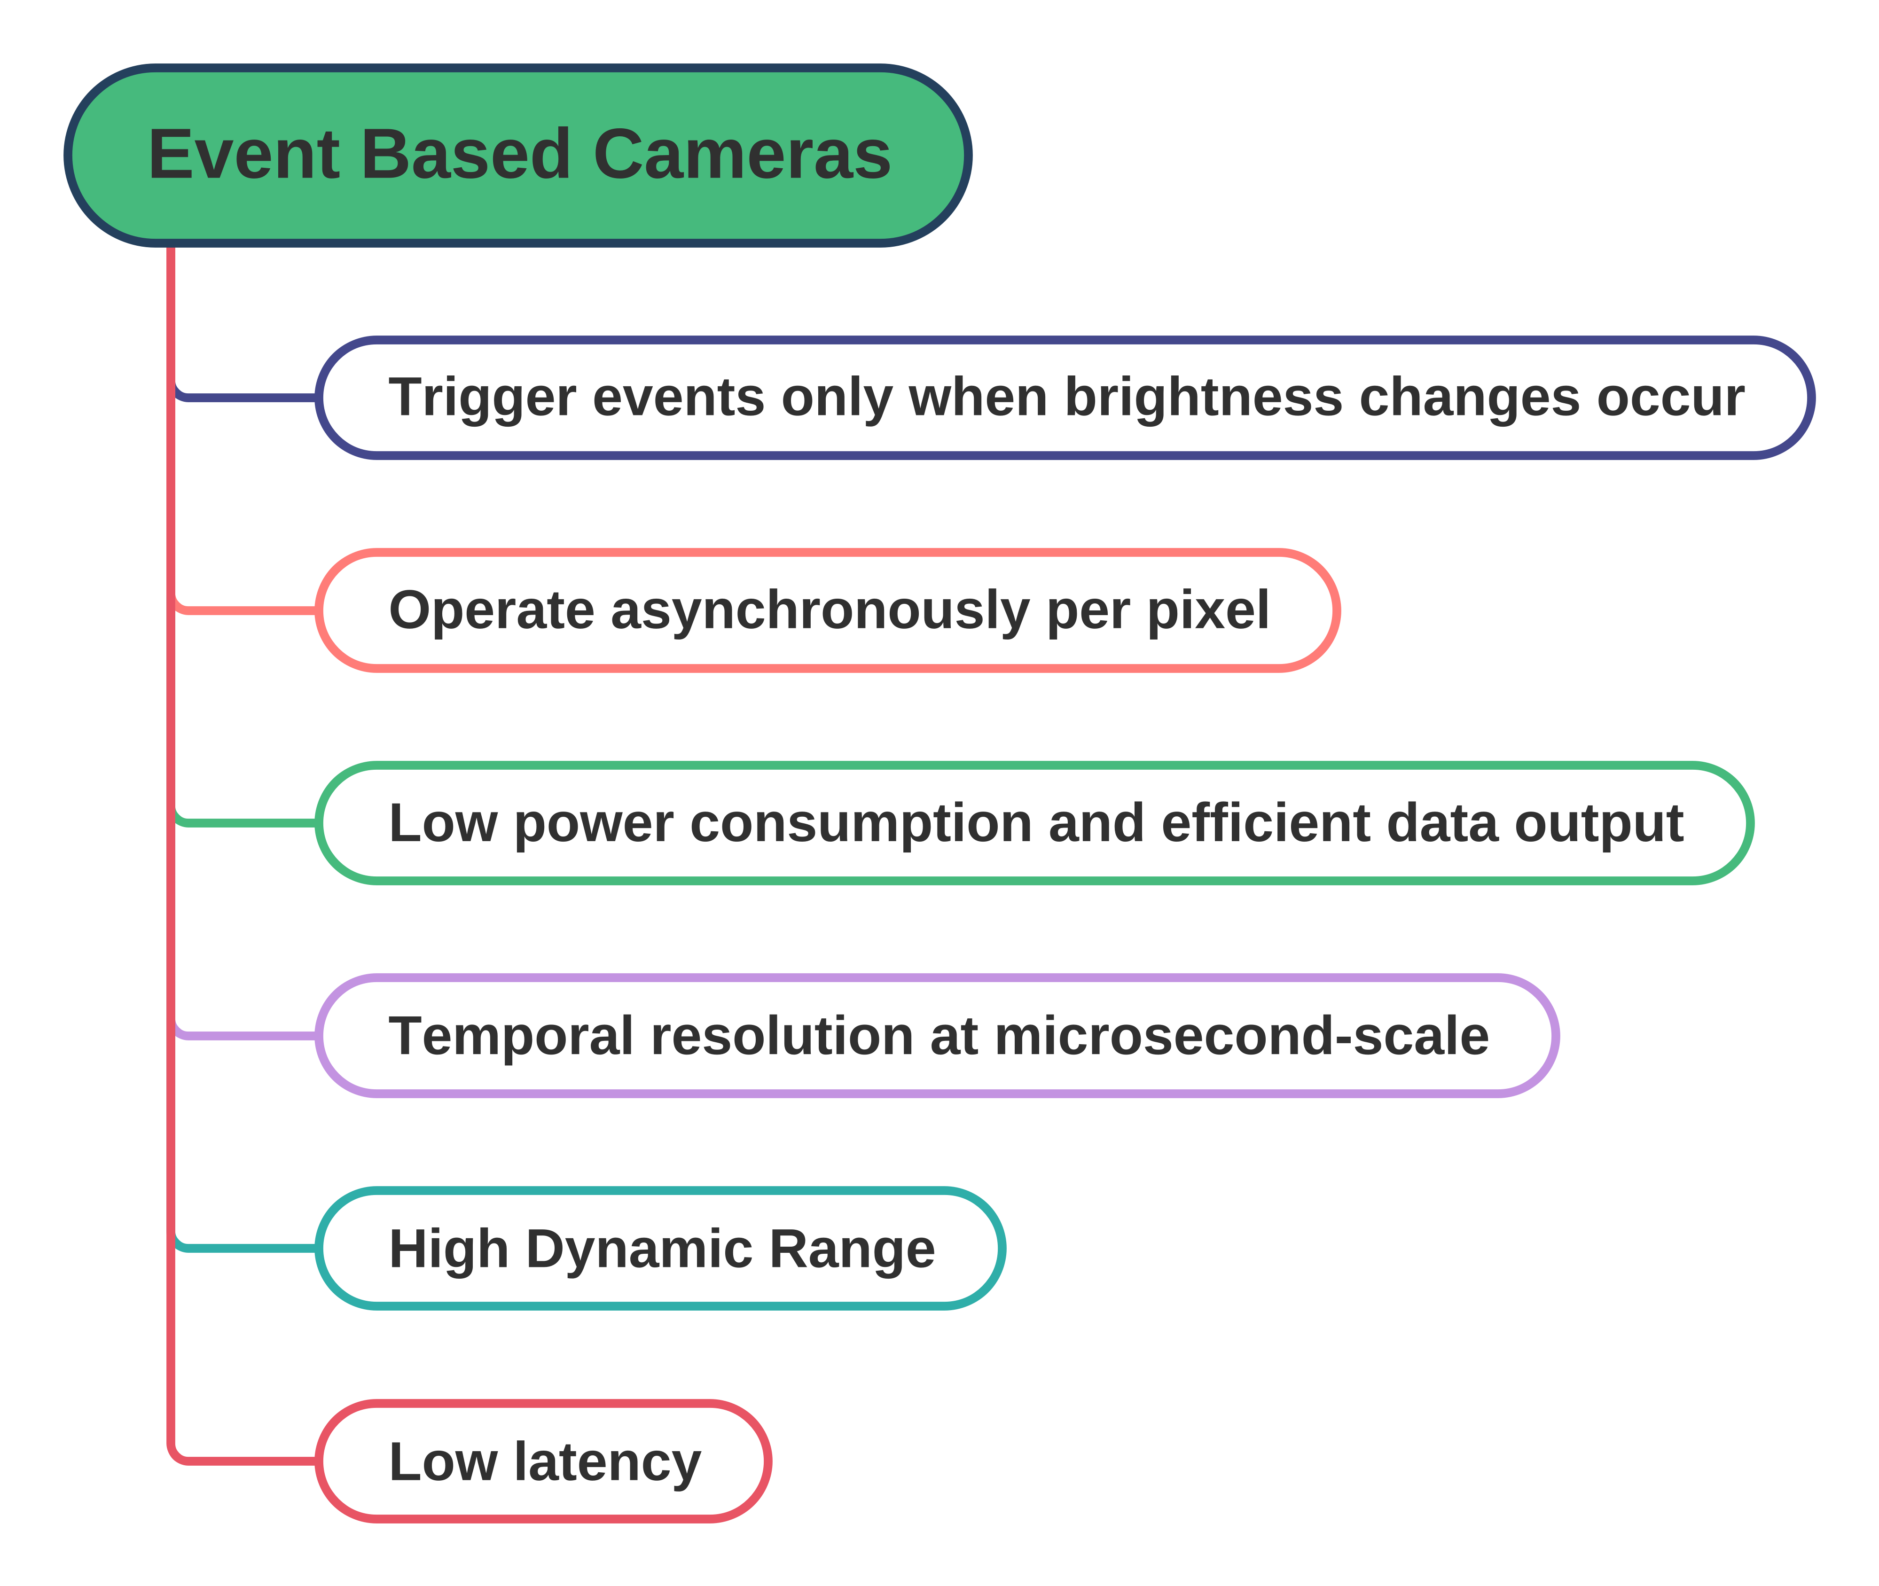
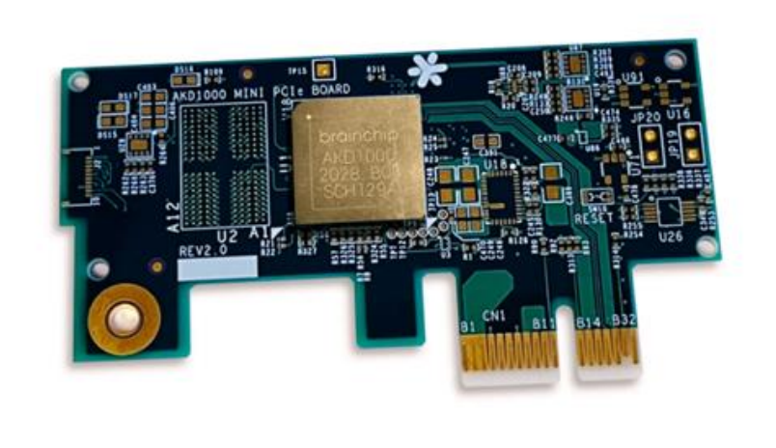
EVENT BASED CAMERAS AND NEUROMORPHIC PROCESSORS
ICSC Italian Research Center on High-Performance Computing, Big Data and Quantum Computing
Missione 4 • Istruzione e Ricerca

Slide 6
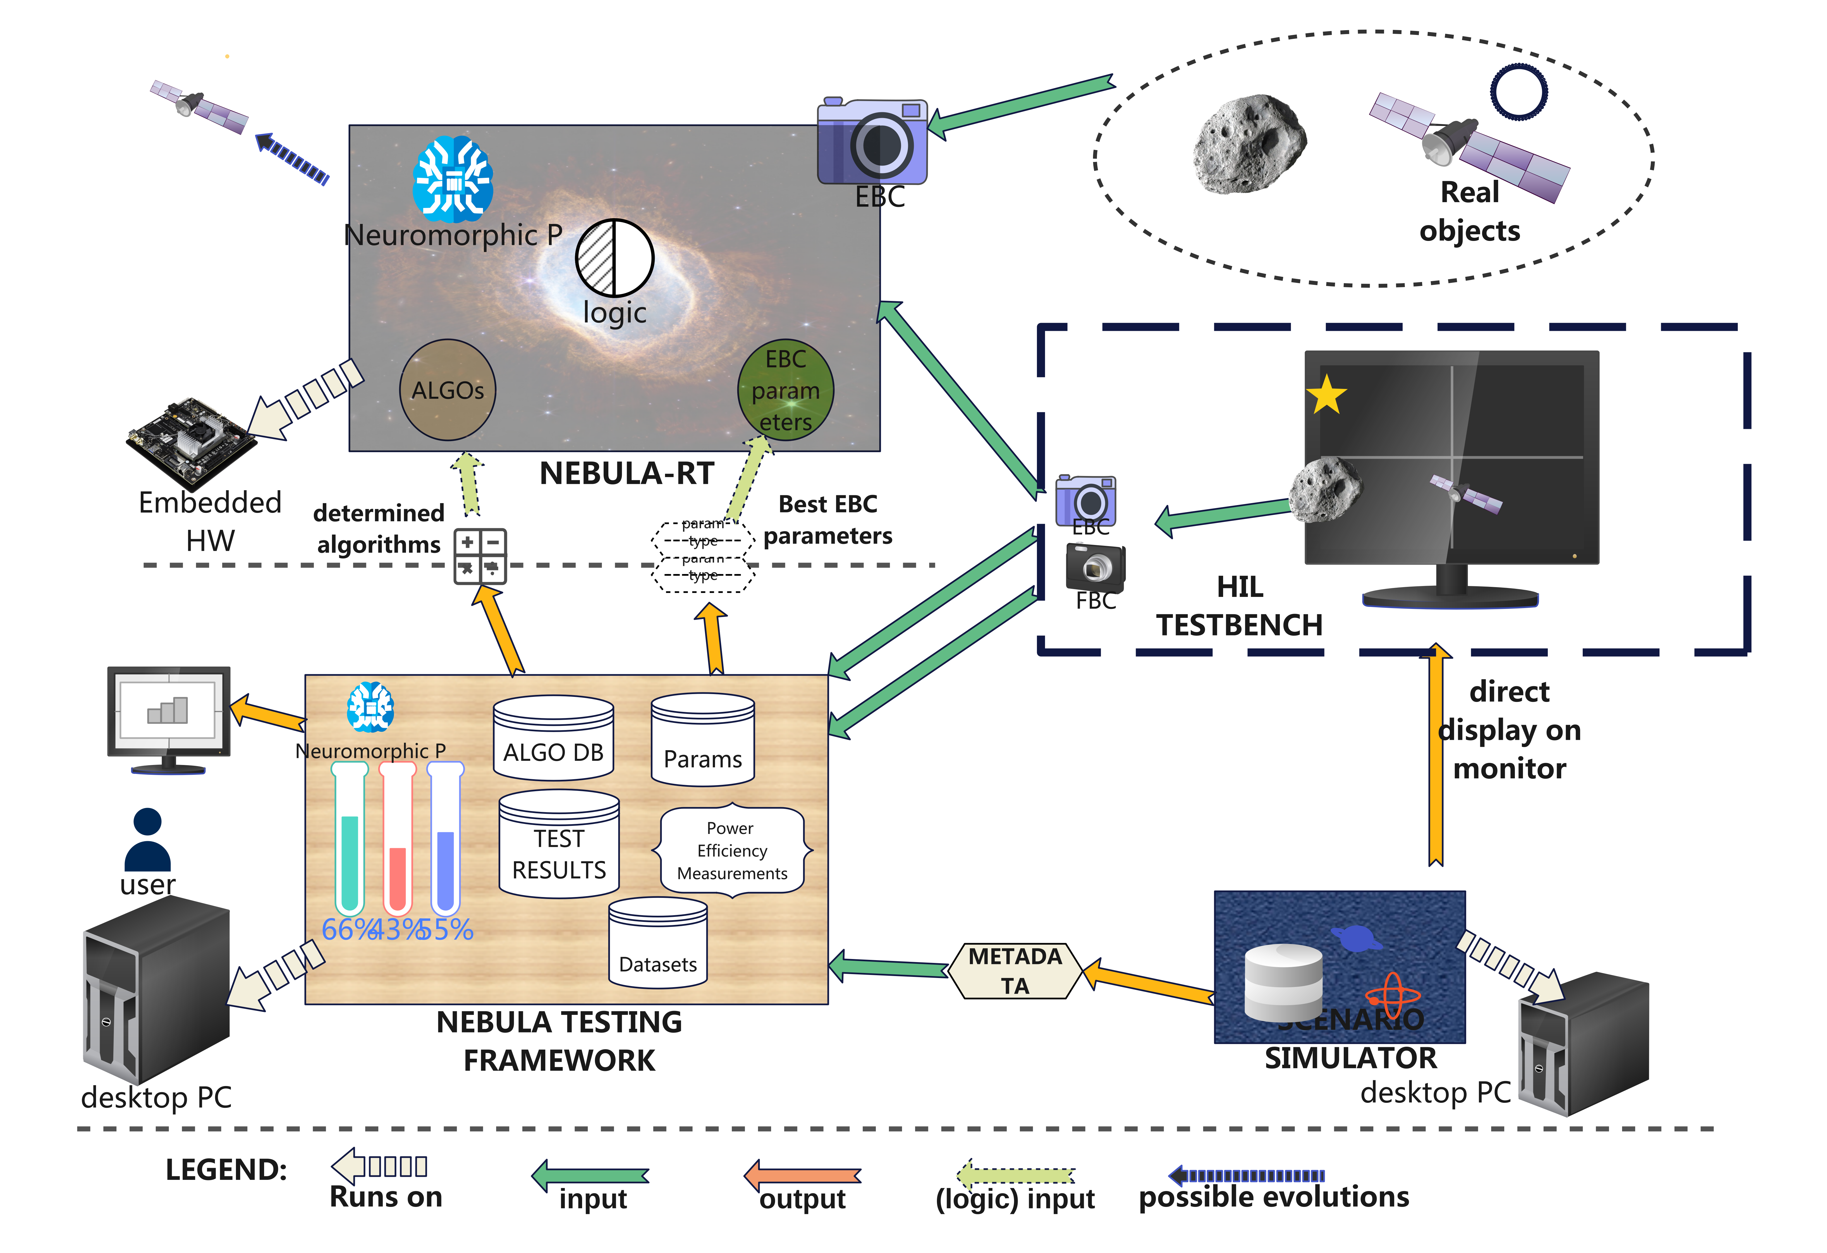
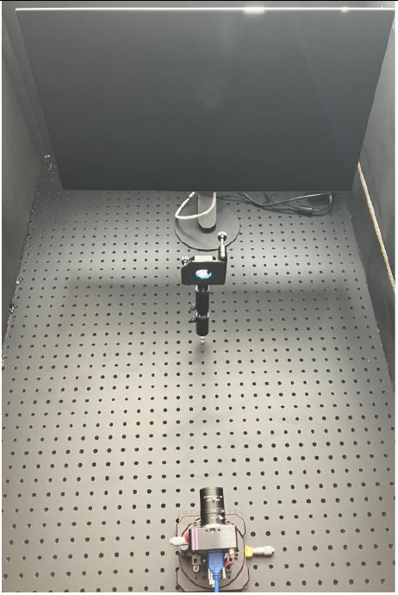
PROJECT ARCHITECTURE
ICSC Italian Research Center on High-Performance Computing, Big Data and Quantum Computing
Missione 4 • Istruzione e Ricerca

Slide 7
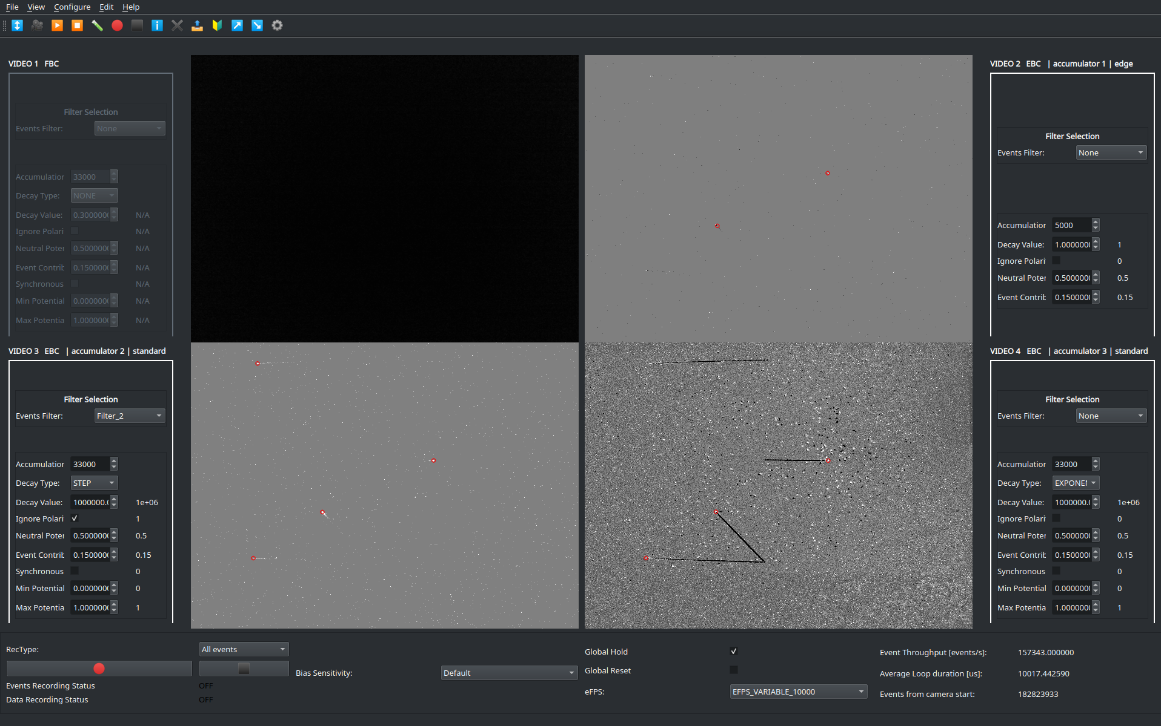
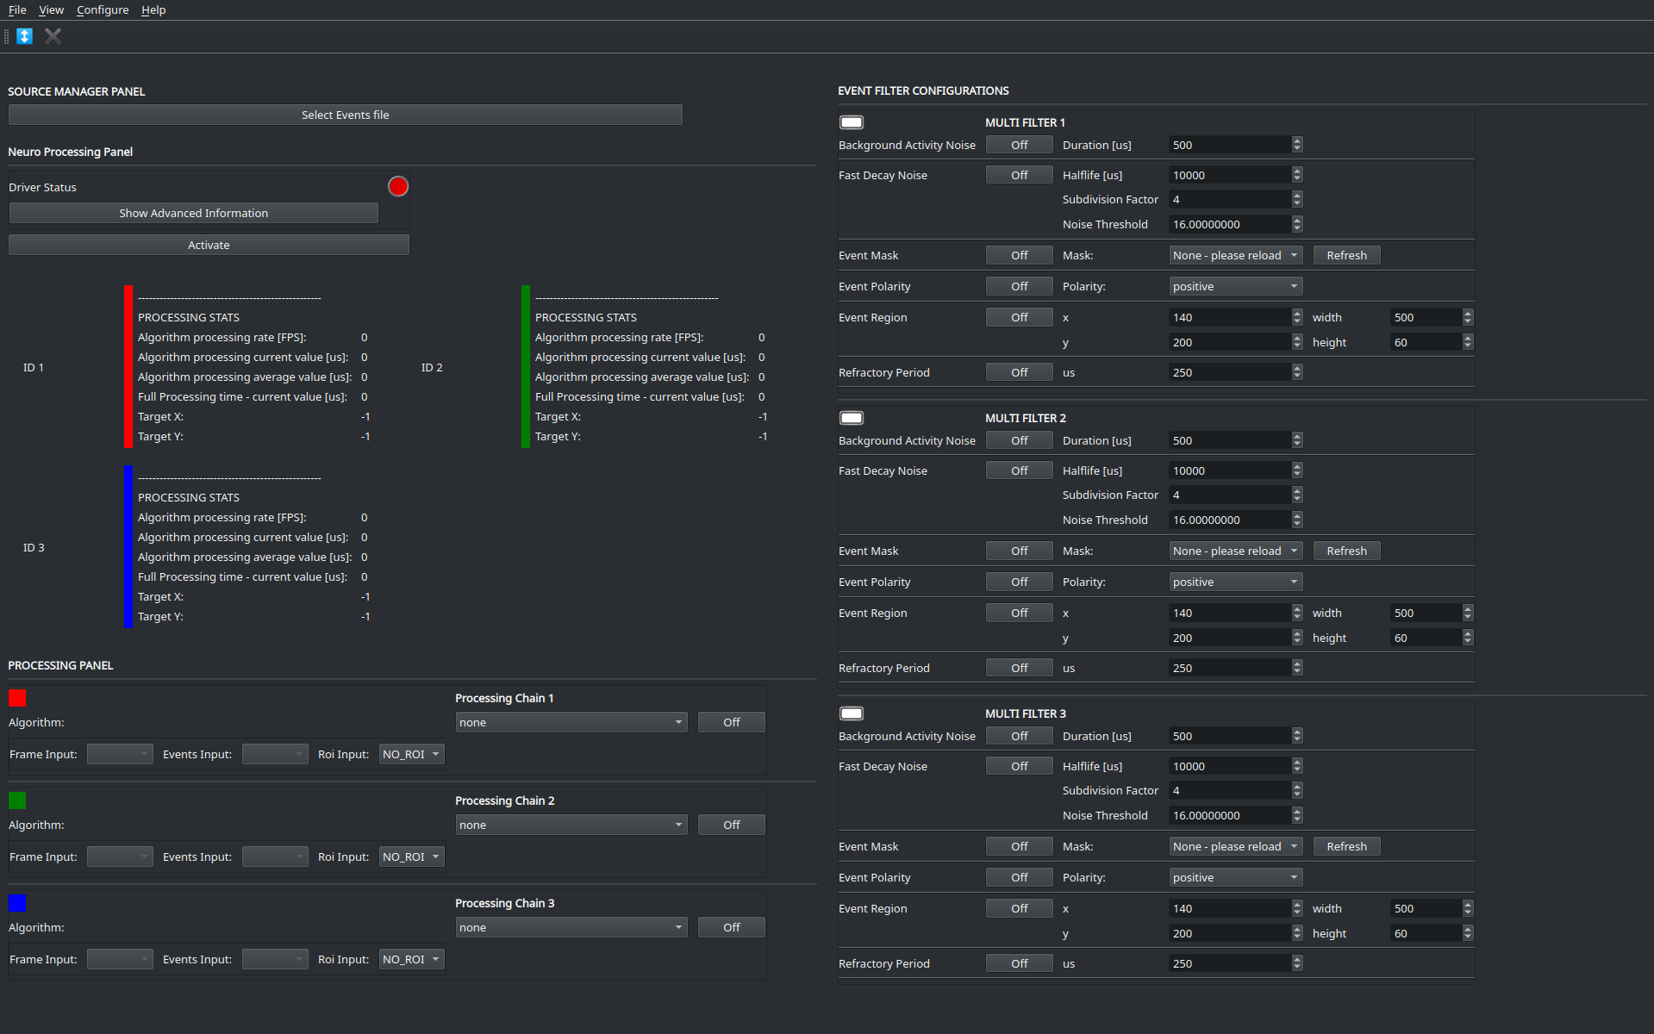
SOFTWARE TESTING FRAMEWORK UI
ICSC Italian Research Center on High-Performance Computing, Big Data and Quantum Computing
Missione 4 • Istruzione e Ricerca

Slide 8
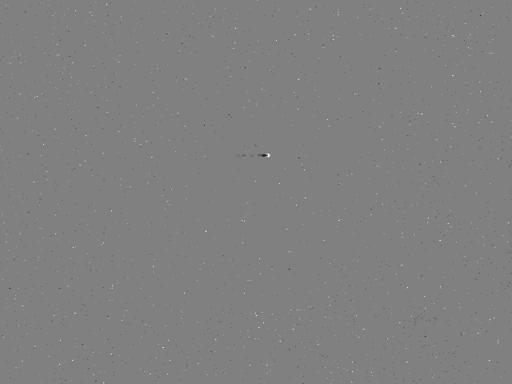
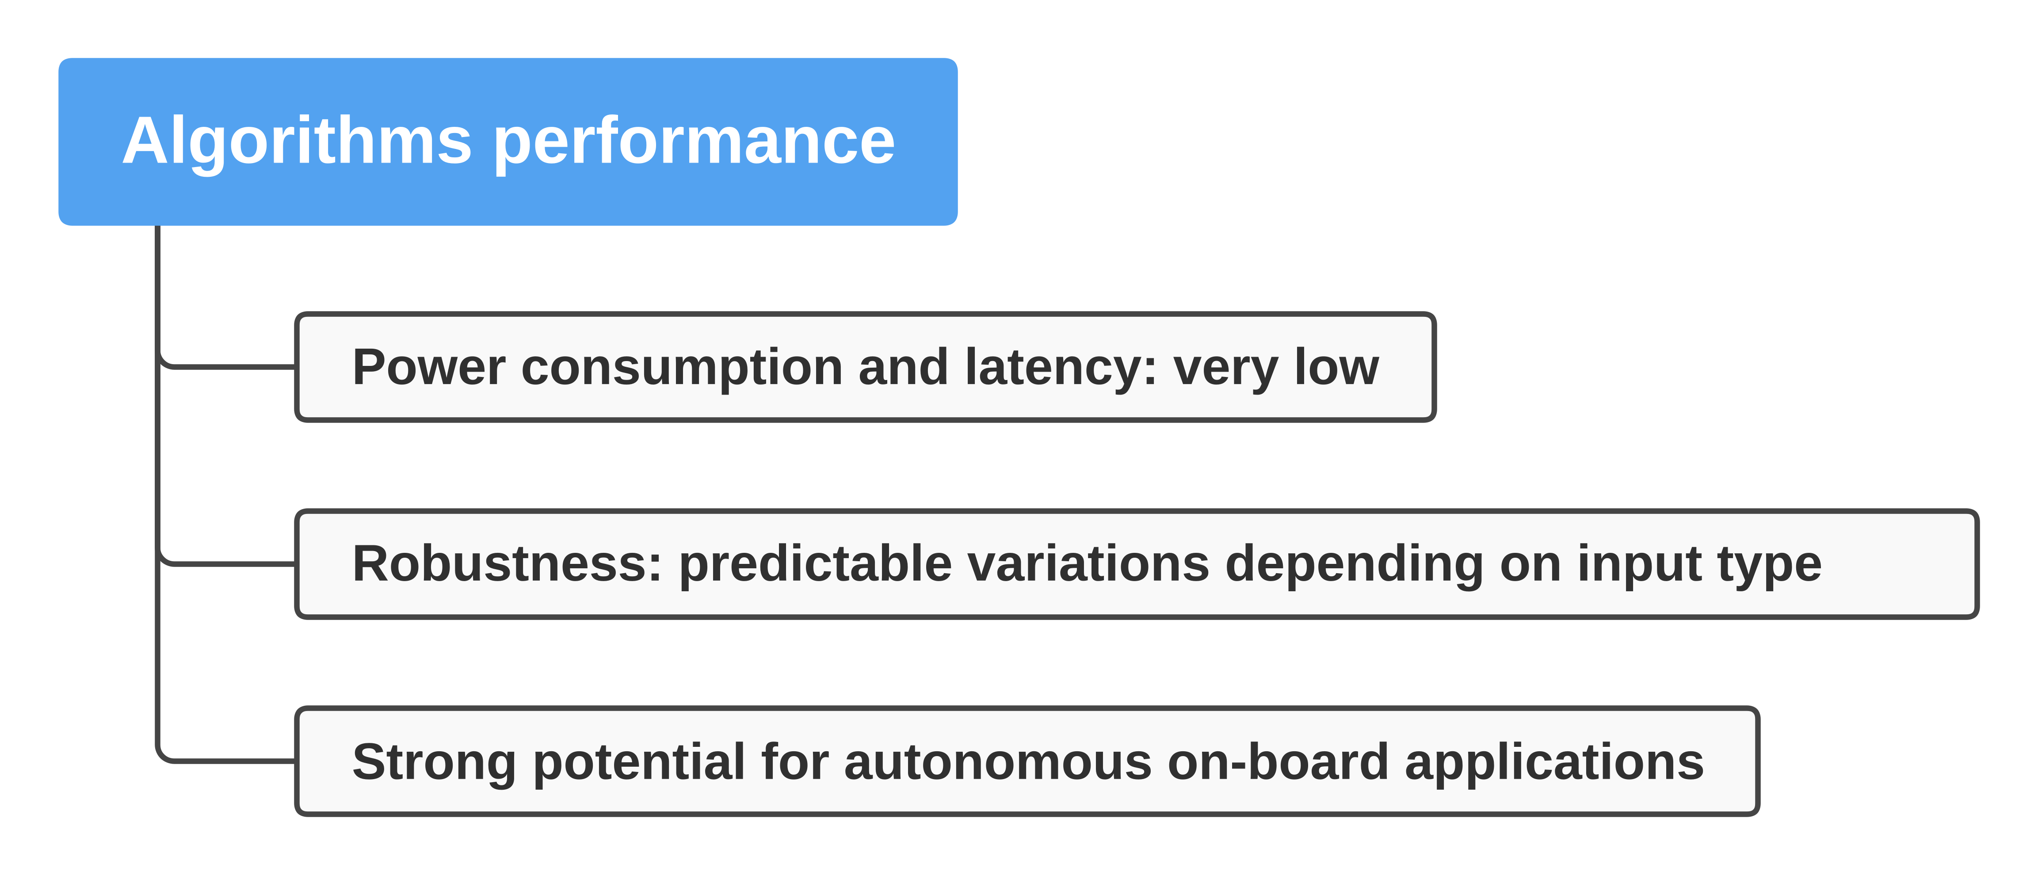
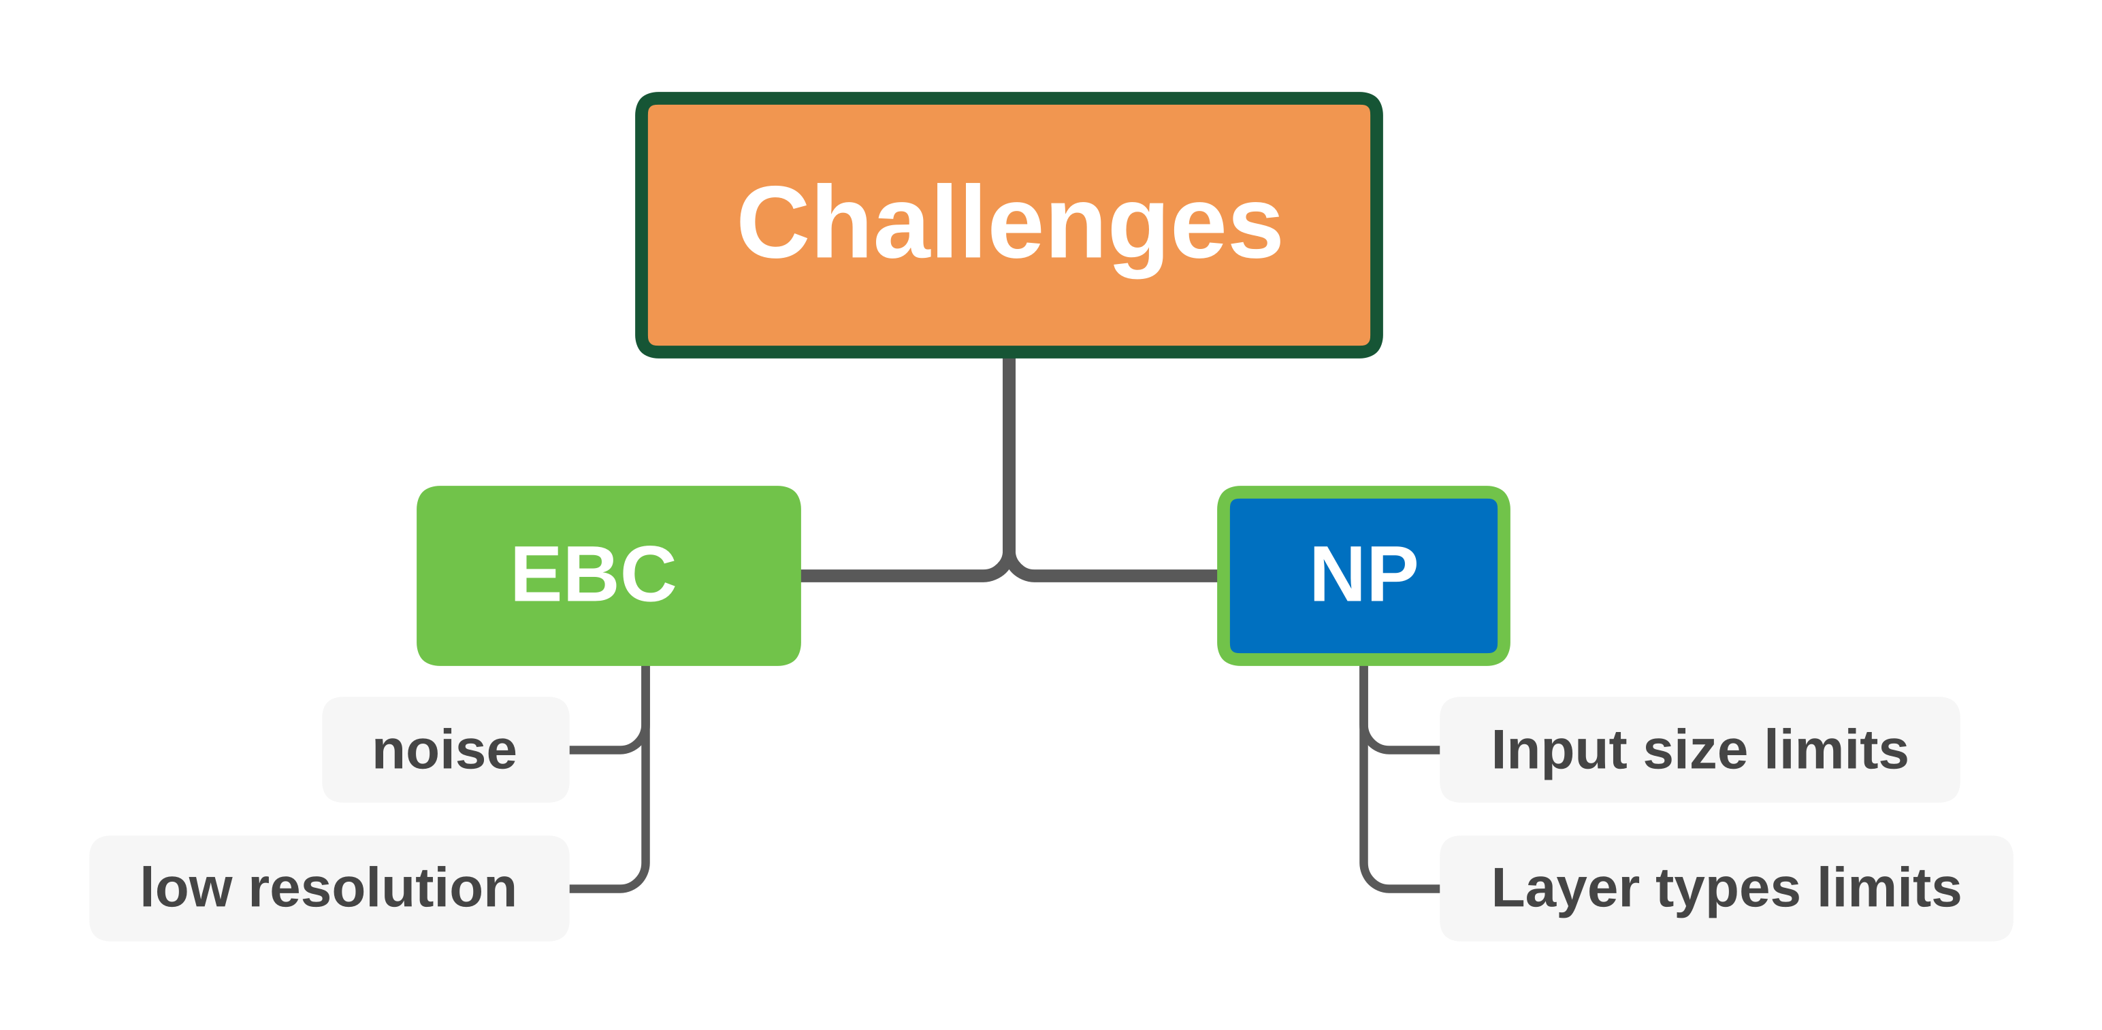




RESULTS AND CHALLENGES
ICSC Italian Research Center on High-Performance Computing, Big Data and Quantum Computing
Missione 4 • Istruzione e Ricerca

Slide 9
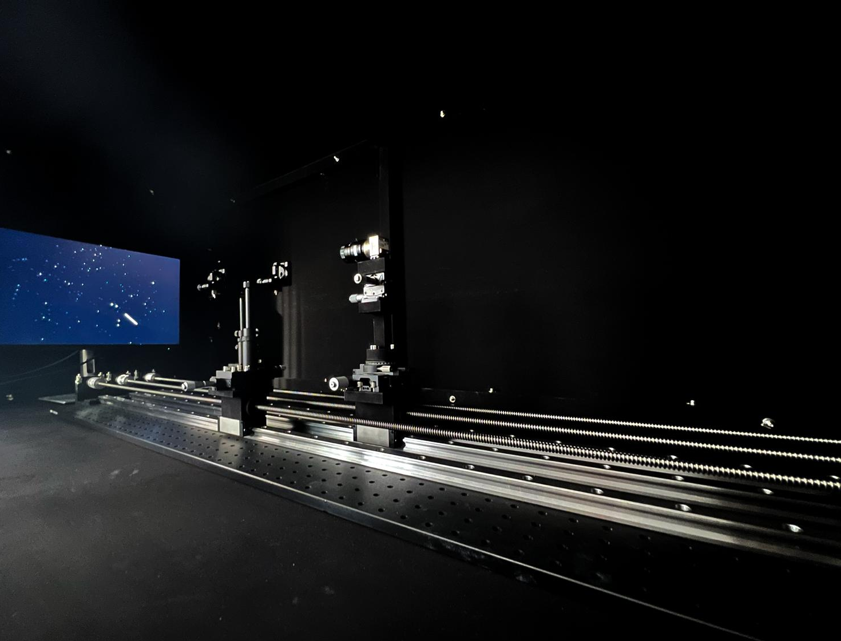

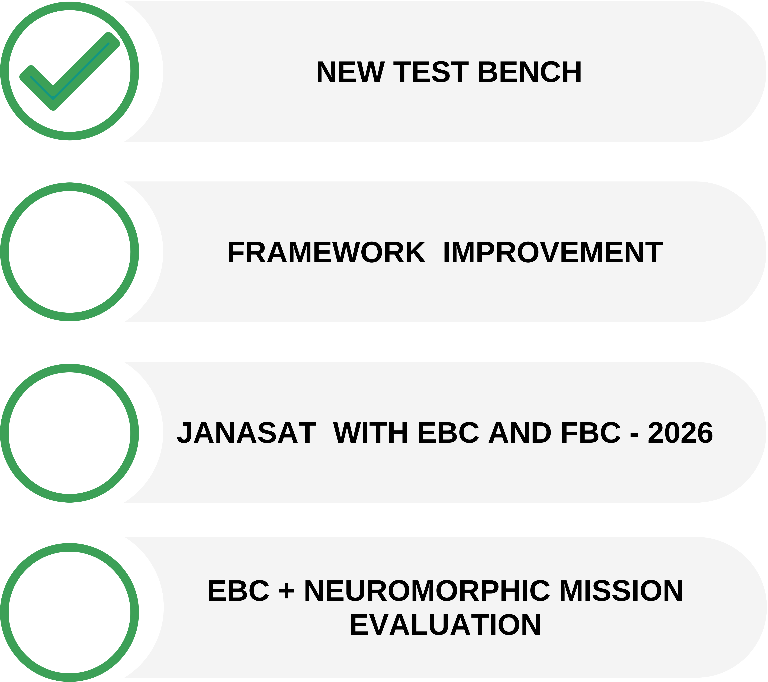
NEXT STEPS
ICSC Italian Research Center on High-Performance Computing, Big Data and Quantum Computing
Missione 4 • Istruzione e Ricerca

Slide 10

Thank you
ICSC Italian Research Center on High-Performance Computing, Big Data and Quantum Computing
Missione 4 • Istruzione e Ricerca

