Slide 1

ICSC Italian Research Center on High-Performance Computing, Big Data and Quantum Computing
Missione 4 • Istruzione e Ricerca

Slide 2

Progetto WAVES - Wastewater Virome Analysis for Environmental Surveillance at Hospital Building Level
Giovanni Chillemi - Lazzaro Spallanzani – IRCCS
ICSC Italian Research Center on High-Performance Computing, Big Data and Quantum Computing
Missione 4 • Istruzione e Ricerca

Slide 3






WAVES
Investigation strategy based on the use of wastewater as biological material for virome analysis and to characterize modifications in the virome composition in patients with specific non-communicable diseases
WP1: wastewater collection and viral nucleic acid extraction
WP2: metagenomic analyses
WP3: bioinformatic analyses
WP4: bioactive molecule identification
WP5: project coordination, management, and dissemination
ICSC Italian Research Center on High-Performance Computing, Big Data and Quantum Computing
Missione 4 • Istruzione e Ricerca

Slide 4

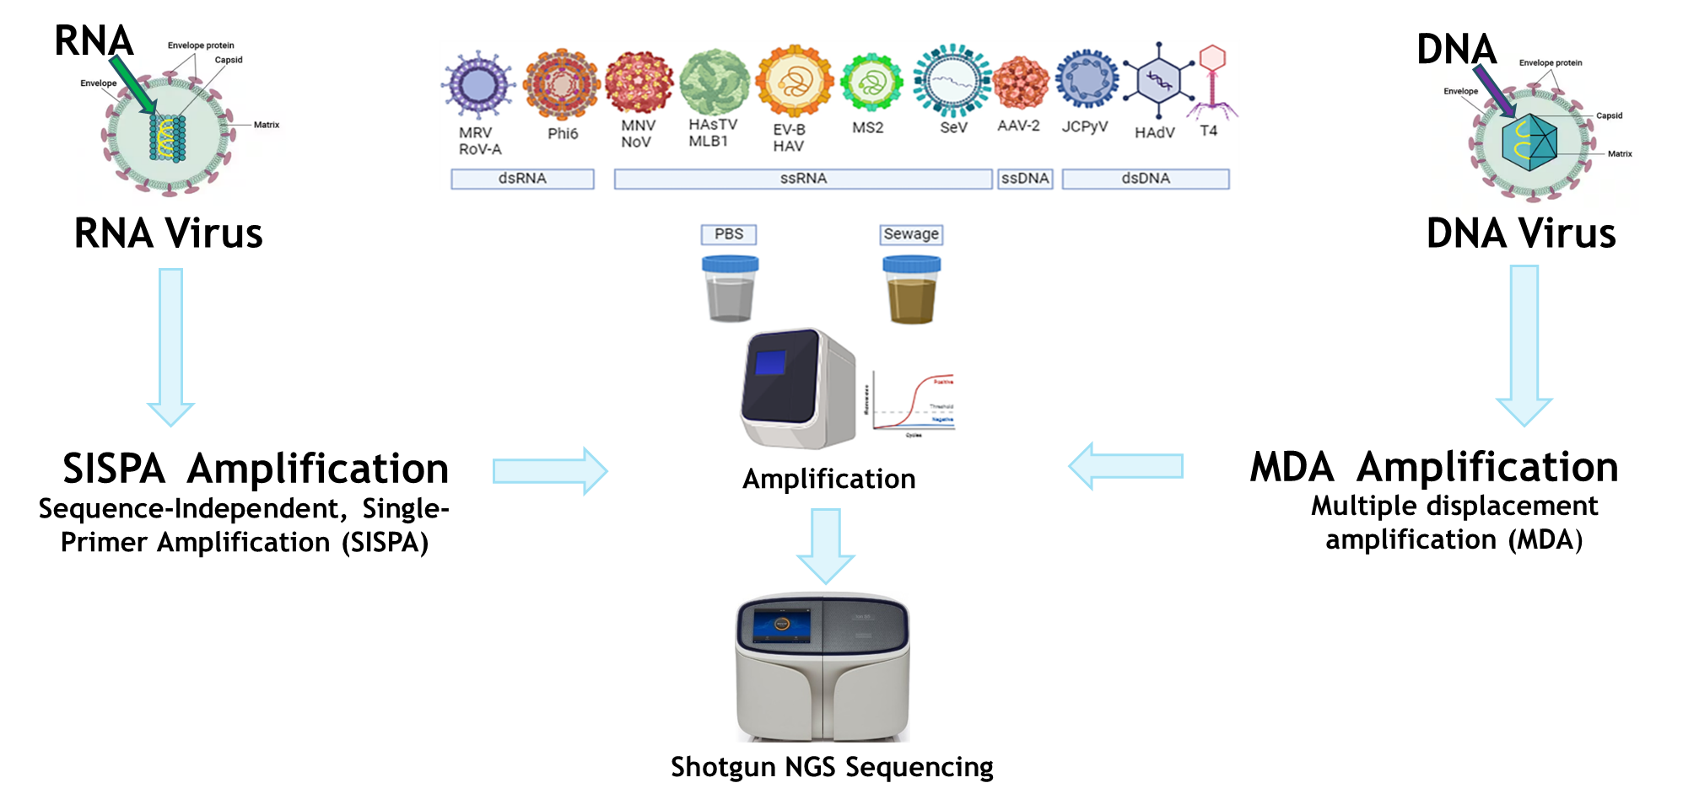



Wastewater samples collected in the city of Perugia (Central Italy) from:
Urban Wastewater Treatment Plant
virome of the general population
Local hospital
virome of hospitalized patients
University building
virome of the young and healthy population
ICSC Italian Research Center on High-Performance Computing, Big Data and Quantum Computing
Missione 4 • Istruzione e Ricerca

Slide 5

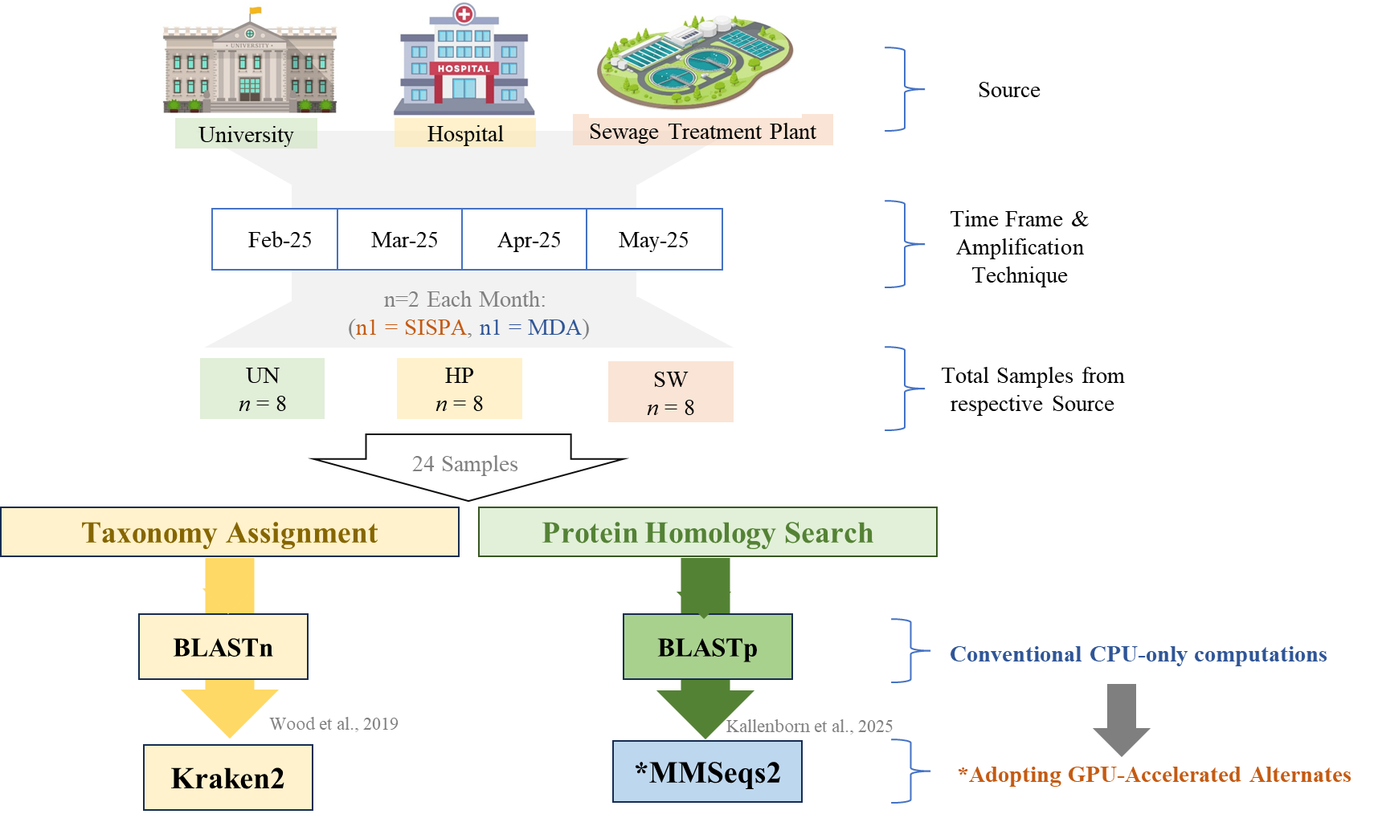
ICSC Italian Research Center on High-Performance Computing, Big Data and Quantum Computing
Missione 4 • Istruzione e Ricerca

Slide 6
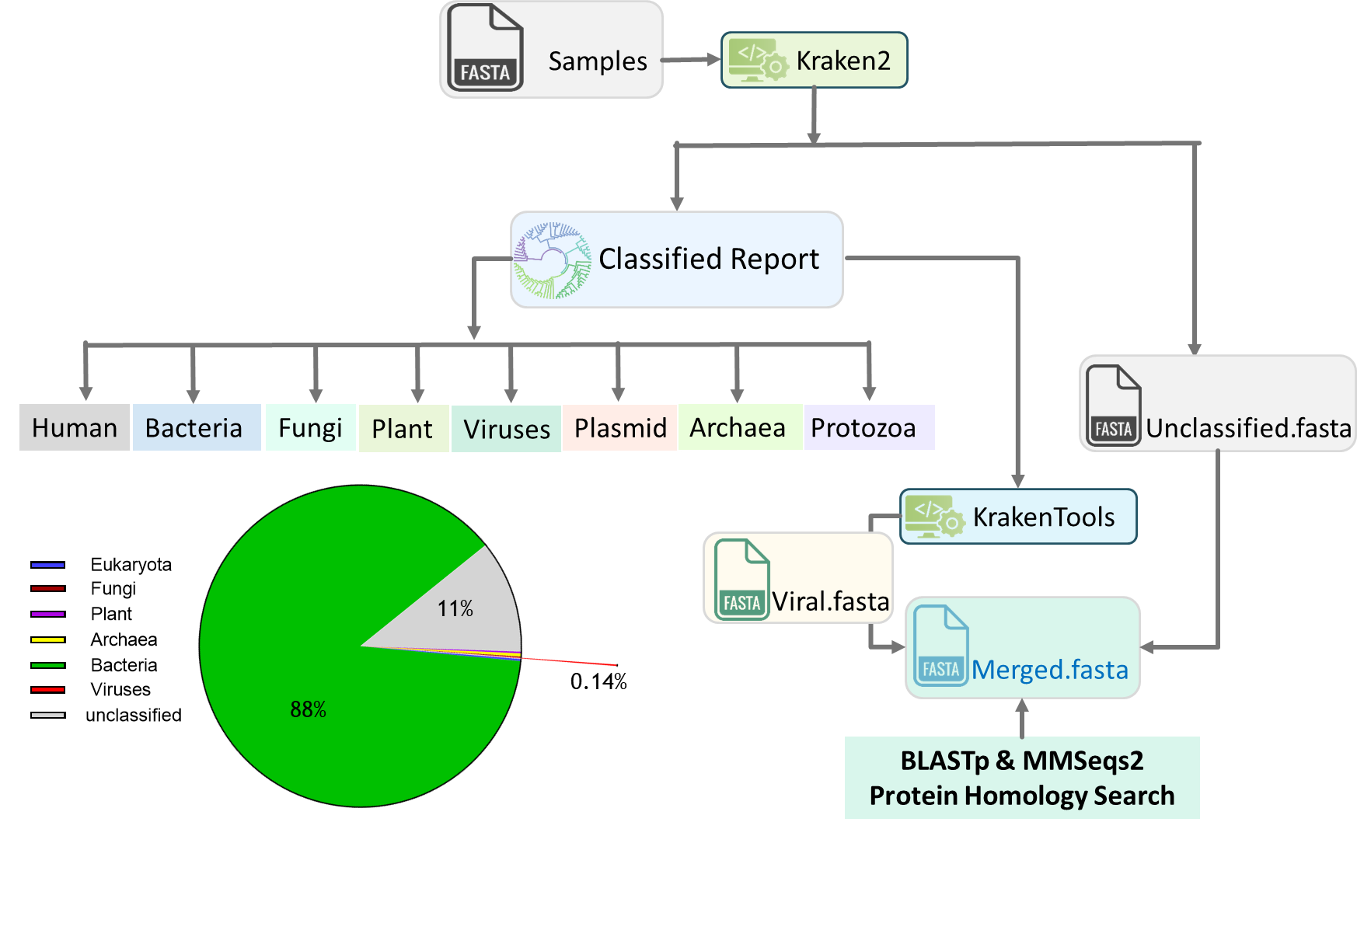
ICSC Italian Research Center on High-Performance Computing, Big Data and Quantum Computing
Missione 4 • Istruzione e Ricerca

Slide 7
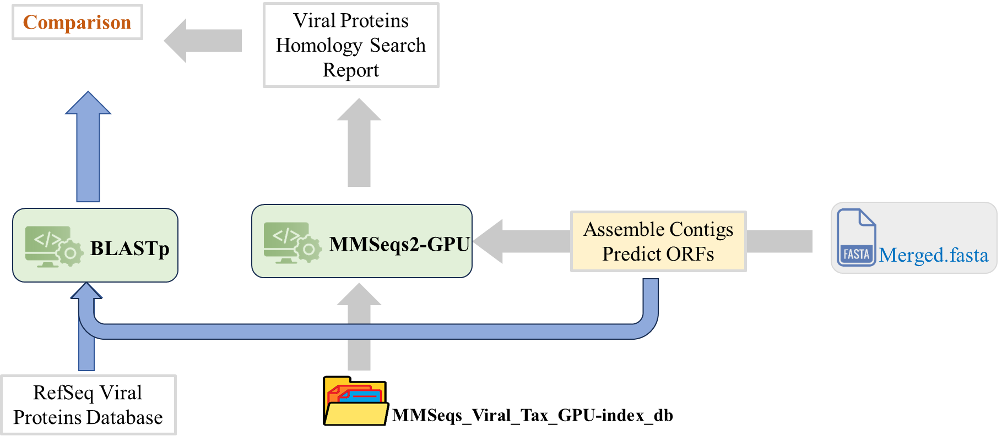
ICSC Italian Research Center on High-Performance Computing, Big Data and Quantum Computing
Missione 4 • Istruzione e Ricerca

Slide 8
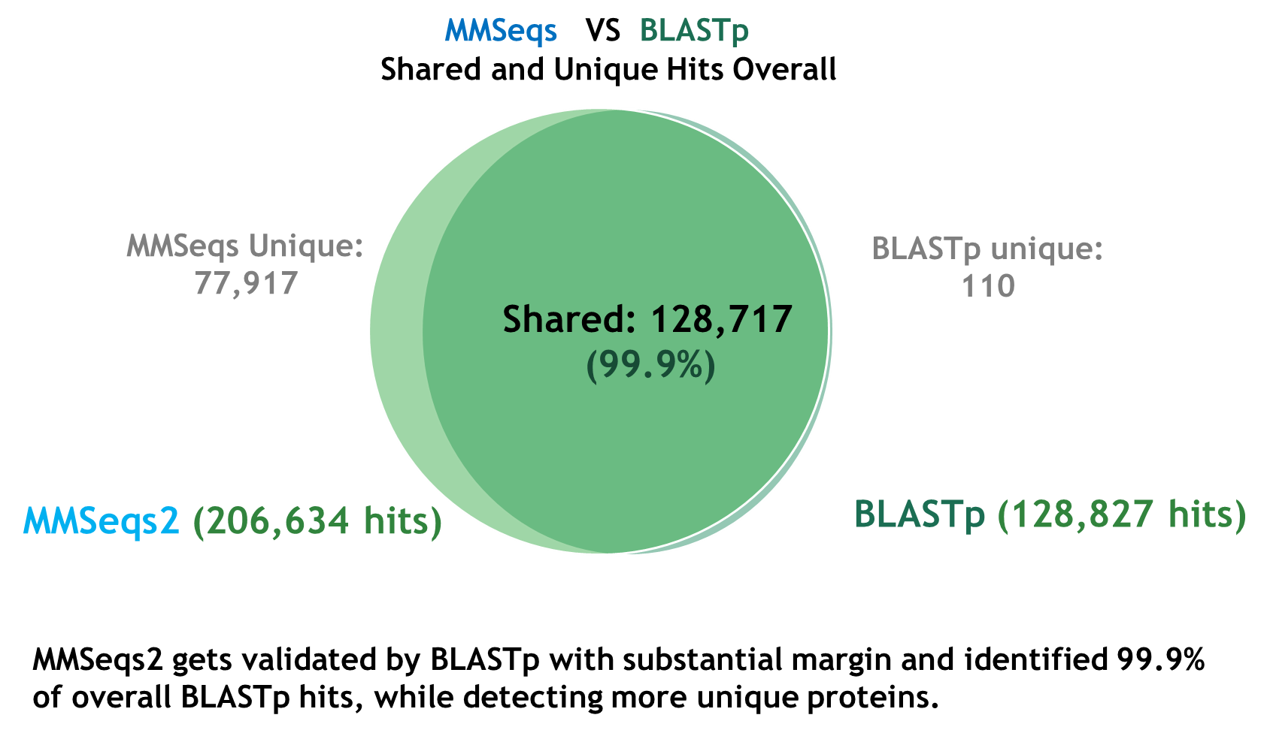
ICSC Italian Research Center on High-Performance Computing, Big Data and Quantum Computing
Missione 4 • Istruzione e Ricerca

Slide 9
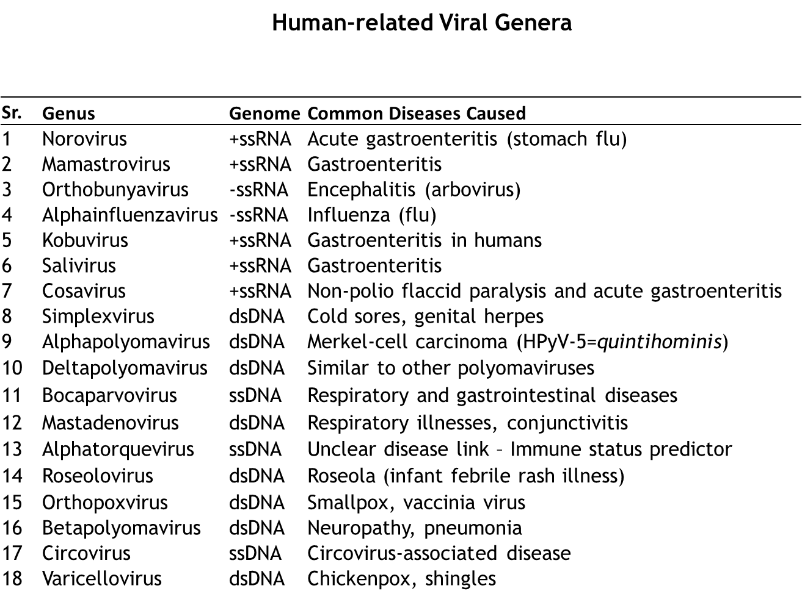
ICSC Italian Research Center on High-Performance Computing, Big Data and Quantum Computing
Missione 4 • Istruzione e Ricerca

Slide 10
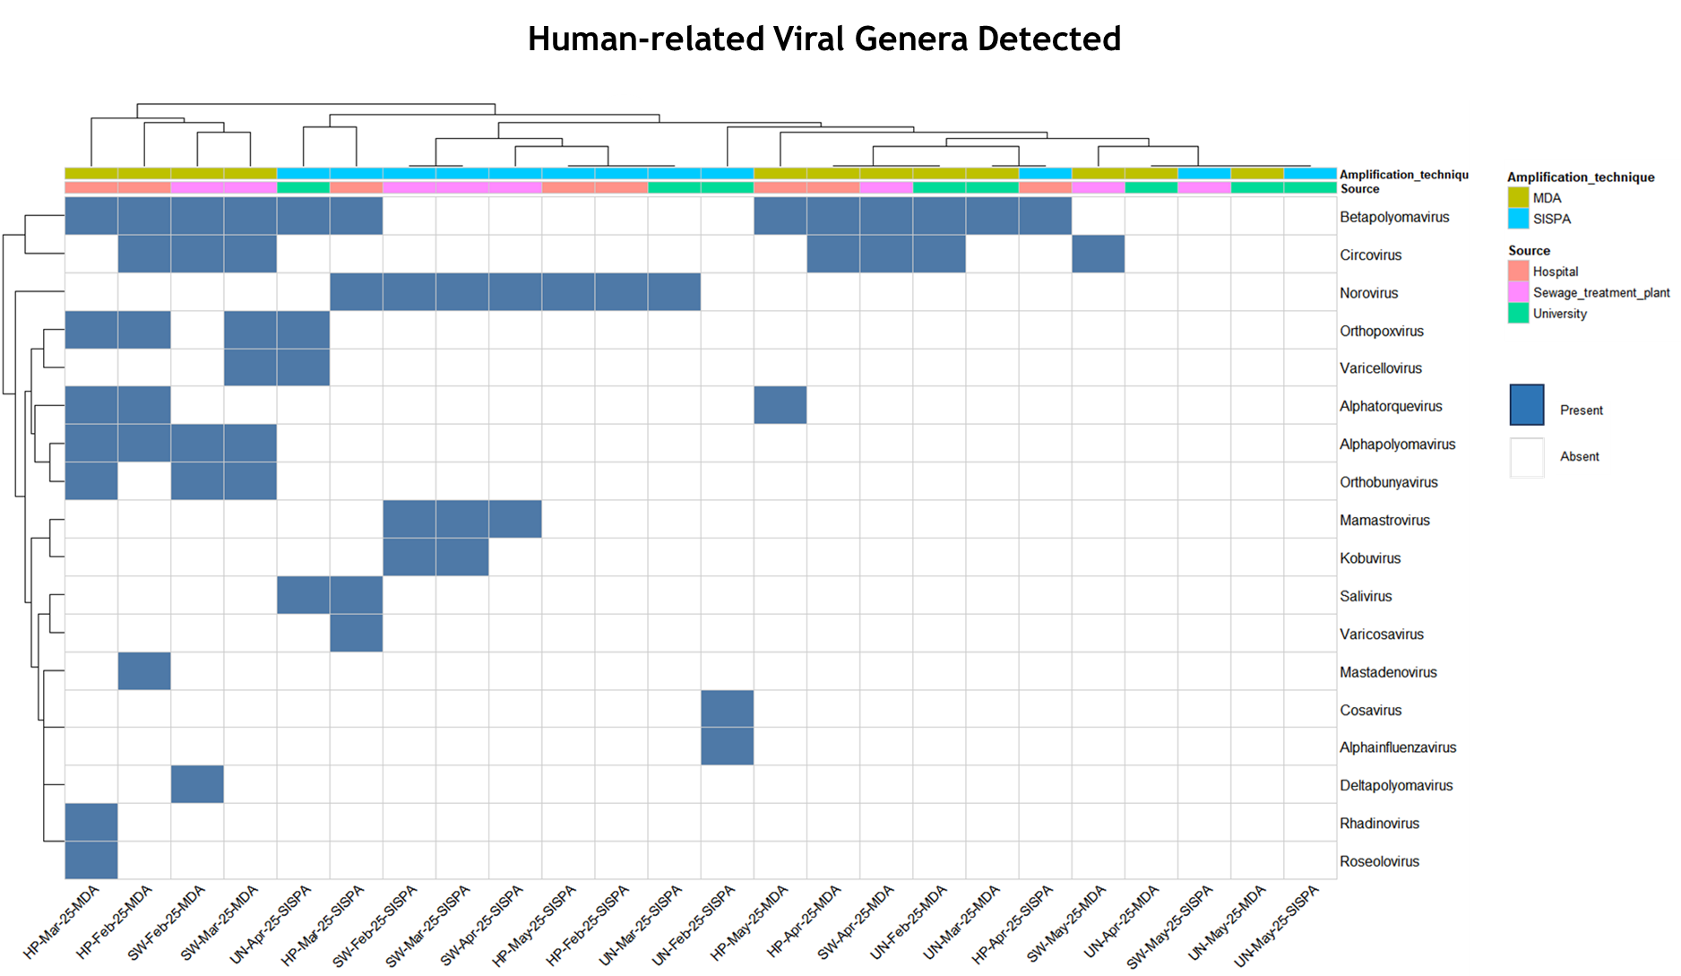
ICSC Italian Research Center on High-Performance Computing, Big Data and Quantum Computing
Missione 4 • Istruzione e Ricerca

Slide 11
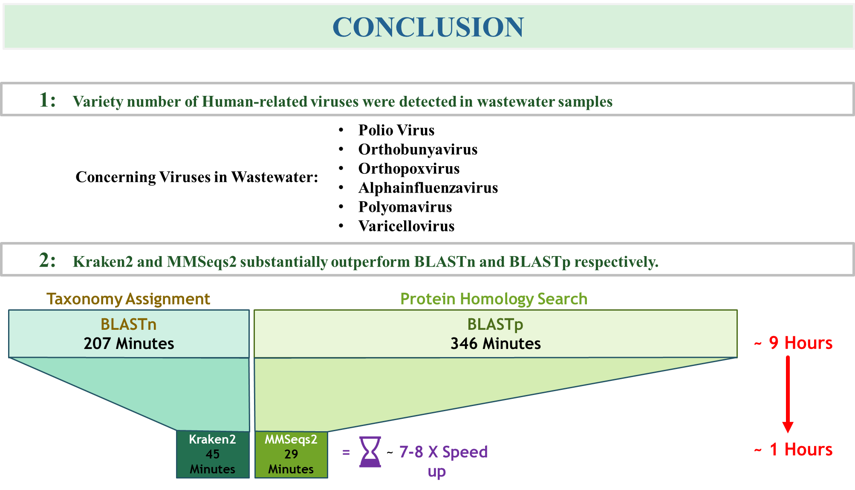
ICSC Italian Research Center on High-Performance Computing, Big Data and Quantum Computing
Missione 4 • Istruzione e Ricerca

Slide 12
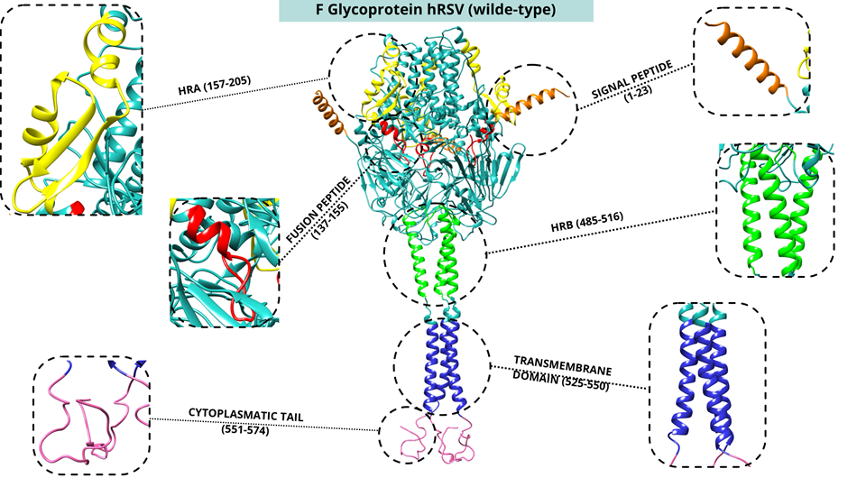
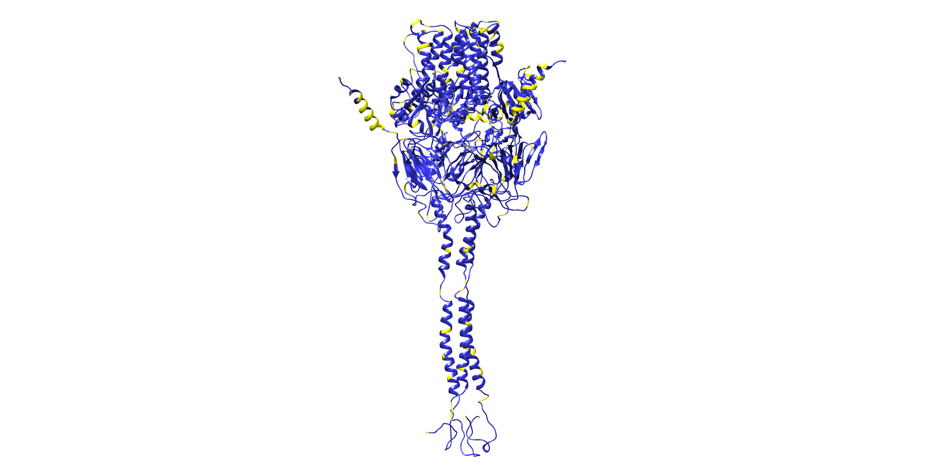
Human respiratory syncytial virus (hRSV)
Yellow → mutated residue
ICSC Italian Research Center on High-Performance Computing, Big Data and Quantum Computing
Missione 4 • Istruzione e Ricerca

Slide 13
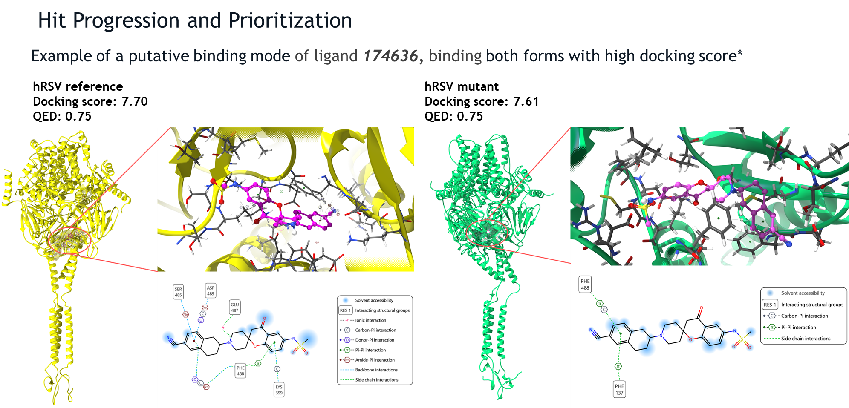
ICSC Italian Research Center on High-Performance Computing, Big Data and Quantum Computing
Missione 4 • Istruzione e Ricerca

Slide 14


Maya Petricciuolo, Agnese Carnevali,
Ermanno Federici
Adeel Mumtaz Abbasi, Daniele Pietrucci,
Ludovica Picarone, Caterina Precone, Nico Sanna
Filippo Lunghini, Carmine Talarico
Martina Rueca, Giulia Berno, Fabrizio Carletti, Alessandra Nappo, Cesare Gruber, Fabio Filippini, Pietro Giorgio Spezia, Giovanni Chillemi, Fabrizio Maggi
ICSC Italian Research Center on High-Performance Computing, Big Data and Quantum Computing
Missione 4 • Istruzione e Ricerca

Slide 15

Grazie
per
l’attenzione
ICSC Italian Research Center on High-Performance Computing, Big Data and Quantum Computing
Missione 4 • Istruzione e Ricerca

