Slide 1

ICSC Italian Research Center on High-Performance Computing, Big Data and Quantum Computing
Missione 4 • Istruzione e Ricerca

Slide 2


Democratizing simulations
Riccardo Bertossa
ICSC Italian Research Center on High-Performance Computing, Big Data and Quantum Computing
Missione 4 • Istruzione e Ricerca

Slide 3


Who we are?
We are a startup driven by the vision of democratizing atomistic material simulations with intuitive, cloud-based tools.
Why democratizing?
We want to allow the world to transition from a “trial and error”
to an “engineered” approach in materials R&D. To respond
to the rising demand for
advanced materials.
ICSC Italian Research Center on High-Performance Computing, Big Data and Quantum Computing
Missione 4 • Istruzione e Ricerca

Slide 4

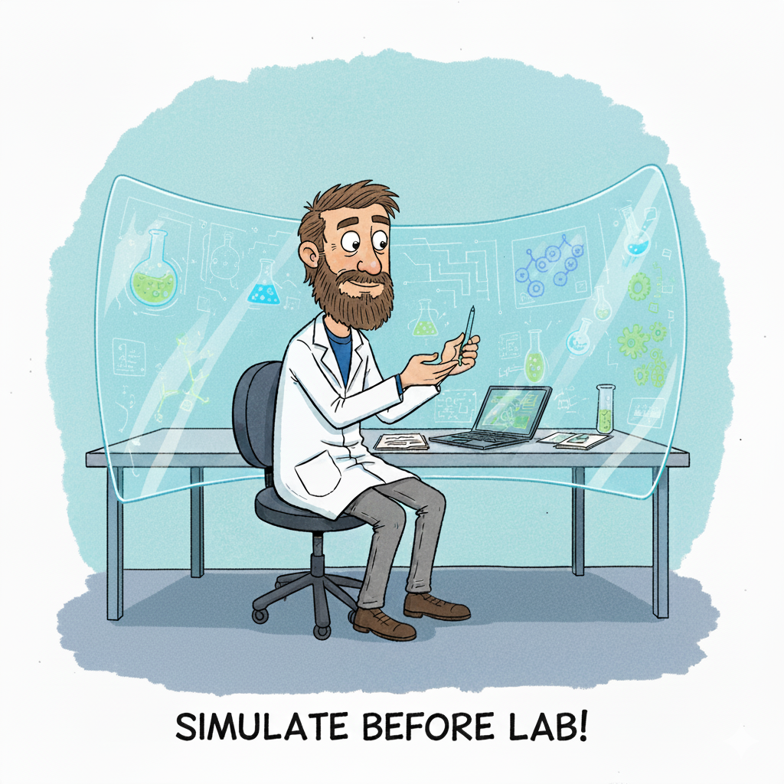
Now
THE BARRIER
What we aim
IT Knowledge
Infrastructure
Codes
Setup Complexity
Data Management
Expensive
Difficult
Limited
Cheap
Easy
Fast
Time wasting
Green
More options
ICSC Italian Research Center on High-Performance Computing, Big Data and Quantum Computing
Missione 4 • Istruzione e Ricerca

Slide 5

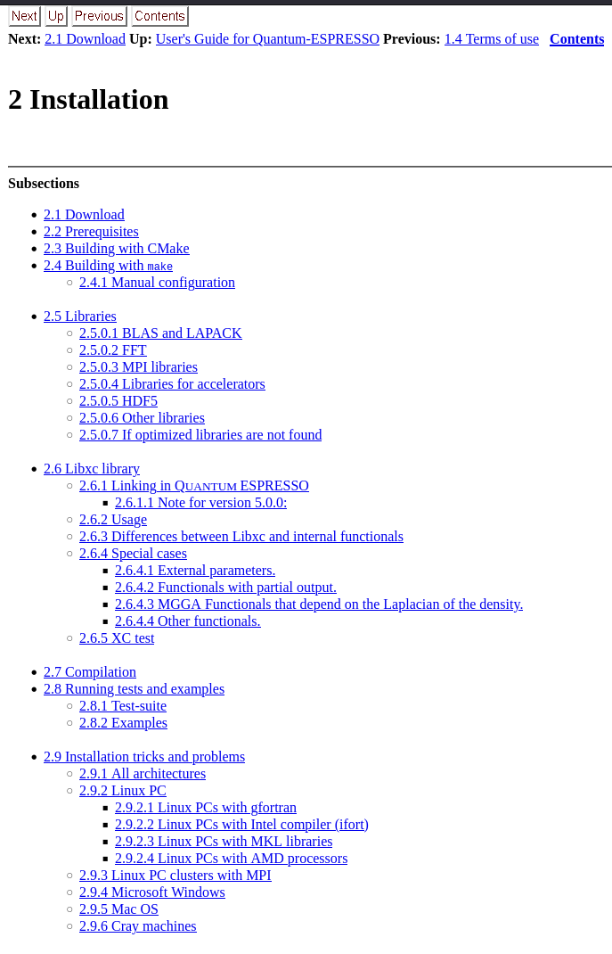
Google “installing quantum espresso”: first result is the official user guide
2.2 Prerequisites
To install QUANTUM ESPRESSO from source, you need first of all a minimal Unix environment, that is: a command shell (e.g., bash, sh) and utilities make, awk, sed. In order to install external libraries from scratch, you will also need git v.2.13 or later. For MS-Windows, see Sec.2.9.4. If you prefer installation with CMake (supported since v.6.7), you will need a recent (v.3.20 or later) working CMake software; otherwise you will need the configure command from autoconf (and, for FoX compilation only, m4).
Note that the scripts contained in the distribution assume that the local language is set to the standard, i.e. "C"; other settings may break them. Use export LC_ALL=C (sh/bash) or setenv LC_ALL C (csh/tcsh) to prevent any problem when running scripts (including installation scripts).
Second, you need a Fortran compiler compliant with F2008 standard. For parallel execution, you will also need MPI libraries and a parallel (i.e. MPI-aware) compiler. For massively parallel machines, or for simple multicore parallelization, an OpenMP-aware compiler and libraries are also required. To compile for GPUs you need a recent version of the NVidia HPC SDK (software development kit), formerly PGI compiler, freely available for download.
As a rule, QUANTUM ESPRESSO tries to keep compatibility with older compilers, avoiding nonstandard extensions and newer features that are not widespread or stabilized. If however your compiler is older than a few (∼5) years, it is likely that something will not work. The same applies to mathematical and MPI libraries. For GPU compilation, you need v.21.7 or later of the NVidia HPC SDK (previous versions may or may not work).
Big computing centers typically provide a Fortran compiler complete with all needed libraries. Workstations or ``commodity'' machines using PC hardware, may or may not have the needed software. If not, you need to buy a commercial compiler or to use the open-source gfortran compiler from the gcc distribution (and possibly MPI libraries and run-time software). Note that most commercial compilers are also available free of charge under some conditions (e.g. academic or personal usage, no support) and may provide MPI libraries and run-time software as well.

Slide 6

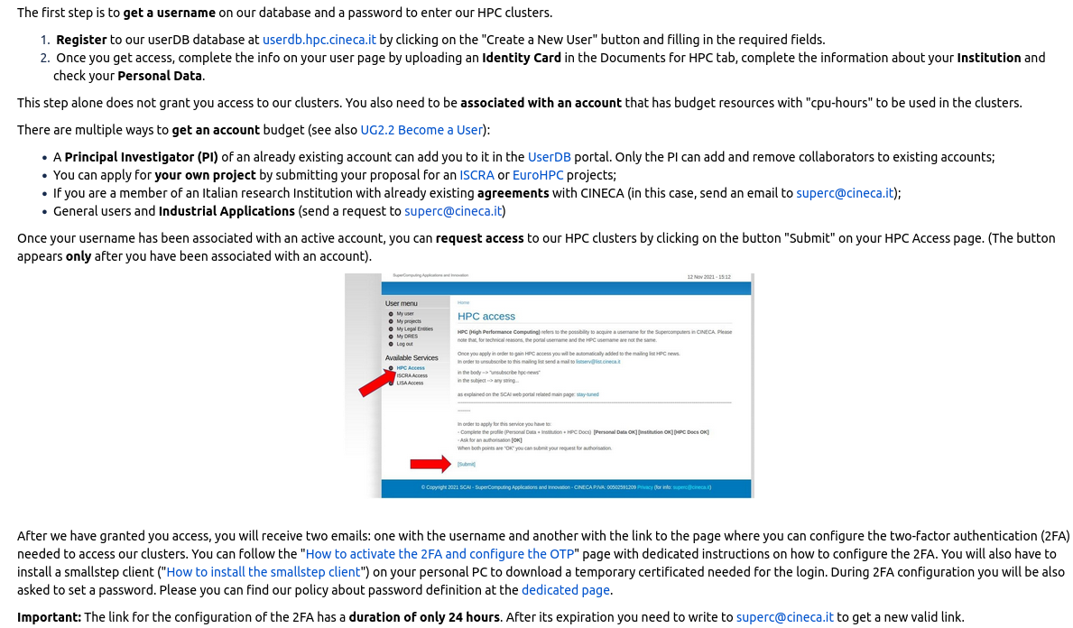
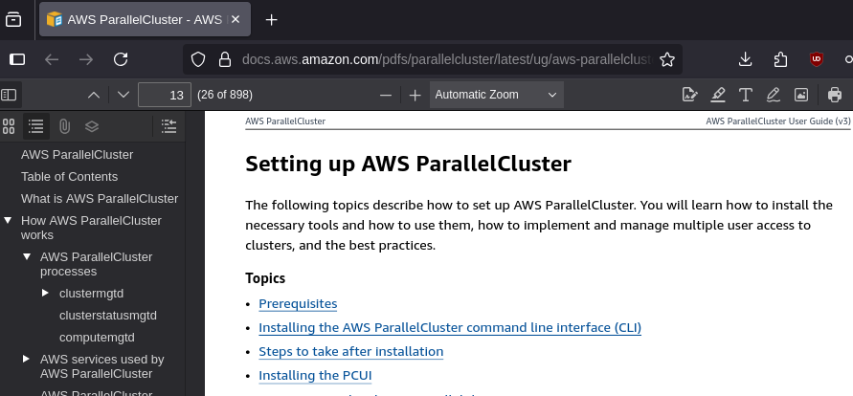
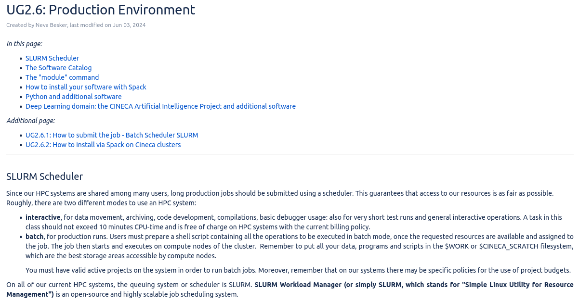
HPC access: “Getting started”
Not an easy subscription

Slide 7
Democratizing Simulations
THE BARRIER
Now
What we aim
IT Knowledge
IT Knowledge
Infrastructure
Infrastructure
MATERYS
Codes
Data Management
Setup Complexity
Expensive
Difficult
Limited
Cheap
Easy
Fast
Data Management
Time wasting
Green
More options
ICSC Italian Research Center on High-Performance Computing, Big Data and Quantum Computing
Missione 4 • Istruzione e Ricerca

Slide 8

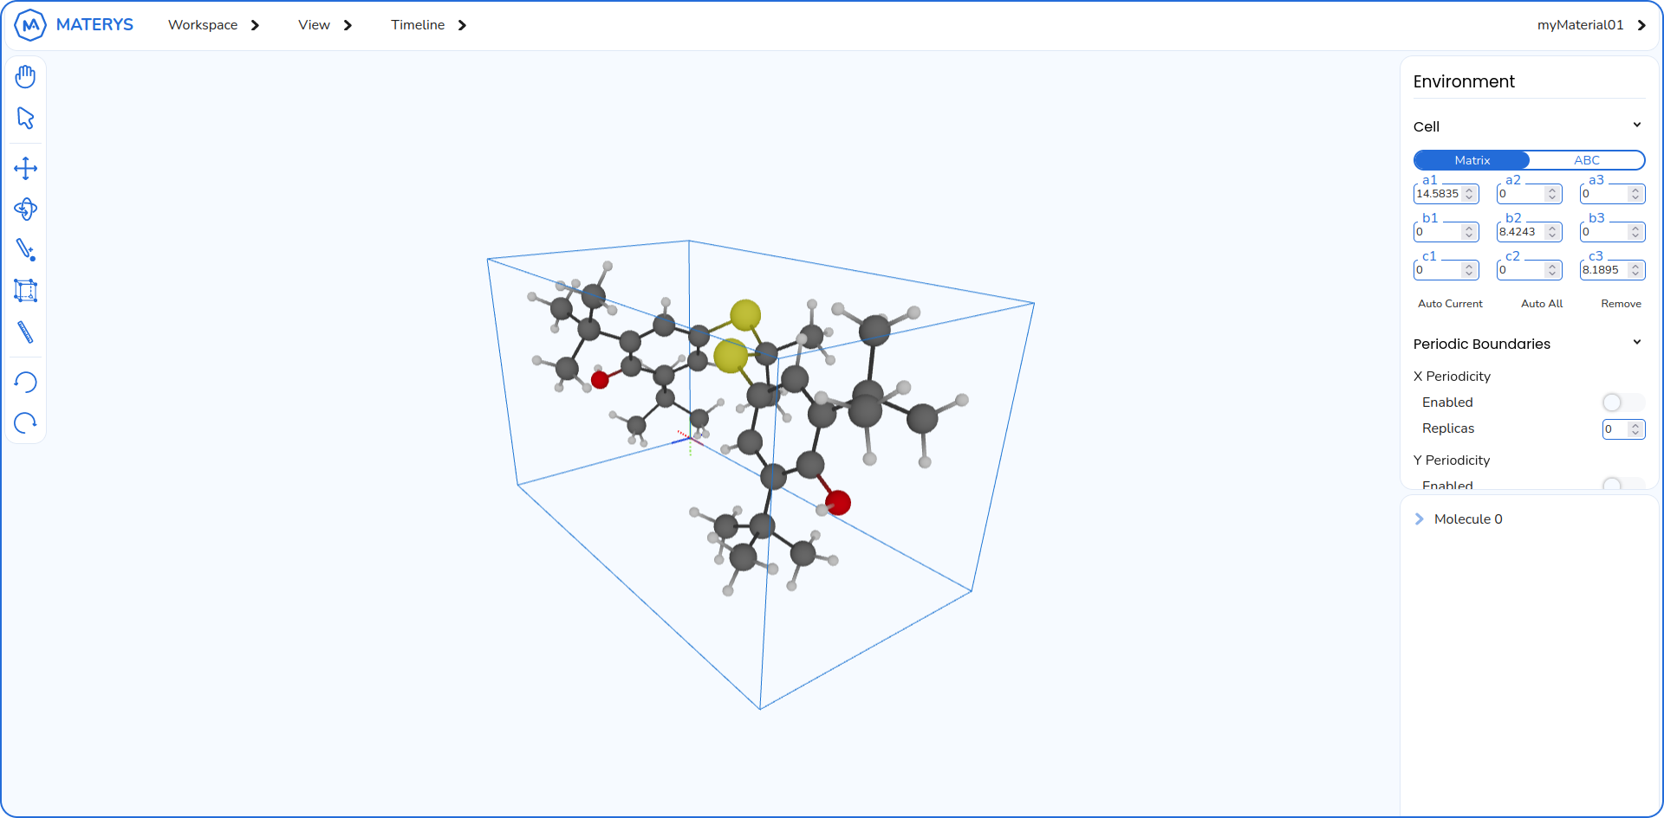
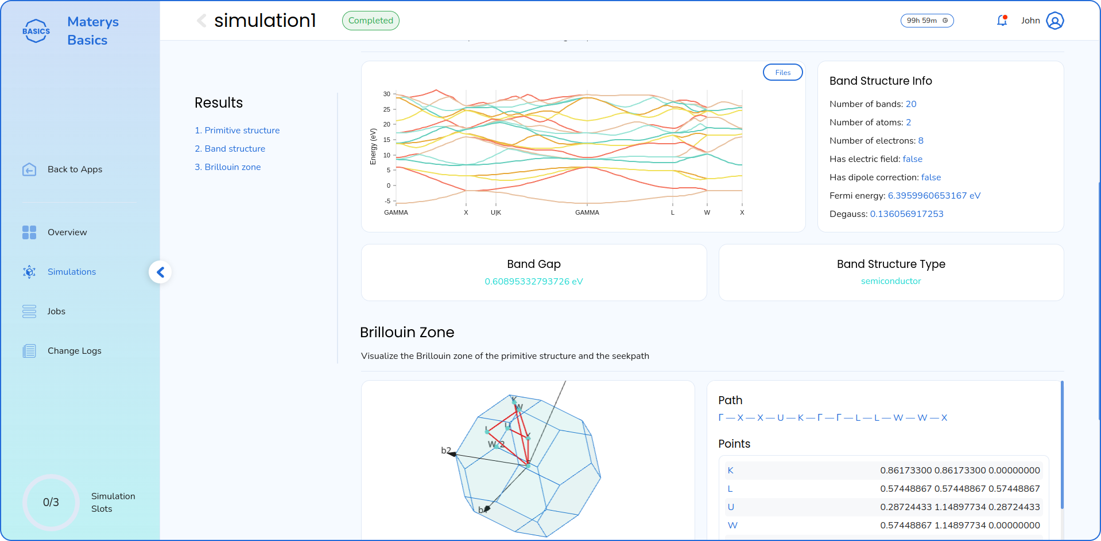
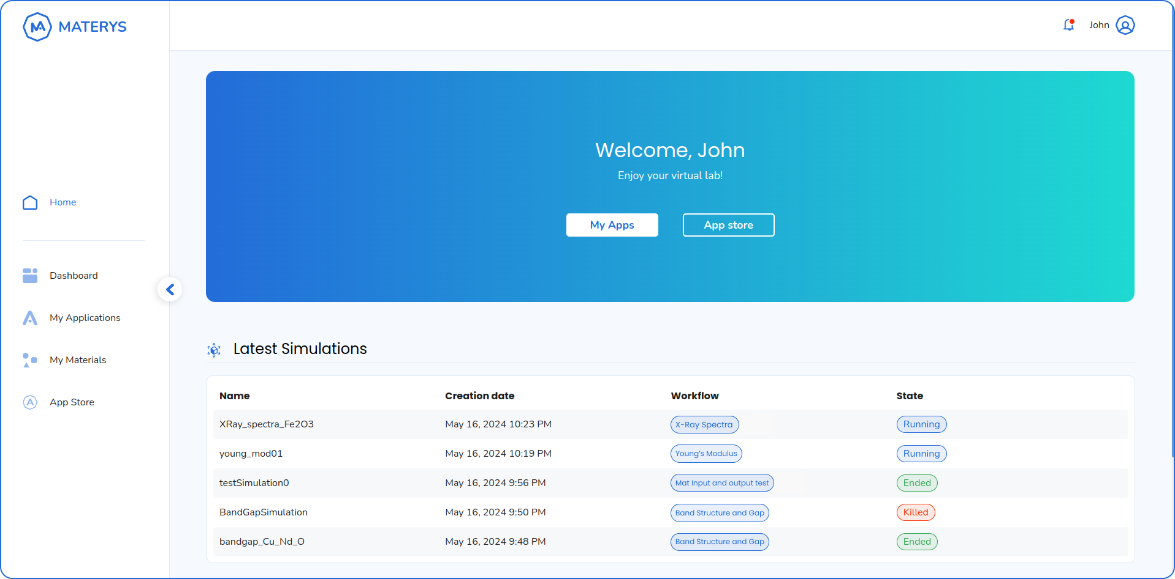
Through our cloud platform, we handle all IT and data management aspects and provide specialized applications to jumpstart your materials R&D in just a few clicks.
ICSC Italian Research Center on High-Performance Computing, Big Data and Quantum Computing
Missione 4 • Istruzione e Ricerca

Slide 9

Enough talking! Here is one example.
This simulation took one minute to set up and about three hours to run.

Slide 10
Platform modularity
Designed from the ground up to make it easy to integrate any existing HPC code
Aiida workflows are particularly easy to share and integrate
AiiDA workflows can work without any modification after telling the platform that they exist
Automatic User interface: widgets are visualized according to the data types of input/outputs
Completely transparent handling of storage and computational credits thanks to a complete slurm integration
ICSC Italian Research Center on High-Performance Computing, Big Data and Quantum Computing
Missione 4 • Istruzione e Ricerca

Slide 11



Materys will be soon available for free until
April 2026 to all members of ICSC.
For early adopters or to schedule a demo.
ICSC Italian Research Center on High-Performance Computing, Big Data and Quantum Computing
Missione 4 • Istruzione e Ricerca

Slide 12

Grazie
per
l’attenzione
ICSC Italian Research Center on High-Performance Computing, Big Data and Quantum Computing
Missione 4 • Istruzione e Ricerca

