Slide 1

ICSC Italian Research Center on High-Performance Computing, Big Data and Quantum Computing
Missione 4 • Istruzione e Ricerca

Slide 2

Spoke 9 – AI-Playing
Marco Di Francesco (Net Service Group)
ICSC Italian Research Center on High-Performance Computing, Big Data and Quantum Computing
Missione 4 • Istruzione e Ricerca

Slide 3





Consortium
Abinsula Srl (Cagliari, Sassari)
Greenshare Srl (Cagliari)
Net Service SpA (Bologna)
ICSC Italian Research Center on High-Performance Computing, Big Data and Quantum Computing
Missione 4 • Istruzione e Ricerca

Slide 4

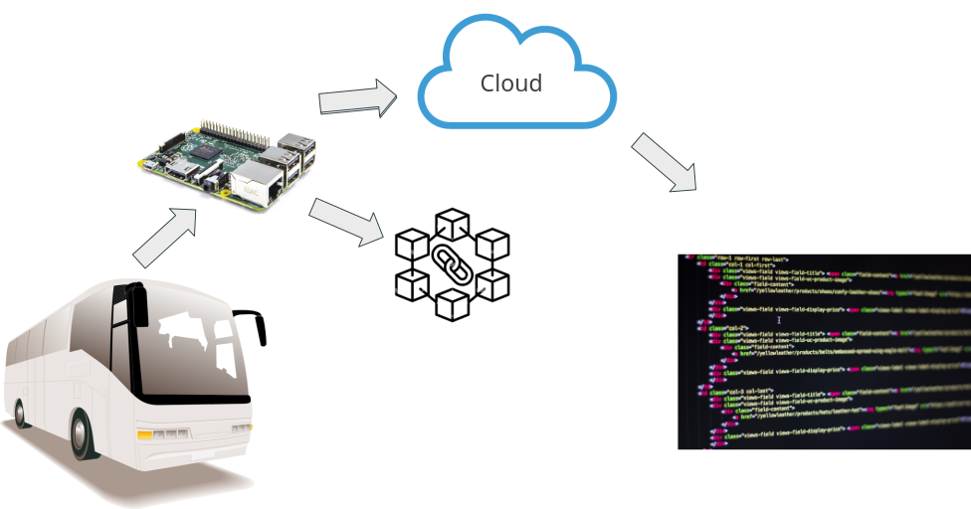

Architecture
Black Box
AI Algorithms
Blockchain
Bus
ICSC Italian Research Center on High-Performance Computing, Big Data and Quantum Computing
Missione 4 • Istruzione e Ricerca

Slide 5
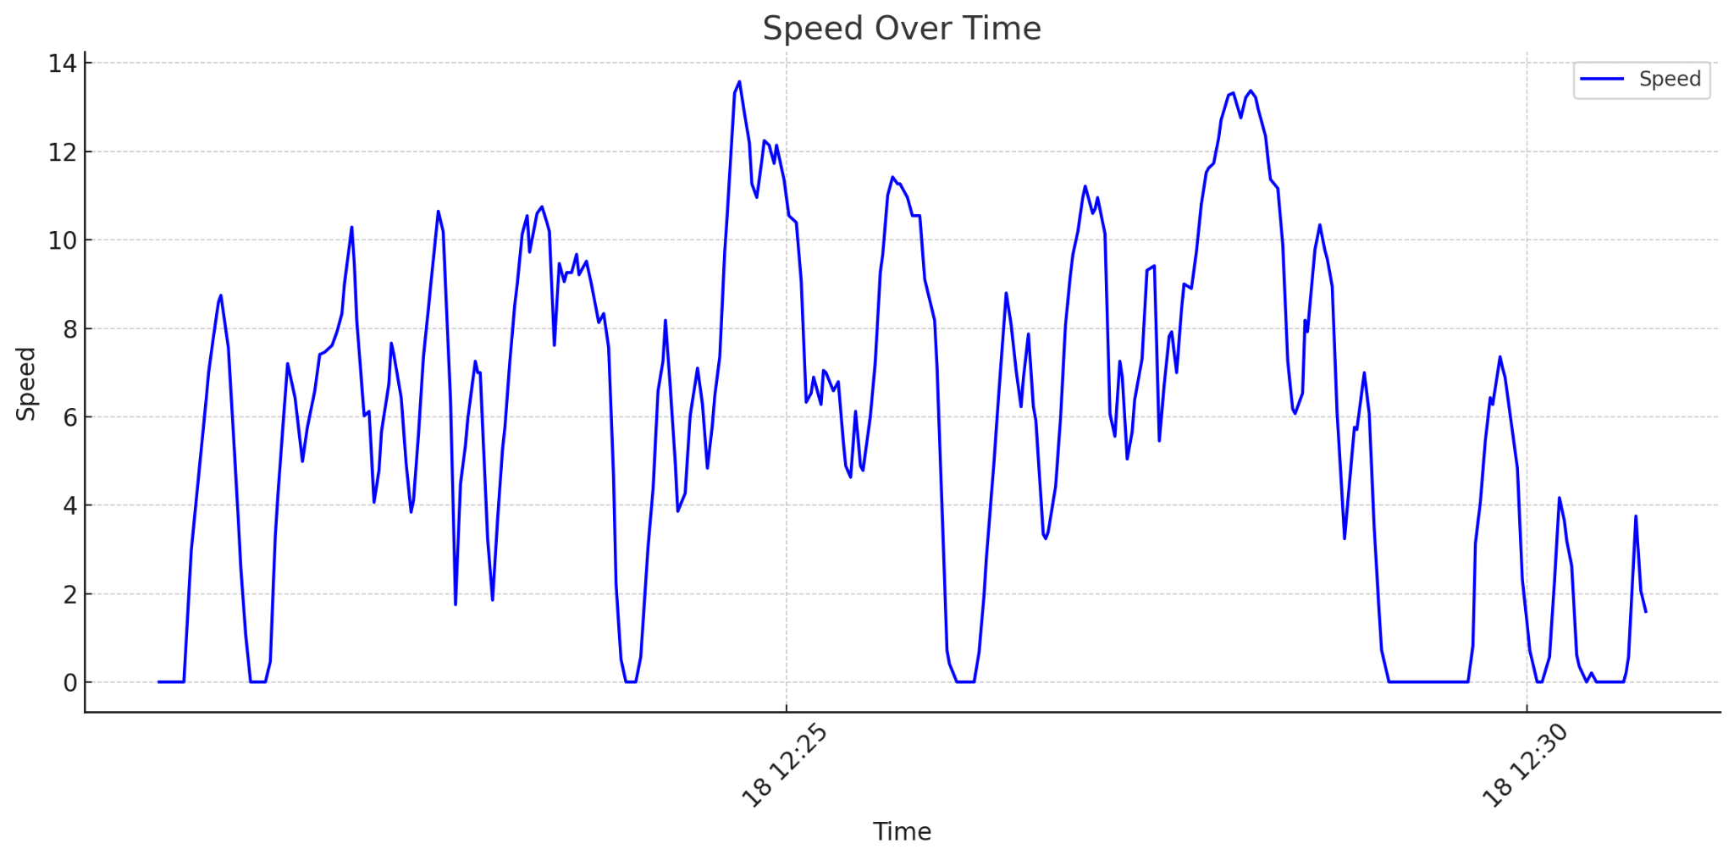
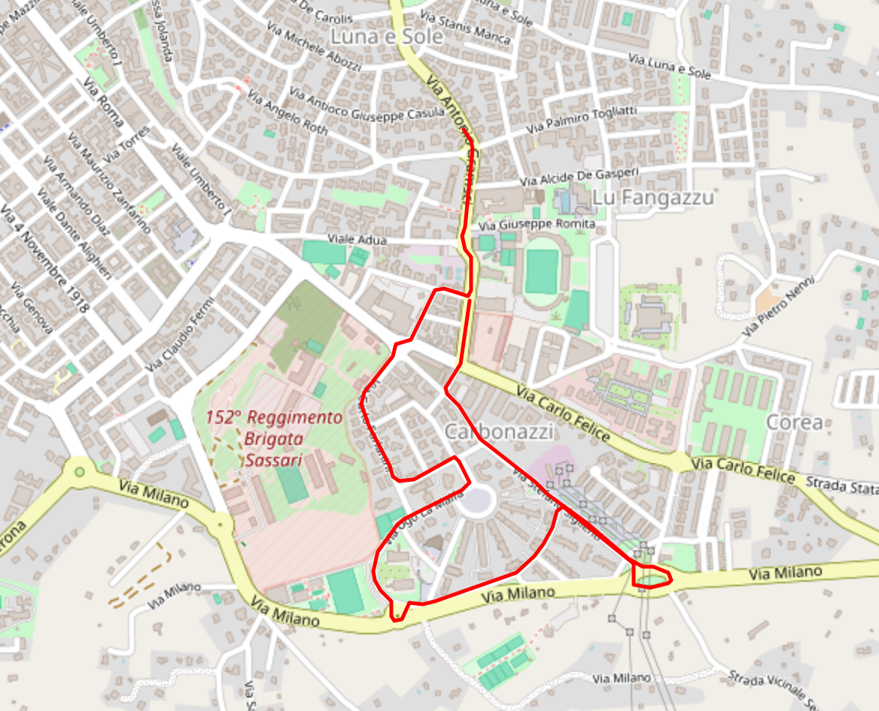
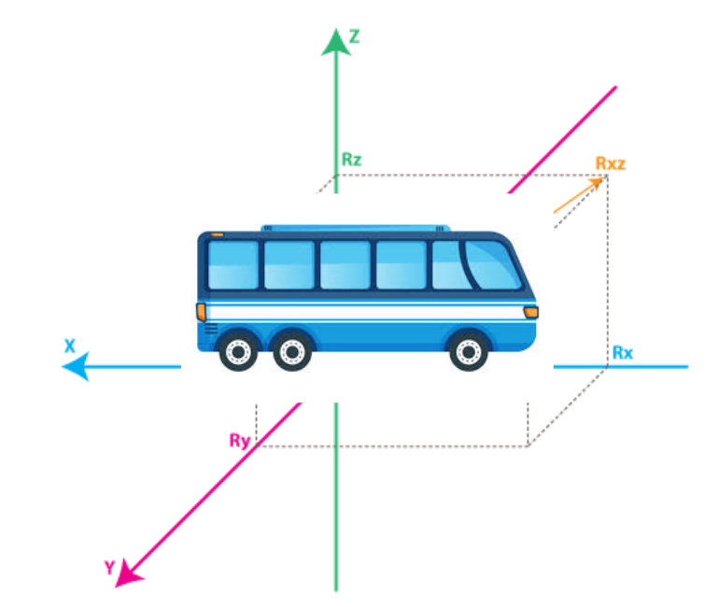
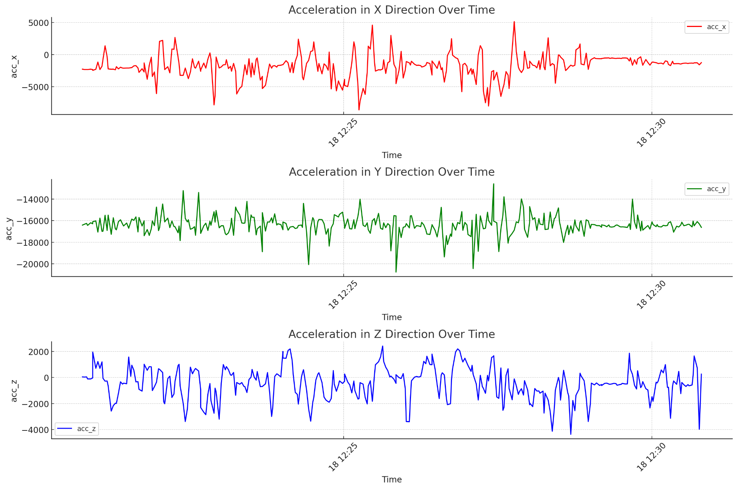
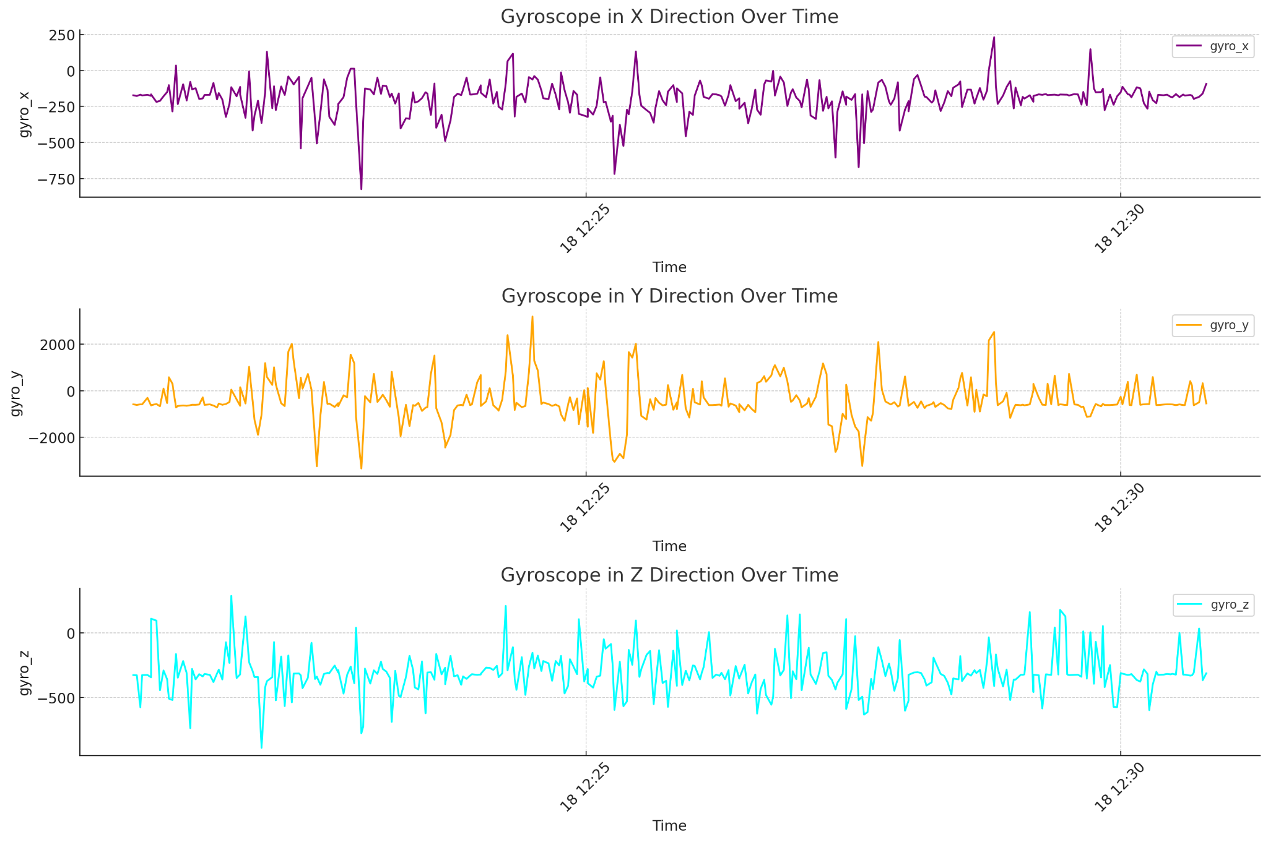
Speed
Tracking
Driving styles
Gyroscope
Acceleration
ICSC Italian Research Center on High-Performance Computing, Big Data and Quantum Computing
Missione 4 • Istruzione e Ricerca

Slide 6

Grazie
per
l’attenzione
ICSC Italian Research Center on High-Performance Computing, Big Data and Quantum Computing
Missione 4 • Istruzione e Ricerca

