Slide 1

ICSC Italian Research Center on High-Performance Computing, Big Data and Quantum Computing
Missione 4 • Istruzione e Ricerca

Slide 2

Spoke 3 – AstroTool/AstroVisio
Marco Di Francesco (Net Service Group)
ICSC Italian Research Center on High-Performance Computing, Big Data and Quantum Computing
Missione 4 • Istruzione e Ricerca

Slide 3







Consortium
Auticon Srl (Milan),
Alkemy SpA (Milan)
Net Service SpA (Cagliari, Cosenza, Lecce)
Consultants
University of Cagliari, Department of Physics
MetaVerso
ICSC Italian Research Center on High-Performance Computing, Big Data and Quantum Computing
Missione 4 • Istruzione e Ricerca

Slide 4

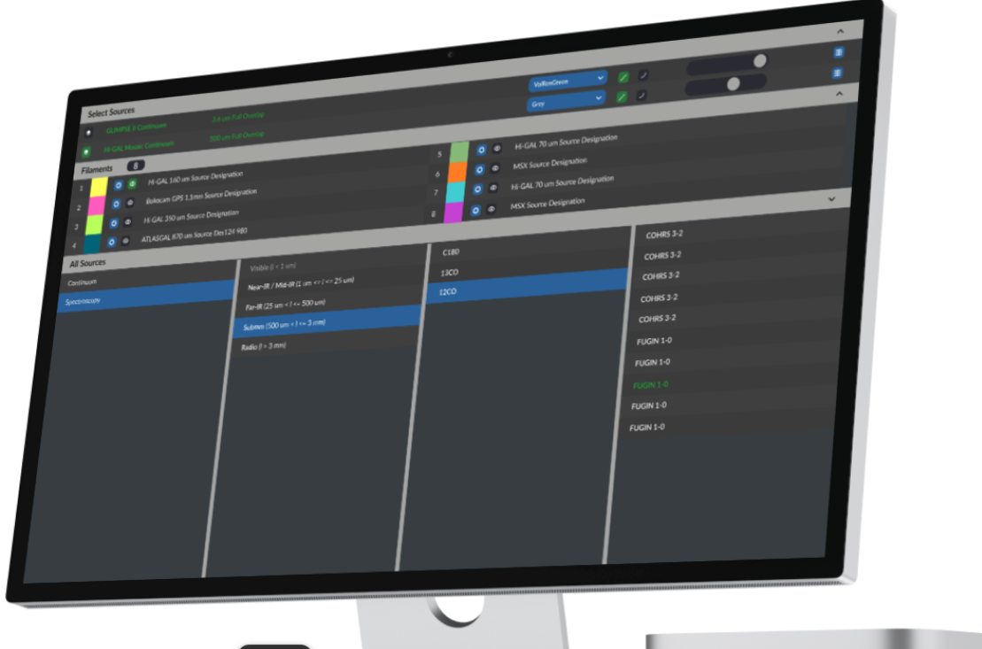
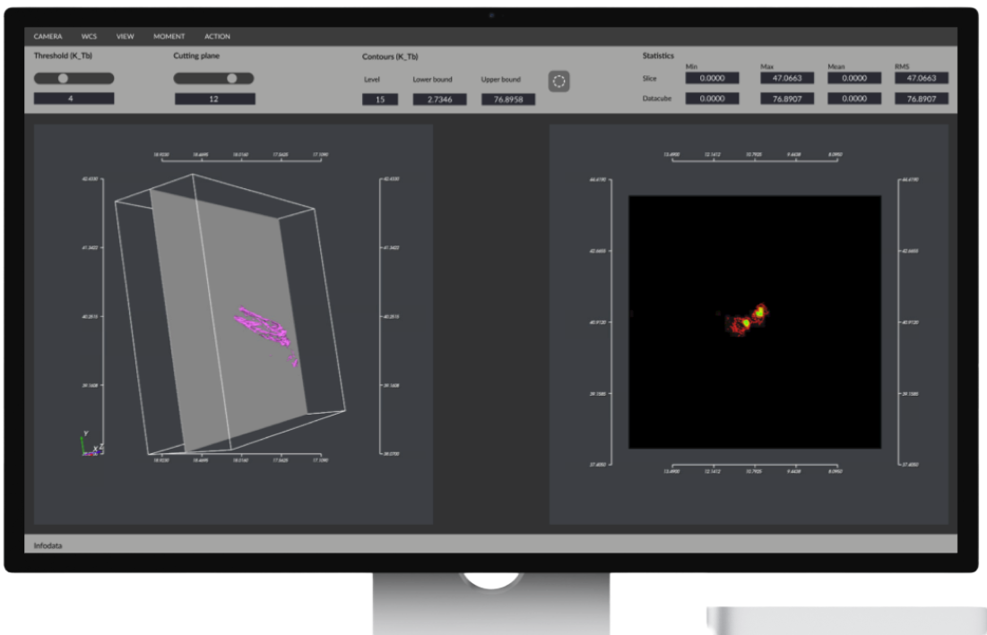
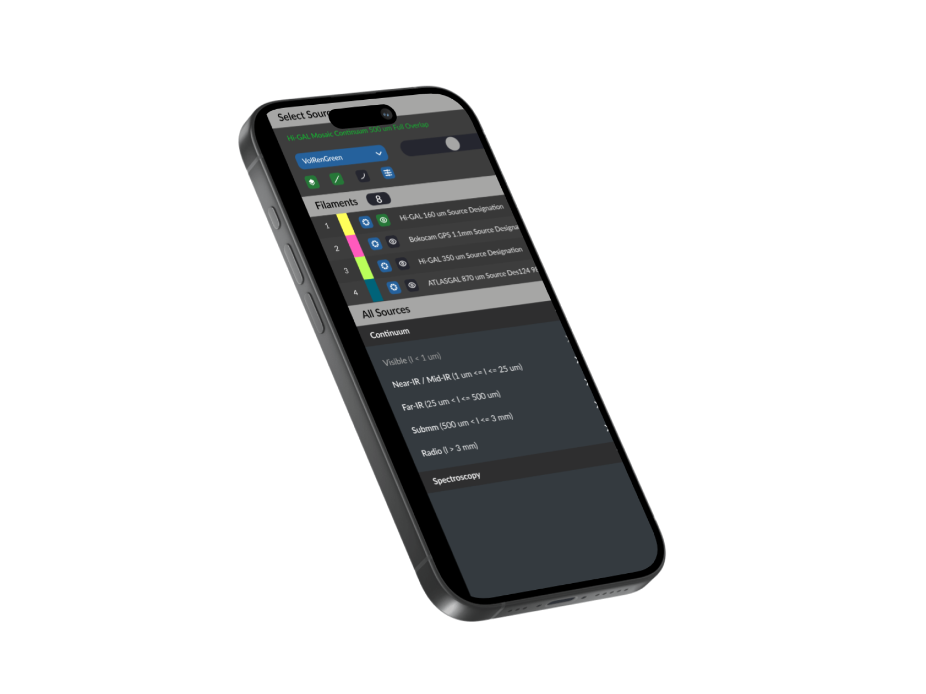
AstroTool
Pre-Processing of Astrophysics Big Data for data analysis and pre-rendering on HPC environment
fddddd
Remote Pre-Rendering of AstroPhysics Data on HPC environment
View and Interact with the rendered images on a modern PC through a specific client/web application
ICSC Italian Research Center on High-Performance Computing, Big Data and Quantum Computing
Missione 4 • Istruzione e Ricerca

Slide 5

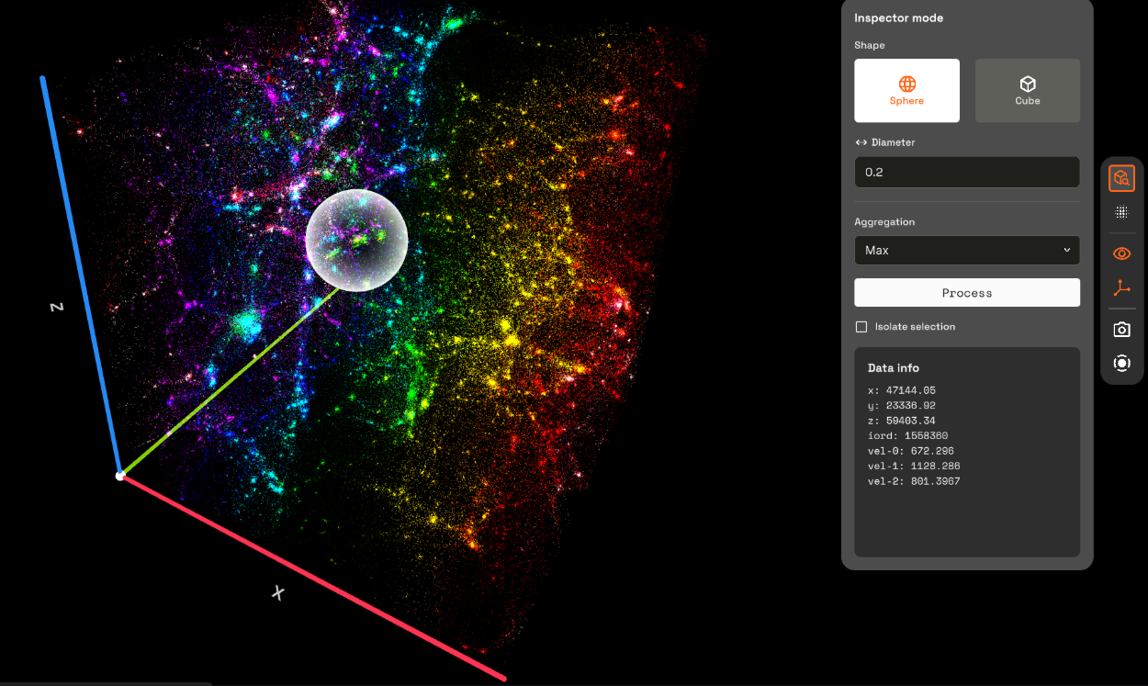
Immersive Technology Application
The project uses VR, XR, and spatial computing to create new interactive astrophysics data analysis tools
Structured Development Phases
Work packages cover research, design, data system setup, and VR software implementation for comprehensive progress.
Collaborative Testing and Feedback
Astrophysicists tested the prototype, providing feedback that enhanced the final product's features and usability (research, documentation, education and divulgation).
Main Features
Visualization rendering​
Inspector and data selection (summarization stats)
Multi file visualizazion reel (time lapse)
Projects and Image export
Visualization recording and export
Enanched Visualization expressiveness (colors and opacity)
ICSC Italian Research Center on High-Performance Computing, Big Data and Quantum Computing
Missione 4 • Istruzione e Ricerca

Slide 6

Grazie
per
l’attenzione
ICSC Italian Research Center on High-Performance Computing, Big Data and Quantum Computing
Missione 4 • Istruzione e Ricerca

