Slide 1

ICSC Italian Research Center on High-Performance Computing, Big Data and Quantum Computing
Missione 4 • Istruzione e Ricerca

Slide 2

VTWIN – Modellazione 3D ed integrazione geospaziale del territorio di Bovino
Andrea Bassani – IDeCOM Srl
ICSC Italian Research Center on High-Performance Computing, Big Data and Quantum Computing
Missione 4 • Istruzione e Ricerca

Slide 3

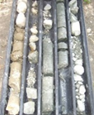



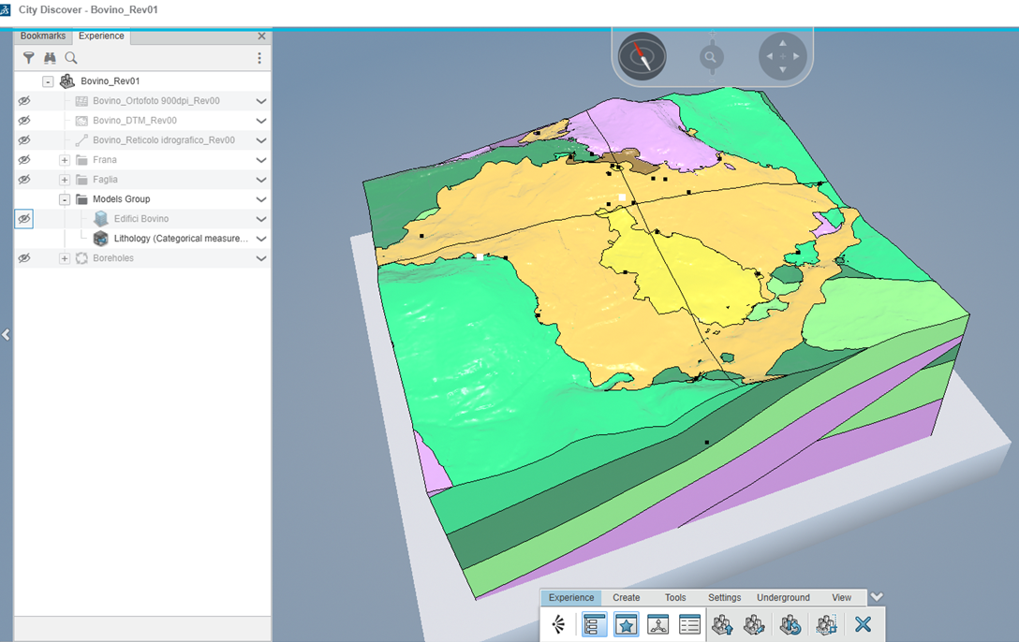
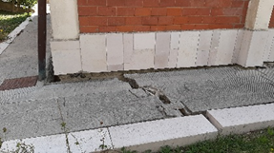
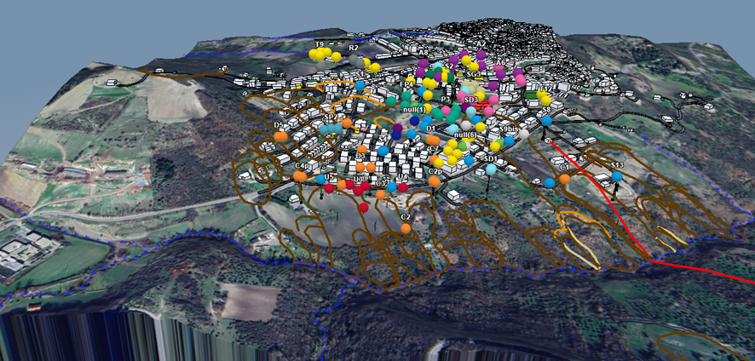
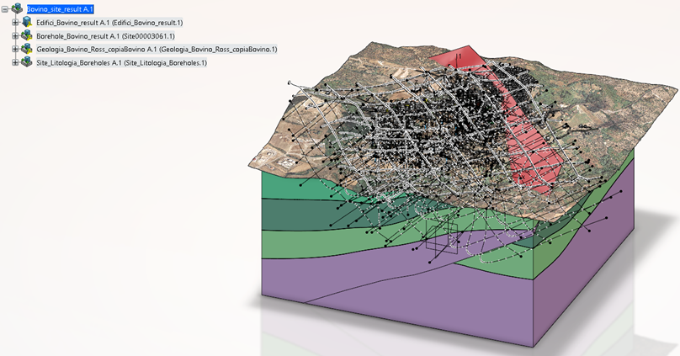
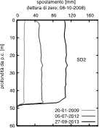

Flusso operativo del progetto VTWIN
Dashboard
Visualization
Interactivity
Analysis
DATA
GIS
Site investigation
Borehole logs
Geotechinal lab tests
In-situ tests
Geological/geomorphological surveys
Topographic surveys
Structural damage surveys
Geophysical tests
Data mapping and analysis
Orthophoto
Digital Terrain Model
Geological map
Geomorphological map
Regional technical map
Geotechnical investigations
PIATTAFORMA
3D MODEL
Conceptual model of landslide
Lithological sections
Geomorphological map
Geological map
Geotechnical model
Digital Elevation Model
Monitoring
Porewater pressure
Deep displacements
Surface displacements
Climatic variables
ICSC Italian Research Center on High-Performance Computing, Big Data and Quantum Computing
Missione 4 • Istruzione e Ricerca

Slide 4
Flusso operativo del progetto VTWIN
Acquisition and organization of data.
Creation of a QGIS project.
Integration of geospatial data into the City environment.
3D modeling of surface elements (buildings and infrastructures).
Integration of the models into the City environment.
Modelling boreholes as physical product.
Generation of a second 3D geological model integrated with geological cross-sections.
Development of the 3D geological model generated exclusively from borehole data.
Organization of the models developed on the platform into a «site» project environment.
Generation of graphs for the visualization of piezometric and inclinometric data.
Development of a dashboard as a shared workspace.
Numerical simulations.
ICSC Italian Research Center on High-Performance Computing, Big Data and Quantum Computing
Missione 4 • Istruzione e Ricerca

Slide 5


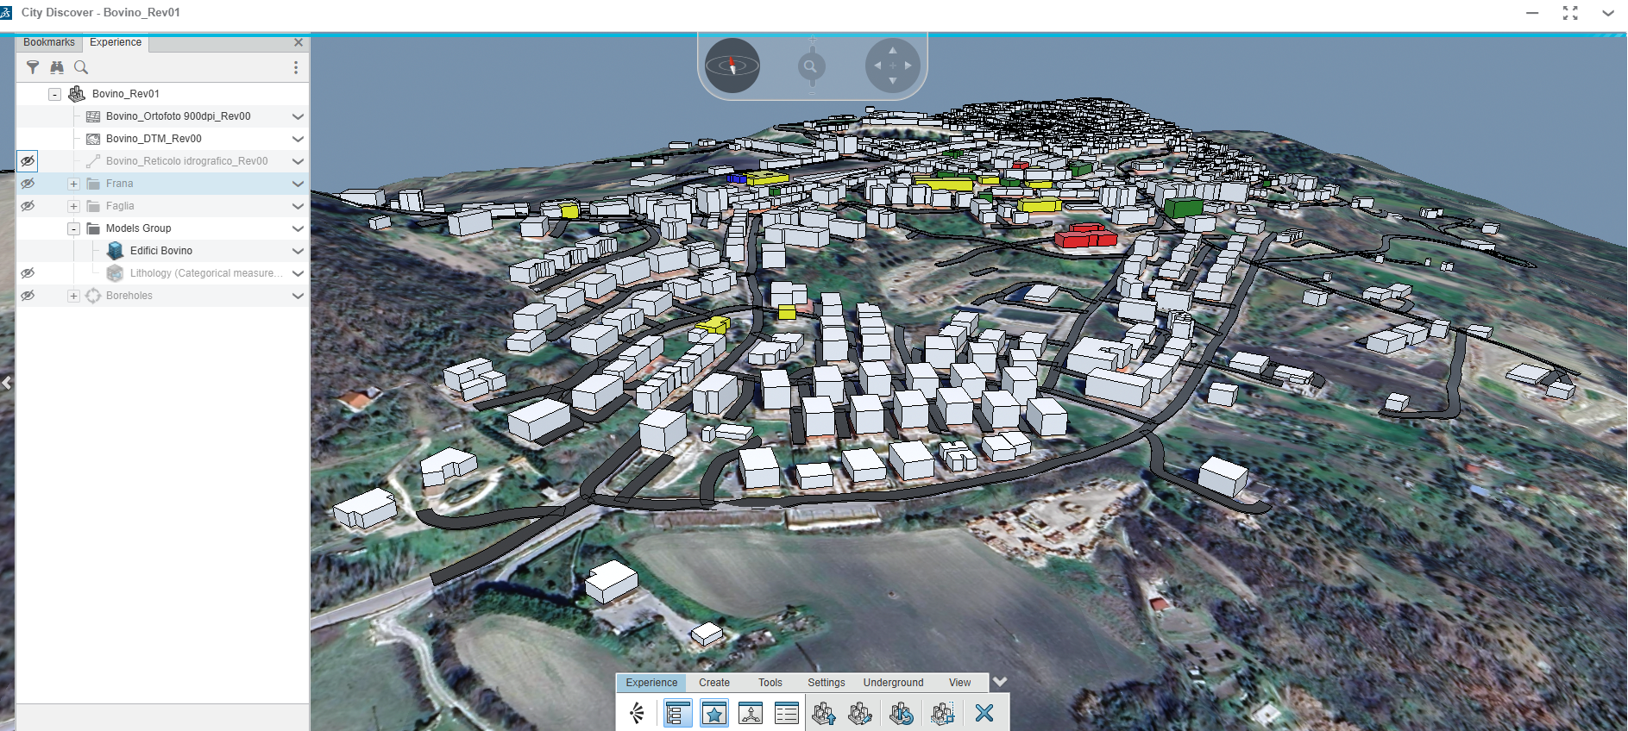
Il VTWIN DI BOVINO
Informazioni GIS
Mappatura del danno edifici
ICSC Italian Research Center on High-Performance Computing, Big Data and Quantum Computing
Missione 4 • Istruzione e Ricerca

Slide 6

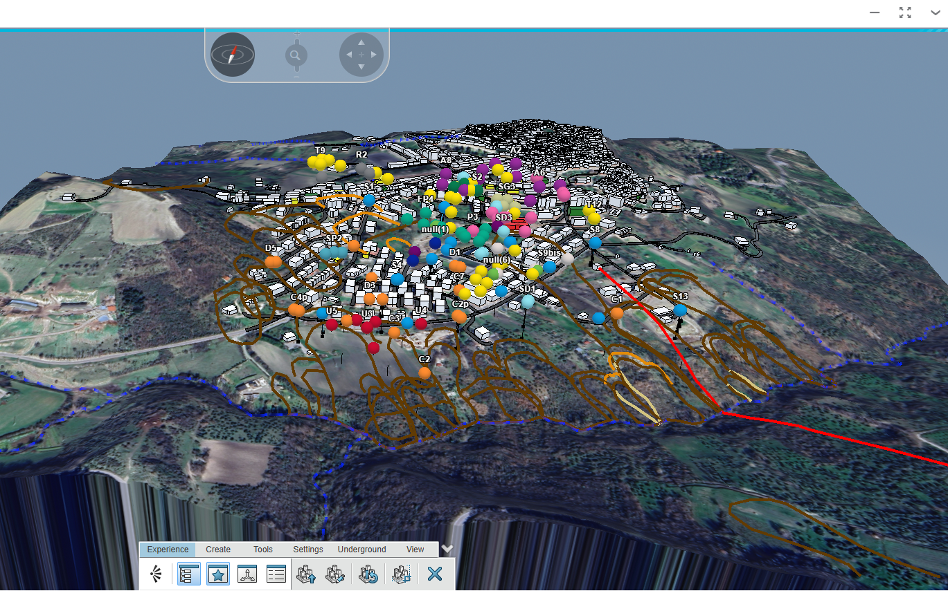
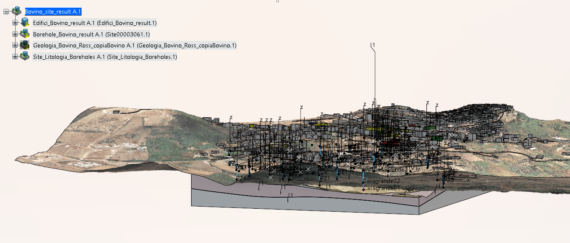
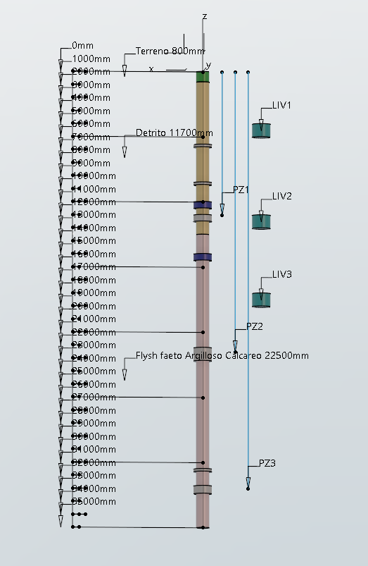
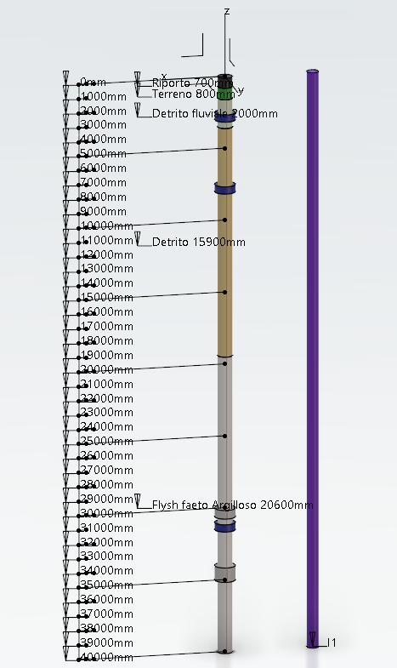
Il VTWIN DI BOVINO
Modello del sottosuolo
Dataset – sondaggi e visualizzazione
Borehole stratigraphy with highlighted stratigraphic horizons indicating the presence of carbonate lithologies
Geological model derived exclusively from borehole data.
Geological model derived from both geological sections and borehole data.
Average groundwater table level relative to ground level
Depth of piezometric cells
Inclinometer
ICSC Italian Research Center on High-Performance Computing, Big Data and Quantum Computing
Missione 4 • Istruzione e Ricerca

Slide 7
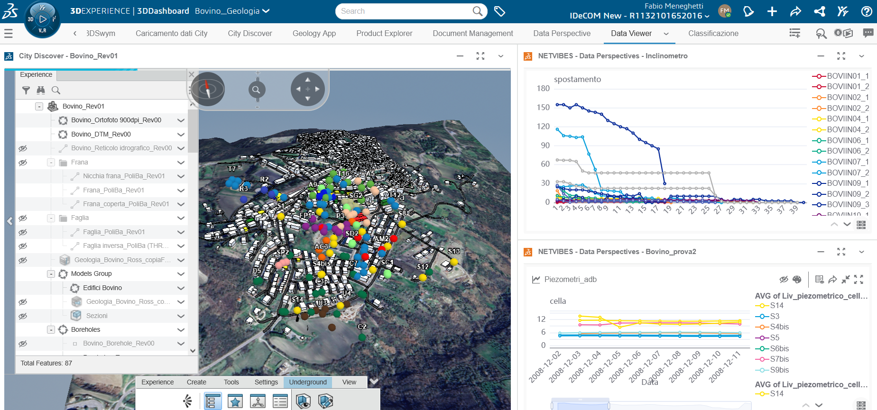
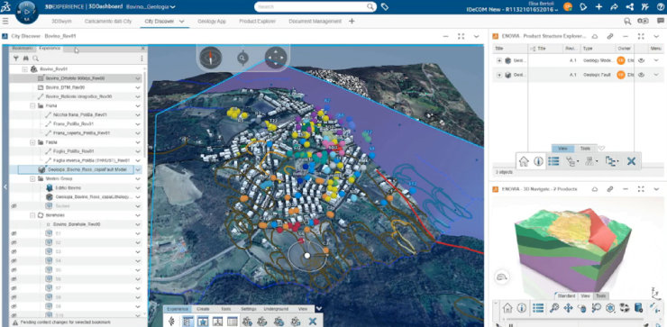
Il VTWIN DI BOVINO
Workspace condiviso – interrogazione Data Set
ICSC Italian Research Center on High-Performance Computing, Big Data and Quantum Computing
Missione 4 • Istruzione e Ricerca

Slide 8

ICSC Italian Research Center on High-Performance Computing, Big Data and Quantum Computing
Missione 4 • Istruzione e Ricerca

Slide 9

Grazie
per
l’attenzione
ICSC Italian Research Center on High-Performance Computing, Big Data and Quantum Computing
Missione 4 • Istruzione e Ricerca

