Slide 1

ICSC Italian Research Center on High-Performance Computing, Big Data and Quantum Computing
Missione 4 • Istruzione e Ricerca

Slide 2






PNRR M4C2 I1.4 Campione Nazionale ICSC – Cascade call SPOKE 1 – “Future HPC and Big Data” (CN00000013 - CUP J33C22001170001)
Directed Acyclic Graph on Cross-Application Programmable I/O
DAGonCAPIO
Raffaele Montella
https://www.dagoncapiouniparthenope.org/
https://capio.hpc4ai.it/
ICSC Italian Research Center on High-Performance Computing, Big Data and Quantum Computing
Missione 4 • Istruzione e Ricerca

Slide 3

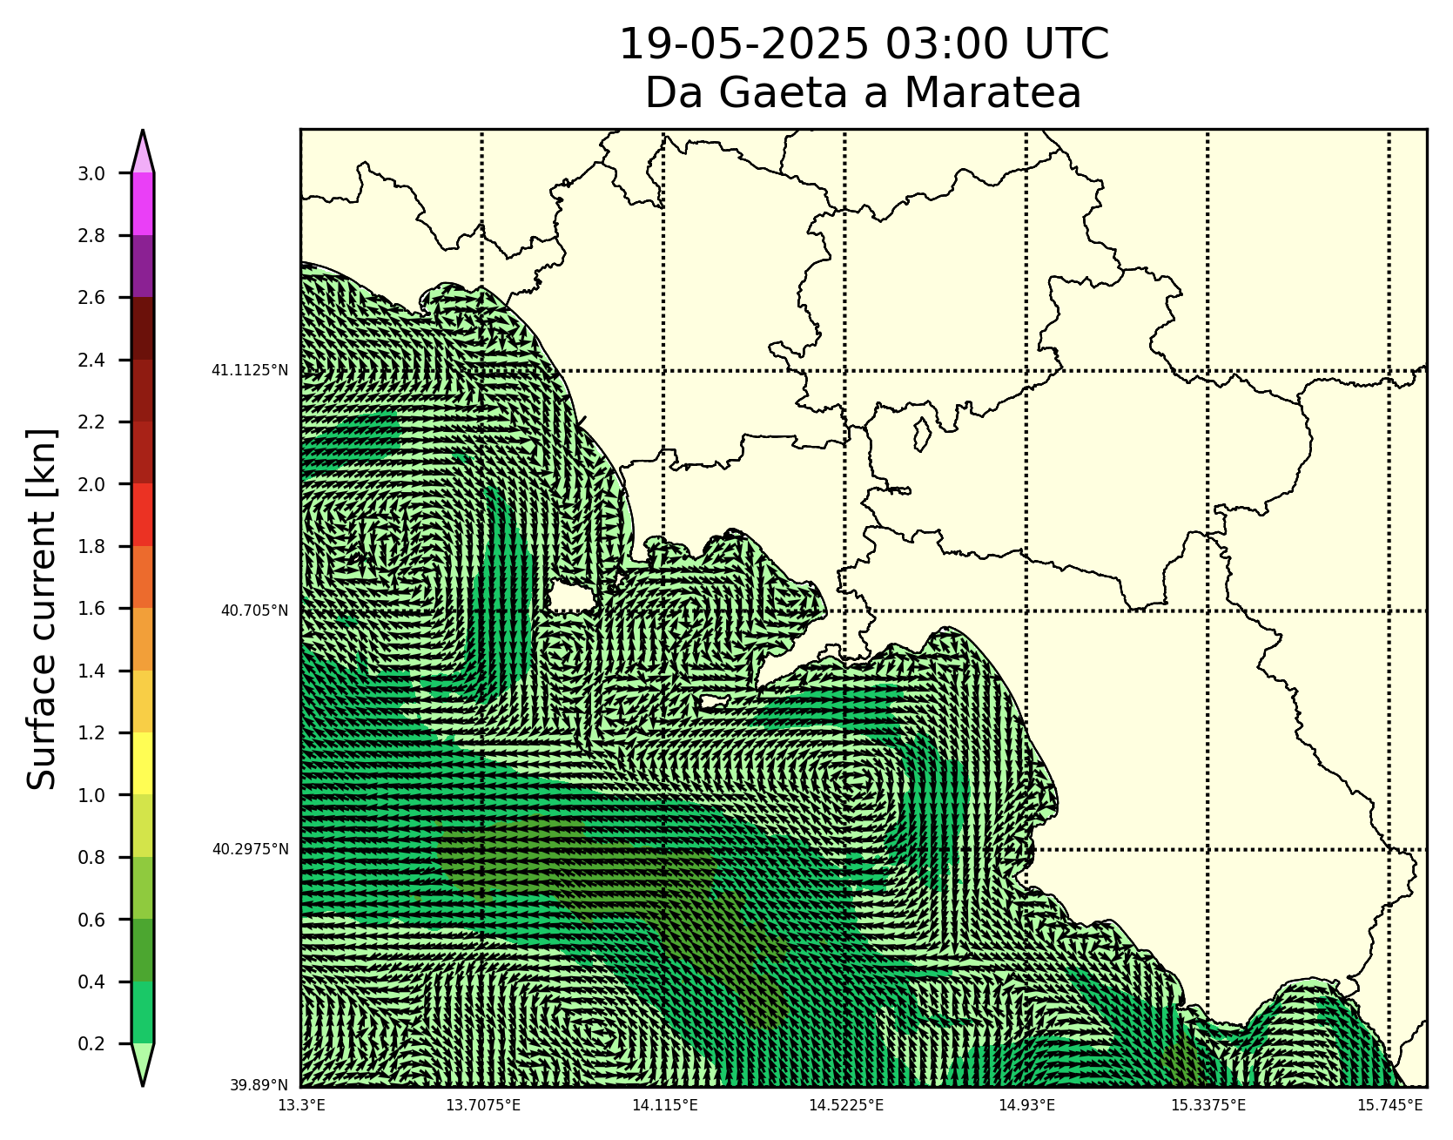
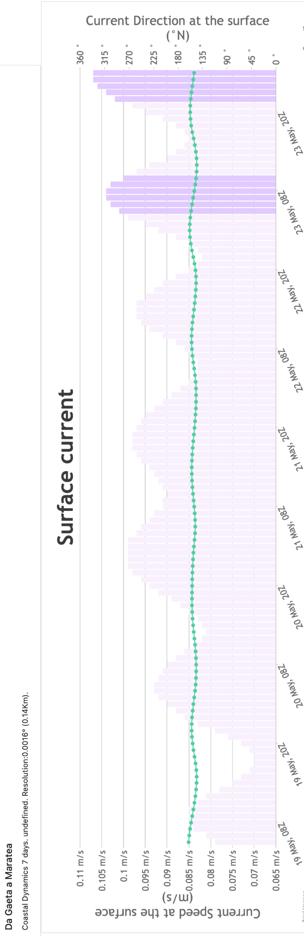

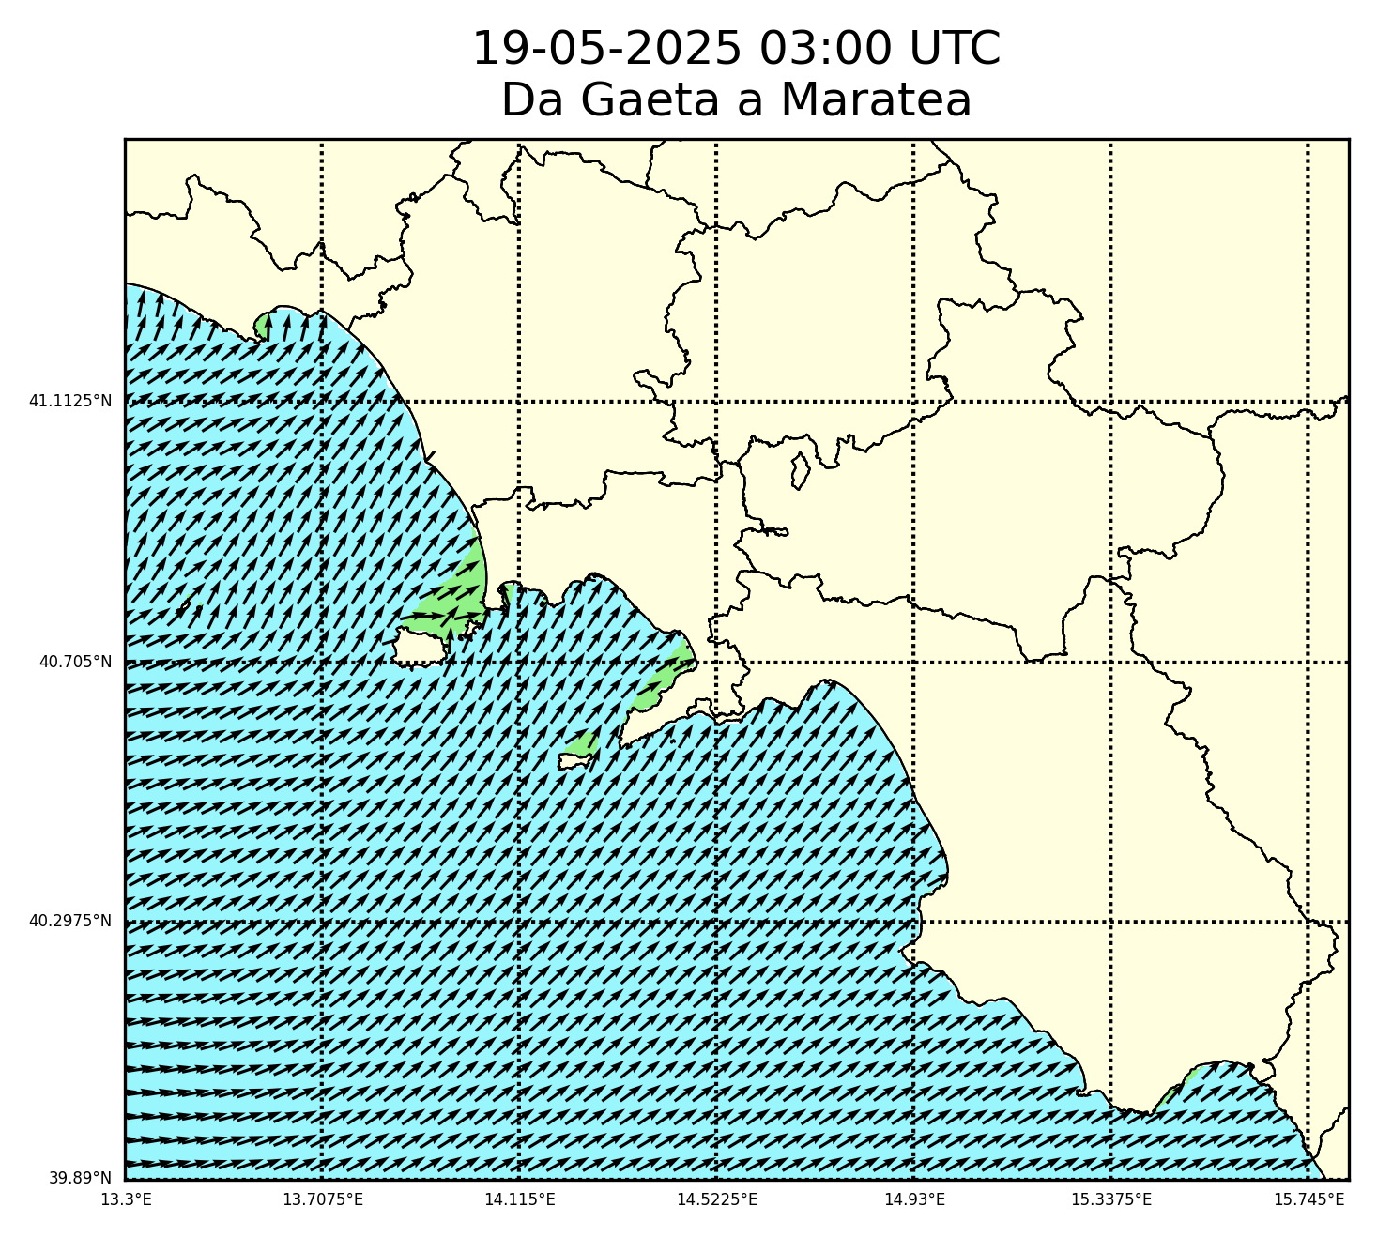
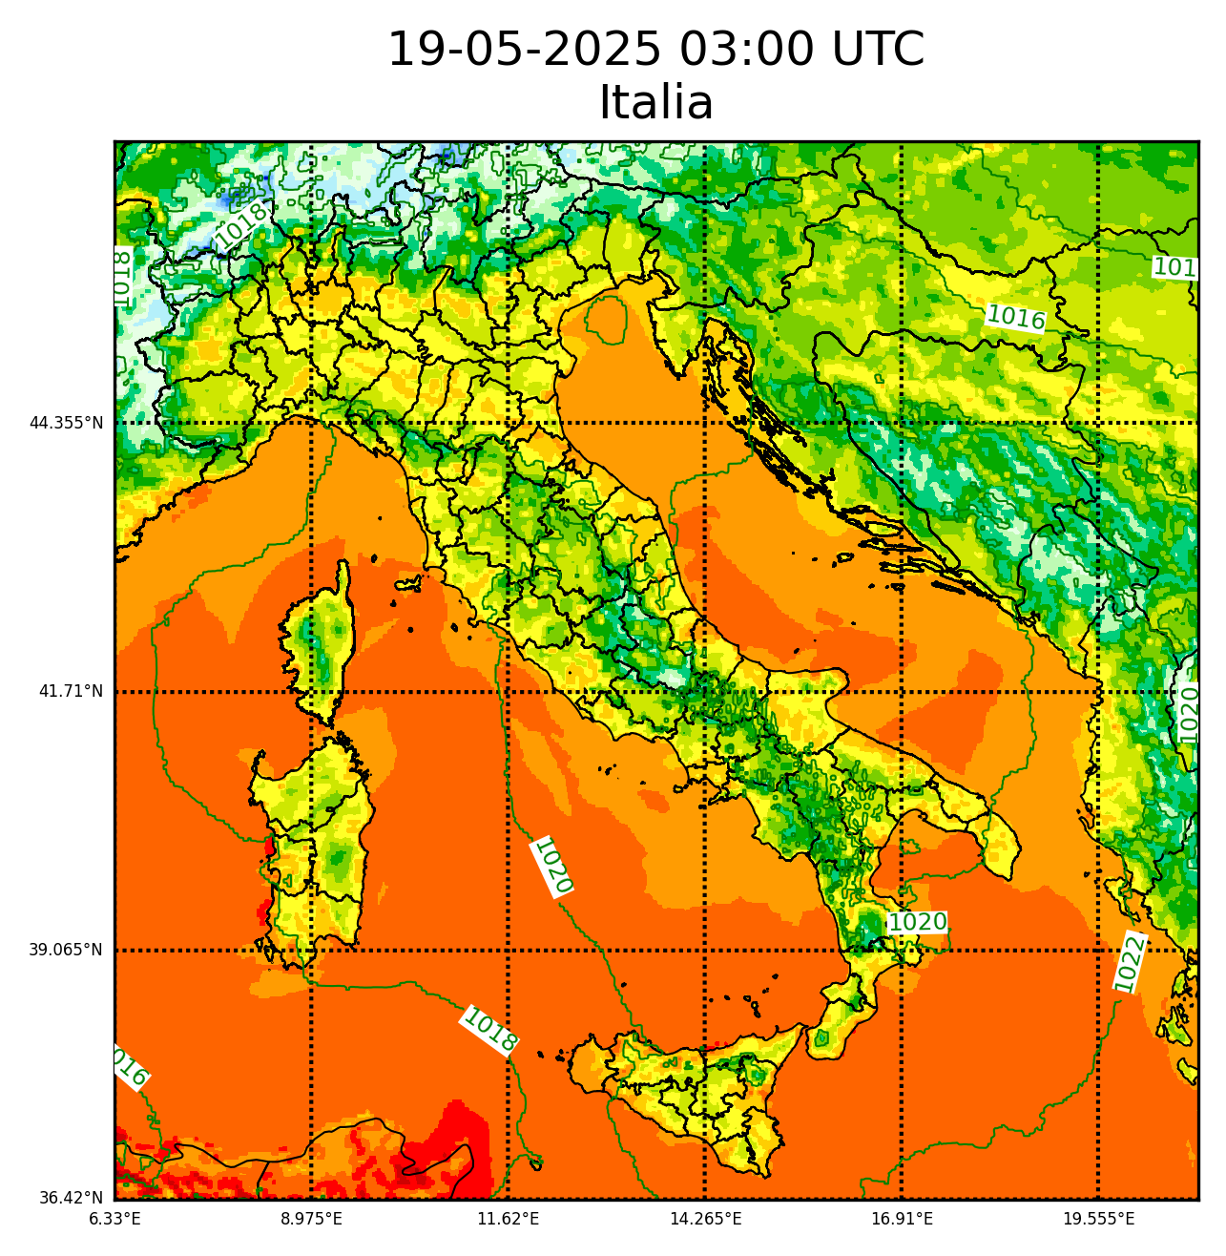
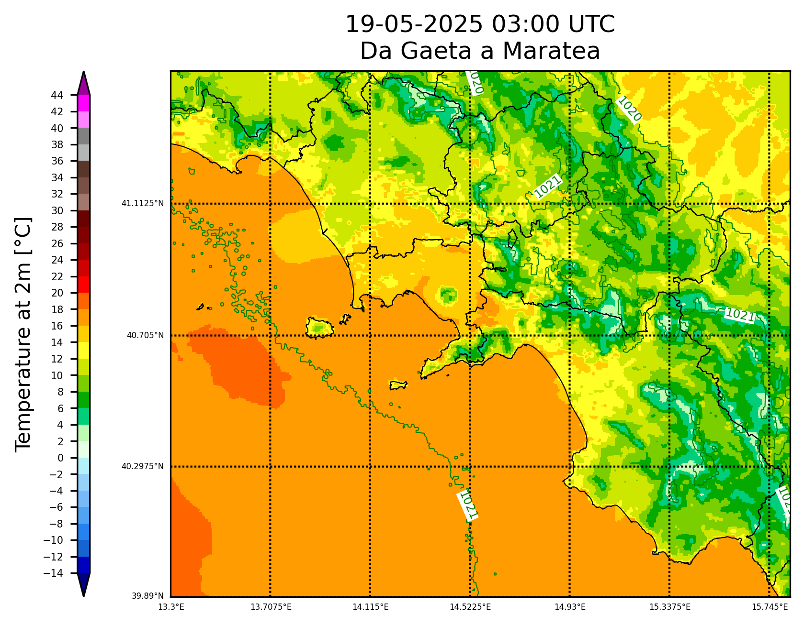
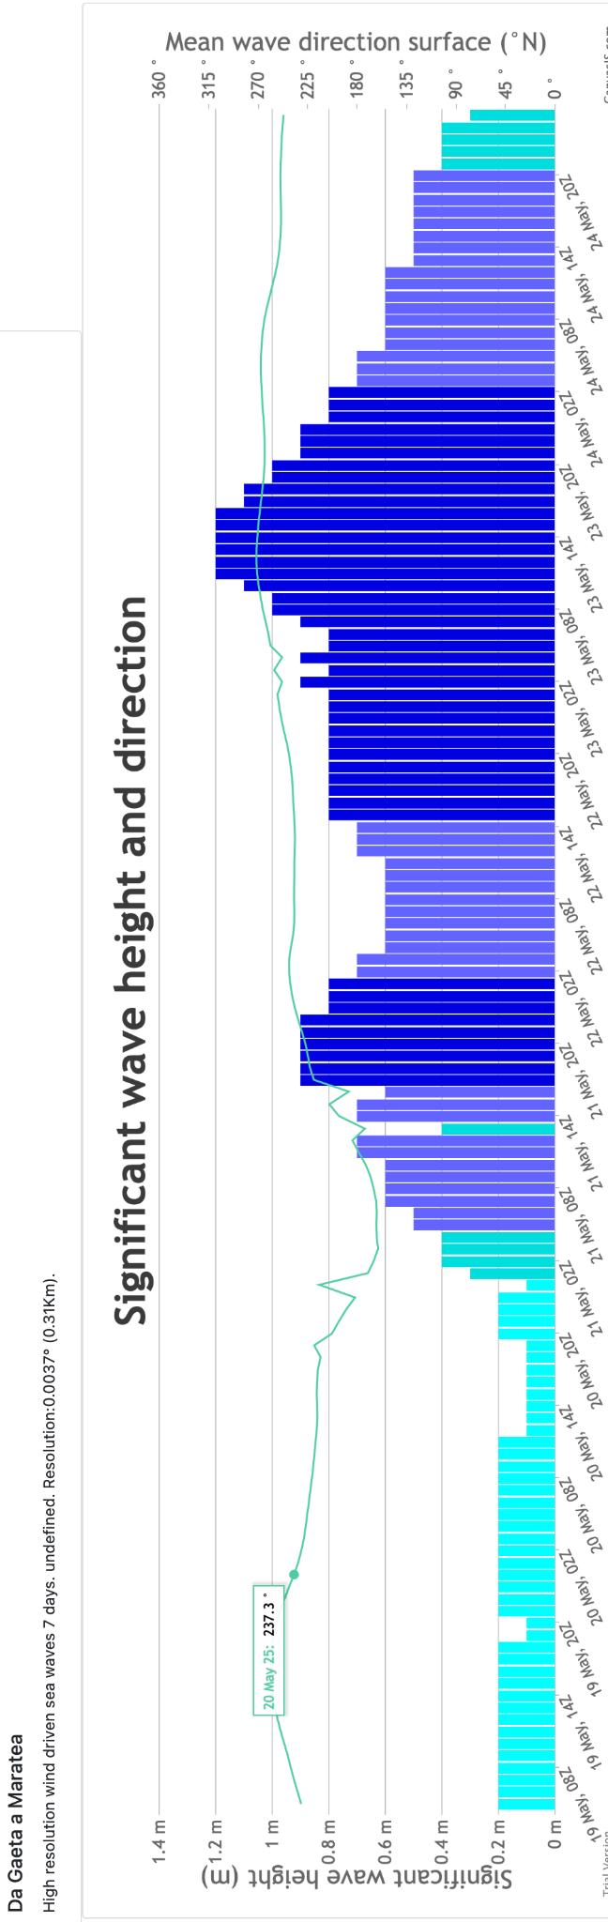
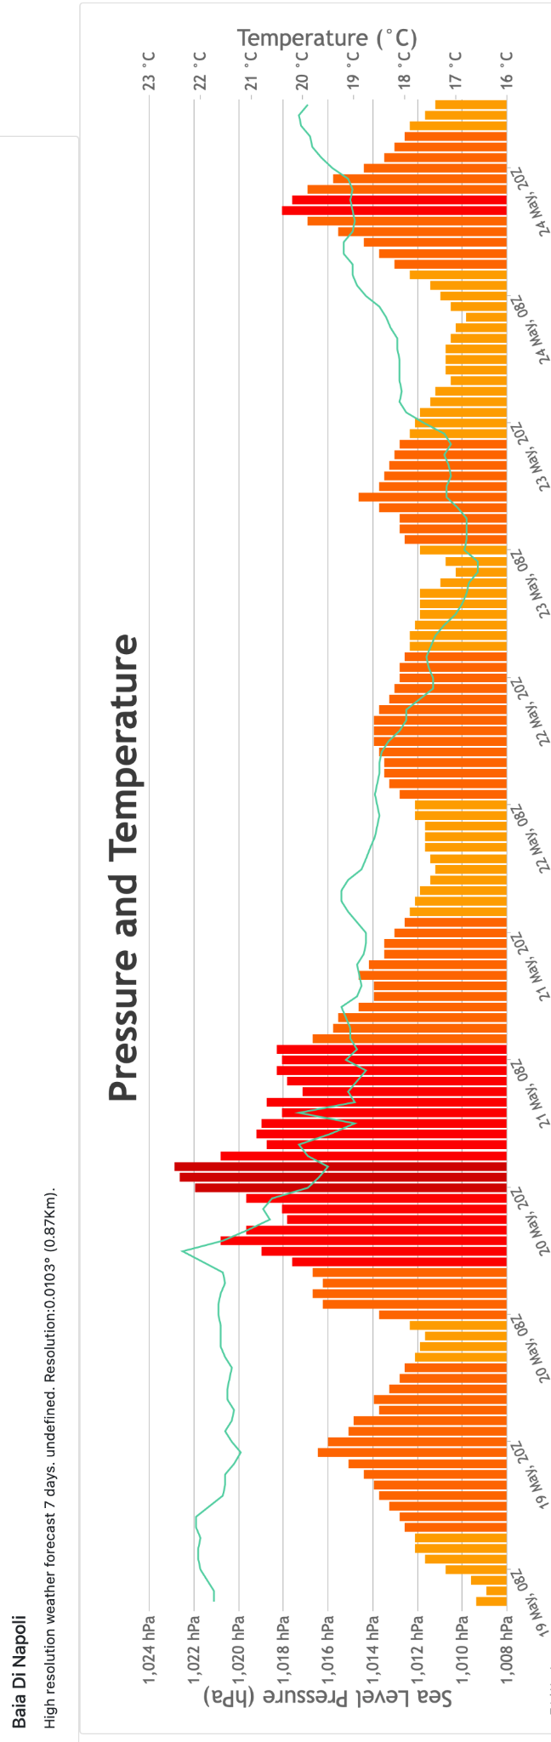
HPC+AI routinary services: high-resolution local environmental modelling
Initial & Boundary conditions
Initial and Boundary conditions
Great challenges, great responsibilities.
Providing results on time.
Users: local agencies, sporting events, regular citizens.
WRF Preparation
ROMS Preparation
Regional Ocean Model System
WW3 Preparation
Wavewatch 3
Weather Research and Forecast
ICSC Italian Research Center on High-Performance Computing, Big Data and Quantum Computing
Missione 4 • Istruzione e Ricerca

Slide 4
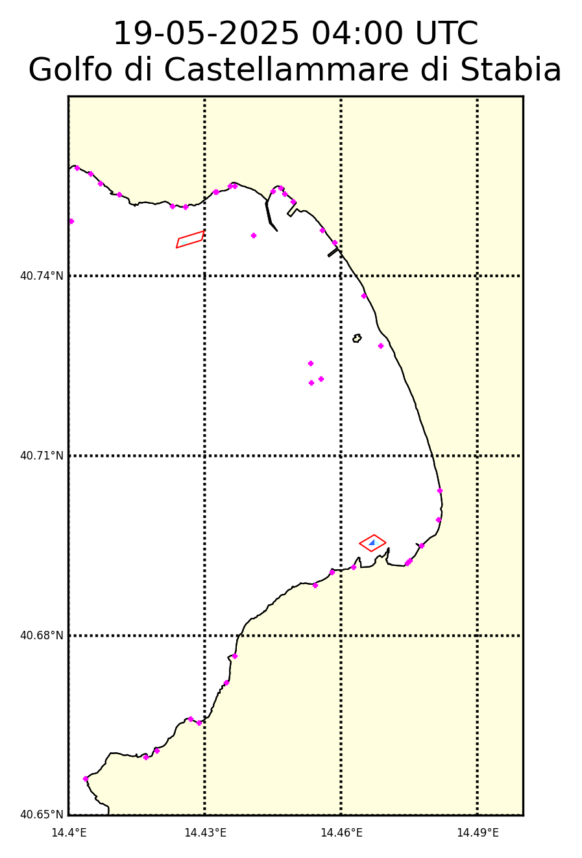
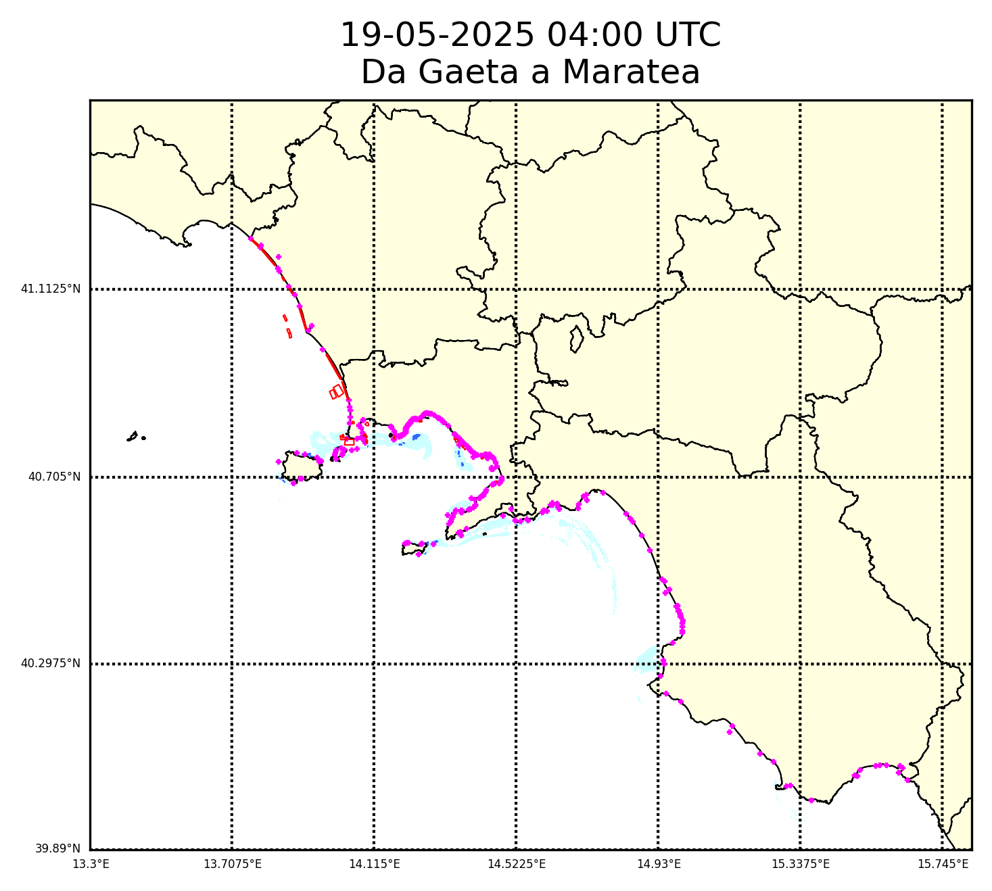
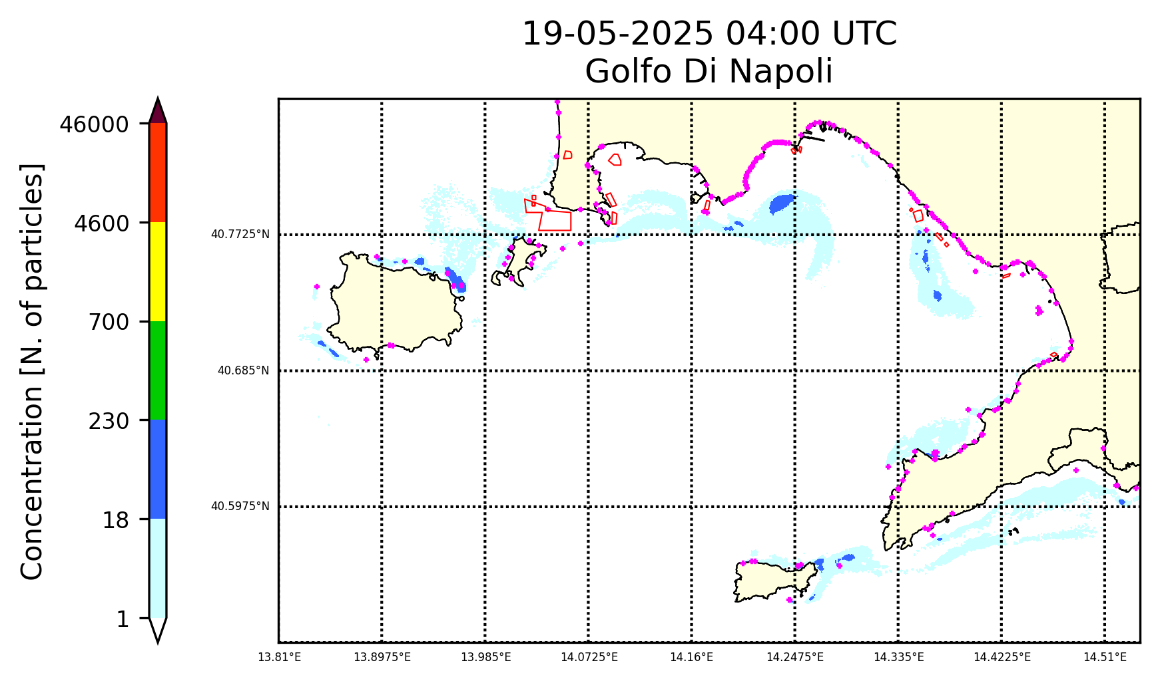
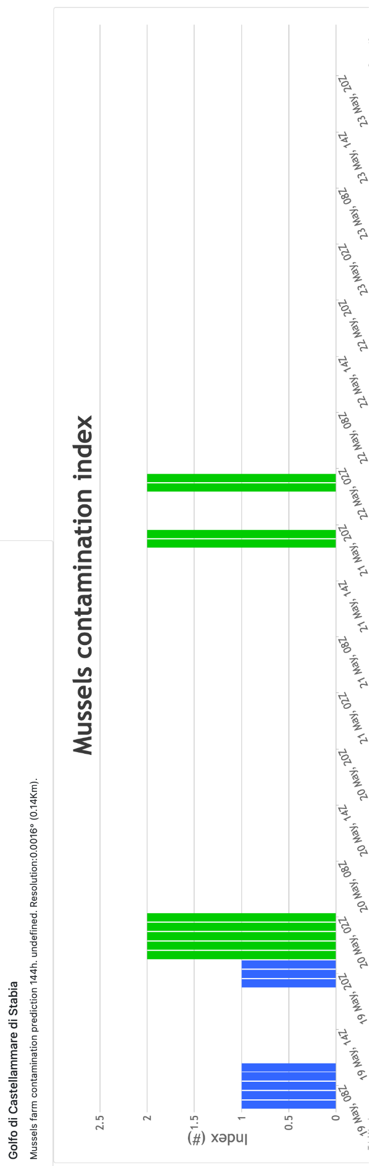
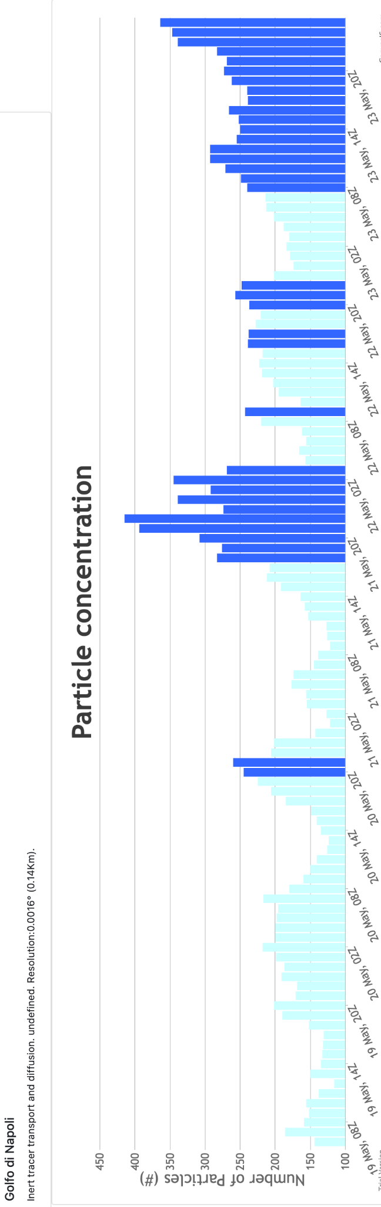
Predicting batteria contamination in farmed mussels
Initial & Boundary conditions
Initial and Boundary conditions
Initial conditions
AIQUAM++
WRF Preparation
ROMS Preparation
Regional Ocean Model System
WaComM++
OOO: orchestration, orchestration, orchestration
WW3 Preparation
Wavewatch 3
Weather Research and Forecast
ICSC Italian Research Center on High-Performance Computing, Big Data and Quantum Computing
Missione 4 • Istruzione e Ricerca

Slide 5
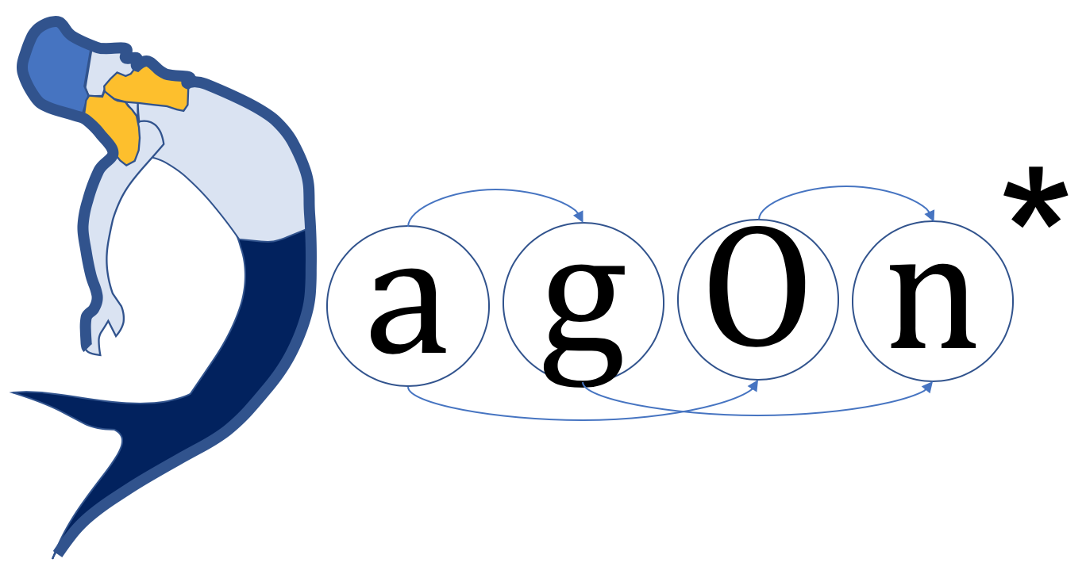
Direct Acyclic Graphs as parallel jobs on anything
DAGonStar is a production-oriented workflow engine
Integrated in the Python environment.
Minimal footprint for external software components execution.
Avoiding any workflow engine centered data management.
Checkpoints for failover and execution recovery.
Straightforward definition of tasks:
  Python scripts.
  Web interaction.
  External software components.
Execution sites independence:
  Local / scheduler (SLURM).
  Containers (Docker).
  Clouds (AWS, OpenStack, DigitalOcean).
Python Script: “DAGonStar Hello World App”
import dagon
…
workflow=Workflow(“myapp”,settings)
workflow.add_task(new Task(“a”,”...”))
workflow.add_task(new Task(“b”,”workflow:///a”))
workflow.add_task(new Task(“c”,”workflow:///a”))
workflow.add_task(new Task(“d”,”workflow:///b workflow:///c”))
workflow.run()
sys.exit(0)
ICSC Italian Research Center on High-Performance Computing, Big Data and Quantum Computing
Missione 4 • Istruzione e Ricerca

Slide 6


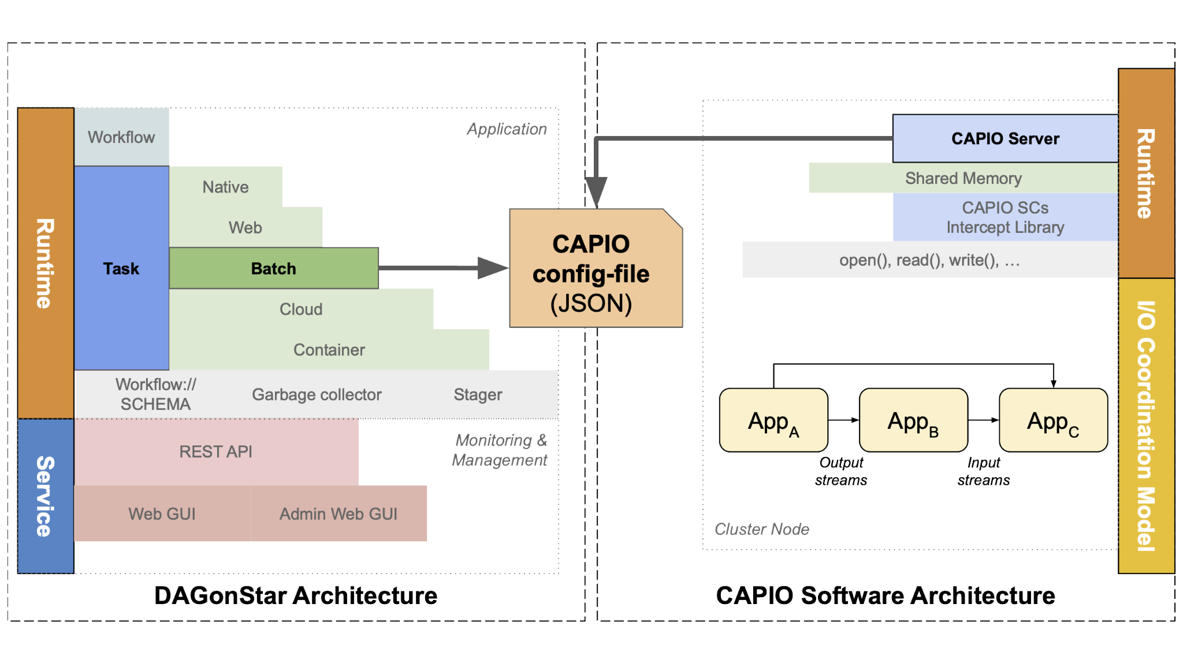
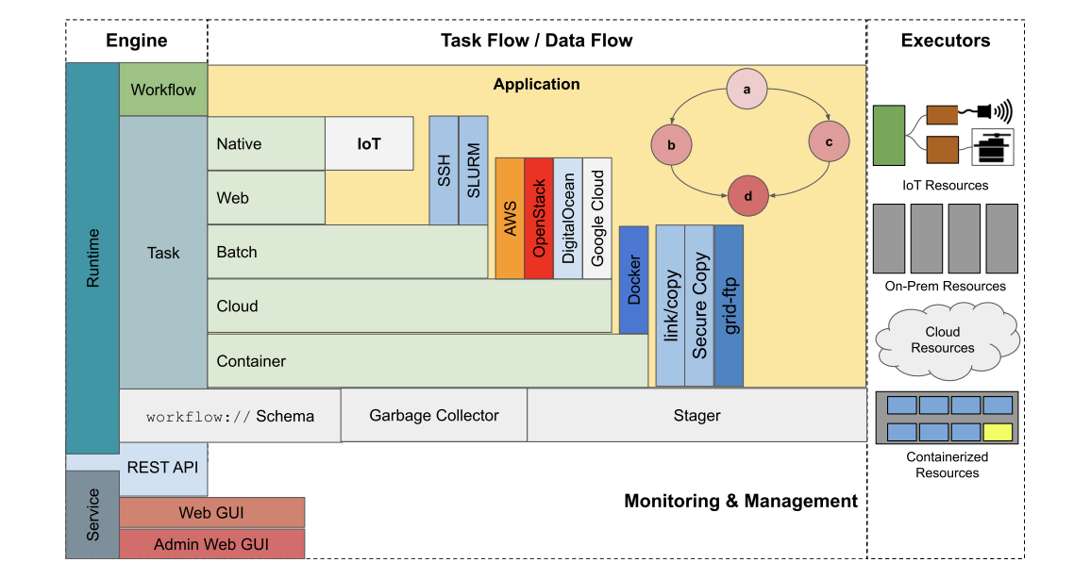
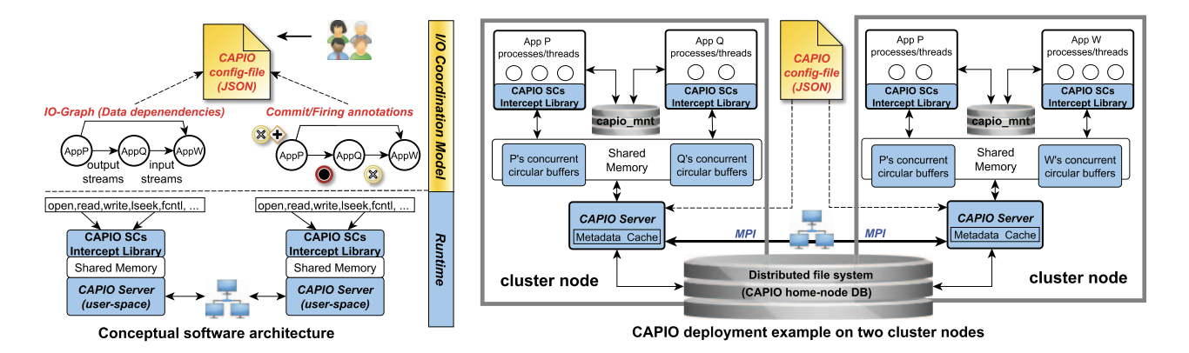
Streaming capabilities for environmental modeling orchestration
DAGonStar batch tasks generate the JSON file based on the dependencies between tasks, identified by the workflow:// schema;
The JSON file is used by the CAPIO server for configuration;
Tasks make up a pipeline in which one produces files and the other reads them;
Posix calls made on these output files will be intercepted by the CAPIO server, allowing it to process data in RAM.
+
=
ICSC Italian Research Center on High-Performance Computing, Big Data and Quantum Computing
Missione 4 • Istruzione e Ricerca

Slide 7
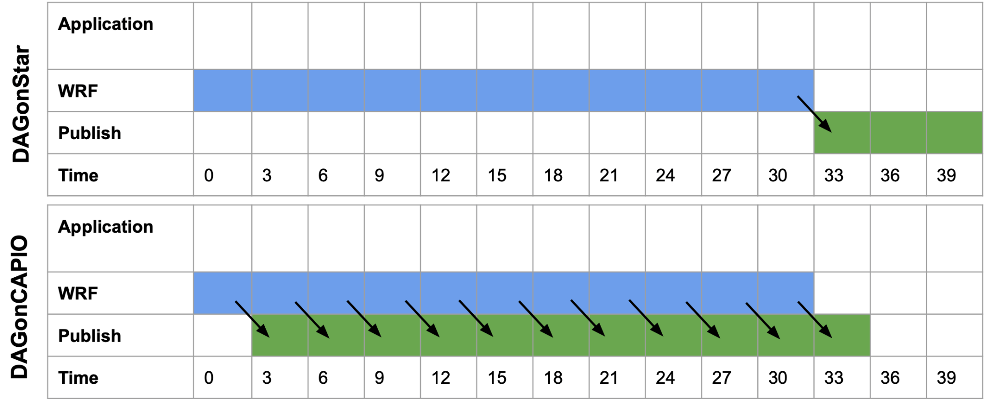
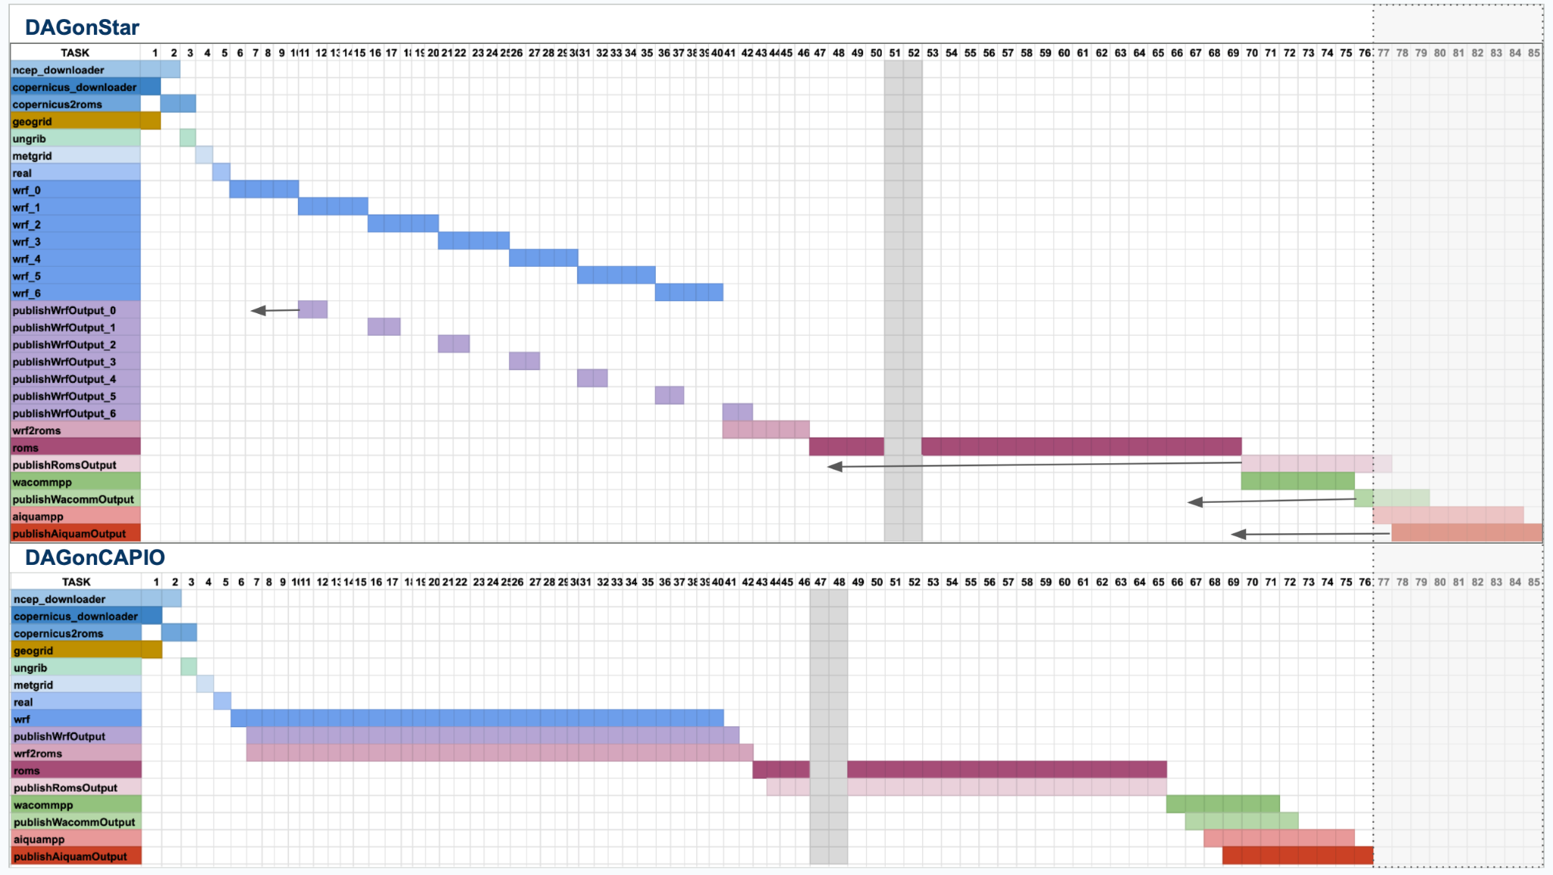
Results
First WRF output @T+~15m
First ROMS output @T+~20
Overall performance improvement -~90m.
~85% of the DAGonStar time.
ICSC Italian Research Center on High-Performance Computing, Big Data and Quantum Computing
Missione 4 • Istruzione e Ricerca

Slide 8

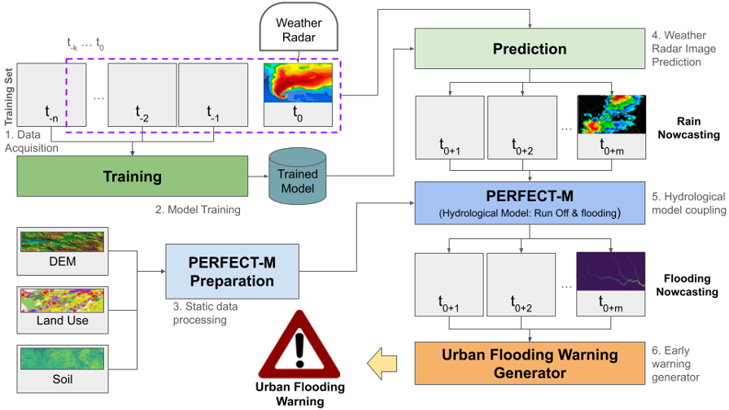
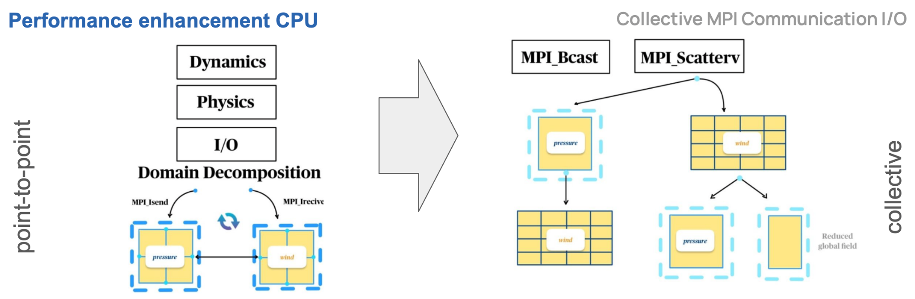
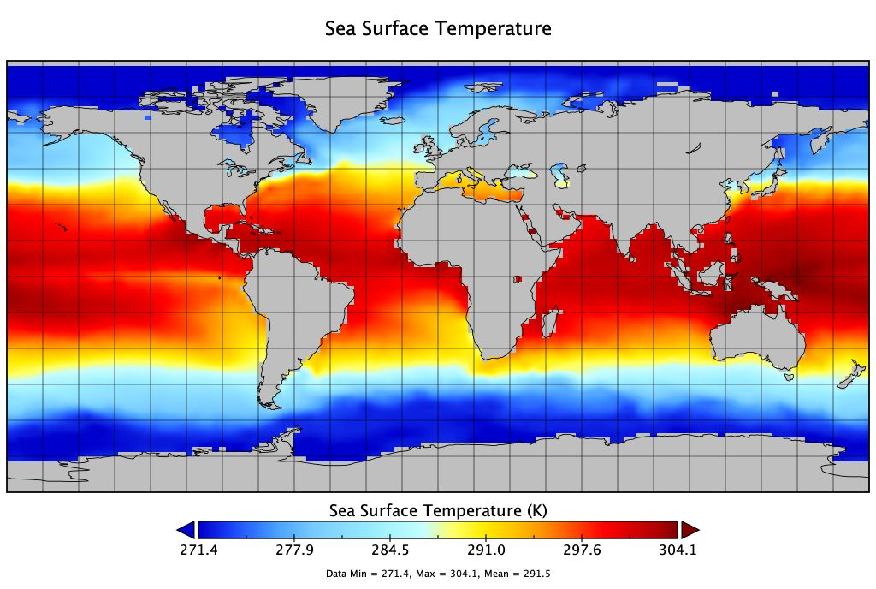
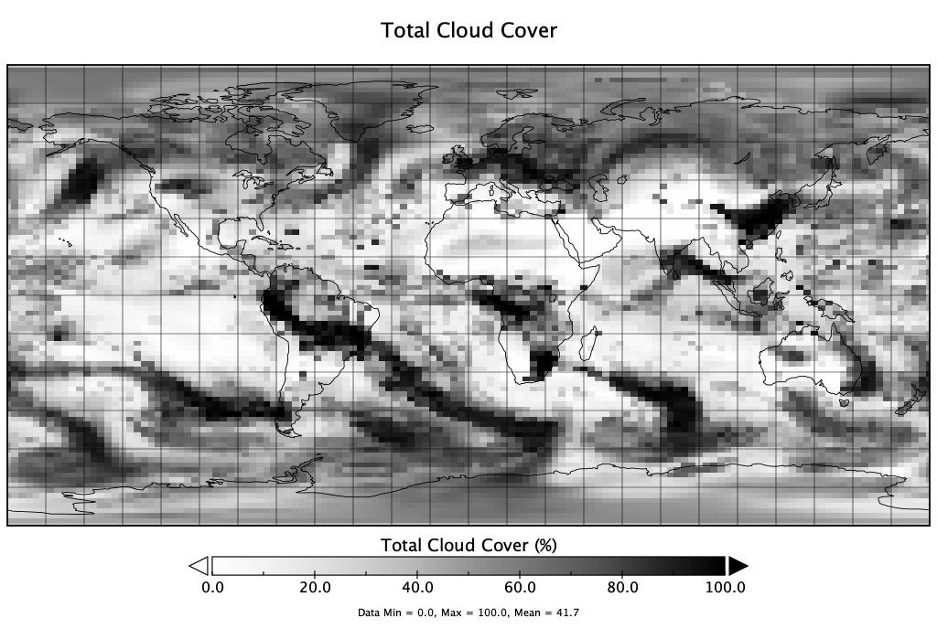
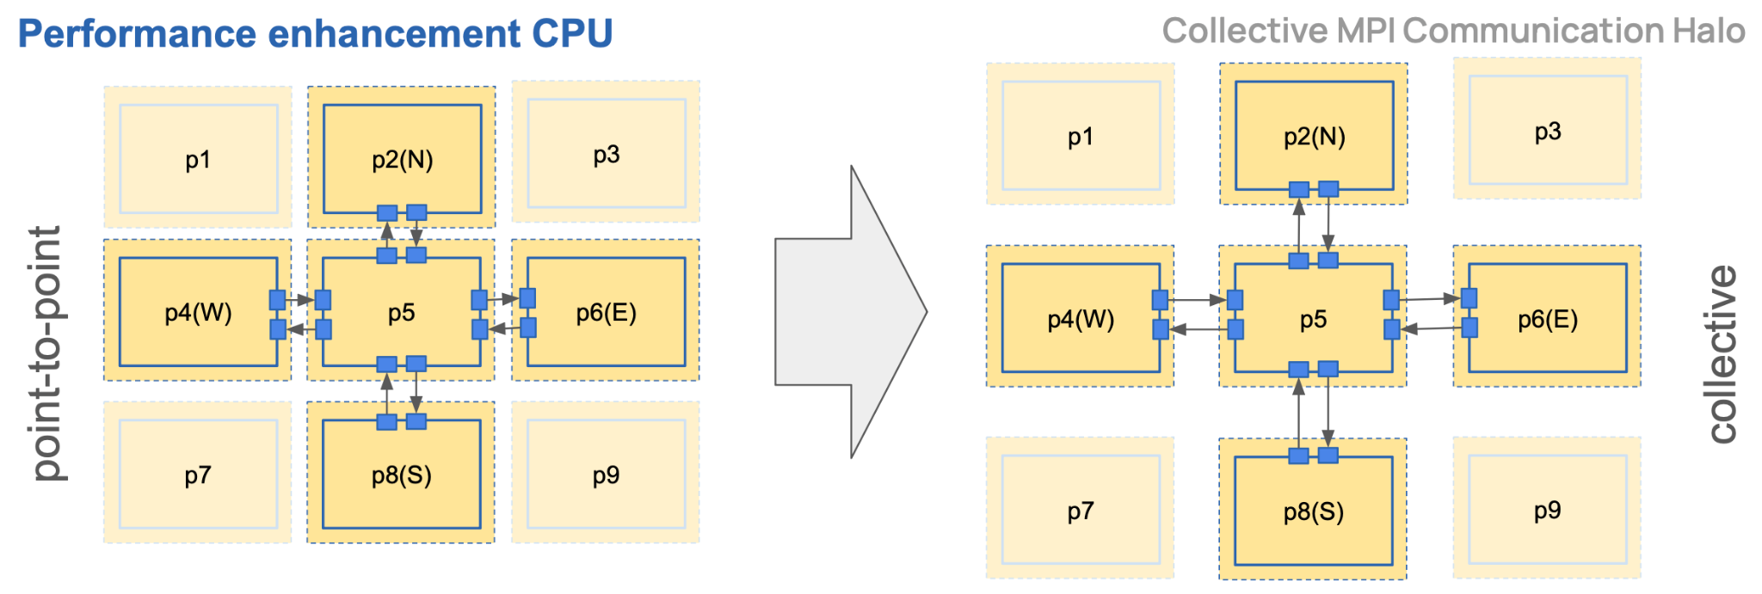
Advantages at the fringe & conclusions
Hi-WeFAI - Spoke 9
GLOWPP - Spoke 4
Develop DAGonCAPIO for HPC+AI environmental applications.
Extend the workflow:// schema to support data streaming as staging system.
Deploy DAGonCAPIO use cases on public cloud to democratize open-source tools and open-data products.
ICSC Italian Research Center on High-Performance Computing, Big Data and Quantum Computing
Missione 4 • Istruzione e Ricerca

Slide 9
Grazie
per
l’attenzione
ICSC Italian Research Center on High-Performance Computing, Big Data and Quantum Computing
Missione 4 • Istruzione e Ricerca

Slide 10

ICSC Italian Research Center on High-Performance Computing, Big Data and Quantum Computing
Missione 4 • Istruzione e Ricerca

Slide 11
ICSC Italian Research Center on High-Performance Computing, Big Data and Quantum Computing
Missione 4 • Istruzione e Ricerca

