Slide 1
Le Tecnologie Abilitanti di ICSC per la digitalizzazione del Paese
Sanzio Bassini (CINECA)

Slide 3
Network

Slide 4
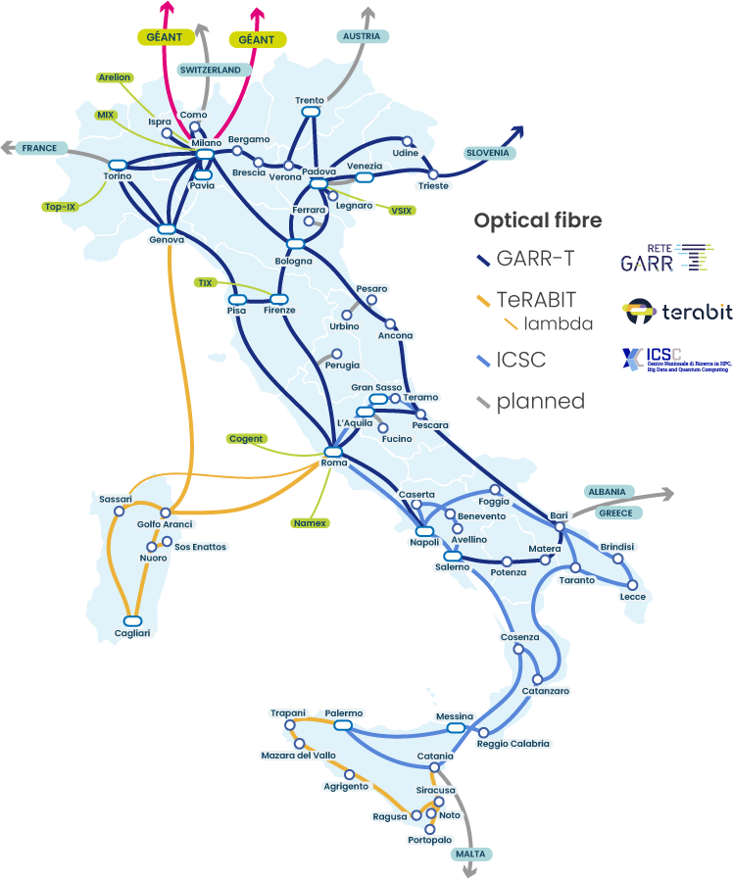
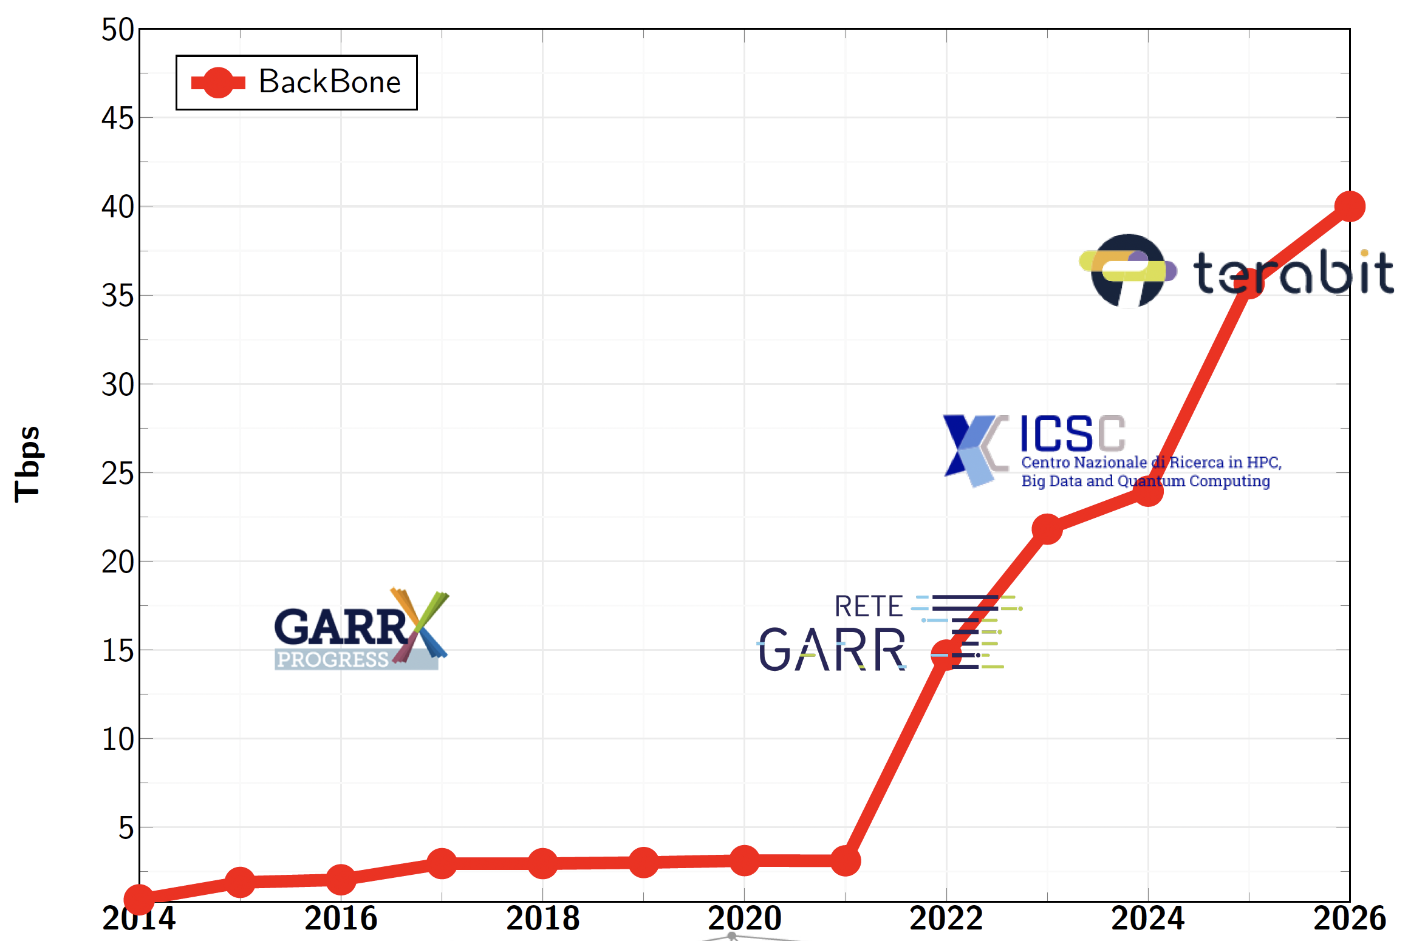
GARR-T Network numbers
40Tbps
24,000 km
3Tbps

Slide 5
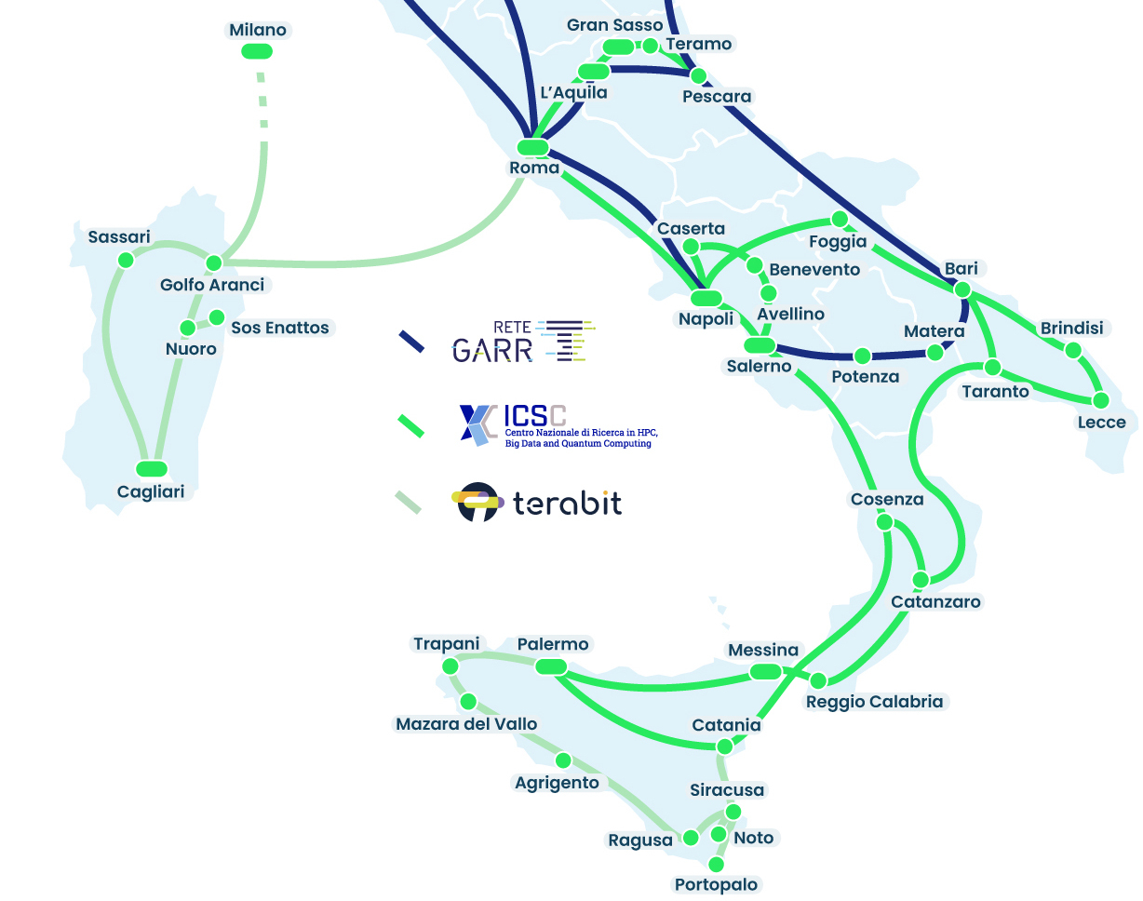
GARR: Procurements Procedures
Fibre Infrastructure 2301 - [20.7^{(*)} M€] – 20y
﻿﻿Optical Fibre + Open Line System
Optical Network 2302 - [15.0^{(*)} M€] – 10y
﻿﻿Upgrade GARR-X Progress Optical Network → GARR-T unified optical network
﻿﻿[TeRABIT] Sardinia {submarine + terrestrial}
﻿﻿[ICSC] Abruzzo {terrestrial}
﻿﻿Network Transport Capacity over Open line system
﻿﻿[Terabit] Sardinia, Southern Sicily
[ICSC] Abruzzo, Campania, Puglia, Calabria, Sicilia
Upgrade Packet Network 2303 - [7.1^{(*)} M€] - 5y
[Terabit] Sardinia, Southern Sicily
﻿﻿[ICSC] Abruzzo, Campania, Puglia, Calabria, Sicilia, Backbone and Edge Connectivity
^{(*) +VAT}

Slide 6
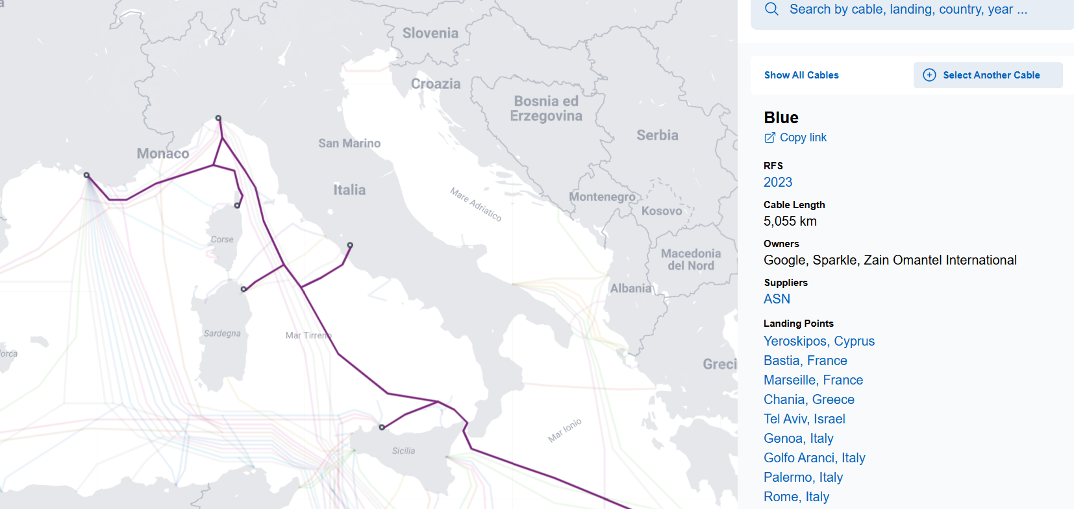



TeRABIT: submarine Cable

Slide 7
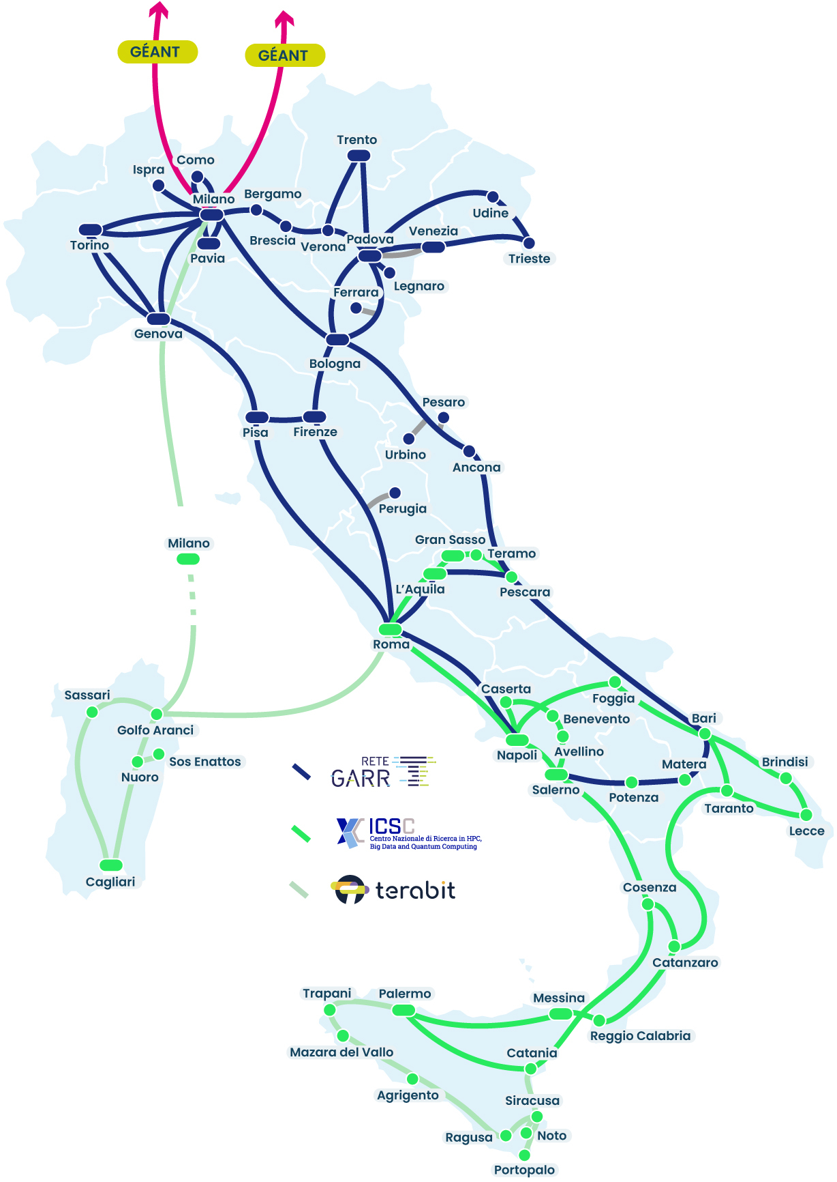



GARR-T: PNRR projects (2023-2025)
Opportunity to develop GARR-T network:
Reach new areas: Sardinia and Abruzzo
Upgrade and integrate network in the South of Italy
Scale-up performance for HPC
GARR-T can reach the goal to become a fully unified and pervasive network for R&E community in the whole country

Slide 8
Distributed Cloud Infrastructure

Slide 9


National Federated Cloud
IDP
CINECA
Leonardo/Lisa
INFN Cloud for CINECA (and others) resources access
Main difficulties on AAI policies (and in turn on access via PaaS). Work started but not completed within the project. Will be addressed in the future
First Proof of Concept
(INDIGO IAM for INFN and CINECA identity federation)
( INDIGO PaaS Orchestrator for access to OpenStack-based resources)
InterLink offloading to reach CINECA HPC resources
RUCIO for INFN and CINECA storage system federation
Activities to be carried on in the European context
Galileo100
To be rethought
IAM
➾
IDP
INFN
Federation
Services
Tier1/Tier-2 Federation
9

Slide 10
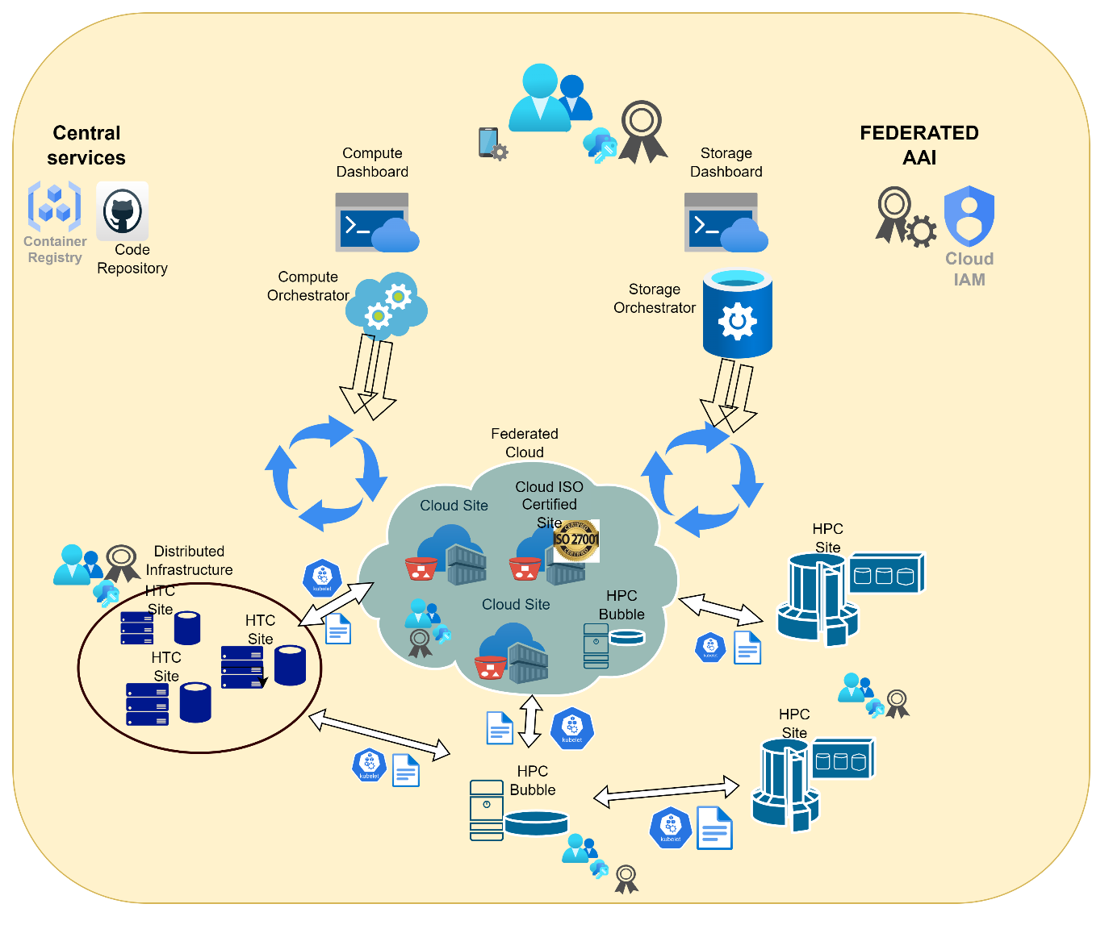
INFN resource access
INFN resources are heterogenous by construction
Cloud access via PaaS and IaaS (OpenStack, Kubernetes)
Grid access
Local access if nothing else works
ISO certified partition for GDPR critical applications
Optimized for High Throughput Computing
HPC bubbles for small parallel workflows and prototypes
Offloading to external systems
e.g. Leonardo and other HPC systems

Slide 11
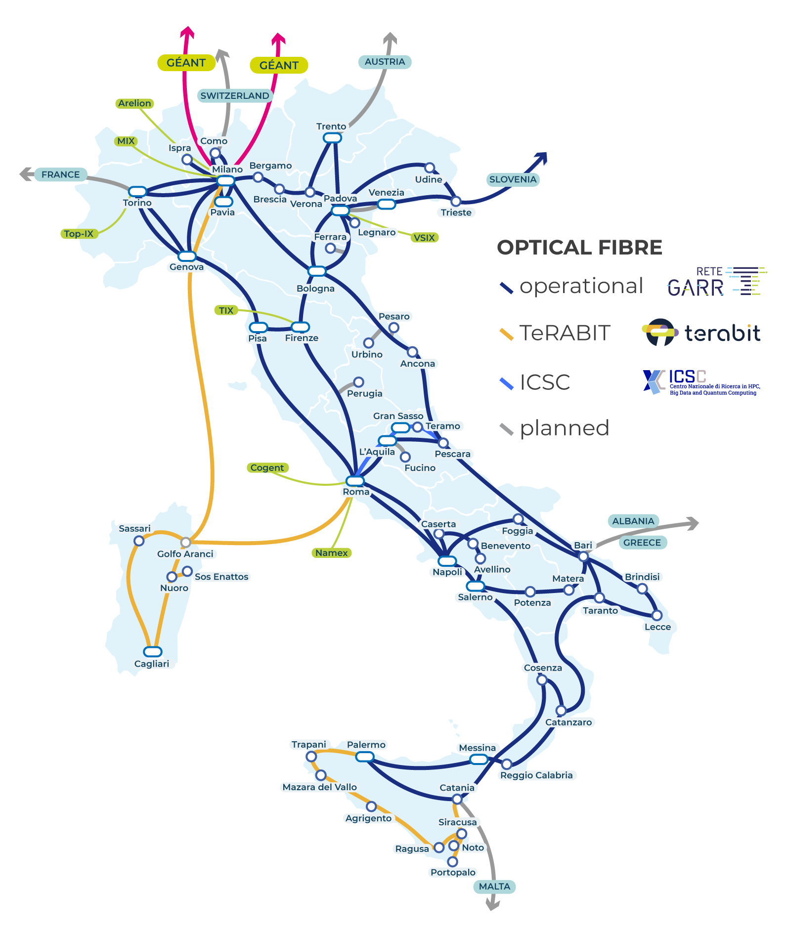


INFN computing centres
Expansion and modernization of data centres (spaces, power, cooling)
Including the upgrade of the Gran Sasso Data Centre for Disaster Resilience and the new Space Economy Data Centre in Frascati
Resource acquisition: network, CPU, GPU, FPGA, storage, tape
Local Data Centre’s network
CPU power for High Throughput Computing
CPU power for High Performance Computing (together with TeRABIT)
Disk storage (high capacity and cloud)
Tape storage
11

Slide 12
HPC

Slide 13
Economic mobilization in millions of Euros

Slide 14
THE MAIN ACTIONS
2020
Leonardo project € 290 Ml
Sistema HPC LEONARDO
Sistema HPTC INFN WLCG
2023
PNRR € 260 Ml
Next GENEU – PNRR
ICSC National Ecosystem
EuroFusion
ACN
2025
Exploitation towards Quality of Service
2021
Evolution
Towards DAMA – Data Manufacture
2024
Innovation € 430 Ml
AI Factory
Progetto IT4LIA
2026-7
Competitiveness € 3-4 Bn
AI Giga Factory
In progress

Slide 15
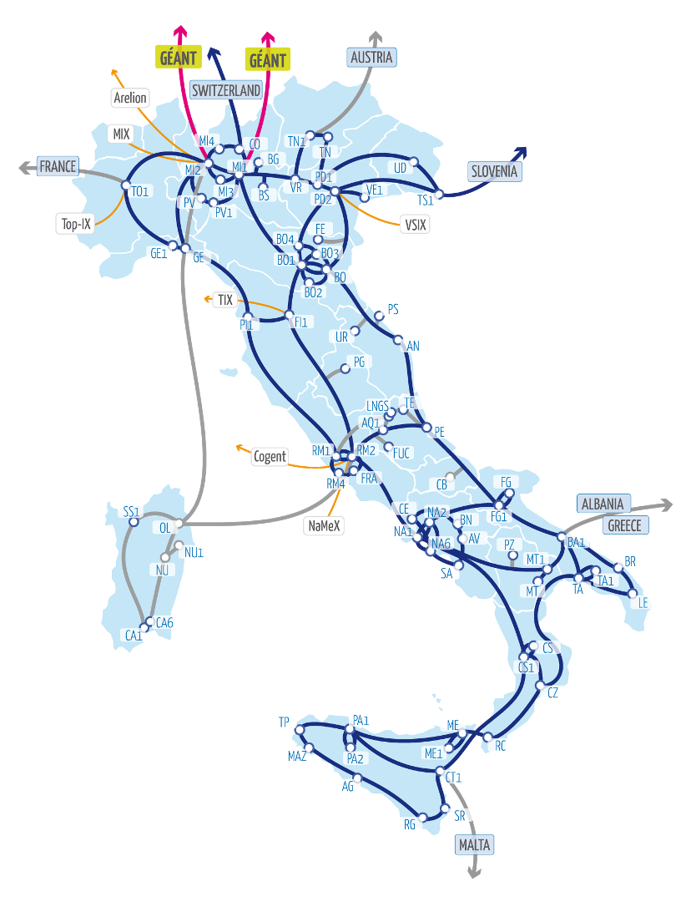



Trieste - SISSA Data Center:
Tier2 SISSA
HPC Multi Tier Infra
Bologna - Casalecchio Data Center:
Tier1 Eurofusion: PITAGORA
Milano ENI Green Data Center:
Tier2: University of Bicocca
Bologna Tecnopolo Data Center
Tier0: LEONARDO + LISA
Tier1 MARCOPOLO: CNR / INAF / AIM
Tier1 cloud: GAIA
Tier1 EuroHPC Industrial Grade
QC NA Pasqal
QC Superconducting IQM
Bologna Data Lake GARDA B
Multi protocol Multi Petabyte
Napoli San Giovanni a T. Data Center
NAPOLI1: CNR / ACN
Data Center Uni Palermo
Tier2: University of Palermo
Napoli Data Lake GARDA N
Multi protocol Multi Petabyte

Slide 16
Towards AI Factory
TECNOPOLO BOLOGNA
MARCO POLO
10 Pflops FP64
30 Pbyte
HPC System
GAIA
130K core
160 GPU
Cloud system
LEONARDO
250 Pflops FP64 -14K GPU
100 Pbyte
HPC System
IT4LIA
AI FACTORY
>50 Exaflops FP8
>100 Pbyte
HPC AI optimized
GARDA-B(ologna)
50 Pbyte flash memory
DataLake
LISA AI
5 Exaflops FP8
AI System
QC
PASQAL
150 Qbit
Neautral
atoms
QC
IQM
54 Qbit
Super
conducting
Industry Grade Cloud partition
Industry Grade
AI partition
CASALECCHIO
NAPOLI
PPP
PITAGORA
30 +15 Pflops FP64
20 Pbyte
HPC System
GARDA-N(apoli)
50 Pbyte flash
memory
DataLake
MEGARIDE
40kcore
100 GPU Cloud
partition
MEGARIDE
3 Exaflops FP8
AI partition
QC
PARTENOPE
150 Qbit
Super
conducting
EuroHPC / Private partner
AI GIGA
FACTORy

Slide 17
Technical specifications
Tender publication
Implementation
Preproduction
Production
Contract
LEONARDO
2023
PITAGORA
2024
Nov. 2025
GAIA Cloud
Nov. 2025
Dec. 2025
MEGARIDE
2025
Nov. 2025
Dec. 2025
QC IQM
Oct. 2025
Dec. 2025
Feb. 2026
MARCOPOLO
Oct. 2025
Dec. 2025
Feb. 2026
LISA
Dec. 2025
Apr. 2025
June. 2026
QC PASCAL
2026
Nov. 2025
Jan. 26
Mar. 2026
May. 2026
TIER2
Jan. 2026
June 2026
Sept. 2026
Nov. 2026
AI FACTORY
Oct. 2025
Nov. 2025
Feb. 2026
July 2026
Oct. 2026
Dec. 2026
INNOVATE

Slide 18
Access policies
For Leonardo, Lisa, It4lia systems... 50% is available to EuroHPC
Pro TCO Quota for AIM e ACN
20% of the PNRR TCO pro quota available to ICSC and OGS
The remainder is available to CINECA for ISCRA (no less than 80%) and pay per use (no more than 20%)

Slide 19
What Next
Scale HPC

Slide 20
Distributed
Napoli
Bologna
Quality of Service – H24
…
Post Leonardo exaflop HPC at Scale
AIF + AIGF
Cloud at Scale
Post Megaride ACN SOC
INFN (Research)
Special system
Data Lake 500 PByte
Experimental Systems EU Technologies
METEO
PITAGORA
INDUSTRIAL GRADE
Data Lake 500 PByte
Business continuity – Disaster rcovery

