Slide 1
Breaking the cycle: advancements in Universal Influenza Vaccine Design An UISS-Flu application
Valentina Di Salvatore
Dipartimento di Scienze del Farmaco e della Salute
Università degli studi di Catania

Slide 2
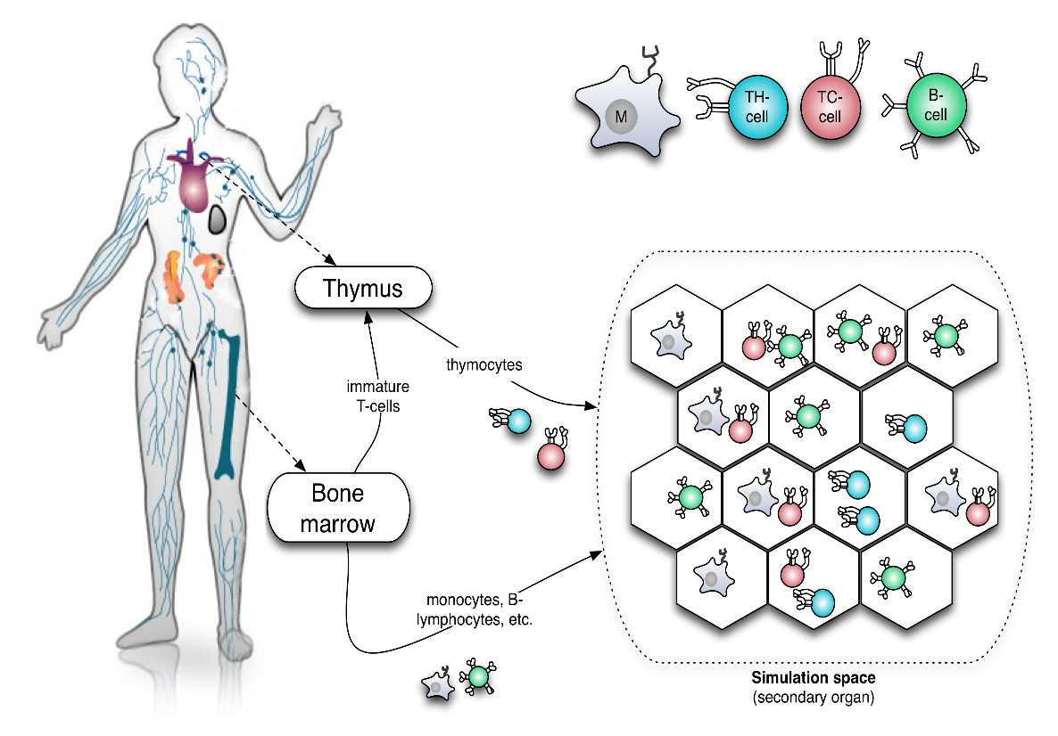
UISS modelling and simulation platform
The Universal Immune System Simulator (UISS) is an agent-based model designed to accurately replicate the key features of the human immune system.

Slide 3
Utilizing a multi-layered approach, UISS incorporates three distinct layers:
UISS
Physiology model
Disease model
Treatment model
It describes the physiological response of the human immune system to a particular stimulus
It represents the immune dynamics related to the mechanism of action and progression of a particular disease
It depicts the effects that a specific treatment used to control or prevent the disease has on the immune system.

Slide 4
UISS disease layer modules
UISS-MS designed for Multiple Sclerosis
UISS-COVID designed for COVID-19
UISS-FLU designed for Influenza

Slide 5
UISS-FLU
Intended as IST to be ported on HPC.
UISS–FLU is a specific disease layer implementation added to the UISS general framework that aims at simulating the dynamics of the immune system response to the H5N1 influenza A infectious disease.
UISS-FLU has also been added with the treatment layer able to simulate and predict the efficacy of a potential vaccine formulation.

Slide 6
Aim of the study
Influenza vaccine efficacy depends on matching vaccine strains with circulating viruses.
Yet, the virus's genetic variability complicates strain selection.
Current vaccine strategies use surveillance data to predict prevalent strains for seasonal vaccines.
This study seeks to investigate cross-reactivity among 6 HA and 2 NA influenza proteins, aiming to identify functionally similar forms.
Key features will be extracted for potential use in designing a universal vaccine.

Slide 7
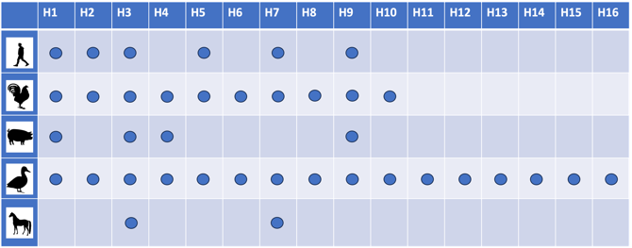
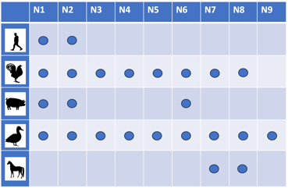
Antigenic subtypes of hemagglutinin (H) and neuraminidase (N)
Based on their surface glycoproteins, HA and NA, influenza A viruses can be categorized into 16 HA subtypes and 9 NA subtypes (plus two more influenza-like genomes, H17N10 and H18N11, recently identified from bats), with further stratification based on strains.

Slide 8
A simple idea

Slide 9
The proposed workflow
Alignment of selected H-proteins
BLASTp (https://blast.ncbi.nlm.nih.gov/Blast.cgi?PROGRAM=blastp&PAGE_TYPE=BlastSearch&LINK_LOC=blasthome)
Evaluation of the antigenicity of hit match sequences
Antigenic Peptide Prediction tool on the University of Madrid Immuno-medicine Group website (http://imed.med.ucm.es/Tools/antigenic.html).
Identification of Helper T-lymphocyte epitopes
IEDB MHC I/MHC II binding tools (http://tools.iedb.org/mhci/ and http://tools.iedb.org/mhcii/).
Identification of B-cell epitopes
BediPred software at the IEDB Analysis Resource (http://http://tools.iedb.org/bcell/).
Evaluation of allergenicity and toxicity of the selected epitopes
AllerTOP v.2.0 and ToxinPred v. 3.0.
UISS-Flu simulations

Slide 10
Latest publications
Beyond the state of the art of reverse vaccinology: predicting vaccine efficacy with the Universal Immune System Simulator for influenza
Russo Giulia, Crispino Elena, Maleki Avisa, Di Salvatore Valentina, Pappalardo Francesco
DOI: https://doi.org/10.21203/rs.3.rs-2111487/v2
Reverse Vaccinology for Influenza A Virus: From Genome Sequencing to Vaccine Design
Di Salvatore, V., Russo, G., Pappalardo, F.
Methods in molecular biology (Clifton, N.J.), 2023, 2673, pp. 401–410

Slide 11
Thank you for your attention! Do you have any question?
Write to: valentina.disalvatore@unict.it

