Slide 1
WP6 Drug-target studies and drug repurposing
Bologna Dec. 21st 2023

Slide 2
WP6 Drug-target studies and drug repurposing
Task 6.1 Identification of innovative drug discovery targets from genome bioinformatics analyses (M6, M18)
Task 6.2 Drug repurposing studies using novel target and the FDA-approved drug database (M36)
Task 6.3 Molecular medicine studies to link actionable genes, personalized treatments, and drug-target interaction model (M36)
MS6. Drug repurposing for precision medicine (M36)
D6.1 Novel targets for drug discovery (M 6, 18)
D6.2 Models of protein-drug interactions (M 30,36)
Bologna Dec. 21st 2023

Slide 3
WP6 Drug-target studies and drug repurposing
ADMINISTRATIVE REPORT – Hirings
Uni Pavia PhD, Tutor Lescai: partenza 4/4/2023 –Eugenio Franzoso
PhD, Tutor Zanella: partenza 1/2/2023 –Ivan Cucchi
POST-DOC Marta Gaviraghi (Casellato) 1.11.2023
Uni Torino - 1 Post Doc (assegno di ricerca), tutor F. Spyrakis; Start Nov 2023
Uni Bologna - Giulia Babbi, RTDa - gruppo Martelli
- Claudio Pino, dottorando - gruppo Musiani
- Alessandro Loreti, dottorando - gruppo Rivalta
Uni Catania - 1 RTDA, Active
Uni Bari - 1 RTDA, 1 PhD both active; Only PhD active on WP6
2 more PhD fellowships at the moment on hold
Uni Padova - Valeria D’Andrea Fisica e Astronomia RTDA 18/09/2023
Alessandro Rubbi Scienze Chimiche PhD Student 01/01/24
IIT Genova - 1 Postdoc (Riccardo Ocello) Started 16 September 2023
CNR - 2 Positions RTD for ITB and IGB, Selection procedures ended and funding allocated to institutes
- 1 RTD position undergoing recrutiment at IBIOM-CNR
INFN – No positions required
Bologna Dec. 21st 2023

Slide 4
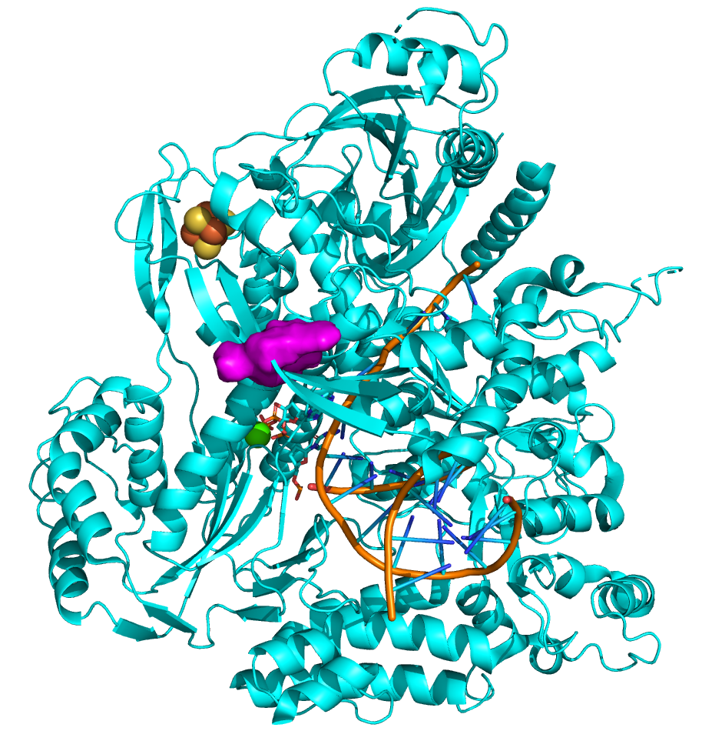
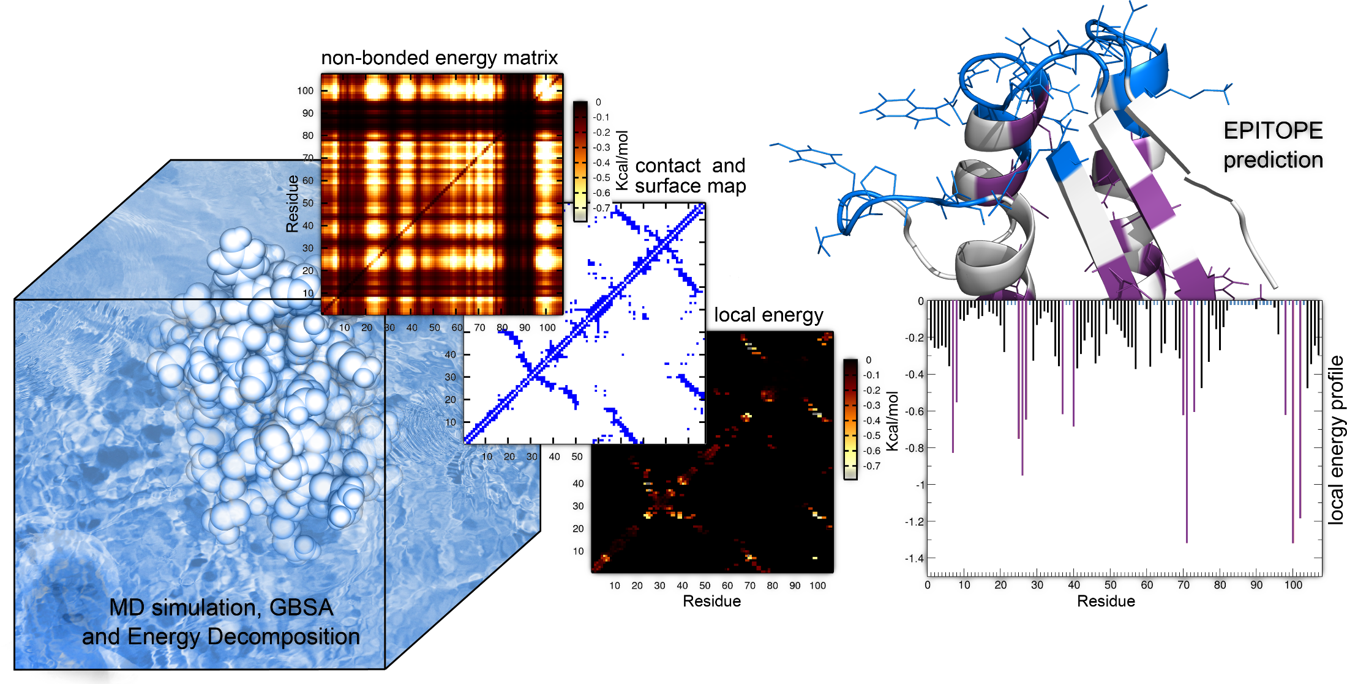
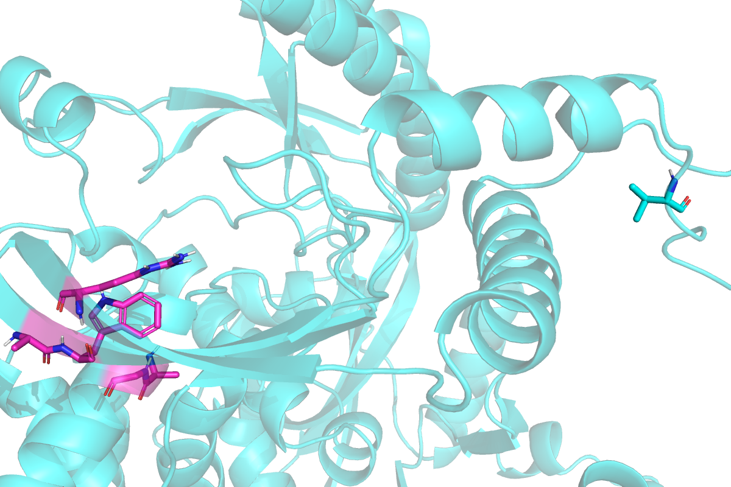
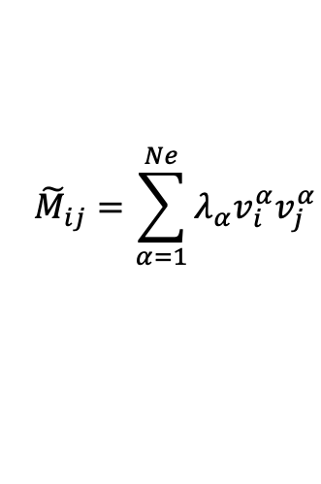
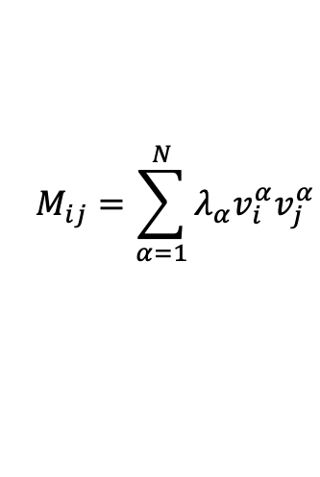
Human Polymerase Epsilon
$${\tilde{M}}_{ij}=\sum_{α=1}^{Ne}{λ_{α}v_{i}^{α}v_{j}^{α}}$$
$$M_{ij}=\sum_{α=1}^{N}{λ_{α}v_{i}^{α}v_{j}^{α}}$$

Slide 5
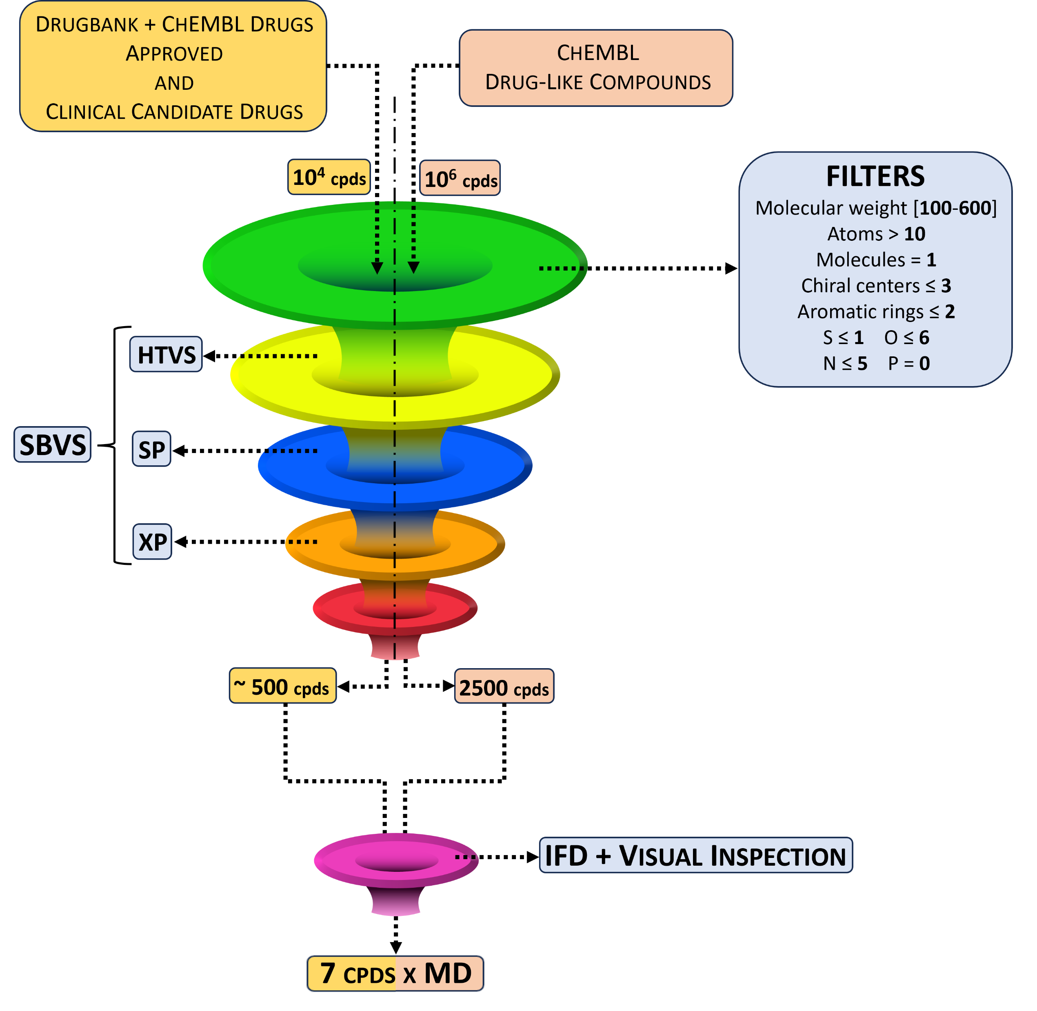
Human Polymerase Epsilon
1 Drug Under Test / New MD on whole system

Slide 6
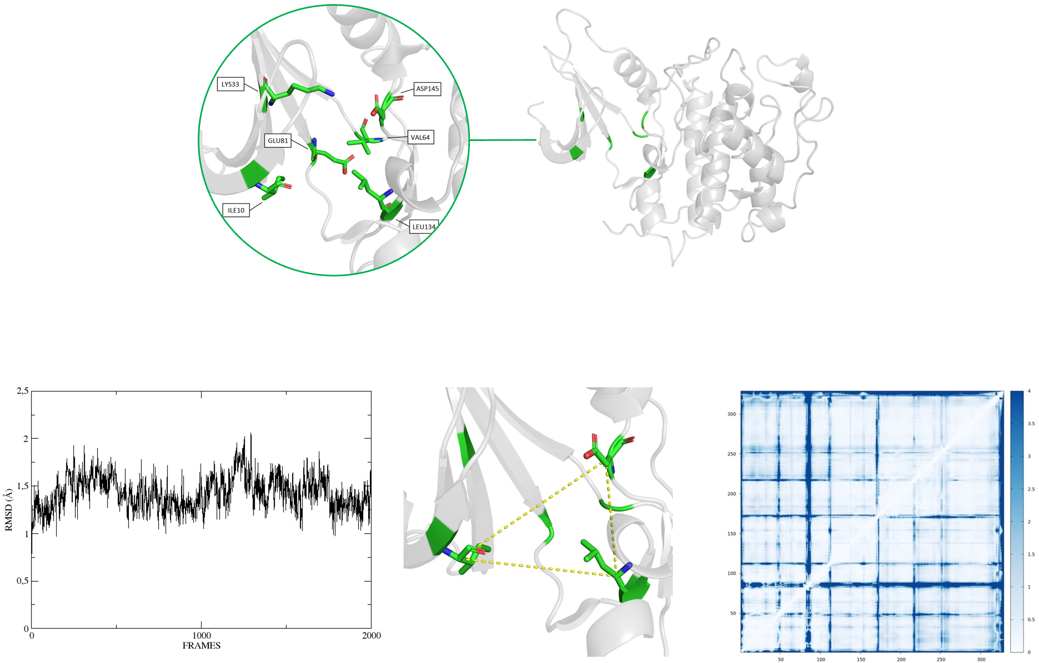
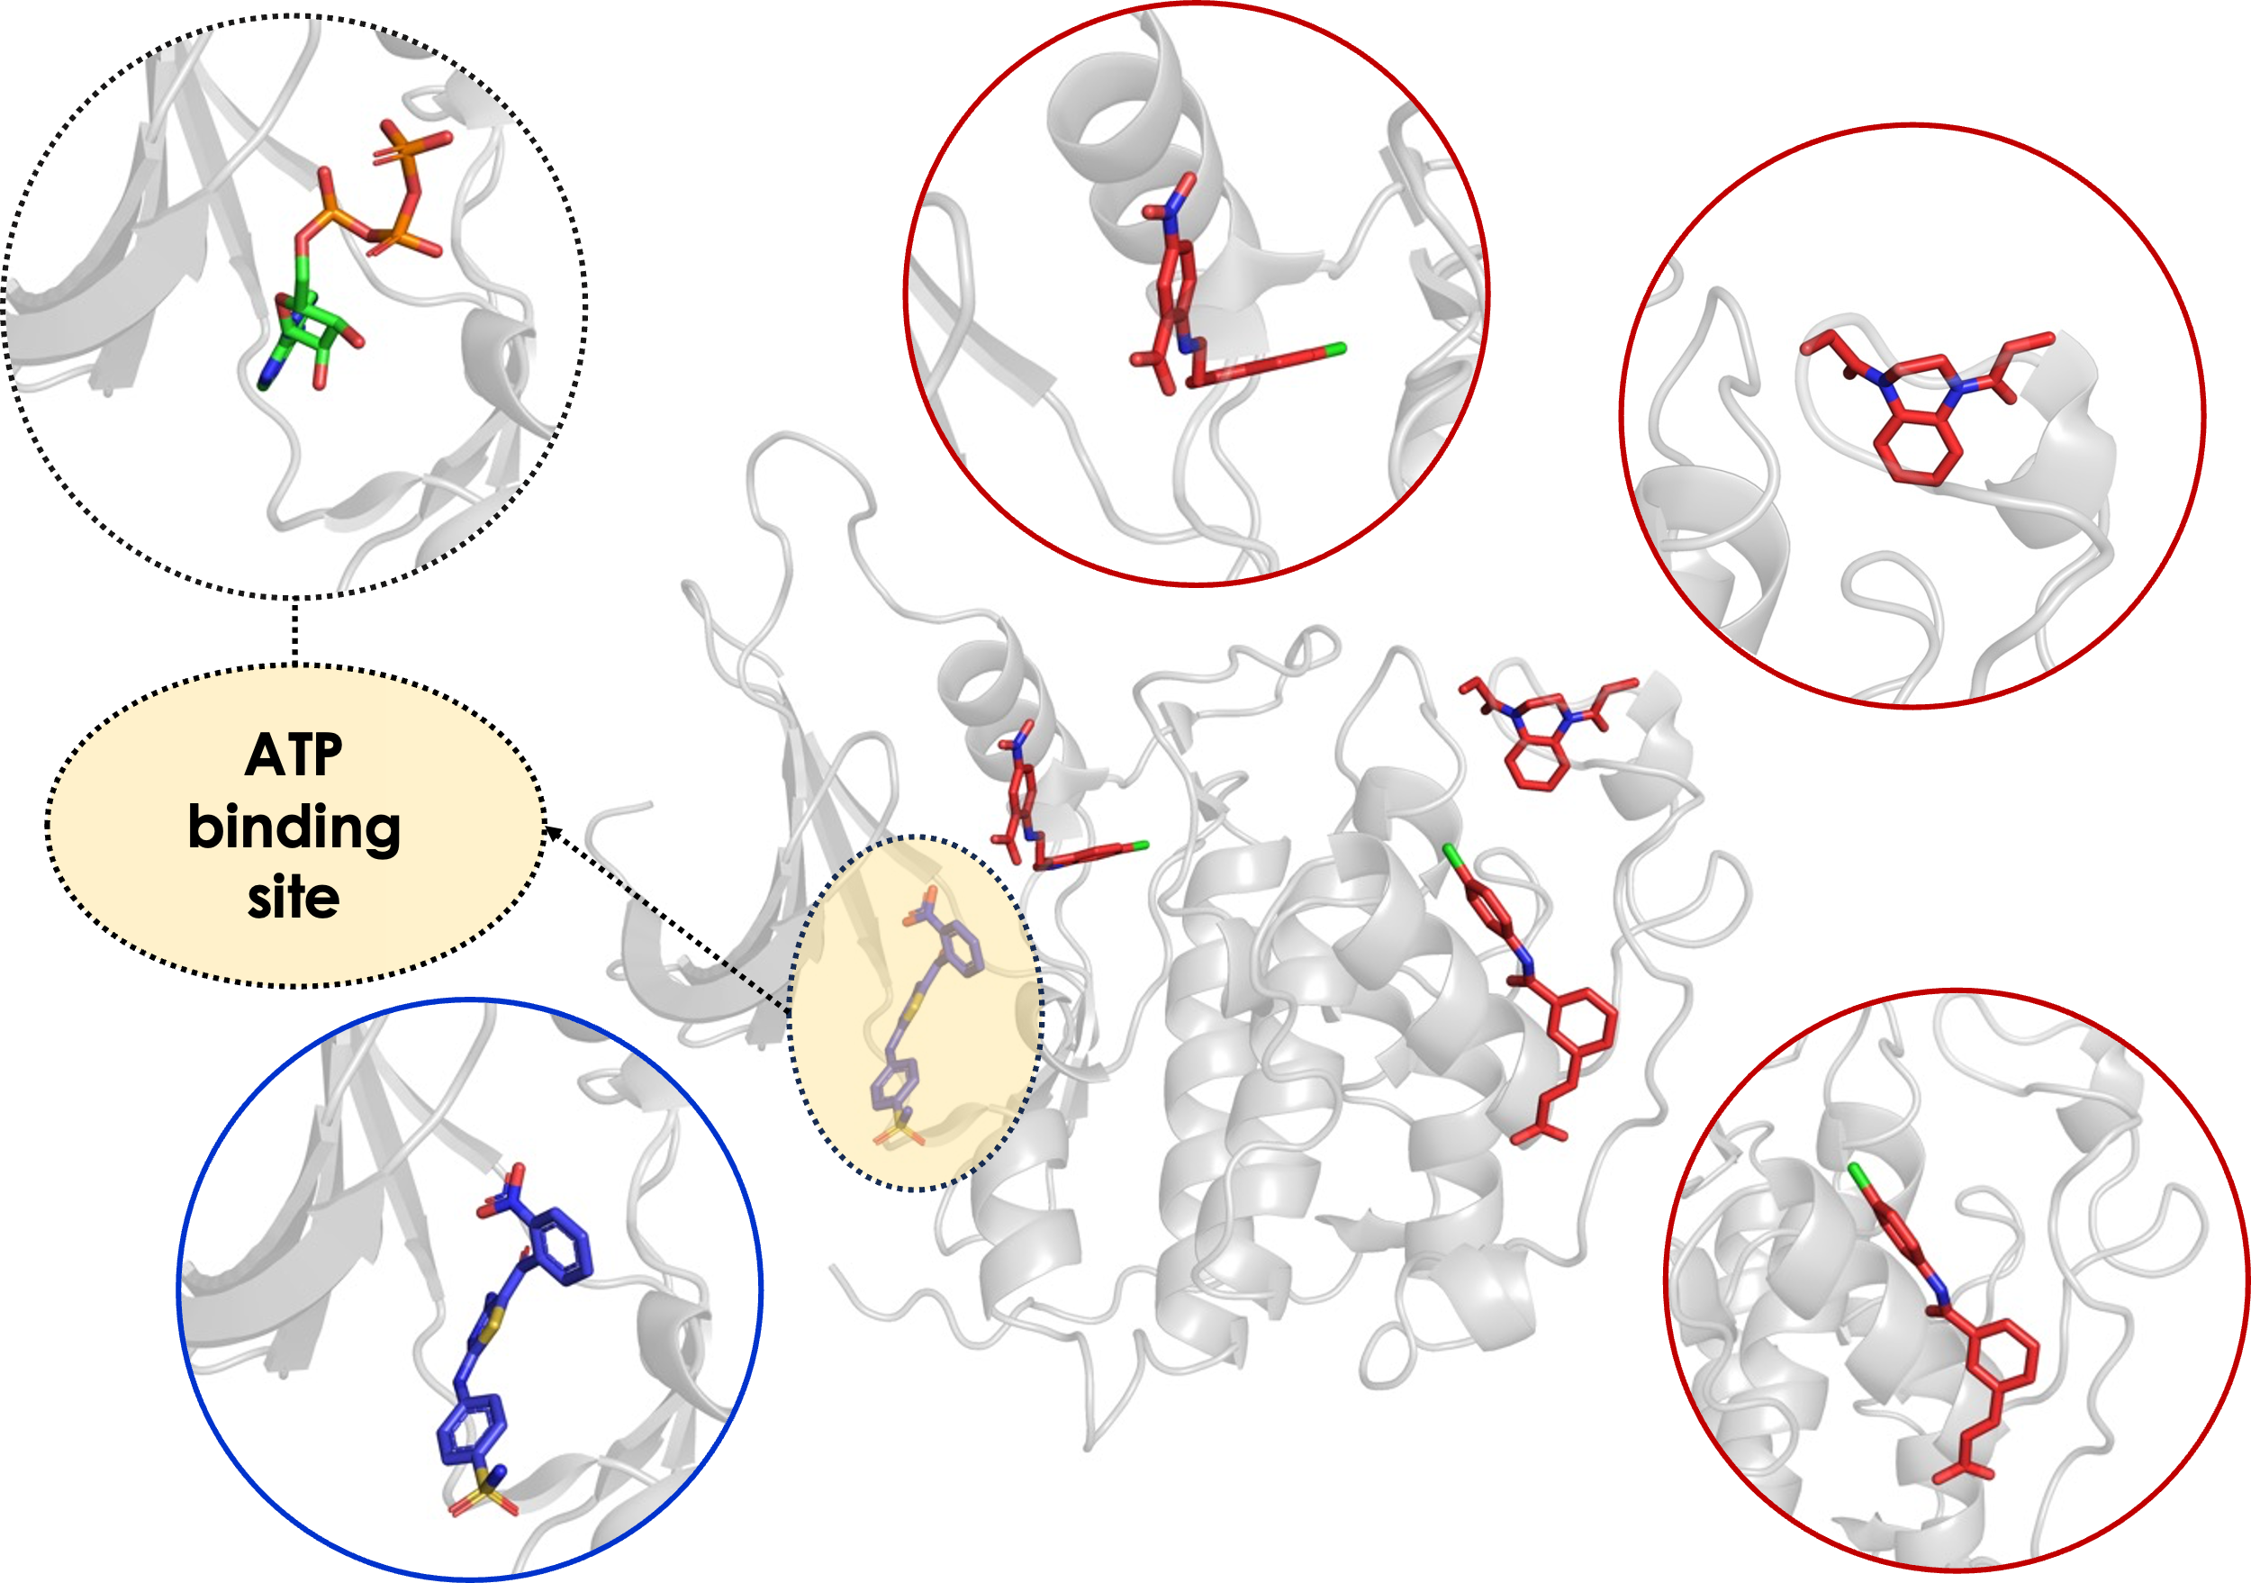
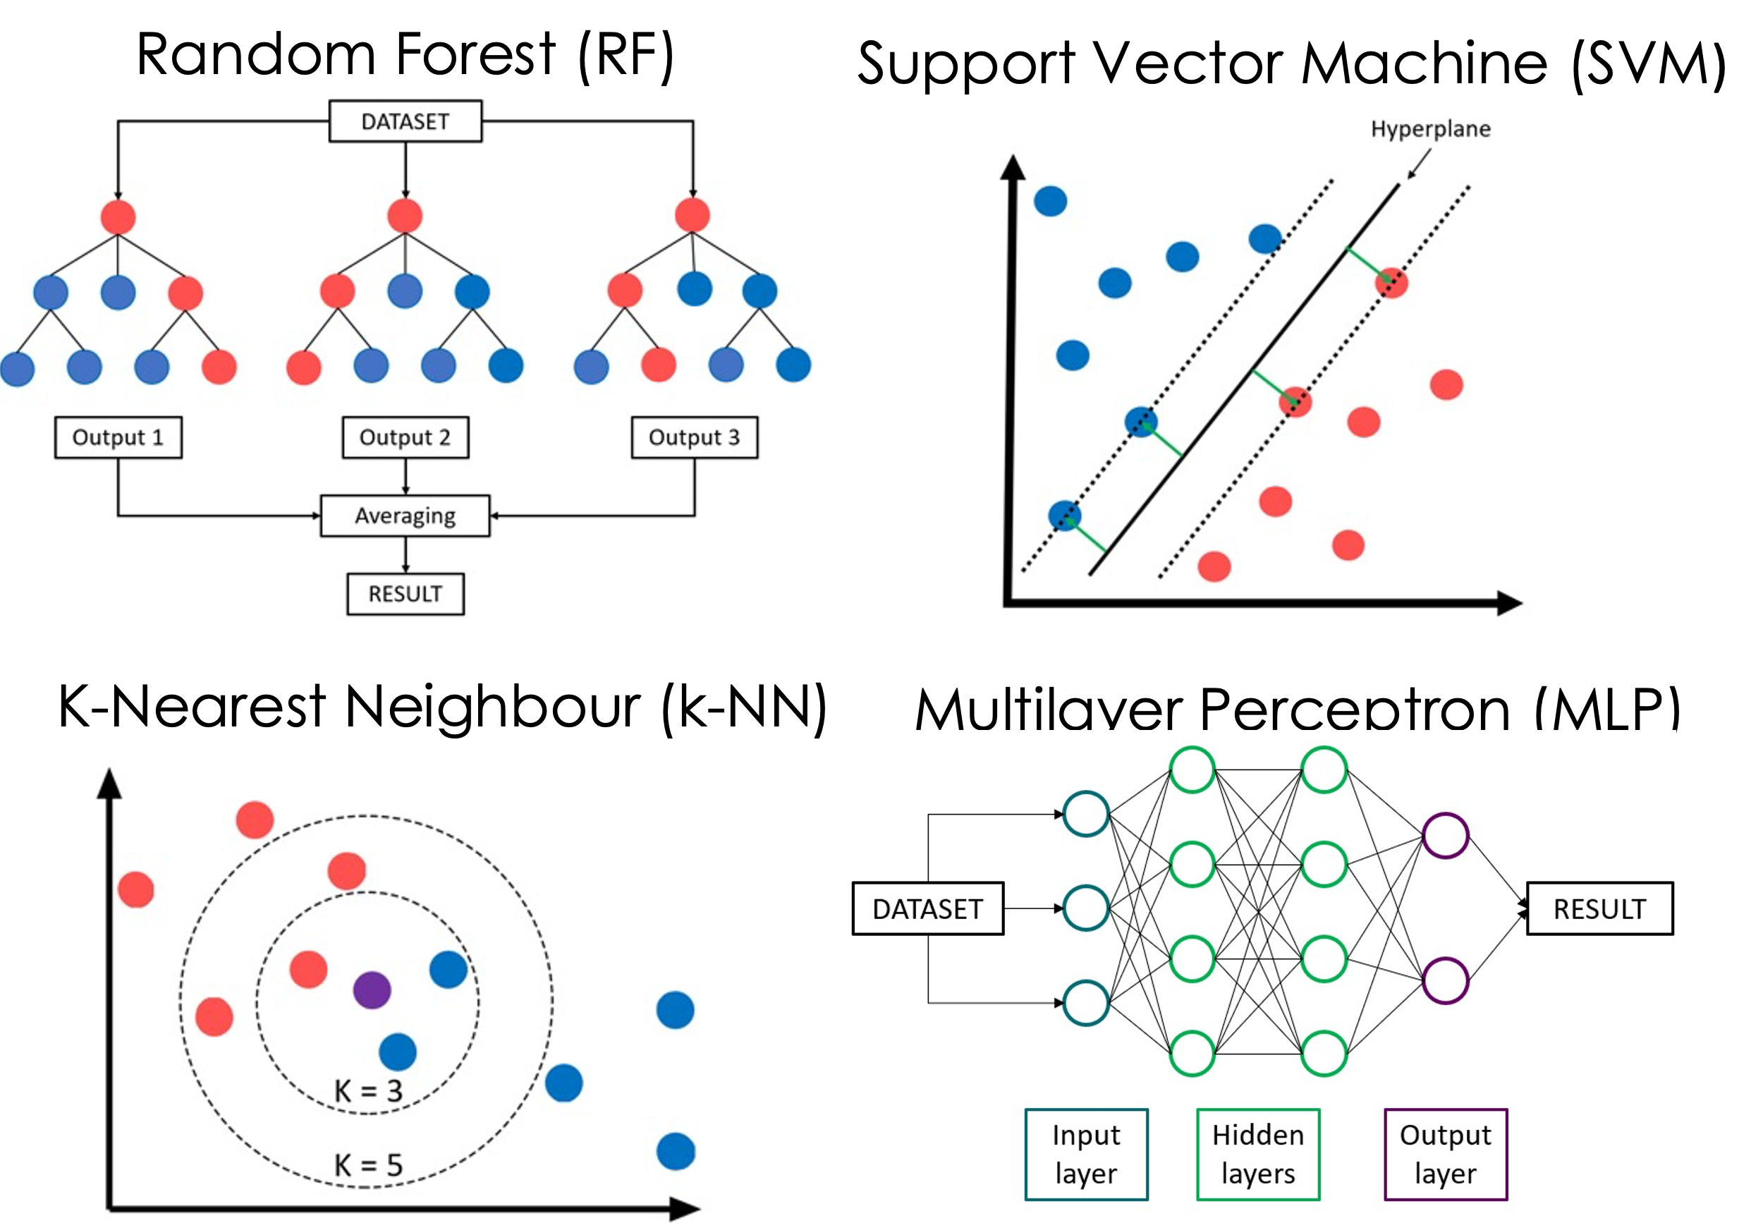
Prediction of Functional Profiles of Ligands

Slide 8
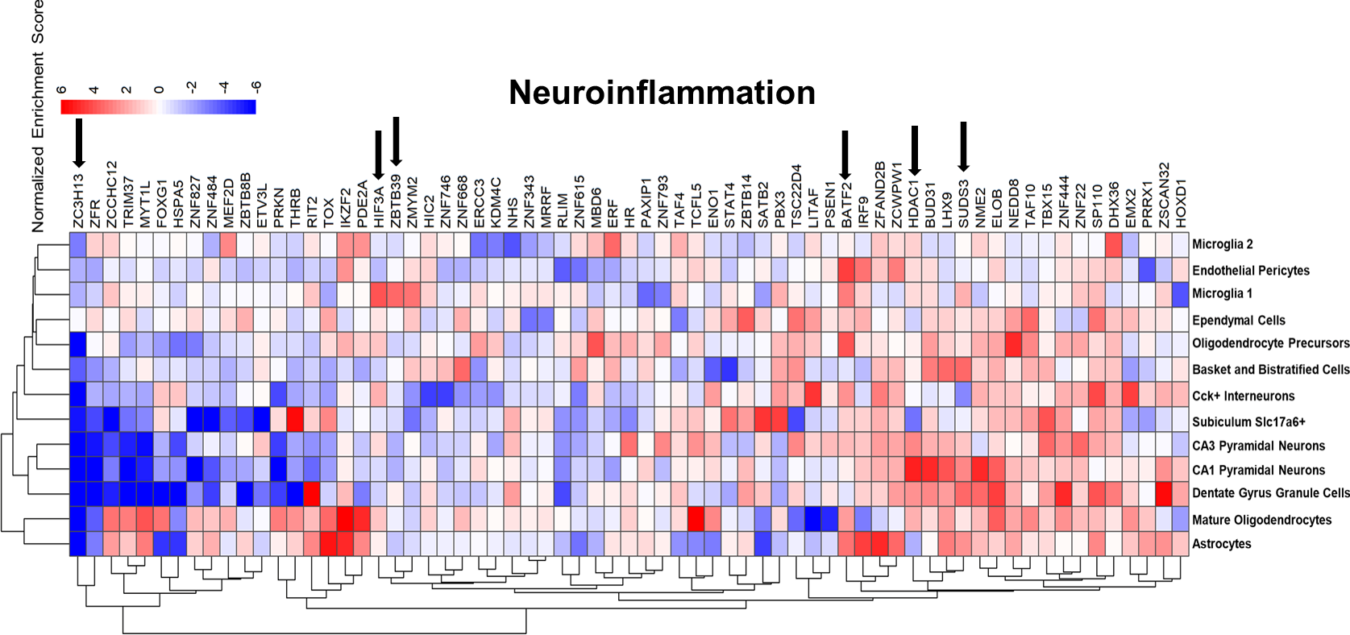
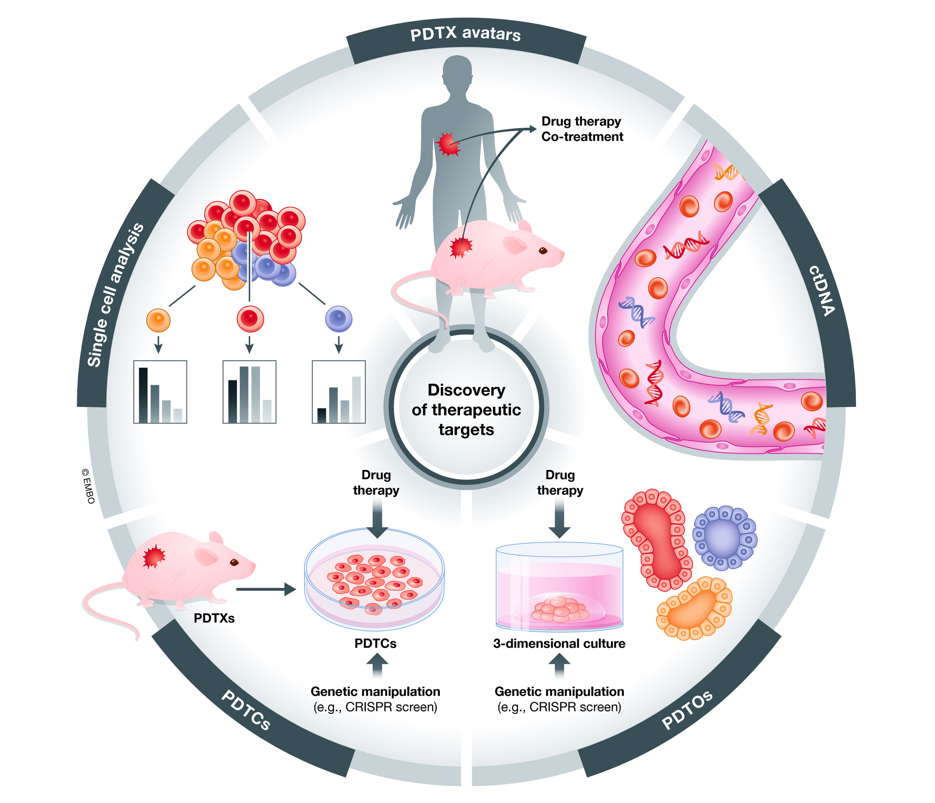
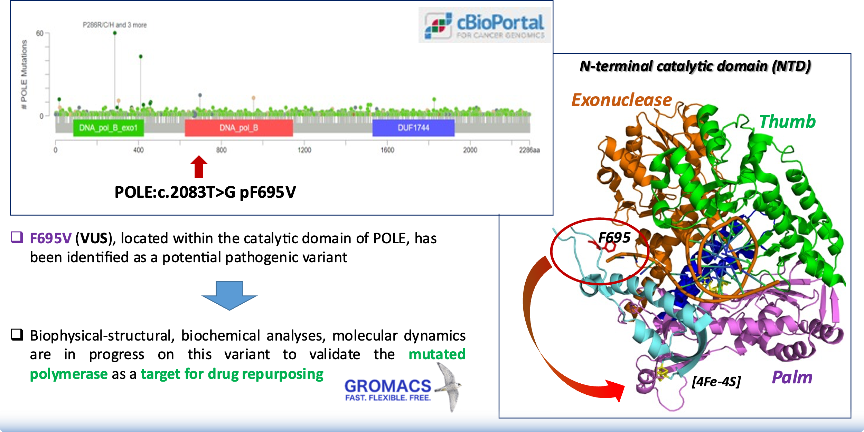
WP6 Drug-target studies and drug repurposing
Identification of innovative drug discovery targets from genome bioinformatics analyses
Analysis of structures, dynamics, interactions and interfaces in chaperones, inflammasome networks, ion channels, actin, other targets for cancer, hematopoiesis and neurodegeneration.
AlphaFold2 predictions.
UniPV, UniTO, CNR
Transcriptomics, bioinformatic analyses for the identification of novel targets in neuroinflammation
UniBO, CNR, UniCT
Genomic analysis of patient derived samples, identification of specific potential cancer-associated mutations on a new target involved in DNA synthesis – combination with biophysics and comp to select compounds.
UniBa, IIT, UniPV

Slide 9
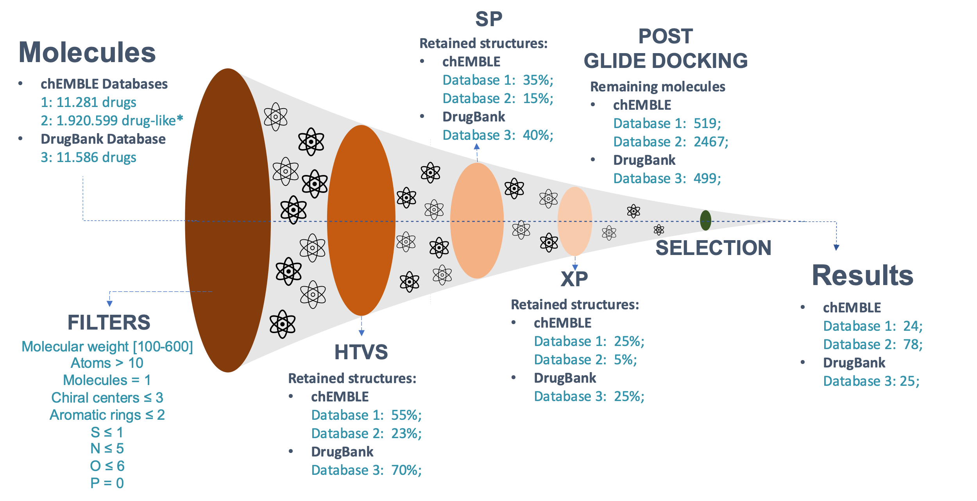
WP6 Drug-target studies and drug repurposing
Drug repurposing studies using novel target and the FDA-approved drug databases (Padova, Pavia, Torino, Bologna, Catania, IIT, CNR)
Application of classical and development of novel ML and DL methods for drug-target interaction prediction
UniTO, UniPD, UniCT, UniBO, IIT, CNR
Studies of networks, allostery, deep-learning to characterize possible drug-induced effects
UniPD, UniBO, UniPV

Slide 10
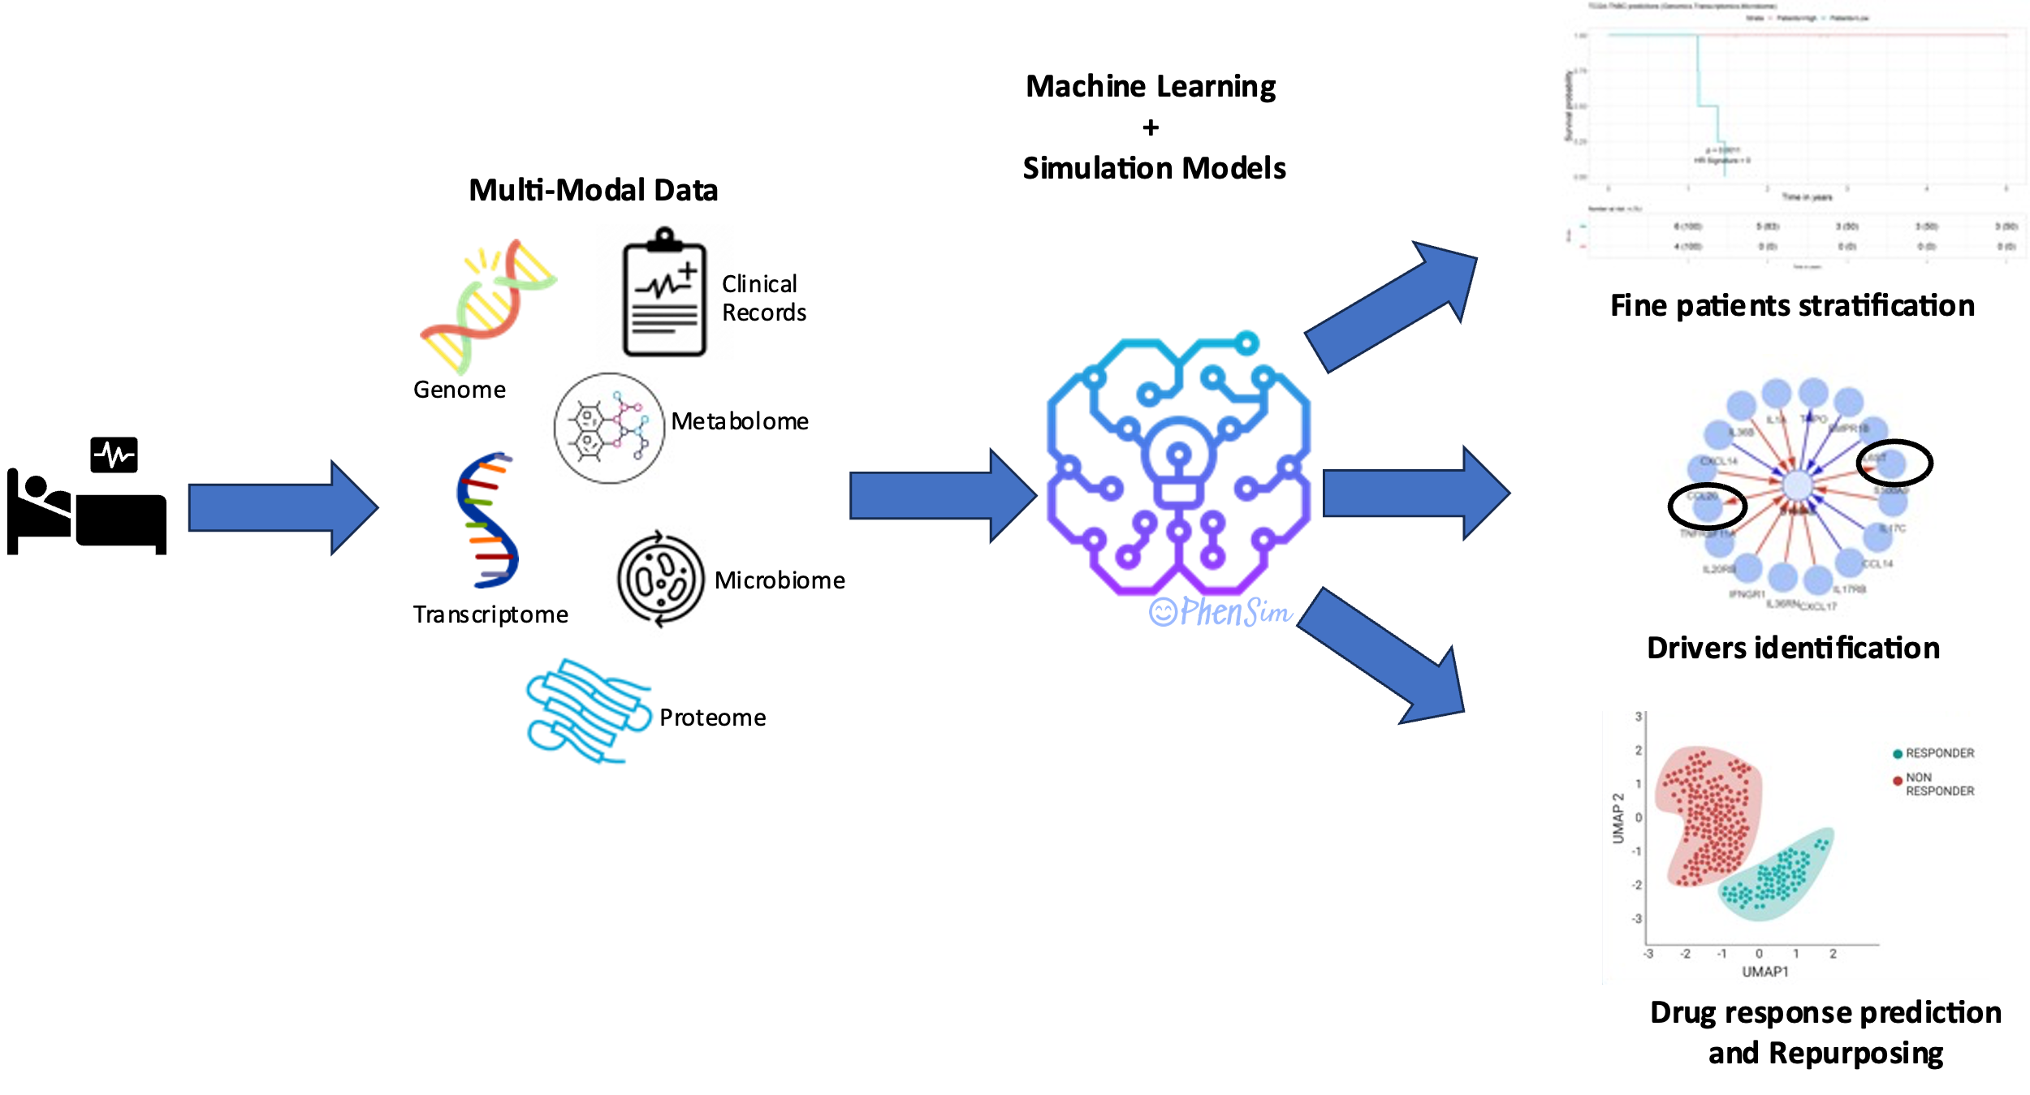
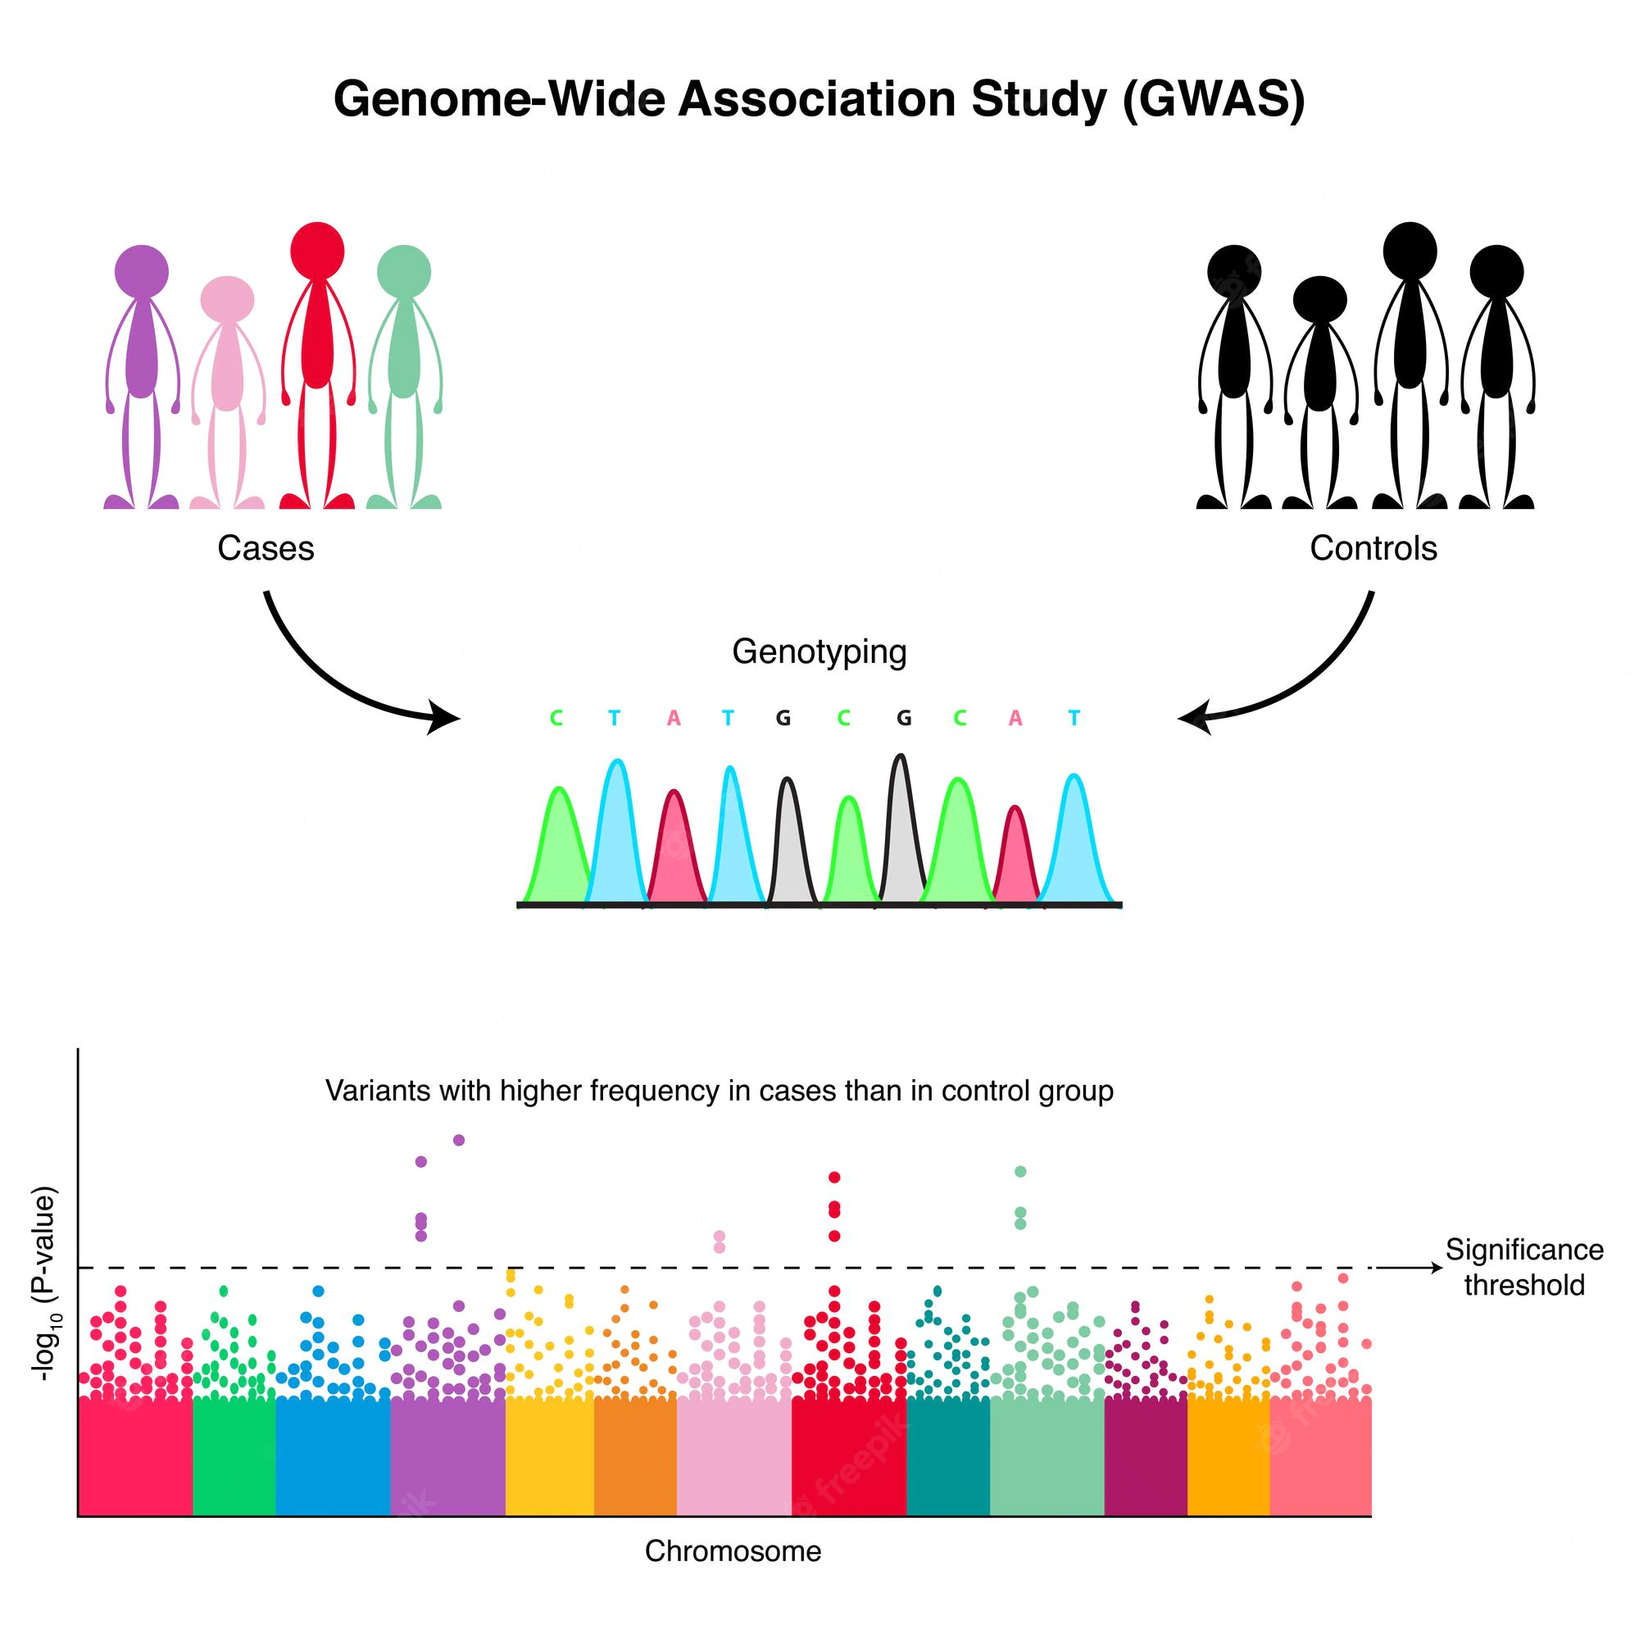
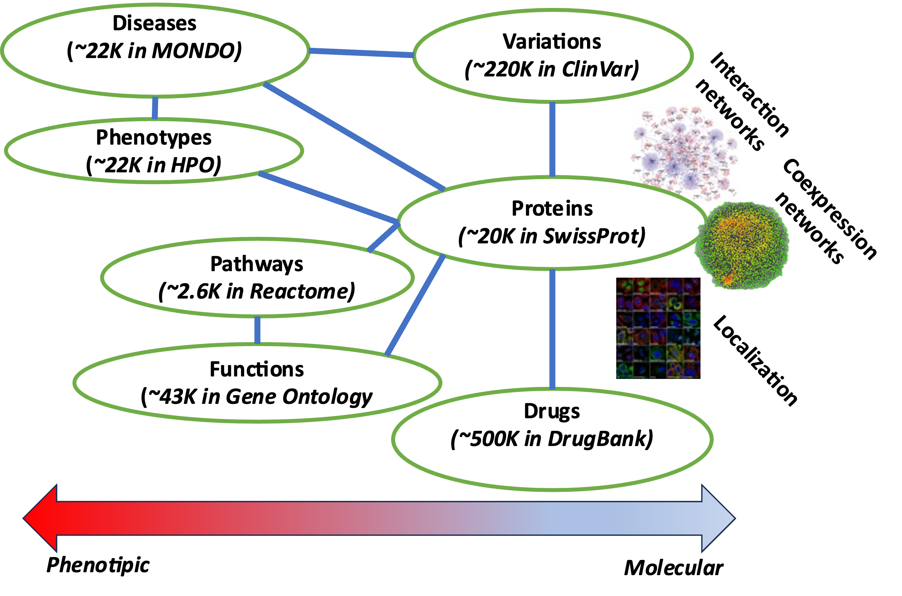
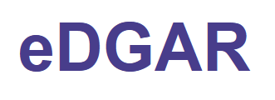
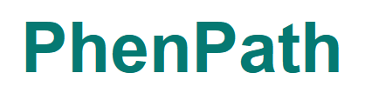
WP6 Drug-target studies and drug repurposing
Molecular medicine studies to link actionable genes, personalized treatments, and drug-target interaction model
Studies of Associations between genes and phenotypes to identify targets.
CNR, IIT, UniCT, UniBO
Data Integration, comprehensive model development, patient stratification for Breast Cancer, Neuroinflammation…
UniCT, UniPD, UniPV, UniTO, UniBO

Slide 11
WP6 Drug-target studies and drug repurposing
Task 6.1 Identification of innovative drug discovery targets from genome bioinformatics analyses
Task 6.2 Drug repurposing studies using novel target and the FDA-approved drug database
PERSONALIZED MEDICINE
NEW DRUGS
NEW METHODS
Task 6.3 Molecular medicine studies to link actionable genes, personalized treatments, and drug-target interaction models
Bologna June 22nd 2023

