Slide 1
WP2@UNICT
scPhensim

Slide 2
PHENSIM
Phenotype Simulator
Alaimo, S., Rapicavoli, R.V., Marceca, G.P., La Ferlita, A., Serebrennikova, O.B., Tsichlis, P.N., Mishra, B., Pulvirenti, A. and Ferro, A., 2021. PHENSIM: phenotype Simulator. PLoS computational biology, 17(6), p.e1009069., doi: 10.1371/journal.pcbi.1009069

Slide 3
PHENSIM
Probabilistic algorithm to calculate the effect of genes, proteins and metabolites deregulation on the KEGG and REACTOME pathways.
microRNAs (miRNAs) from experimental validate databases are included.
Available as a web-app at: https://phensim.tech
Implemented to simulate:
  Drugs
  Activating/Inhibiting Mutations
  Exosomes

Slide 4
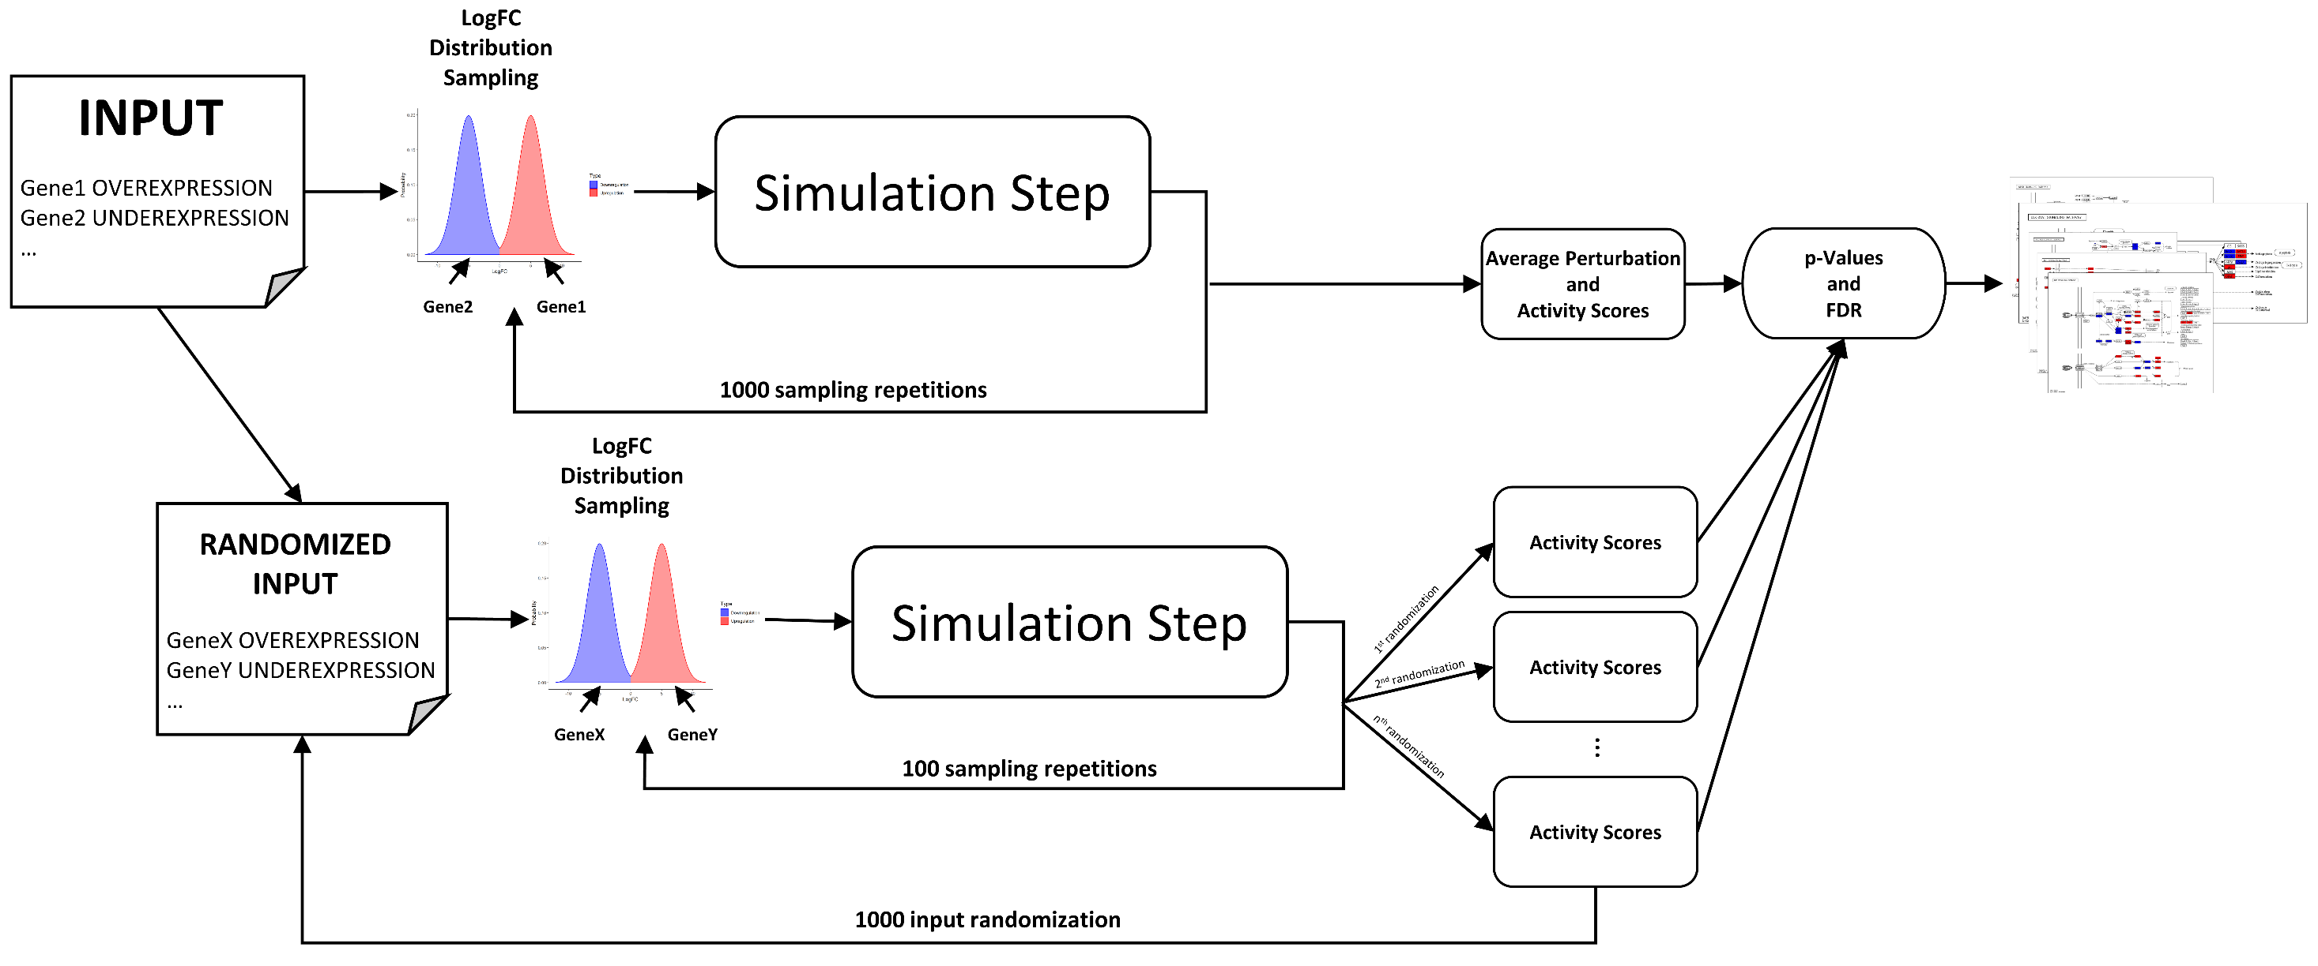
PHENSIM
For simulate the effect of one or more de-regulations on pathways:
  the algorithm calculates synthetic expression changes (Simulated LogFCs) and applies the MITHrIL algorithm (gene perturbation analysis on pathways) several times.
  at the end of the procedure, we can calculate an Activity Score for each gene:
    The activity score is positive if a gene is likely activated, negative if inhibited, zero otherwise.
  For each Activity Score we compute a p-value indicating the probability that the observed effect is relevant to the phenomenon being simulated (or random).

Slide 5
Conclusion
We are working on a Phensim version that could be distributed on Leonardo system.

Slide 6
scPHENSIM
Multi-Agent Adaptive Simulation Framework for Evolution in Networks of Networks(MASFENON)
A flexible framework for the modeling of interconnected networks and their evolution

Slide 7
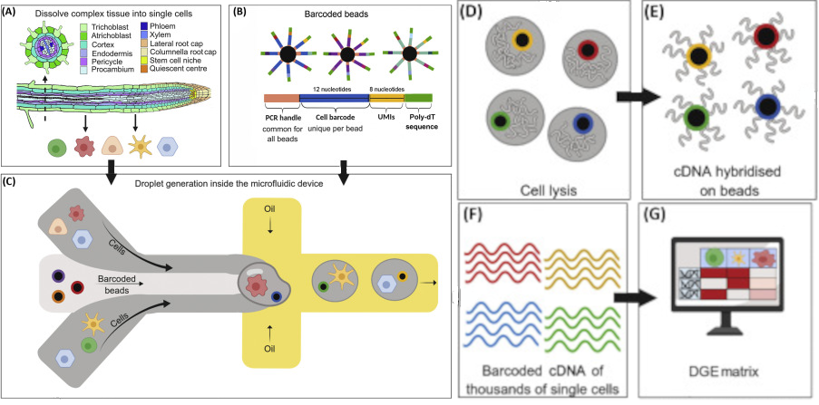
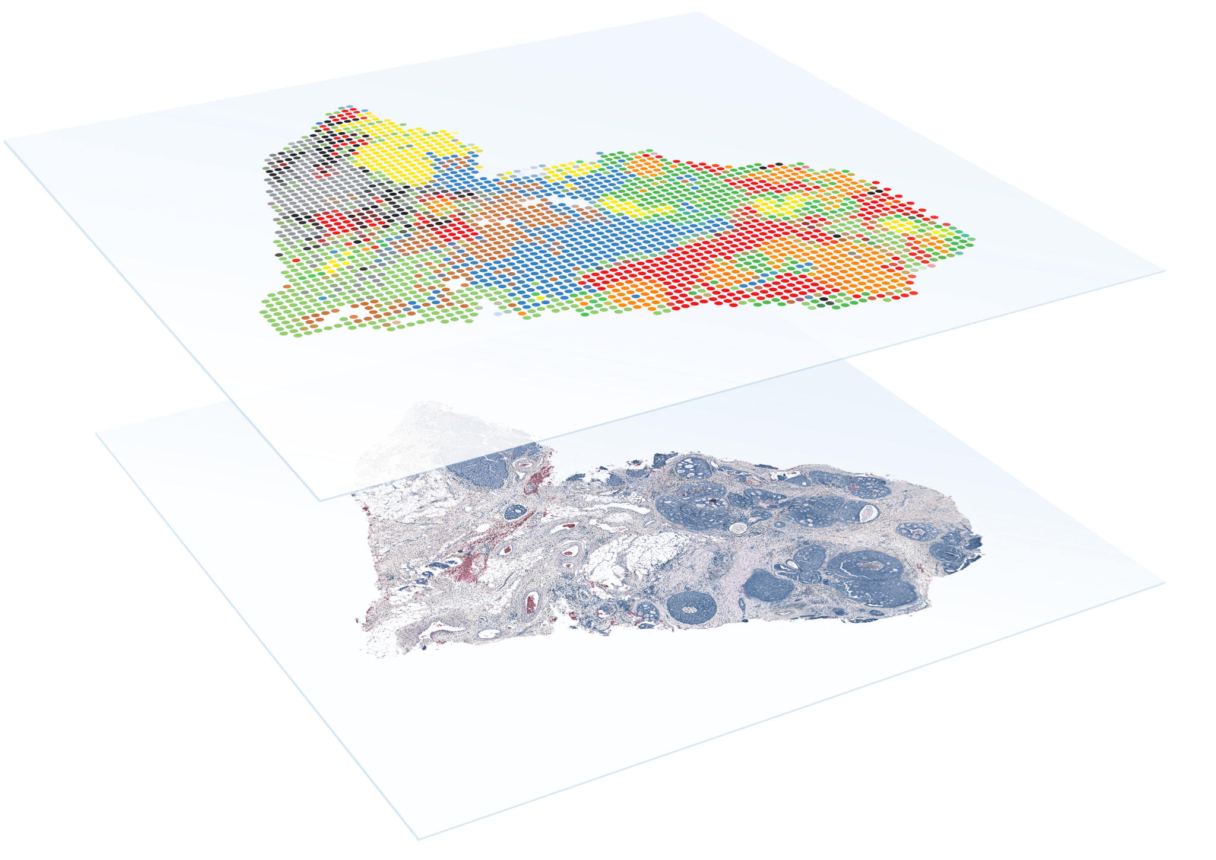
Introduction
Importance of understanding cell-to-cell interactions and perturbations
Challenges in analyzing single-cell and spatial transcriptome data
Role of pathway analysis in studying cellular processes
Integration of multi-omics

Slide 8
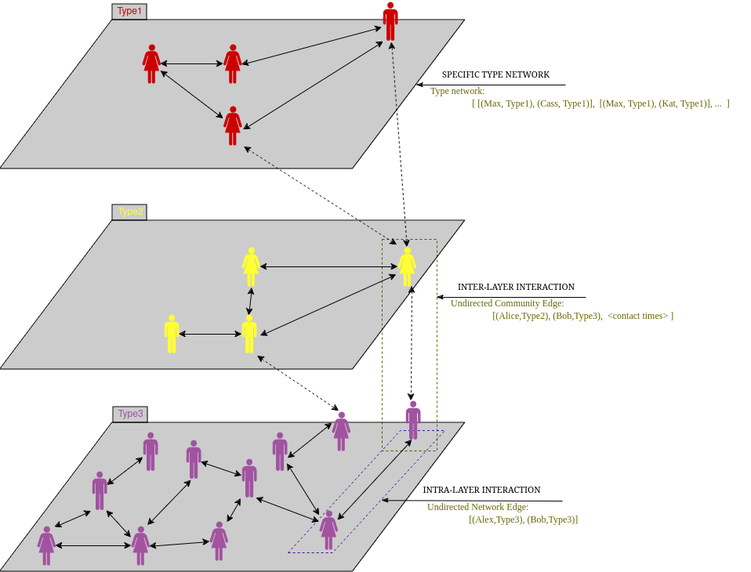

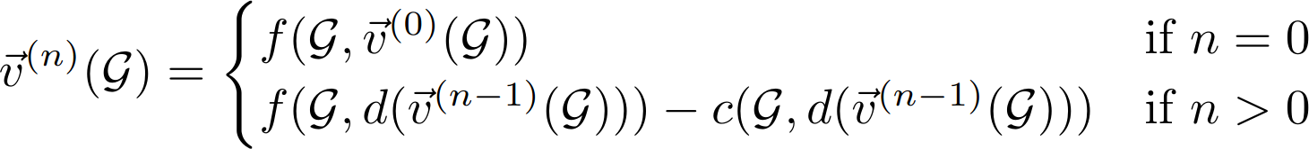

scPHENSIM (multi-agent system)
Our computational methods involve a two-fold approach: Intra-propagation and Inter-propagation mechanisms, driving the nuanced analysis of attributed networks within MASFENON (which is a method).
STEP ONE:
Intra-propagation Mechanism:
Iterative process
Customizable propagation function
Adaptable scaling
The propagation process is driven by a mathematical formalization combined with decay and conservation principes
Propagation (fully customizable)
Conservation (scaling function customizable)
Dissipation (scaling function customizable)
Perturbation value at time n for graph G

Slide 9

scPHENSIM (multi-agent system)
Our computational methods involve a two-fold approach: Intra-propagation and Inter-propagation mechanisms, driving the nuanced analysis of attributed networks within MASFENON (which is a method).
STEP TWO:
Inter-propagation Mechanism:
Multi-agent system (net communication)
Virtual nodes (buffer role for incoming and outcoming information)
Temporal communication between agents
OpenMPI is used for inter-propagation communication

Slide 10
scPHENSIM (multi-agent system)
Our computational methods involve a two-fold approach: Intra-propagation and Inter-propagation mechanisms, driving the nuanced analysis of attributed networks within MASFENON (which is a method).
STEP TWO:
Inter-propagation Mechanism:
Multi-agent system (net communication)
Virtual nodes (buffer role for incoming and outcoming information)
Temporal communication between agents
OpenMPI is used for inter-propagation communication

Slide 11
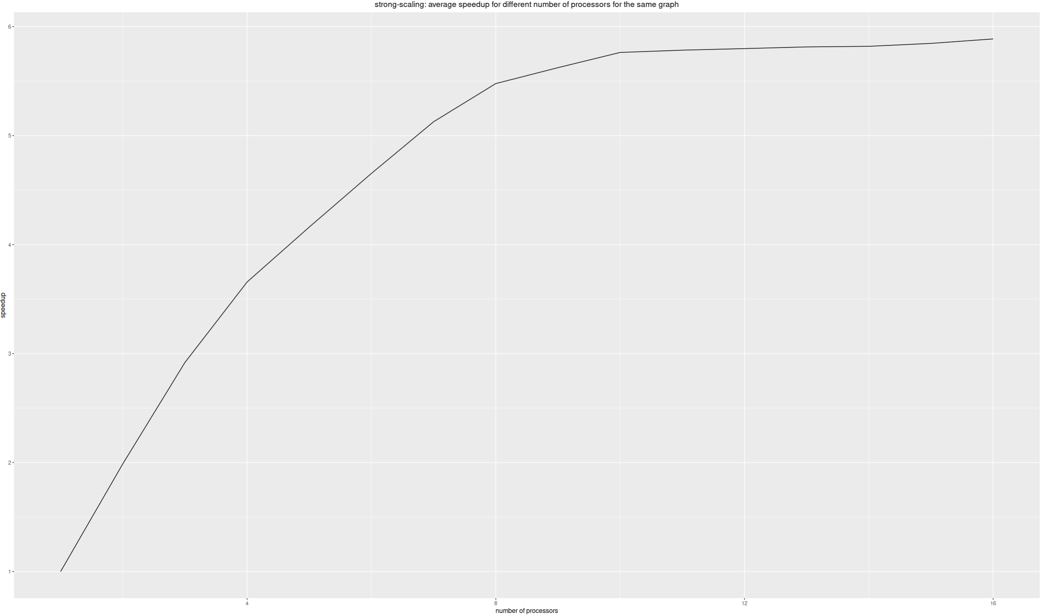
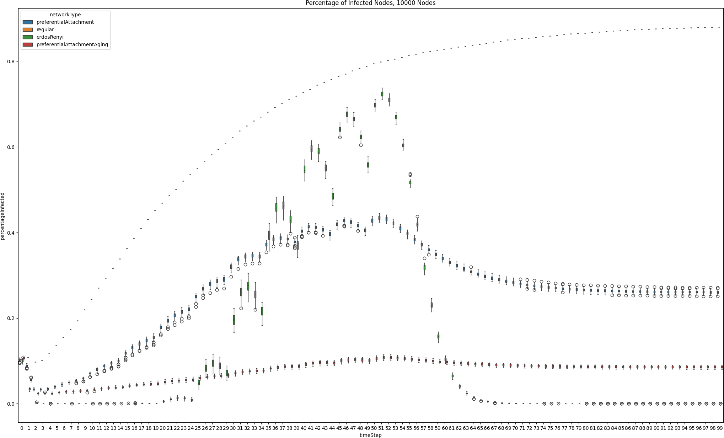
Results and Future outlooks
The preliminary study of the framework were conducted in a controlled environment to test the capabilities. In these preliminary work, the framework was tested on random and regular generated networks in the context of epidemics. The results were the following:
Performance: The SC-Phensim framework exhibits a sublinear speedup in performance, indicating that it scales efficiently with network size and number of processors used.
Non-Normal Distribution: Analysis through boxplots and Shapiro-Wilk tests revealed non-normal distributions of infected individuals at each timestep across various graph types. This indicates that the framework changes behaviour with the type of network that is used, and the results will be non-trivial or directly derivable from the initial information on the networks

Slide 12
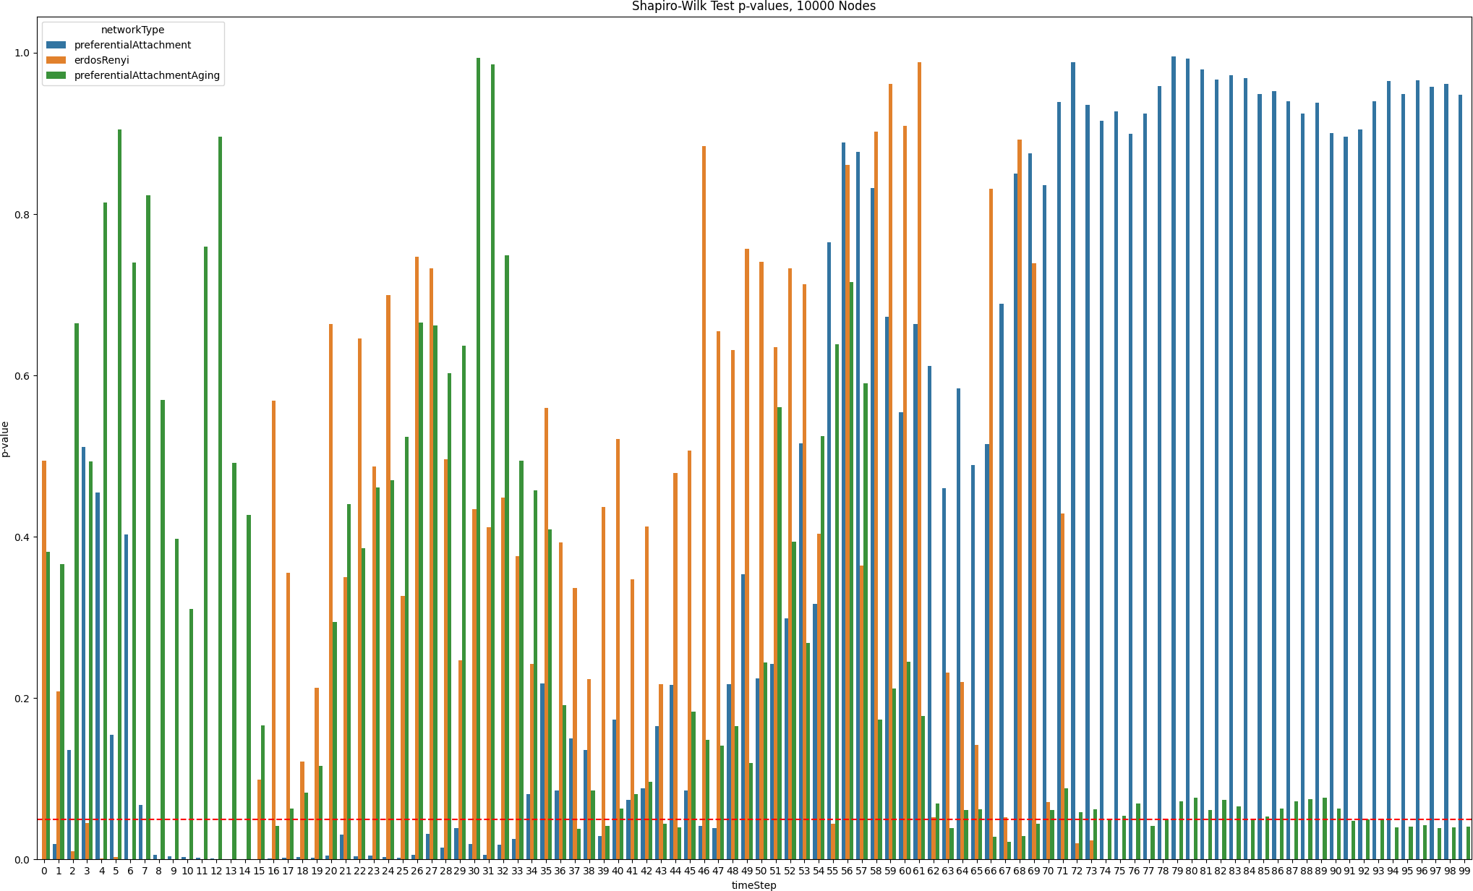
Results and Future outlooks
The preliminary study of the framework were conducted in a controlled environment to test the capabilities. In these preliminary work, the framework was tested on random and regular generated networks in the context of epidemics. The results were the following:
Diverse Behavior: The study observed significant variations in epidemic spread dynamics among different graph models, suggesting that network structural characteristics, such as connectivity patterns and degree distributions, play a crucial role in the evolution observed with the framework.

Slide 13
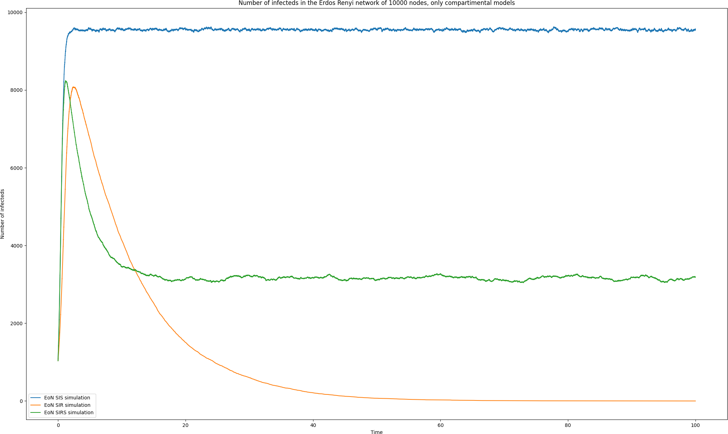
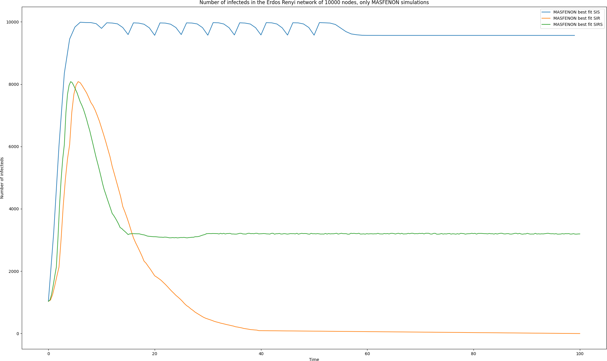
Results and Future outlooks
To see how the models behaved against state-of-the-art models for epidemics, we compared the results of classical compartmental models with the results of scPhensim:
scPhensim vs. Compartmental Models: tested against traditional compartmental models (SIR, SIS, SIRS) on various graph structures. Results demonstrated that scPhensim does not lead to all nodes being infected but rather stabilizes at certain convergence values, showcasing its ability to capture complex dynamics, including multi-stability and temporal interactions.
Customization and Model Fitting: By fine-tuning parameters, scPhensim can emulate the epidemic curves of SIR, SIS, and SIRS models with high accuracy. Adjusting the dissipation and propagation functions allows researchers to tailor scPhensim's behavior to match specific epidemic scenarios, demonstrating its versatility and robustness in modeling complex network interactions

Slide 14
Results and Future outlooks
To see how the models behaved against state-of-the-art models for epidemics, we compared the results of classical compartmental models with the results of scPhensim:
Single-cell and Spatial data: we are now working with Single-cell data to observe the evolution of the collective behavior of cells in a Cell-to-cell communication environment.

Slide 15
Gruppo
Research Group
  Alfredo Pulvirenti (Group Leader, Associate Professor)
  Salvatore Alaimo (RTDb)
  Antonio Di Maria (RTDa)
  Grete Privitera (Post-doc)
  Giorgio Lo Cicero (dottorando and scPhensim author)
  Giulia Cavallaro (dottoranda)
  Roberto Grasso (dottorando)
Collaboratori
  Ernestina De Francesco (RDTa)
Collaboratori esterni
  Istituto Oncologico Mediterraneo Ricerca (IOM Ricerca)
  Ilaria Cosentini (CNR)
Notes:
Nei vari progetti sono coinvolte diverse persone.
Specifica che al momento sei principalmente coinvolto nell’attività di augmentation delle pathway … (WP1) e nella classificazione (WP6)

Slide 16
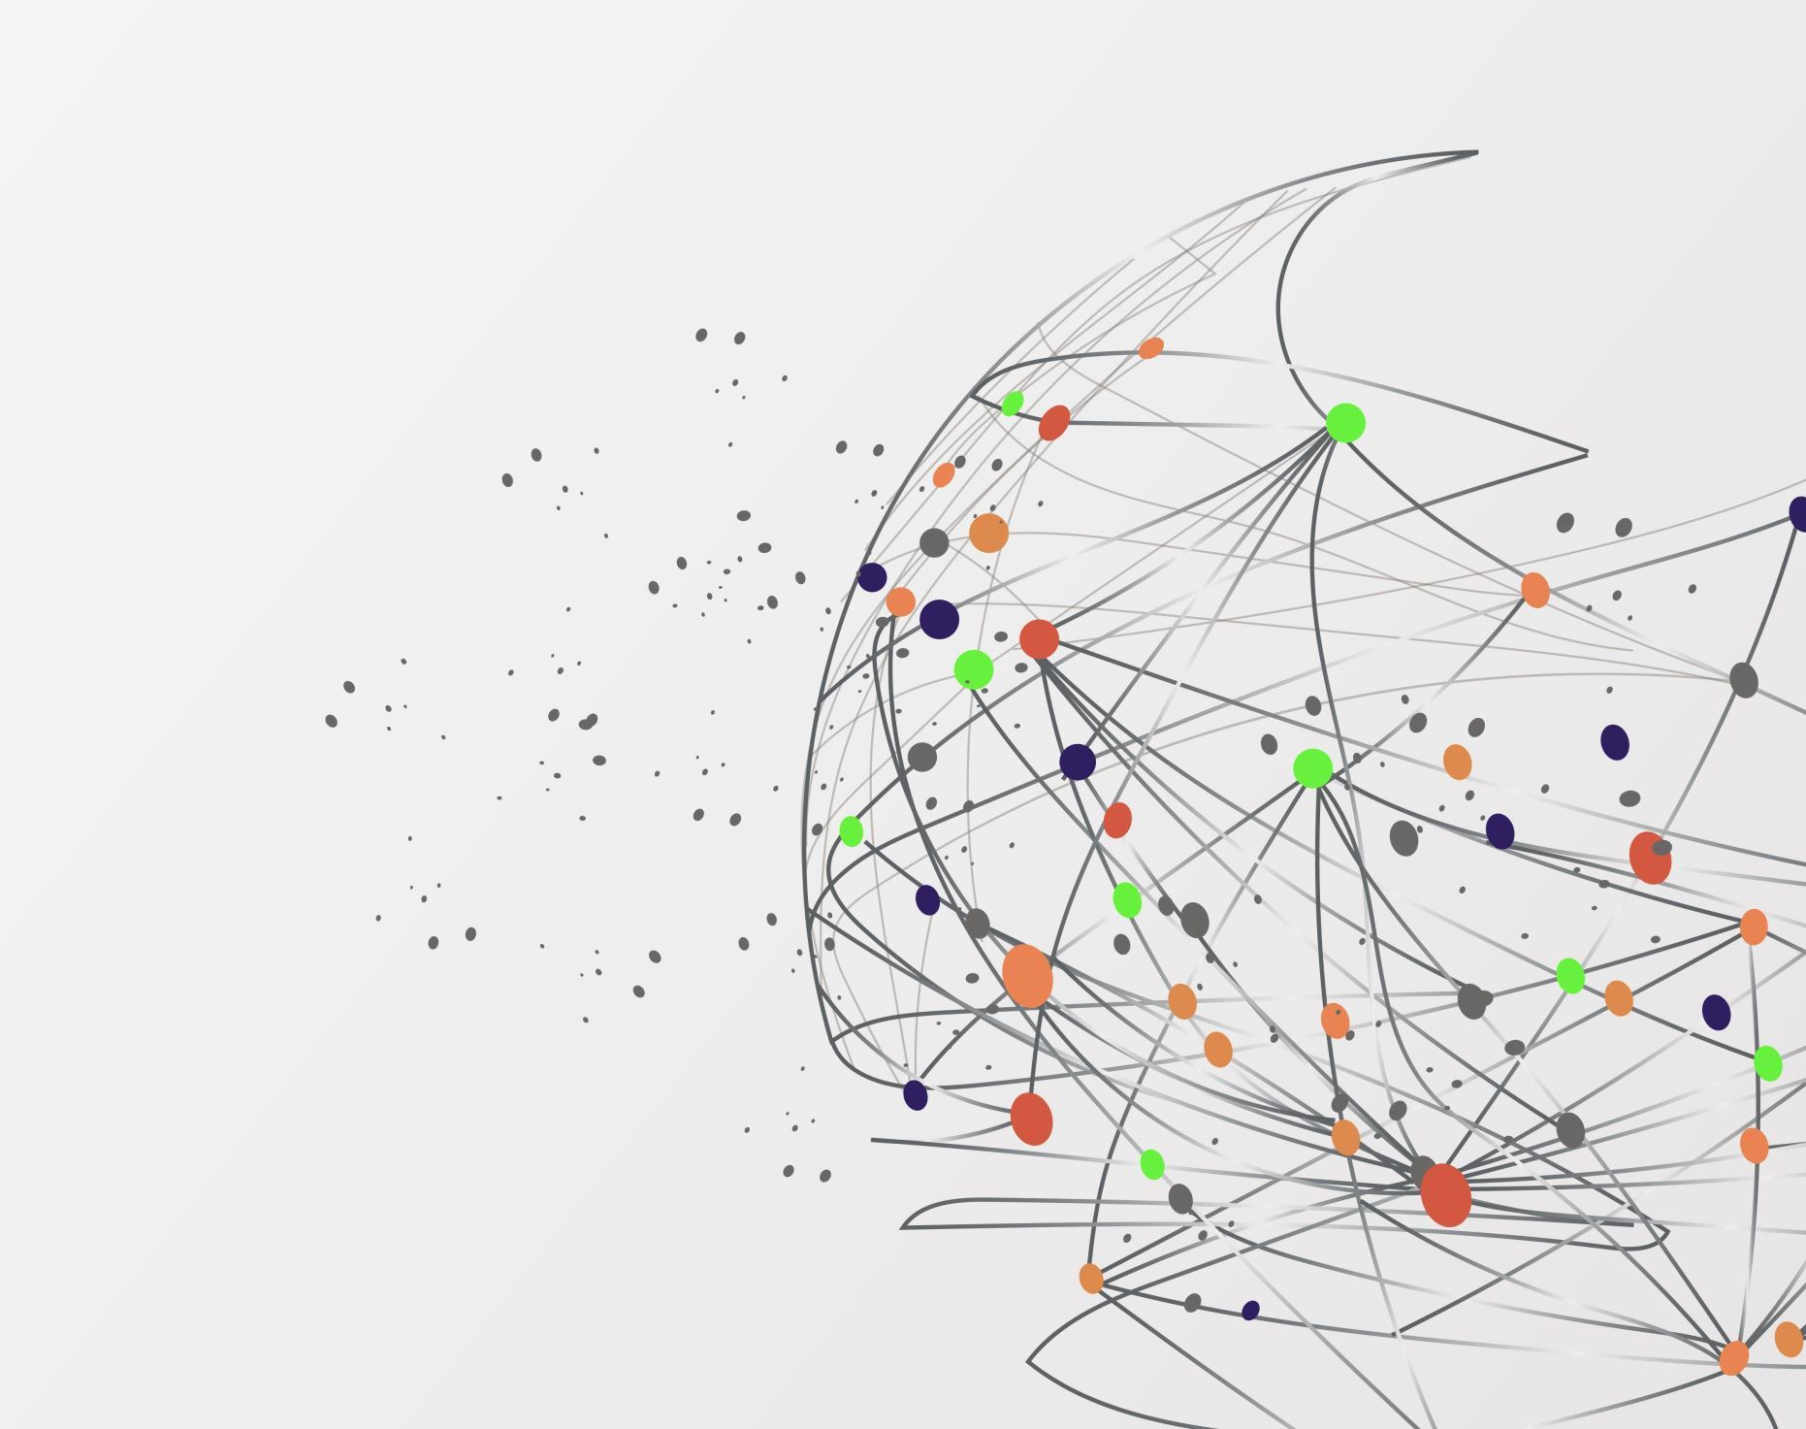
THANKS FOR THE ATTENTION

