Slide 1

Meeting plenario Spoke 8
soluzione di WP2: OptScaff
CINECA,
25/06/2024
Via Magnanelli 6/3
Casalecchio di Reno
Dott. Lorenzo Santoro
lorenzo.santoro@poliba.it

Slide 2
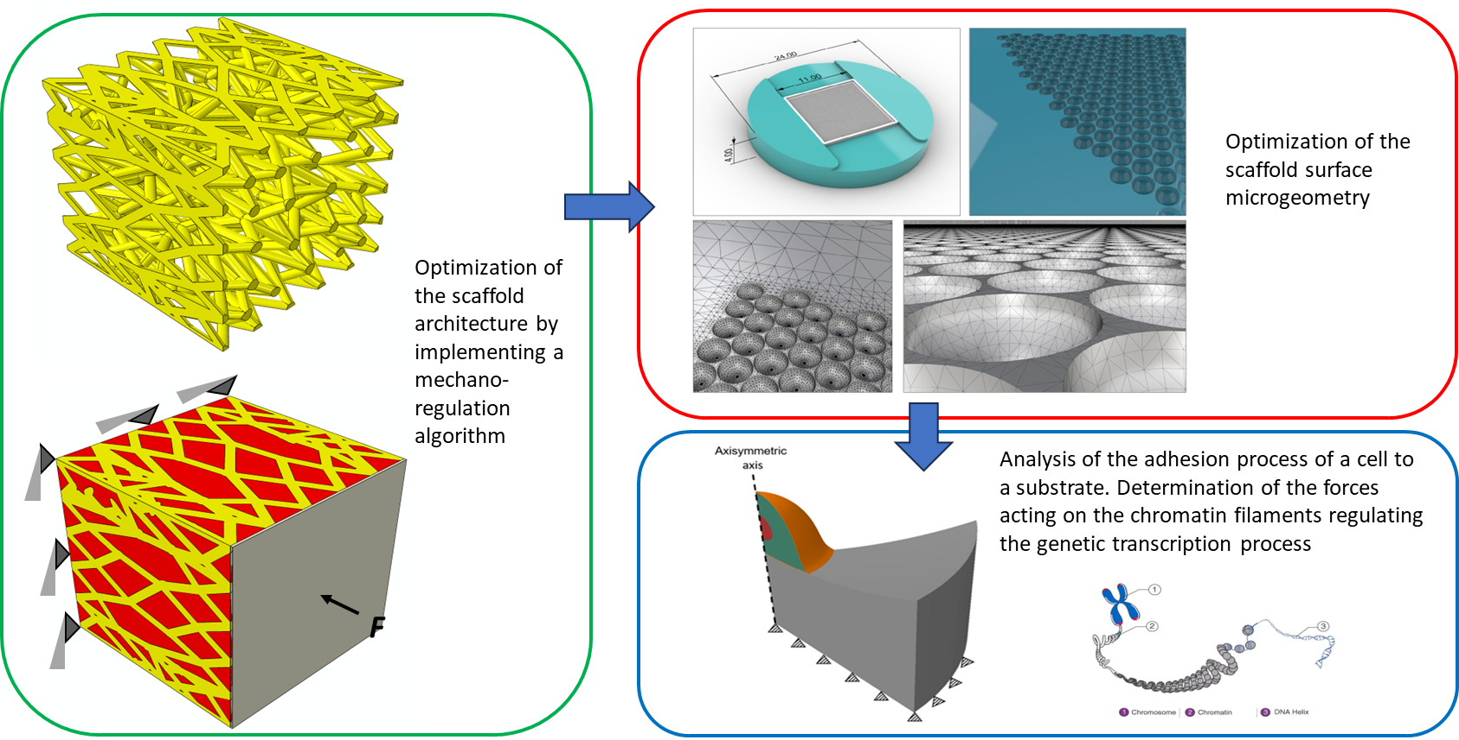
TARGET: Numerical models development for simulating cellular adhesion phenomena on substrates characterized by mechanical and topological features in order to design the optimal scaffold surface for bone tissue engineering.

Slide 3
RESOURCES REQUESTED TO INFN
Virtual license server on cloud standard partition
VM on EPIC Cloud
  28 Core
  1 GPU
  256 GB RAM
  2 TB Storage
Request authorized by Spoke Leaders
Submission to RAC: 28/06/2024

Slide 4
TESTING
Speed-up without GPU:
up to 30% compared to 12 core configuration
up to 72% referred to 4 core configuration
Speed-up with GPU:
from 40 to 20% for 14‒28 core configurations
from 57 to 20% for 4‒28 core configurations

Slide 5
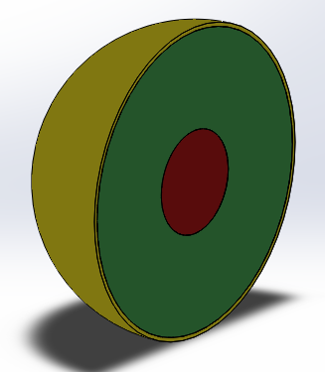
Finite element framework for simulating mesenchymal stem cell adhesion on a flat substrate
Adhesion between the mesenchymal stem cell and the substrate is simulated by using an elastic quasi-static axisymmetric finite element model.
cortex
nucleus
Two deformable parts representing the mesenchymal stem cell and the substrate were schematized according with geometry and properties reported in Refs. [1,2,3].
Three partitions of the cellular domain (nucleus, cytoskeleton and cortex).
The cell as a whole has a radius of 15 μm;
The nucleus is characterized by a radius of 5 μm;
The cortex has a thickness of 0.4 μm;
cytoskeleton
Cell part in the model
nucleus is 33 kPa
cytoskeleton is 3.3 kPa [2]
cortex is 264 kPa
The Young’s modulus of the:
[1] Adam J. Engler et al.: Matrix elasticity directs stem cell lineage specification. Cell 126, 677-689 (2006). DOI 10.1016/j.cell.2006.06.044.
[2] R. Vargas-Pinto et al.: The effect of the endothelial cell cortex on atomic force microscopy measurements. Biophysical Journal, volume 105, 300–309 (July 2013).
[3] E. Migliorini et al.: Nanoindentation of mesenchymal stem cells using atomic force microscopy: effect of adhesive cell-substrate structures. Nanotechnology 32 (2021) 215706 (15pp).

Slide 6

height of 70 μm
width of 50 μm
Substrate part:
[1,2]
Young’s modulus of 198 kPa.
Cell and substrate were assumed as incompressible materials (Poisson’s ratio equal to 0.4999).
The use of axisymmetric parts allowed to save computational resources and convergence analysis was executed to find mesh-independent solutions.
The adhesion process simulation was performed by using a multistep procedure.
Substrate part in the model
Progressive establishing of the contact between parts surfaces in order to avoid convergence problems.

Slide 7
The interaction between cell and substrate surface was defined through the general contact algorithm
Contact property: normal behaviour with a hard contact formulation
The cell was meshed with:
9951 linear quadrilateral elements of type CAX4RH
74 linear triangular elements of type CAX3H
The substrate was meshed with:
72000 linear quadrilateral elements of type CAX4RH.
An element size of about 0.2 μm was selected
The executed partitions allowed the mesh to be regular without any distortion.

Slide 8
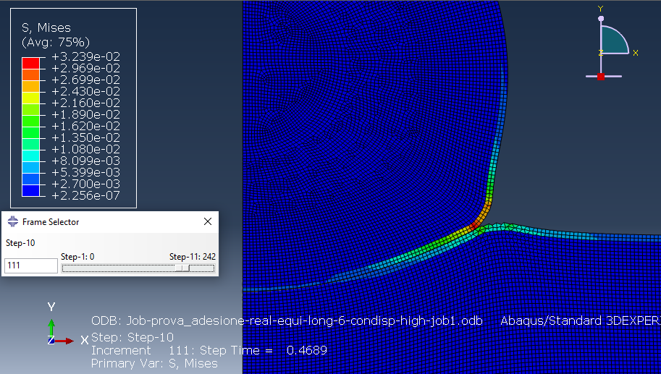
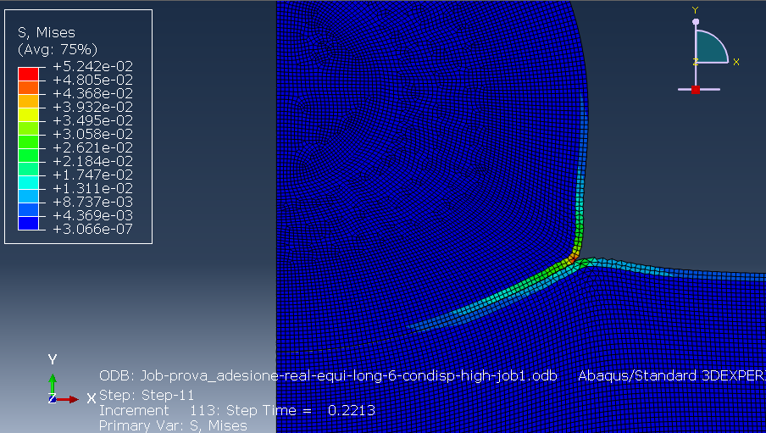
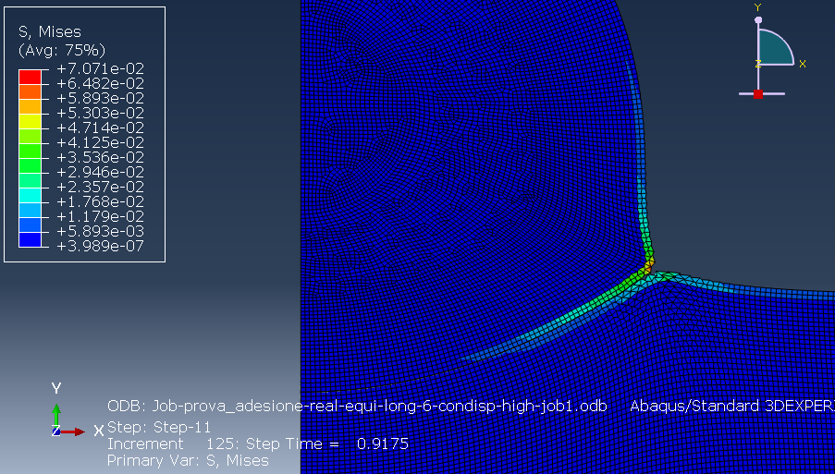
(a)
(b)
(c)

Slide 9
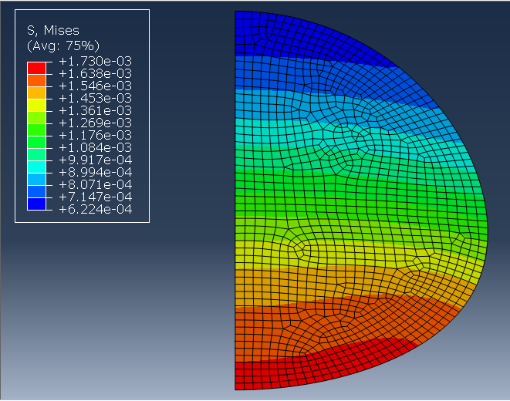
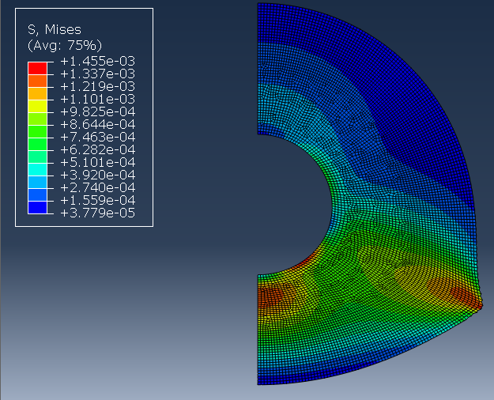
stress field induced inside the nucleus and the cytoskeleton
Von mises stress calculated for the nucleus
Von mises stress calculated for the cytoskeleton

Slide 10
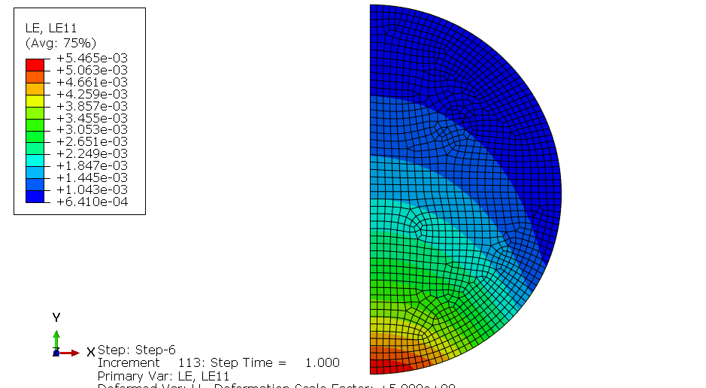
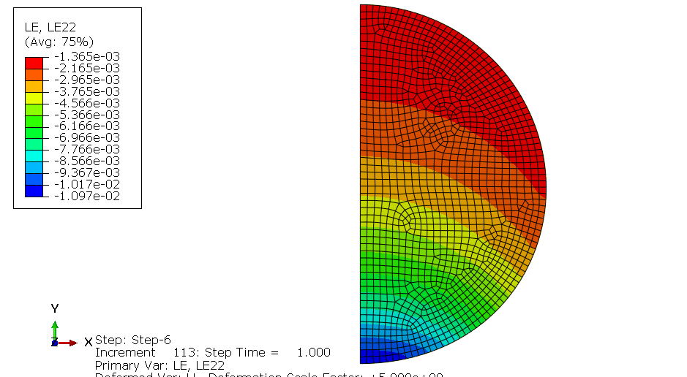
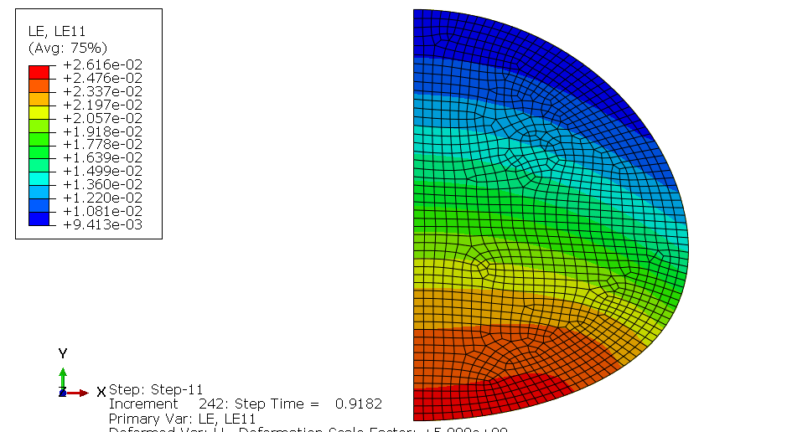
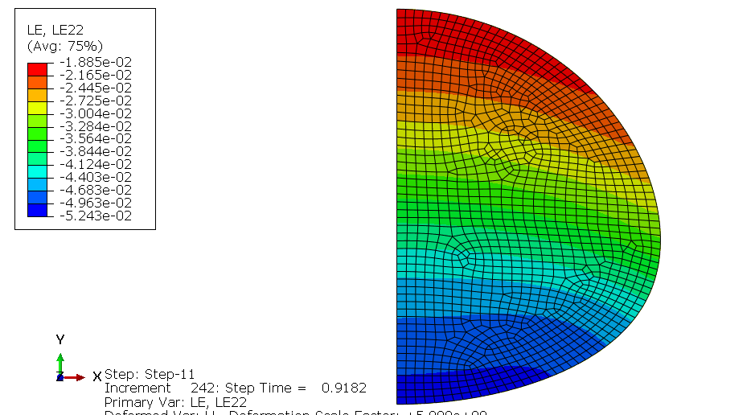
STEP 6
LE11
LE22
STEP 11
LE11
LE22

Slide 11
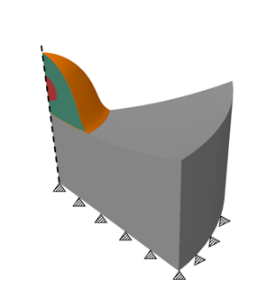
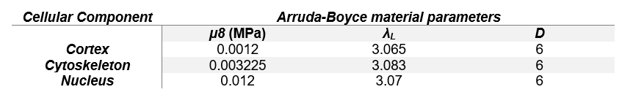
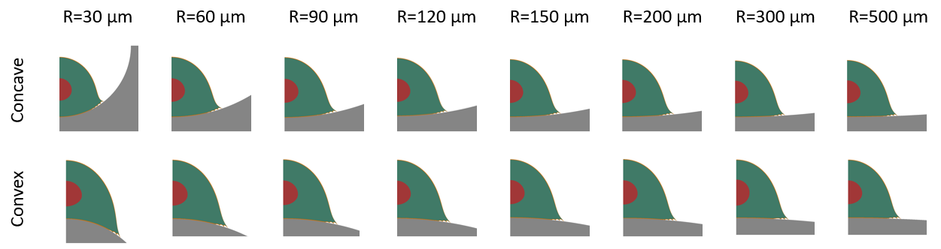
Adhesion process of mesenchymal stem cells on curved surfaces
Hard surface
[3] E. Migliorini et al.: Nanoindentation of mesenchymal stem cells using atomic force microscopy: effect of adhesive cell-substrate structures. Nanotechnology 32 (2021) 215706.

Slide 12
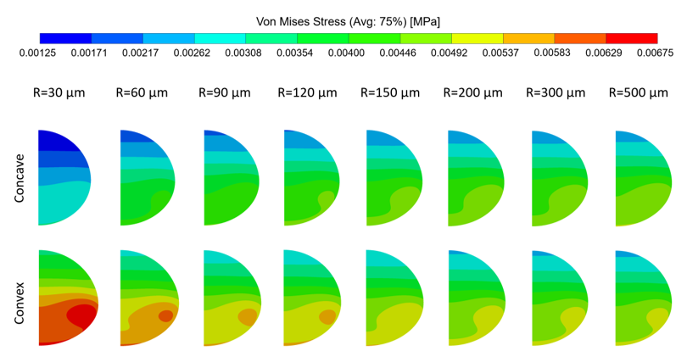
Von mises stress calculated for the nucleus

Slide 14
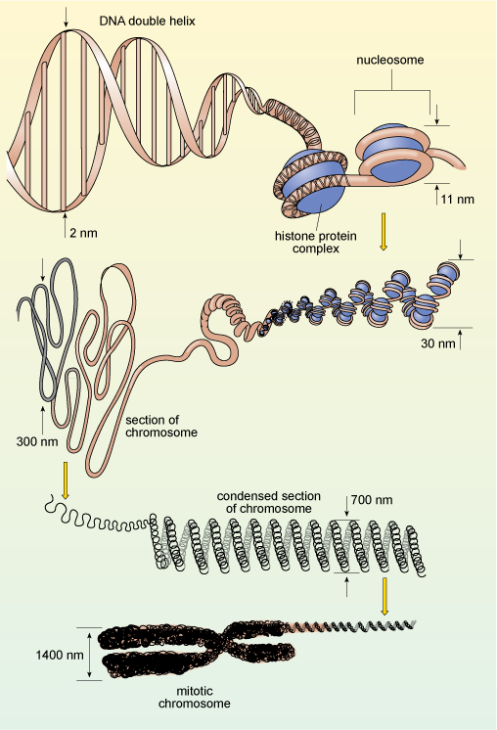
In the eukaryotic cellular structure, the genetic material consisting of DNA molecules is arranged in the chromatin architecture:
an efficient package system to allocate long chains of DNA polymer in a region of the cell having limited extension (i.e., nucleus, with a diameter of about ten micrometers);
a stable arrangement of genetic material which opposes to transcriptional factor-double helix interactions, thus inhibiting transcription process and genetic expression.
The compaction of genetic material in the chromatin structure prevents the expression of the information codified in the deoxyribonucleotides sequences, avoiding the genes transcription.
In order to make accessible the DNA to enzymes (i.e., RNA-polymerase) and transcriptional factors, it is necessary to perturb chromatin architecture.
The dynamic conformational alteration of chromatin arrangement, which can also affect chromatin localized sectors, underlies the exposure of genetic material and the beginning of transcriptional activity.

Slide 15
Thank you very much for your attention
lorenzo.santoro@poliba.it

Slide 16
ACKNOWLEDGEMENTS
The support given by INFN (Barbara Martelli, Giusy Sergi, Diego Michelotto, Carmelo Pellegrino, Stefano Zani) and in particular by Andrea Chierici is gratefully acknowledged

