Slide 1
WP2: Digital twins and in silico trials
Meeting plenario ICS-C Spoke 8
24-25 Jun 2024 - CINECA, Bologna

Slide 2
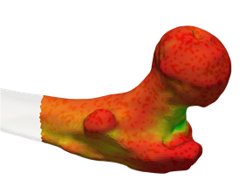
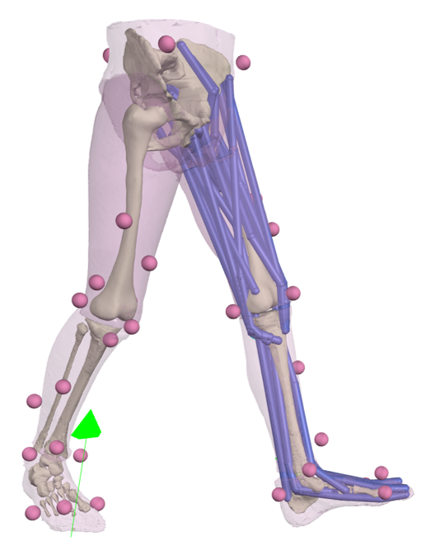
Research target and outputs: UNIBO
BBCT-Hip: porting of the BBCT digital twin for the prediction the risk of fracture at the proximal femur on a cloud HPC platform where sensitive data can be treated
BoneStrength: predicting the effectiveness of osteoporosis drugs and interventions for reducing hip fracture incidence
Myobolica: enabling the use of a stochastic approach to explore the space of physiologically plausible muscle activations and forces to model suboptimal muscle control
IST4JR: estimate the probability associated with the most common clinical failure modes for Joint Replacements

Slide 3
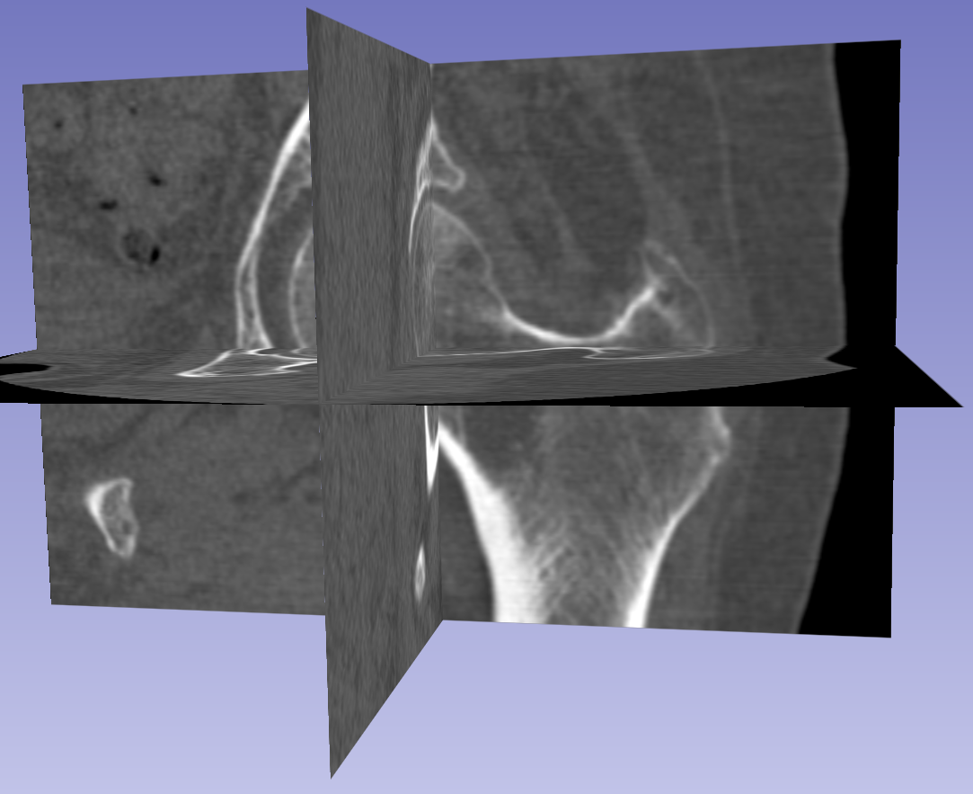
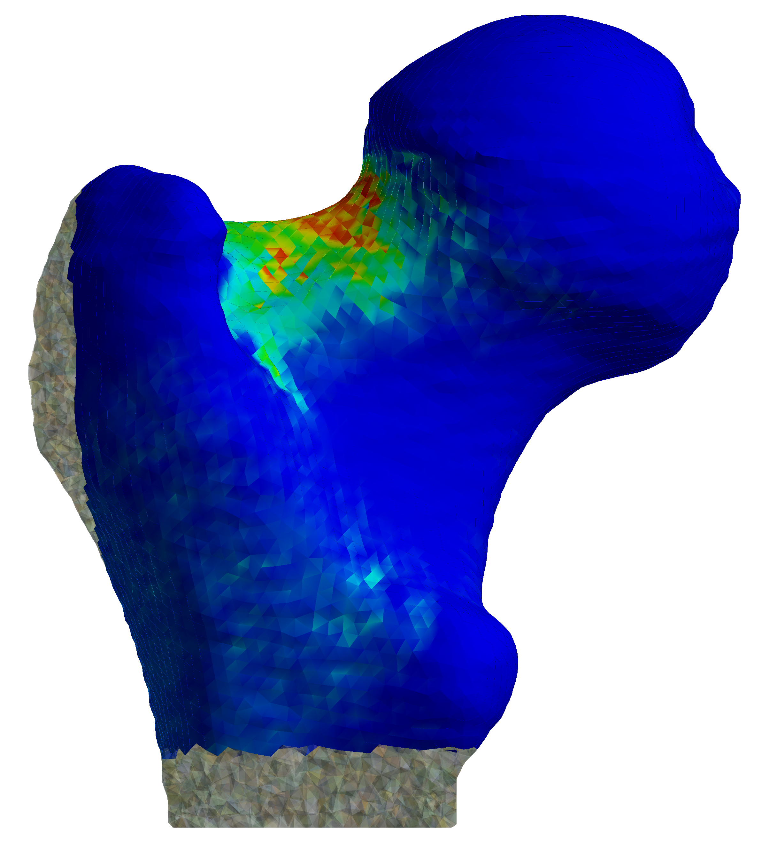
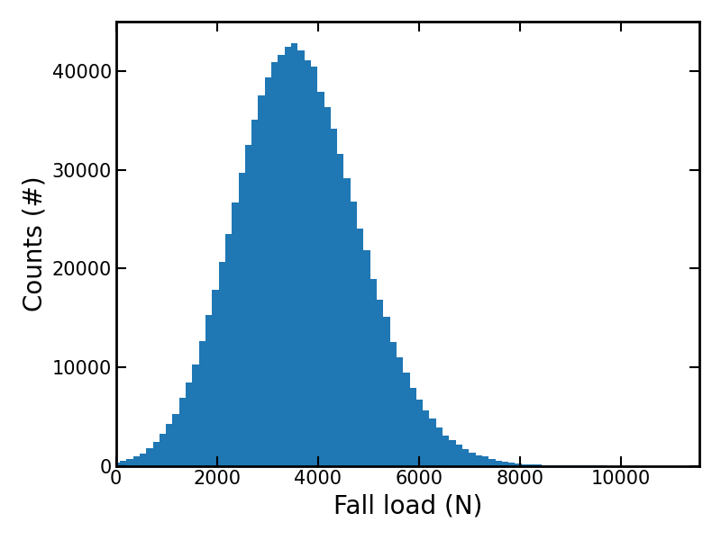
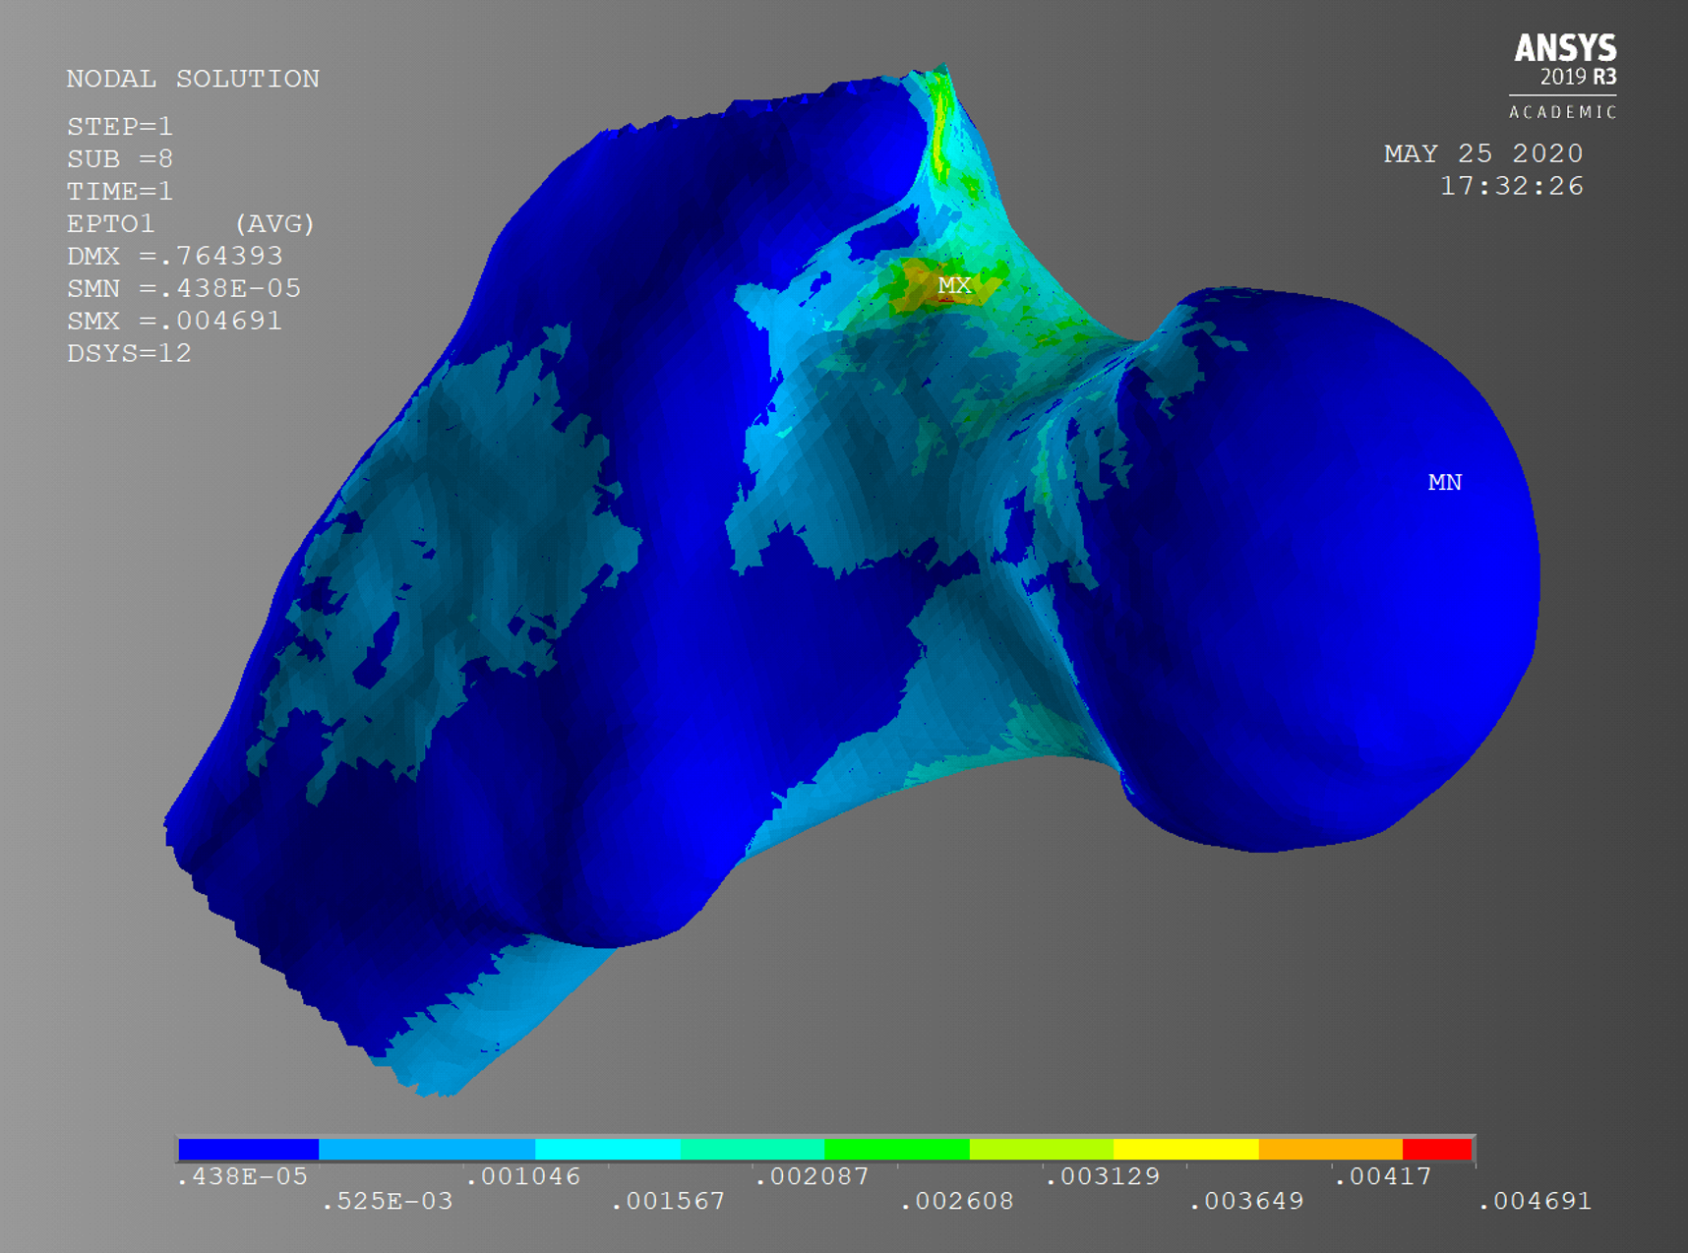
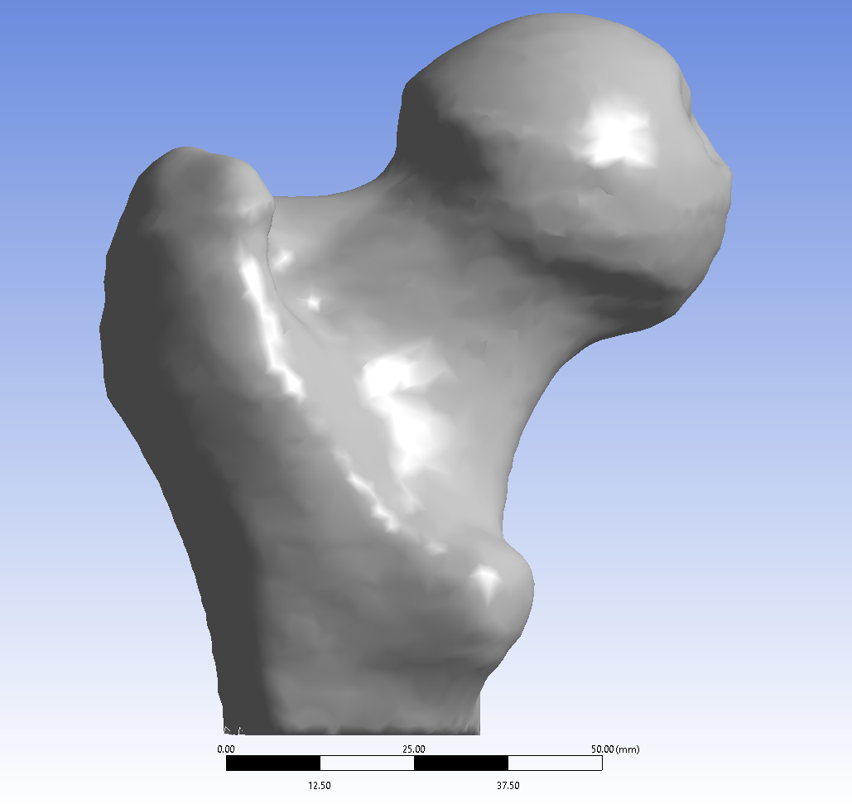
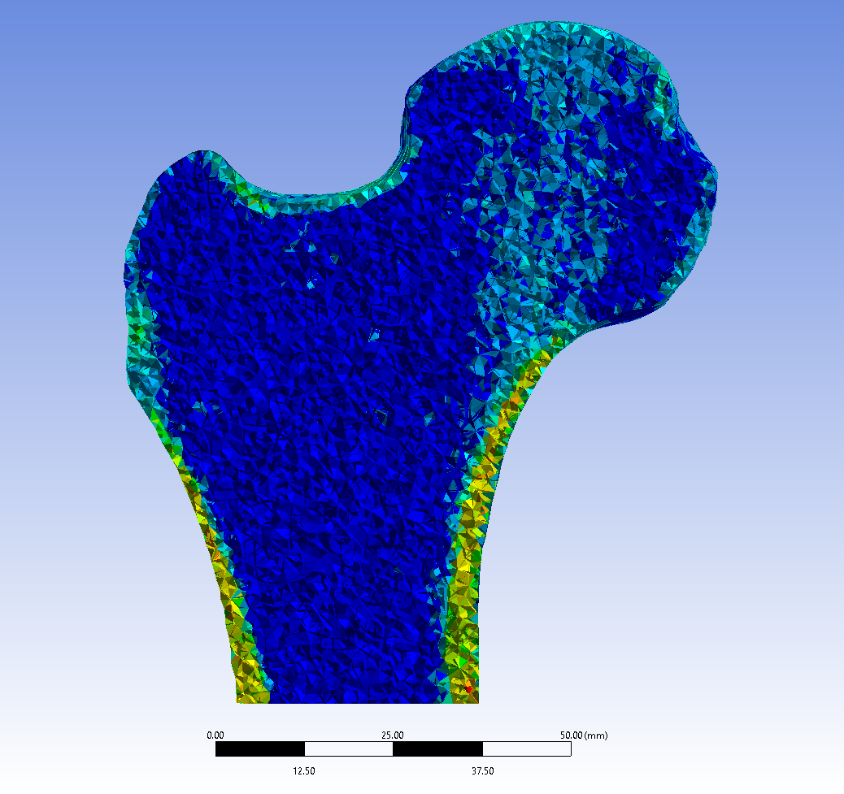
BBCT-Hip
BBCT-Hip: Digital Twin for the prediction of proximal femur fracture risk due to side-fall
Validated with retrospective cohorts, showing a stratification accuracy higher than current clinical standards
31%
ARF0
3D model
Material mapping
INPUT
QCT + Patient characteristics
OUTPUT
Risk of hip fracture
Falling conditions
Different fall angles
Stochastic model
Deterministic model

Slide 4
BBCT-Hip
Goal: pursue clinical validation with a prospective cohort (~300 subjects enrolled at Rizzoli Orthopaedic Institute)
Target architecture: INFN Cloud Secure (EPIC). Porting started in synergy with DARE project
The workflow has been developed and tested on HPC systems (including Galileo100) with anonymised data. The use of pseudonymised data requires a GDPR-compliant system.
50-100 core-hours needed for each patient
50k core-hours will be requested, including porting and scalability tests
Request in preparation (end of June 2024)

Slide 5
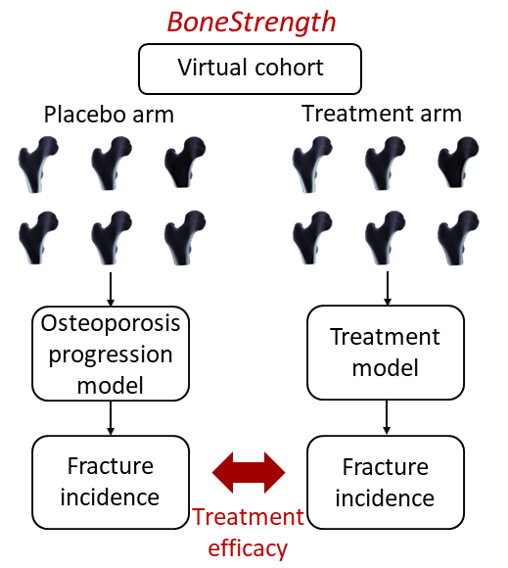
BoneStrength
BoneStrength: In Silico trial to predict the effectiveness of osteoporosis drugs and/or interventions for reducing hip fracture incidence
Sample size (N>1000) and endpoint (fracture incidence) equivalent to phase III clinical trials

Slide 6
BoneStrength
Target HPC: Galileo100
For 1000 virtual patients and 10 years of follow-up, approximately 7000 simulated falls; 20 realisations to obtain convergence of the stochastic process; 1.3 core-hours per single FE simulation
200k core-hours needed for each clinical trial arm
1M core-hours requested for sensitivity analyses and to simulate at least two interventions
Request submitted on 24/01/2024; approved on 07/06/2024

Slide 7
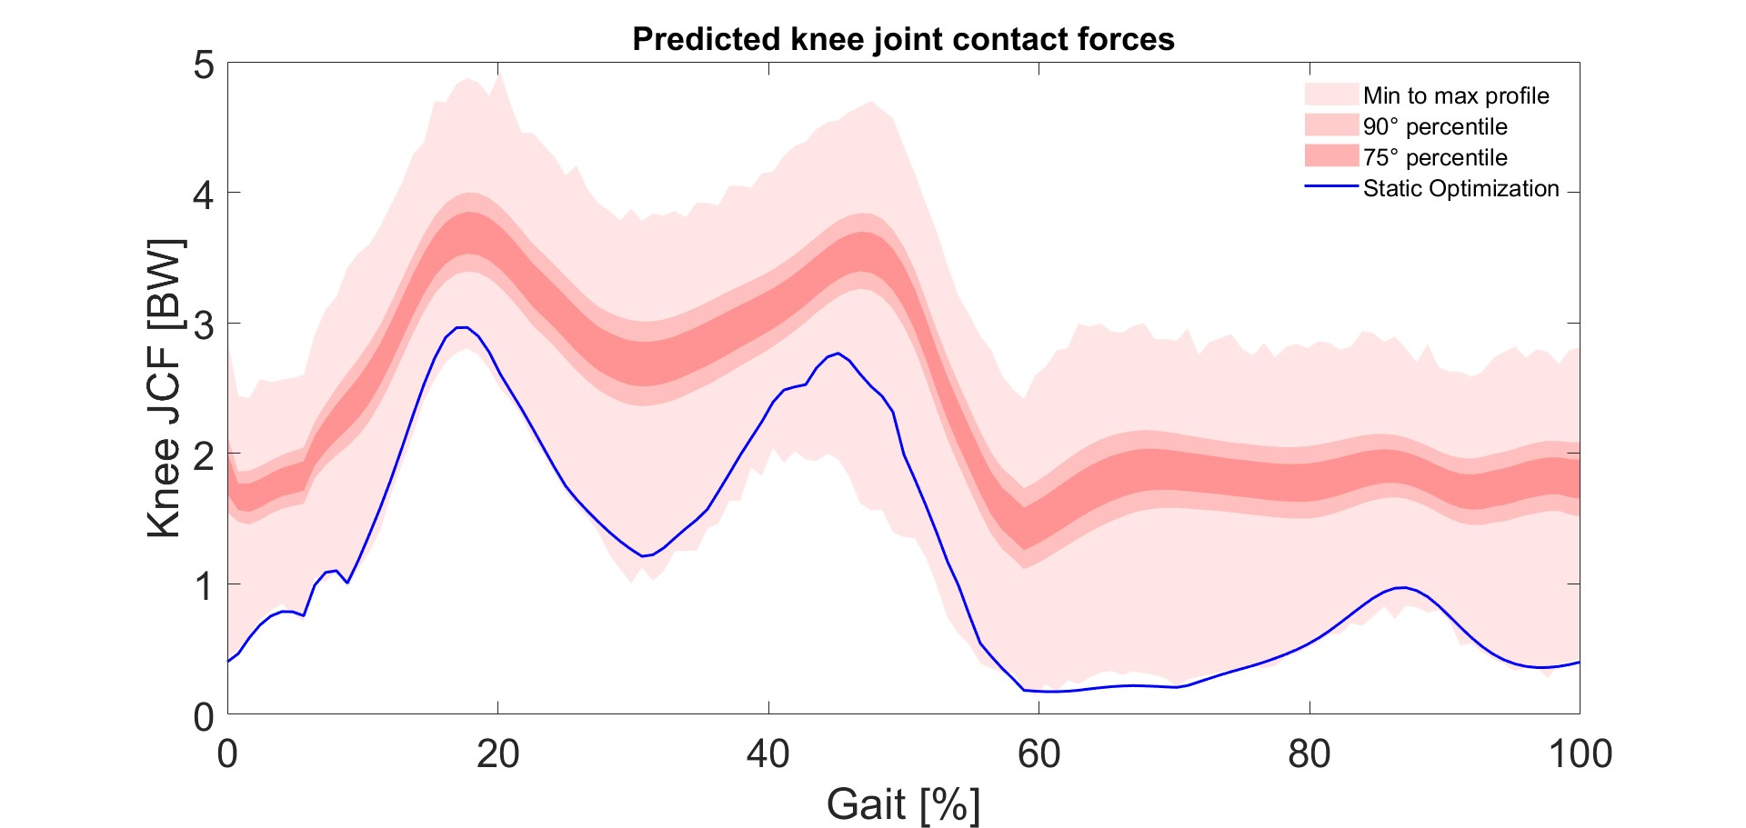
Myobolica: overview
A novel stochastic approach to estimate a band of physiologically plausible solutions
Muscle forces and activations
800k
Digital twin of the musculoskeletal system
Bones and muscles from MRI
Kinematic data from motion capture
solutions

Slide 8
Myobolica on HPC
Sensitivity analysis on the two constitutive parameters
51 hours per simulation on local workstation for a single step…
…but we usually test three consecutive steps (i.e. gait cycles – from heel contact to heel contact)
Convergence analysis to identify the minimum number of consecutive steps to be simulated
51 x 3 x 800k = months
Request of 10 vCPUs (50 GB RAM), 2k hours on INFN cloud to parallelize the simulations
Request submitted: 27/05/2024

Slide 9
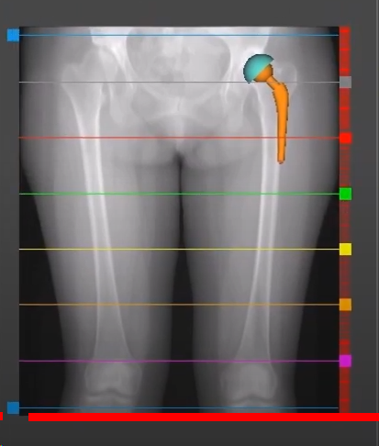
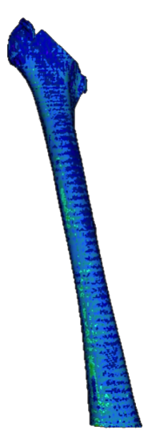
IST4JR: overview
Femur.stl
Implant.stl
CutPlane.stl
In Silico Trial for
Hip replacement designs
1
FE model
2
Mechanical Properties
3
Contact Analysis
F
HFValid dataset
Planning
Primary stability?
Information supporting new stem design
M_{i-f}
M_{p-f}
In house software
CTdata.DICOM
Patient-specific
Automatic pipeline
Notes:
Develop a computer model that can be used to estimate primary stability in hip replacements.
Develop an In Silico Trial solution that can be used to generate information supporting new device safety and/or effectiveness.

Slide 10
IST4JR on HPC
100 patients considering 3 different implant designs and 3 different surgical poses.
Sensitivity analyses (approximately 50 for each configuration).
Each simulation requires > 3 hours with approx 30 GB RAM and 4-6 cores.
Request in preparation (end of June 2024)
Target HPC: Galileo100
Automation and porting of the pipeline
In Silico Trial pipeline
Incidence of aseptic loosening in virtual cohorts

