Slide 1


Centro Nazionale di Ricerca in HPC, Big Data e Quantum Computing​
Gruppo di lavoro inter-istituzionale per la standardizzazione di dati sanitari e servizi
Serena Moscato, Sabato Mellone, University of Bologna
Plenaria Spoke 8, Bologna, 25 Giugno 2024
ICSC Italian Research Center on High-Performance Computing, Big Data and Quantum Computing
Missione 4 • Istruzione e Ricerca
Notes:
Cover

Slide 2
Background and general objective
Why inter-institutional: to make synergies between the three projects (ICSC, AHDB, and DARE) to create a common approach for clinical data processing, in terms of standards, formats and exposed services
Need: To set up certified and appropriately configured tools to enable the use and reuse of clinical data for biomedical research purposes within the limits dictated by current laws
Common goal
ICSC: to understand data anonymity, who is the data controller and/or processor, impossibility of working directly with non-anonymised data – these aspects are particularly relevant in biomedical research
DARE: development of tools for primary, secondary, and tertiary prevention, usually on large amount of data (e.g., public health monitoring, data management models for particular populations, continuous monitoring) – need for large computing power
AHDB: allows researchers from UNIBO and the three research hospitals in Bologna to collect and access large volumes of health data in compliance with legal, organizational, and regulatory requirements

Slide 3



Background and general objective
General objective: To define how an entity, such as AHDB, and resource and service providers such as CINECA and INFN (ICSC) can interact in a structured manner being compliant with the current laws

Slide 4
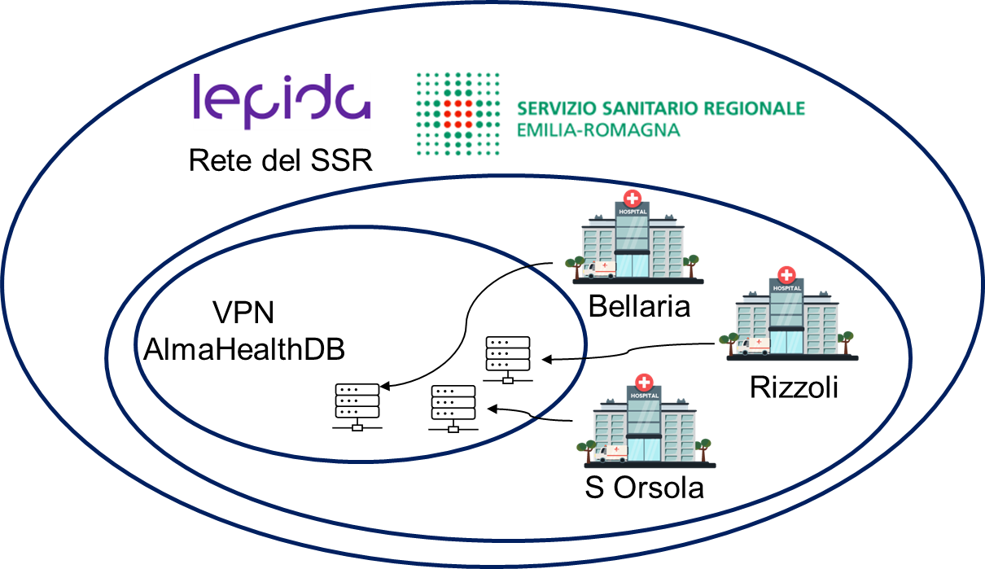
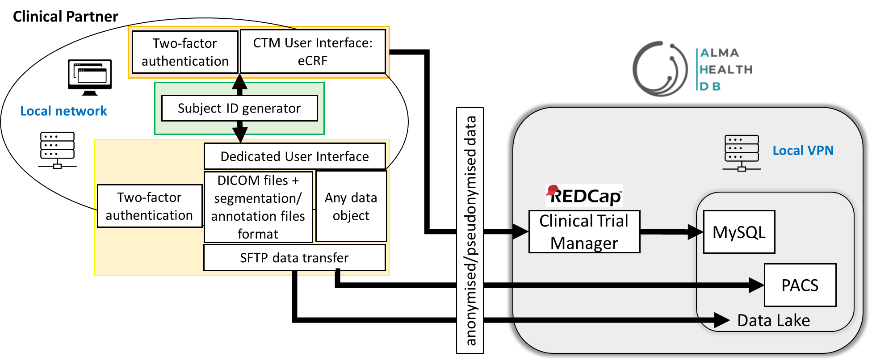
AlmaHealthDB
AHDB is a procedural infrastructure designed to enable the use and reuse of clinical data for biomedical research purposes, in compliance with the current laws
Inter-institutional project between University of Bologna and the three IRCCS in Bologna (Rizzoli, S. Orsola, Bellaria)
AHDB machines are positioned within the regional health service network managed by Lepida

Slide 5

DARE – Digital Lifelong Prevention
A national strategic initiative funded by the Ministry of University and Research (MUR) for the years 2022-2026 as part of the National Plan for Complementary Investments to the PNRR - Decree Law No. 59 of 6 May 2021, converted and amended by Law No. 101/2021 "Research initiatives for innovative technologies and pathways in the health and care sector" ​
Its main objective is the valorization of health data
A public-private partnership aimed at studying, coordinating and implementing innovative digital health solutions in Italy with a specific focus on primary, secondary and tertiary prevention: from mitigation of health risks to disease monitoring

Slide 6
2 implementation scenarios
Scenario #1 (short-mid term)
Scenario #2 (long term)

Slide 7
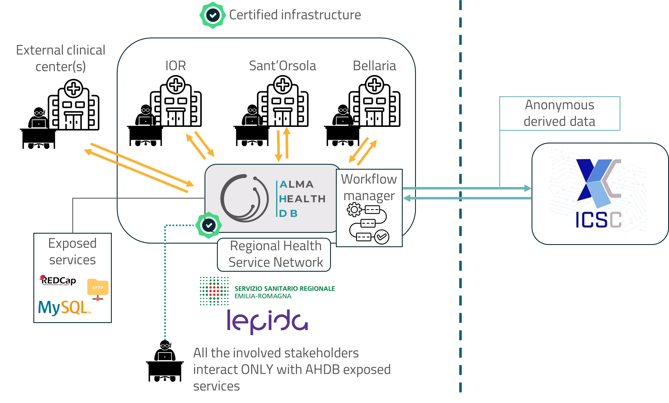
Scenario #1 (short-mid term)
Data is managed by data processors and controllers (on the left side), within a certified and authorized infrastructure (i.e., AHDB), while the EPIC INFN + Cloud Secure CINECA received only anonymous derived data
All the services are exposed by AHDB (data ingestion, processing, transformation, and anonymization)
A transfer mode (including authentication modalities) is defined, allowing the data to be shared externally (ICSC)
Notes:
Fare in modo che il workflow manager stia alla frontiera e che le frecce passano attraverso il workflow manager
I ricercatori, sanitari e non, interagiscono solo con l’infrastruttura e i servizi a sinistra, a destra ci sono solo dei processi standardizzati senza interfacce utente.
Il ricercatore non accede all’interfaccia di CINECA, per esempio.
In questo modo, non si pongono problemi per la creazione delle interfacce lato centro nazionale. Non è banale, ma è un obiettivo raggiungibile nel medio termine

Slide 8
Scenario #1 (short-mid term)
AHDB has also a workflow manager
Authentication and exchange modalities (formats, standards) agreed between the AHDB and ICSC
Two modalities for the workflow management:
  Dynamic management: ICSC receives anonymized data and decides how to sort data to be processed by the different entities within ICSC
  Static management: All the management is in charge of AHDB, which decides to which entities to send data to

Slide 9
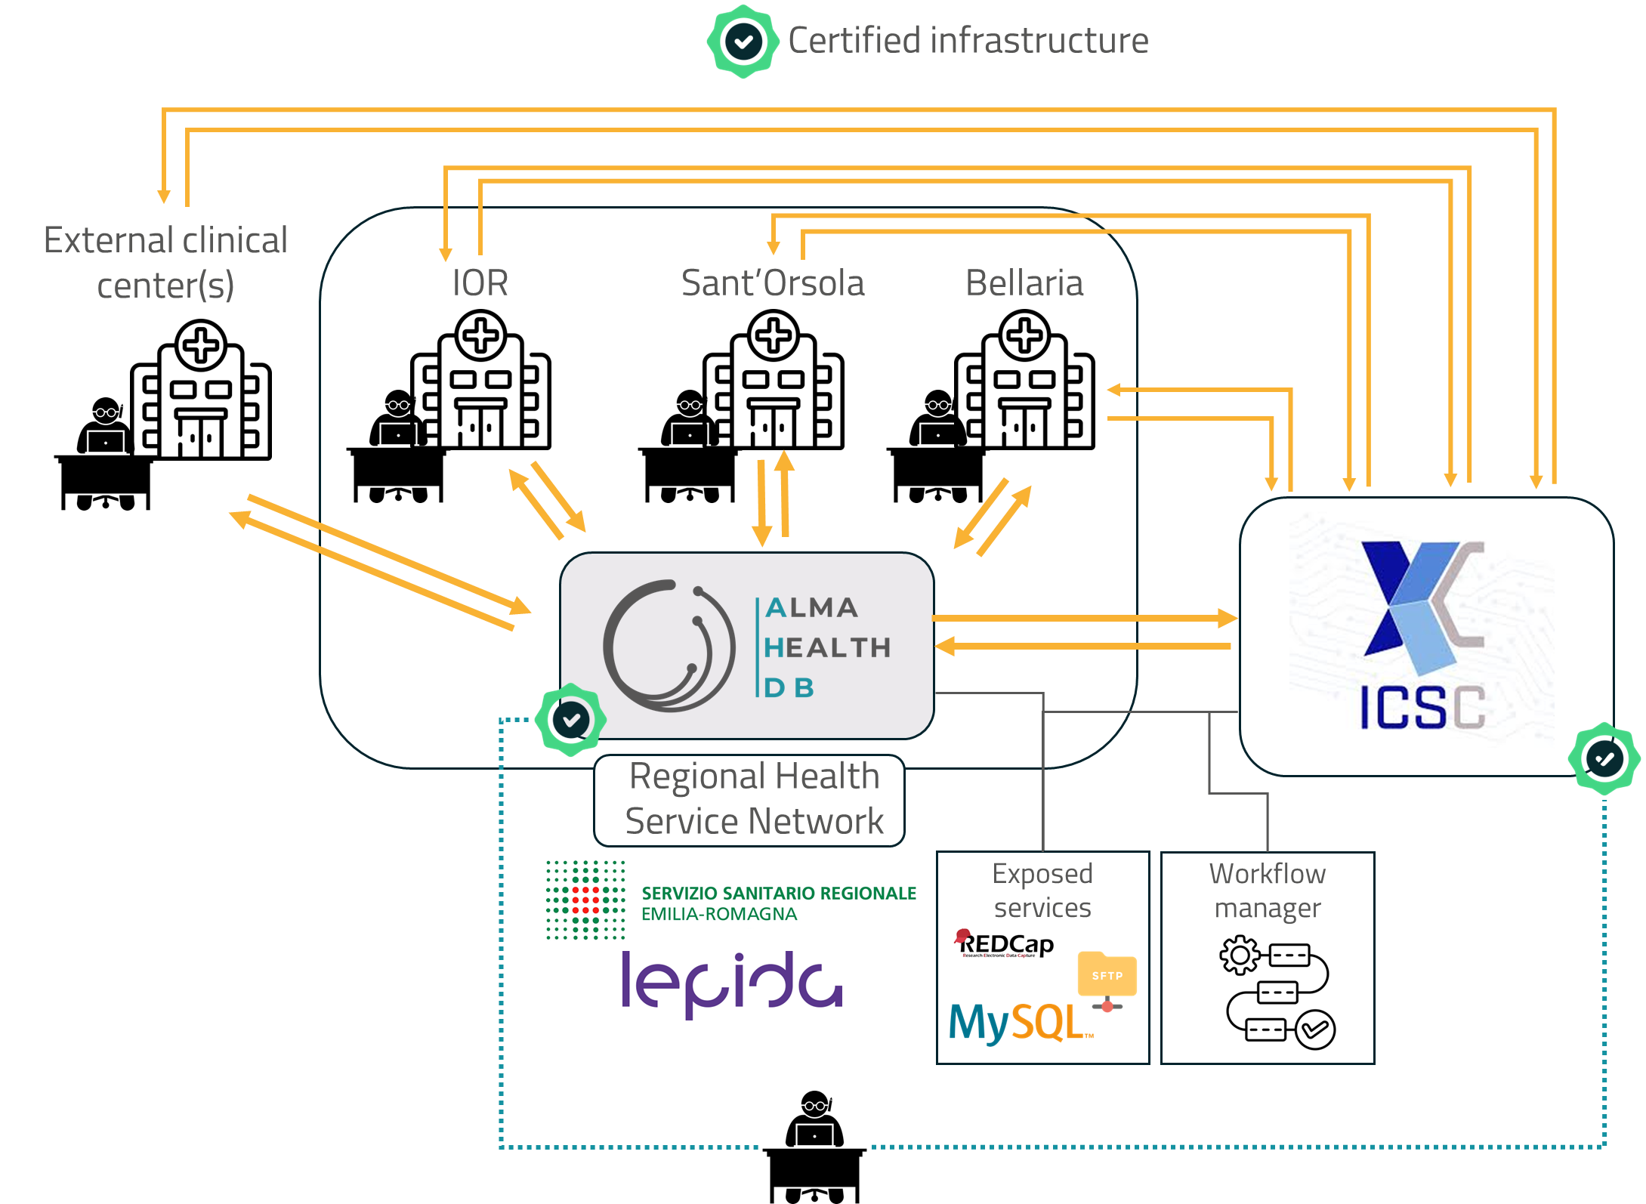
Scenario #2 – long-term
The ICSC becomes a certified infrastructure, so sensitive data can be sent directly to the ICSC platform
No more rigid separation between AHDB and ICSC – ICSC entities can be data processors too
Services can be exposed both by AHDB and ICSC
For the workflow manager, the preferred option is the static management. The long-term objective is to evolve towards a more dynamic management
Notes:
Anche ICSC può essere responsabile del trattamento dei dati, quindi possono trattare i dati anche non anonimi.
Per questo, è possibile esporre una serie di servizi, dalla data ingestion in poi, per cui le persone possono direttamente sfruttare quelle interfacce e servizi senza necessità di intermediazione.
Sono possibili anche gli scenari in cui non c’è bisogno di passare da AHDB.
Quando conviene che ci sia AHDB, ok c’è. Quando non è necessaria, è possibile l’accesso diretto e la configurazione diretta dei servizi direttamente in ICSC.
Potendo funzionare in maniera distribuita che in modalità user-provider, è possibile gestire le risorse in maniera dinamica su ogni singolo progetto.
Questo si svilupperà nel tempo, necessita di vari passaggi intermedi (certificazione delle risorse del centro di calcolo).

Slide 10
First milestone
Scenario #2 to be developed in parallel with the use of Scenario #1
  REDCap configuration on ICSC resources
  Authentication performed on a multitenant, secure, and high reliability Keycloak
Roadmap:
  User group definition to be configured on Keycloak and authorization tree
  Keycloak deployment with secure configuration, multitenancy support, and 2FA enablement
  Deployment of REDCap in secure and high reliability configuration

Slide 11



