Slide 1
WP6@UNICT
Development of a high-performance drug repurposing system for non-communicable diseases

Slide 2
POLE
MUTATIONS

Slide 3

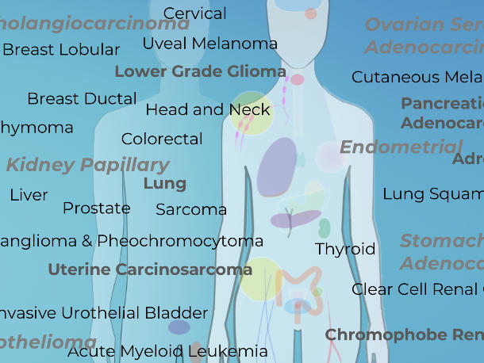
6.1 Gene POLE Network for survival stratification
No unify data concerning samples and
diseases
sample_1-mutations.tsc
sample_1-mutations.tsc
sample_2-mutations.tsc
sample_2-mutations.tsc
sample_3-mutations.tsc
sample_3-mutations.tsc
……………….
……………….
sample_k-mutations.tsc
sample_m-mutations.tsc
sample_1-mutations.tsc
sample_1-mutations.tsc
sample_2-mutations.tsc
sample_2-mutations.tsc
sample_3-mutations.tsc
sample_3-mutations.tsc
……………….
……………….
sample_q-mutations.tsc
sample_j-mutations.tsc
sample_1-mutations.tsc
……………….
sample_t-mutations.tsc

Slide 4

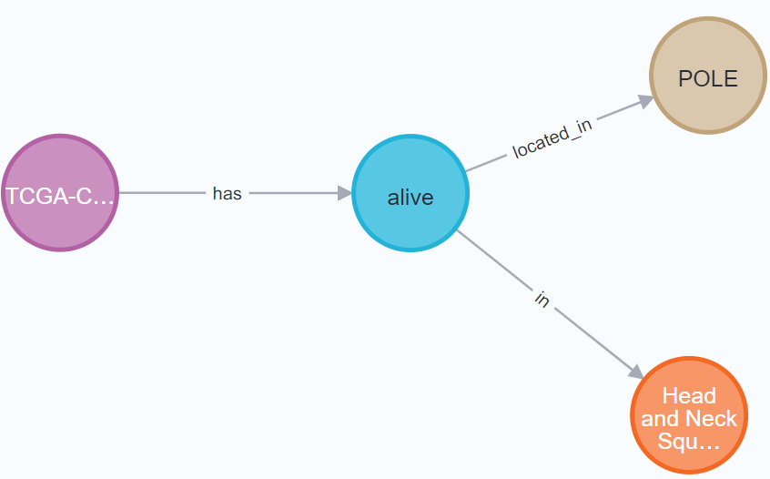
6.1 Gene POLE Network for survival stratification
Goal: Apply several artificial intelligent algorithms and mechanisms to detect pattern of genetic mutations (also related to POLE gene) for featuring in patients' survival. We need to grouping all the data…
Two main phases have been implemented:
1. Collapsing of sample-mutations files as nodes and edges of a graph
mutation
disease_mutations
Transformer
sample
disease

Slide 5



6.1 Gene POLE Network for survival stratification
1. Collapsing of sample-mutations files as nodes and edges of a graph
mutation
Algorithms applications
Centrality measurements for detecting the most relevant genes mutations within the network. These are important for understanding if there are some correlations among diseases.
Community detections for identifying groups of mutations into the network according to the connections among diseases, mutations, patients, etc. Such groups will be used for featuring in patients’ survival
disease_mutations
sample
disease

Slide 6
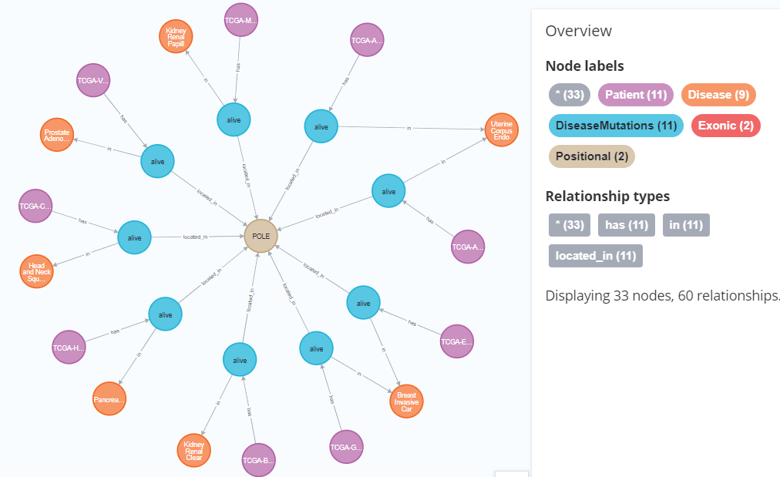

6.1 Gene POLE Network for survival stratification
Example
Look for patients having different diseases, but the same POLE exonic mutation

Slide 7


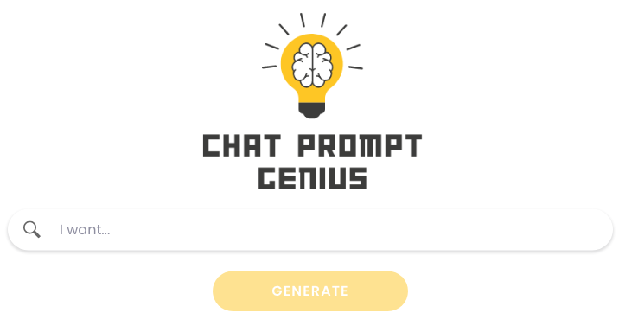
6.1 Gene POLE Network for survival stratification

Slide 8

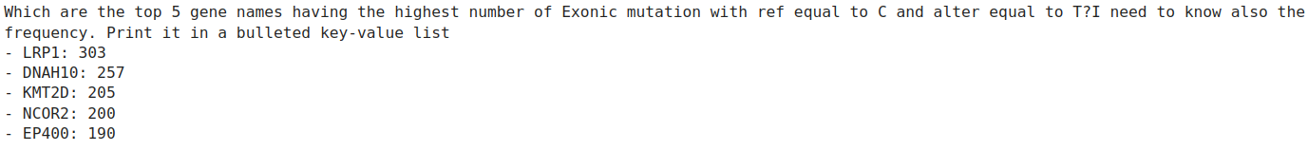
Esempi
Trunked…

Slide 9
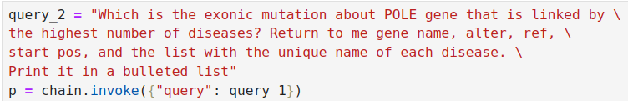
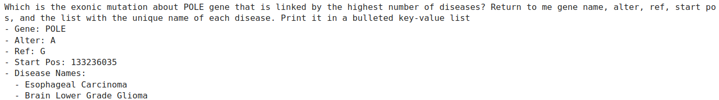
Esempi
Trunked…

Slide 10

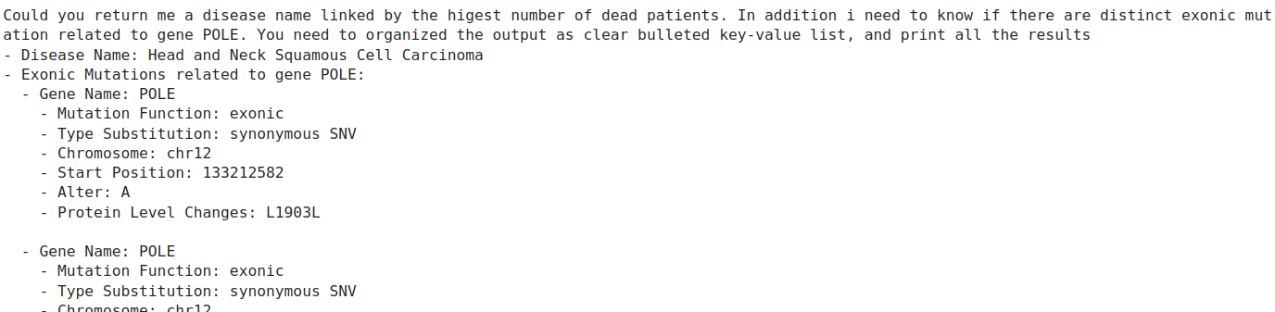
Esempi
Trunked…

Slide 11
DRUG
REPURPOSING

Slide 12
6.2 Drug Repurposing on Cell lines (integration of knowledge from LINCS-TCGA)
Through the Transcriptome Signature Reversion (TSR) it is possible to identify drugs eligible for the specific disease under study. It employs anti-complementary patterns to regularize the genic expression. In this way it is possible to understand which drug its feasible as therapeutic indication for the patients with that pattern.
In that regard, we implemented TRS-System, a high-performance drug repurposing model. The algorithm consists of three phases:
1. Disease signature computation: The gene expression profile associated with the disease in question is determined.
- limma is usually used
- done on-line
  2. Drug signature calculation: The gene expression profile induced by different drugs is established.
    - done off-line
    - time consuming task
  3. Connectivity score (inversion of the transcriptome signature): is measured how well the gene expression profile induced by a drug can reverse the disease one, using the connectivity score.
Koudijs KKM, Böhringer S, Guchelaar HJ. Validation of transcriptome signature reversion for drug repurposing in oncology. Brief Bioinform. 2023 Jan 19;24(1):bbac490. doi: 10.1093/bib/bbac490. PMID: 36445193; PMCID: PMC9851289. https://doi.org/10.1093/bib/bbac490

Slide 13

Library of Integrated Network-based Cellular Signatures (LINCS)
  LINCS is a program under the NIH Common Fund.
  It catalogs the global response of human cells to chemical, genetic, and pathological perturbations.
  The core of the LINCS project is the use of L1000 technology, a platform that enables the measurement of gene expression across a wide range of cell lines and experimental conditions (Level 4 data differential expression).
Genes: 10,174
Drugs: 3,222
Cell lines: 76
RNA plates: 3,613
Experiments: 402,321
Disturbance times: 6h, 24h
Dose: 10 μM
Parameters provided by the filtered LINCS dataset
Notes:
Il calcolo della DEG è improntato sul livello 3 del dataset LINCS.
Per calcolare la DEG è necessario confrontare un tessuto sottoposto all’azione del farmaco e uno di controllo al quale non è stato applicato alcun perturbante ma solo il veicolo di controllo.
L’analisi non è stata eseguita sull’intero livello 3 del dataset LINCS, ma sono stati scelti gli esperimenti con tempo di perturbazione 6h e 24h e dose pari a 10 μM.
Inoltre, i farmaci testati in meno di 5 linee cellulari sono stati eliminati a causa della ridotta dimensione del campione, che implica una scarsa generalizzabilità.
l’elenco dei farmaci facendo l’intersezione tra i farmaci presenti negli esperimenti a 6h e a 24h ottenendo 3222 composti chimici.

Slide 14

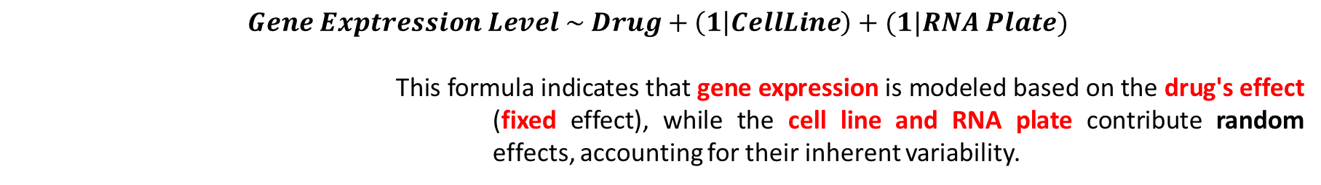
Mixed Linear Model (LMM)
In the context of the LINCS dataset analysis, the LMM is employed to evaluate how different conditions affect gene expression. This model is applied twice for each gene to assess the impact of two different perturbation durations: 6 hours and 24 hours.
Among the various parameters provided by the LINCS dataset, the ones that are significant for the LMM include:
  Drugs: Serve as a fixed effect, as they directly affect gene expression.
  Cell Lines: Contribute random effects based on their unique characteristics.
  RNA Plates: Add variability and are treated as random effects due to differences in processing.
The gene expression levels are the dependent variable in this model. It is computed how the relationship among the factors previously listed. The LMM uses the following formula in R syntax:
$$Gene Exptression Level \sim Drug+\left(1 | CellLine\right)+(1|RNA Plate)$$
This formula indicates that gene expression is modeled based on the drug's effect (fixed effect), while the cell line and RNA plate contribute random effects, accounting for their inherent variability.

Slide 15

Implementation on a cluster of machine
The computation of the Mixed Linear Model has been done using Julia through the BLAS linear algebra module. The algorithm exploits parallel computation.
The BLAS module has been run on top of a cluster with 32 nodes and 128GB RAM.
Considering that each computation requires about 15GB of ram, the best configuration was as follows:
  - 8 parallel computations, 4 processors per computation.
  With this configuration, an average calculation time of 38/39 seconds per gene was obtained.
  For basic and easy repurposing are necessary 150 genes. Since we are considering two different perturbation times, 6h and 24h, 300 gene expression values have to be computed.
  The original model took 2.5 months to complete the task.
  Our system requires 3 hours and 20 minutes. We have thus obtained an efficient system that allows us to calculate the DEG with the LMM approach in a few hours.
Results stored in db

Slide 16
Connectivity score
It measures a drug’s ability to reverse gene expression in diseased tissue to resemble healthy tissue.
  Based on the work of Justin Lamb et al. but uses the alternative method by Chen B. et al.
  Algorithm Output: Produces a ranked list of drugs based on the similarity between differentially expressed genes in diseased tissue and drug-treated tissues.
Score Interpretation:
Positive score: Drug signature mimics the disease effect (genes similarly expressed).
Negative Score: Drug signature is opposite to the disease effect (genes oppositely expressed).
Score range: -1 to 1, indicating the extent of similarity or dissimilarity.
Lamb, Justin, et al. "The Connectivity Map: using gene-expression signatures to connect small molecules, genes, and disease." science 313.5795 (2006): 1929-1935.
Chen, Bin, et al. "Reversal of cancer gene expression correlates with drug efficacy and reveals therapeutic targets." Nature communications 8.1 (2017): 16022.

Slide 17
Example on repurposing on ALS custom samples
samples | tissue | tissue_status
GSM4659163 | Spinal Cord Lumbar | ALS Spectrum MND
GSM4659164 | Spinal Cord Lumbar | Non-Neurological Control
GSM4659166 | Spinal Cord Lumbar | ALS Spectrum MND
GSM4659167 | Cortex Motor Lateral | ALS Spectrum MND
GSM4659168 | Cortex Motor Lateral | Non-Neurological Control
GSM4659165 | Cerebellum | ALS Spectrum MND
GSM4659165 | Cerebellum | Non-Neurological Control
Disease samples coming from three different tissues from ALS patients/controls
  Normalization of RNA-seq data
  Computation of the disease signature through the LMM

Slide 18
Repurposing Results
drug | gene_selection | perturbation_time | connectivity_score
Y-27632 | 50_most_significant | 6h | -0,813676471
ALW-II-38-3 | 50_most_significant | 24h | -0,77254902
BRD-A89067742 | 50_most_significant | 6h | -0,767941176
EI-273 | 50_most_significant | 24h | -0,750147059
ephedrine-(racemic) | 50_most_significant | 6h_24h | -0,749803922
SDZ-21009 | 50_most_significant | 24h | -0,731862745
dihydrexidine | 50_most_significant | 24h | -0,726372549
ephedrine | 50_most_significant | 24h | -0,724117647
fluocinolone-acetonide | 50_most_significant | 6h_24h | -0,719705882
raclopride | 50_most_significant | 24h | -0,715539216
7-hydroxy-PIPAT | 50_most_significant | 24h | -0,705196078
Y-27632 | 100_most_significant | 6h | -0,70513369
tyrphostin-AG-126 | 50_most_significant | 6h | -0,703235294
ALW-II-38-3 | 100_most_significant | 24h | -0,701782531
GR-144053 | 50_most_significant | 24h | -0,701029412

Slide 19
On going
Construction of a web app that allows the drug repurposing on user data from cell line, tissues (Bulk RNA-seq and sc-RNA-seq)

Slide 20
Gruppo
Research Group
  Alfredo Pulvirenti (Group Leader, Associate Professor)
  Salvatore Alaimo (RTDb)
  Antonio Di Maria (RTDa)
  Grete Privitera (Post-doc)
  Giorgio Lo Cicero (dottorando and scPhensim author)
  Giulia Cavallaro (dottoranda)
  Roberto Grasso (dottorando)
Collaboratori
  Ernestina De Francesco (RDTa)
Collaboratori esterni
  Istituto Oncologico Mediterraneo Ricerca (IOM Ricerca)
  Ilaria Cosentini (CNR)
Notes:
Nei vari progetti sono coinvolte diverse persone.
Specifica che al momento sei principalmente coinvolto nell’attività di augmentation delle pathway … (WP1) e nella classificazione (WP6)

Slide 21
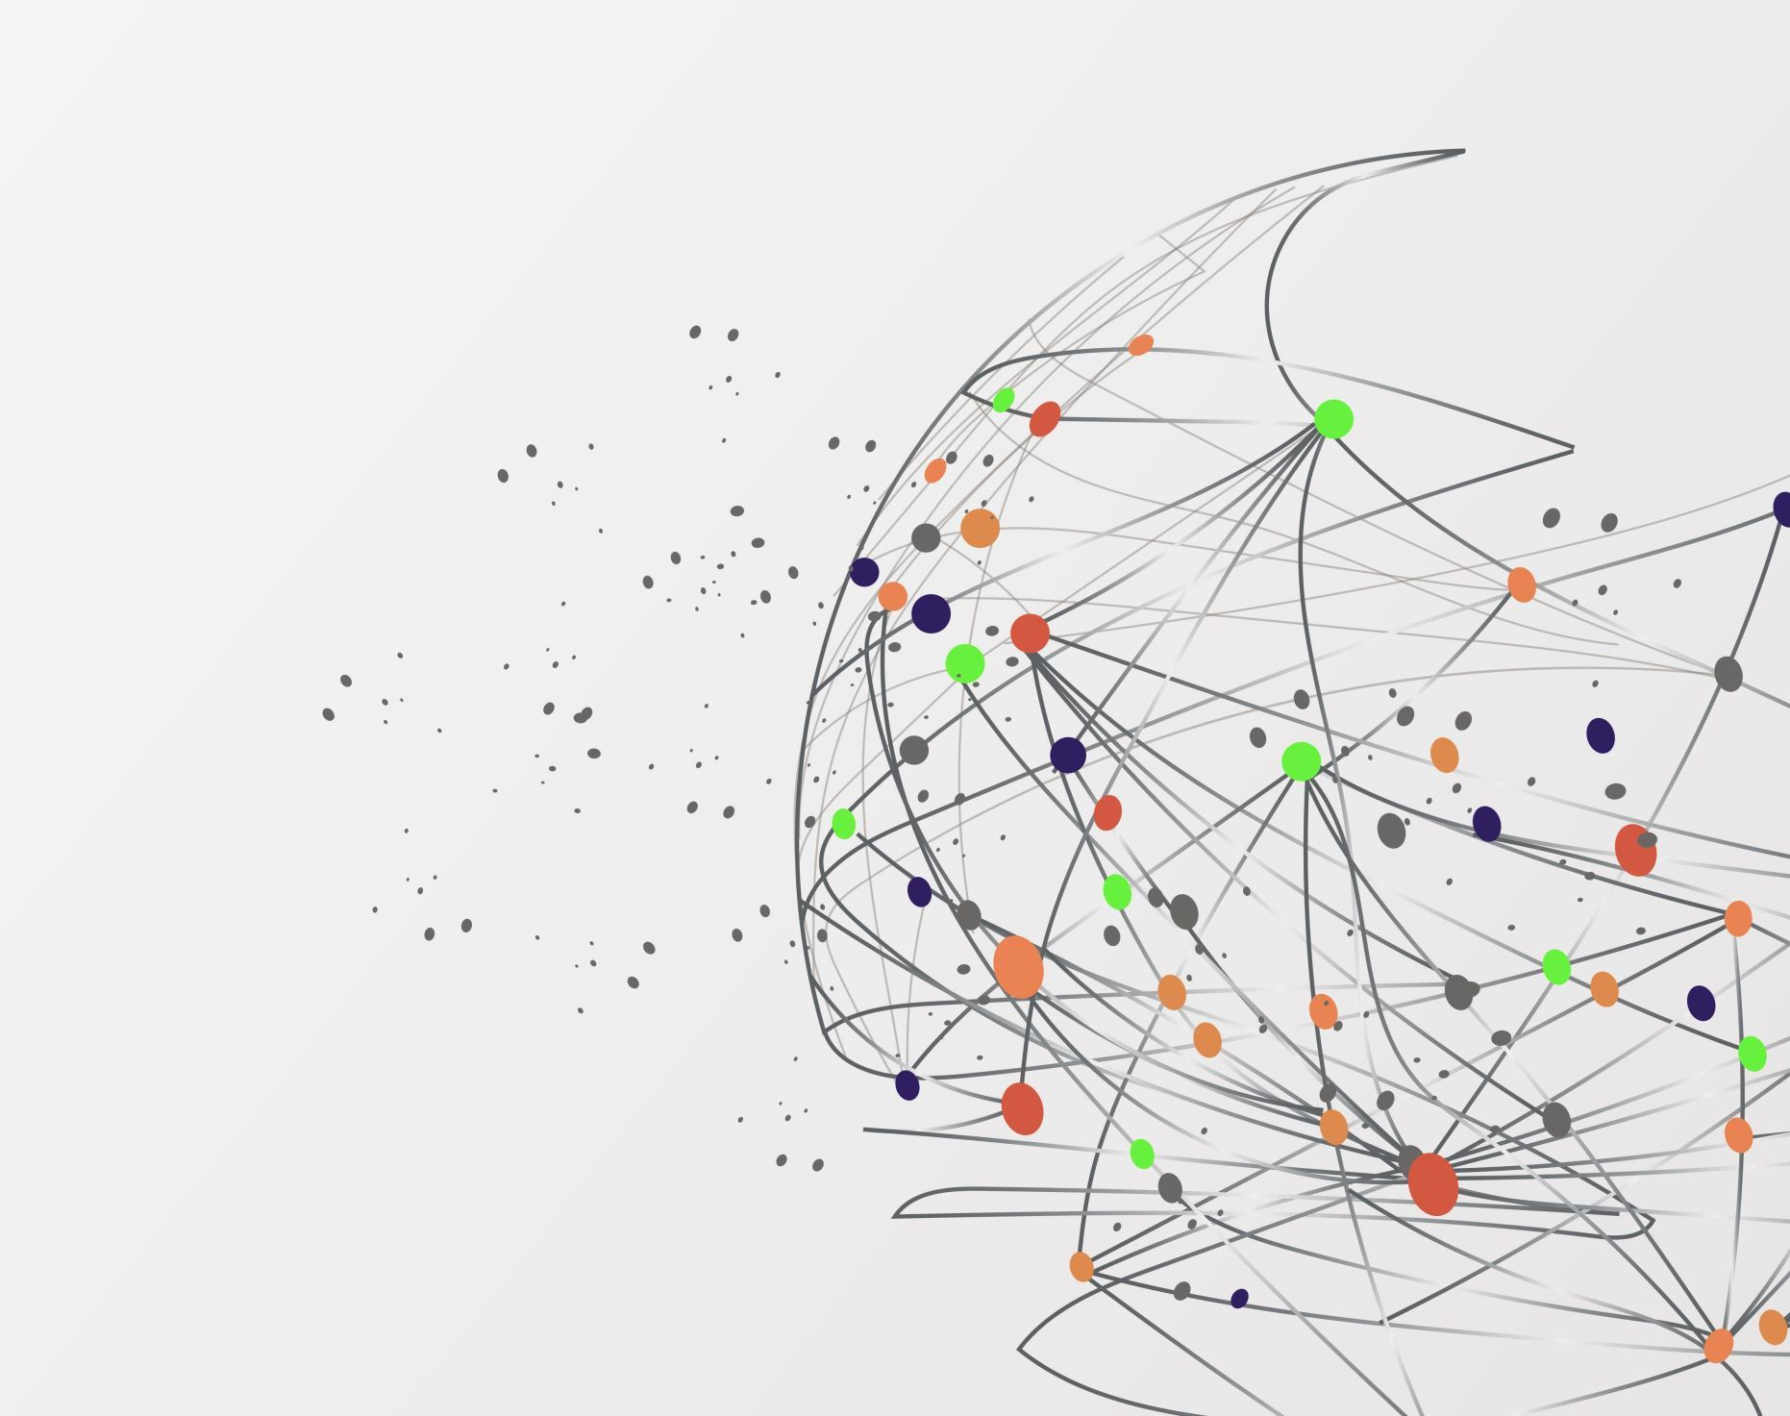
THANKS FOR THE ATTENTION

