Slide 1

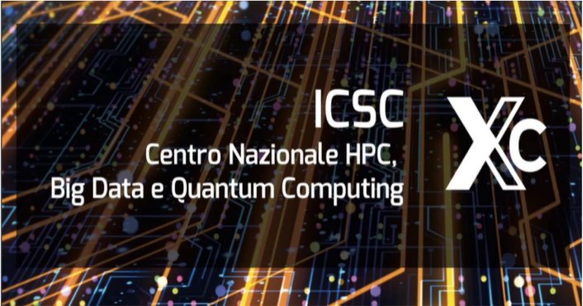


WP6. Drug-target studies and drug repurposing
Bologna 24-25 June 2024
Exploring the POLE variant F695V as a drug target/biomarker to unveil novel therapeutic strategies in cancer
Manuela Vecchi
Fabio Landuzzi
Stefania Girotto

Slide 2


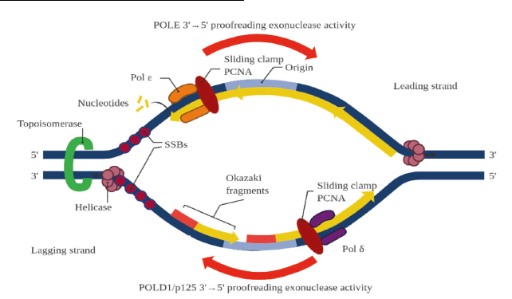
Case Report: Germline/Somatic WGS
Germline WGS
Somatic WGS
CRC
Age: 37
Pathogenic SNV in: APC, KRAS, TP53, CTNND2, SETD1B, TSC2
APC
BMPR1A
EPCAM
MLH1
MSH2
MSH6
MUTYH
NTHL1
PMS2
POLD1
POLE
PTEN
SMAD4
STK11
TMB (TMB/Mb) | MSS (%)
10.15 | 0.12
TMB borderline
MSS (stable)
TMB-High cut-off: ≥ 10 mutazioni/Mb
MSI-High cut-off: ≥ 3.5%
Identification of a VUS in the DNA polymerase epsilon gene (POLE) in position F695V
POLE and POLD1 encode the catalytic and proofreading subunits of DNA polymerase ε and polymerase δ, and play important roles in DNA replication and proofreading
POLE LP/P variants:
Increase base substitutions
Collapse of replication fork
DNA polymerase ε (POLE) is a major DNA polymerase, responsible for synthesizing the leading strand during DNA replication
Production of DNA DSBs
Repair deficiency during DNA replication
Notes:
POLE and POLD1 encode the catalytic and proofreading subunits of DNA polymerase ε and polymerase δ, and play important roles in DNA replication and proofreading

Slide 3

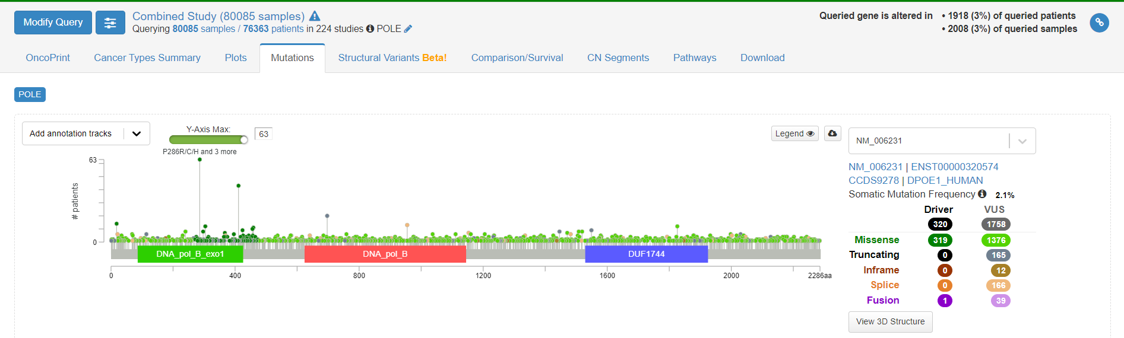
Variants Identified in POLE in Cancer
POLE:c.2083T>G pF695V
F695V is located within the DNA_pol_B domain of POLE

Slide 4
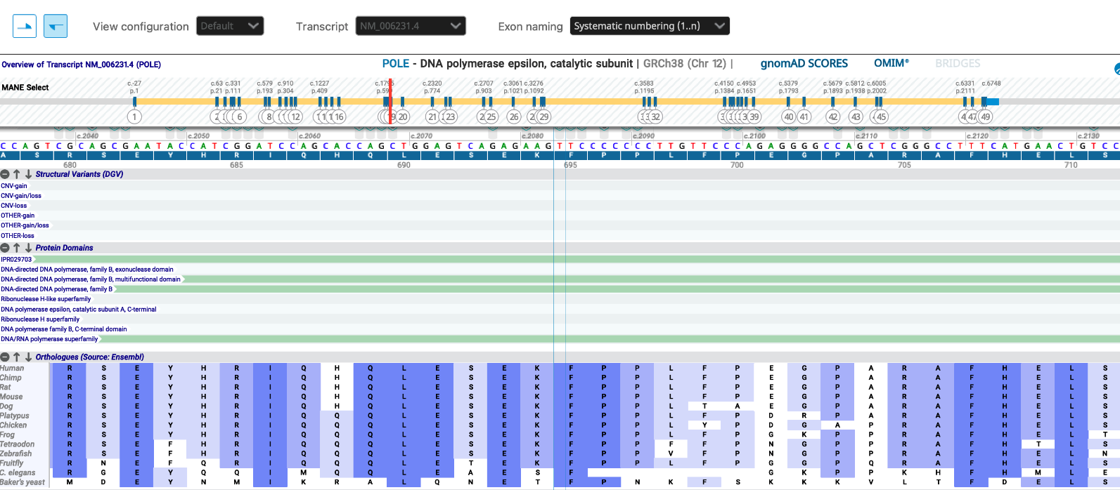
POLE p.F695 is highly conserved from yeast to humans

Slide 5
POLE insufficiency is known to cause developmental abnormalities in humans^{18–20}, and drive replication stress and genomic instability in mice and C. elegans^{21,22}, which is generally attributed to insufficient origin firing.
1. Logan, C. V. et al. DNA polymerase epsilon deficiency causes IMAGe syndrome with variable immunodeficiency. Am. J. Hum. Genet. 103, 1038–1044 (2018).
2. Pachlopnik Schmid, J. et al. Polymerase ε1 mutation in a human syndrome with facial dysmorphism, immunodeficiency, livedo, and short stature (‘FILS syndrome’). J. Exp. Med. 209, 2323–2330 (2012).
3. Frugoni, F. et al. A novel mutation in the POLE2 gene causing combined immunodeficiency. J. Allergy Clin. Immunol. 137, 635–638.e1 (2016).
4. Bellelli, R. et al. Polε instability drives replication stress, abnormal development, and tumorigenesis. Mol. Cell 70, 707–721.e7 (2018).
5. Bellelli, R. et al. Synthetic lethality between DNA polymerase epsilon and RTEL1 in metazoan DNA replication. Cell Rep. 31, 107675 (2020).

Slide 6
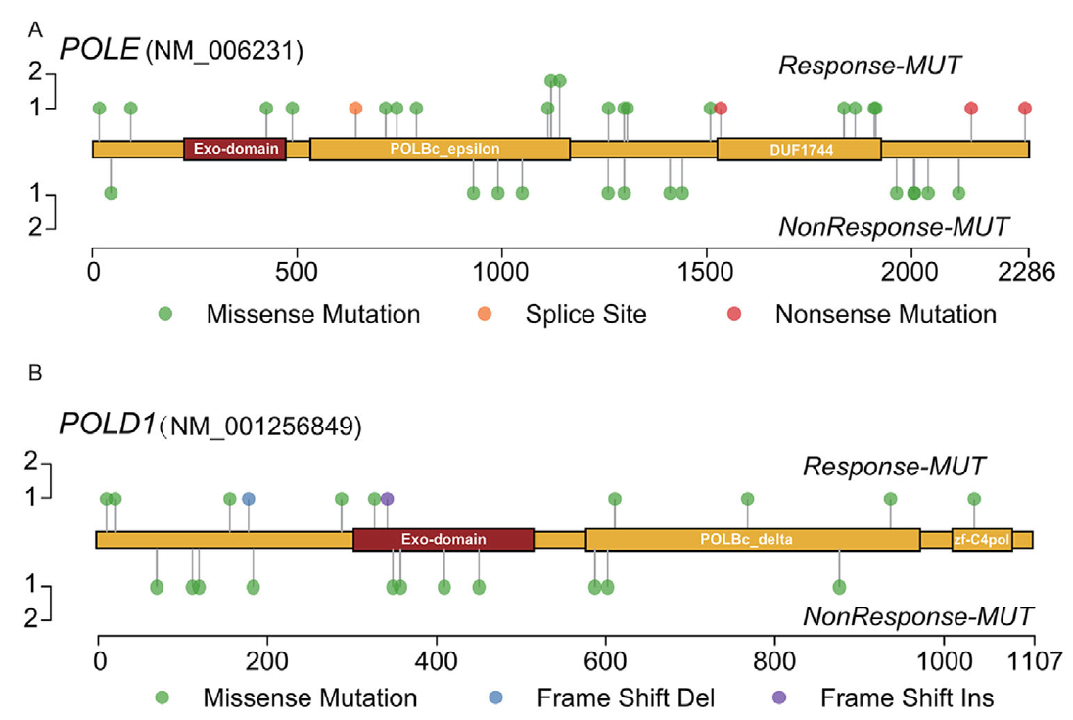
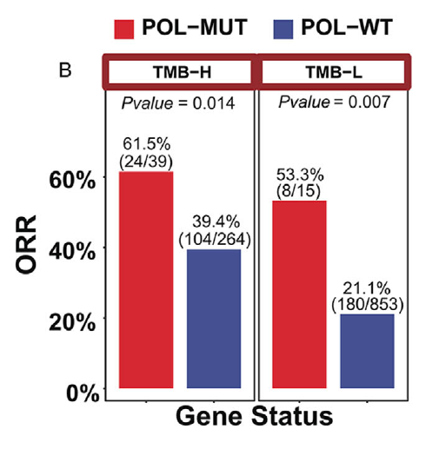
POLE/POLD1 mutation in non-exonuclease domain matters for predicting efficacy of immune-checkpoint-inhibitors
Both unselected POL-MUTs and POL-non-EDMs could serve as biomarkers in screening responders in ICI treatments
in addition to POL-EDMs in integrated cohorts containing 2862 cancer patients receiving immunotherapy;
POL-non-EDM is associated with an activated immune response, even in low-TMB tumors, suggesting that some POL-MUTs might be able to trigger an immune response via some patterns independent of hypermutant status, such as serving as neoantigens with high immunogenicity and directly connecting to immune pathways such as some DDR pathways.
Clin. Transl. Med. 2021;11:e524

Slide 7
Functional Characterization of VUS Variants Identified in POLE
POLE:c.2083T>G pF695V
F695V is located within the DNA_pol_B domain of POLE
Biophysical-structural analyses and molecular dynamics structural predictions
Functional genomics using experimental eukaryotic model organisms
Biophysical-structural analyses and molecular dynamics structural predictions

Slide 8

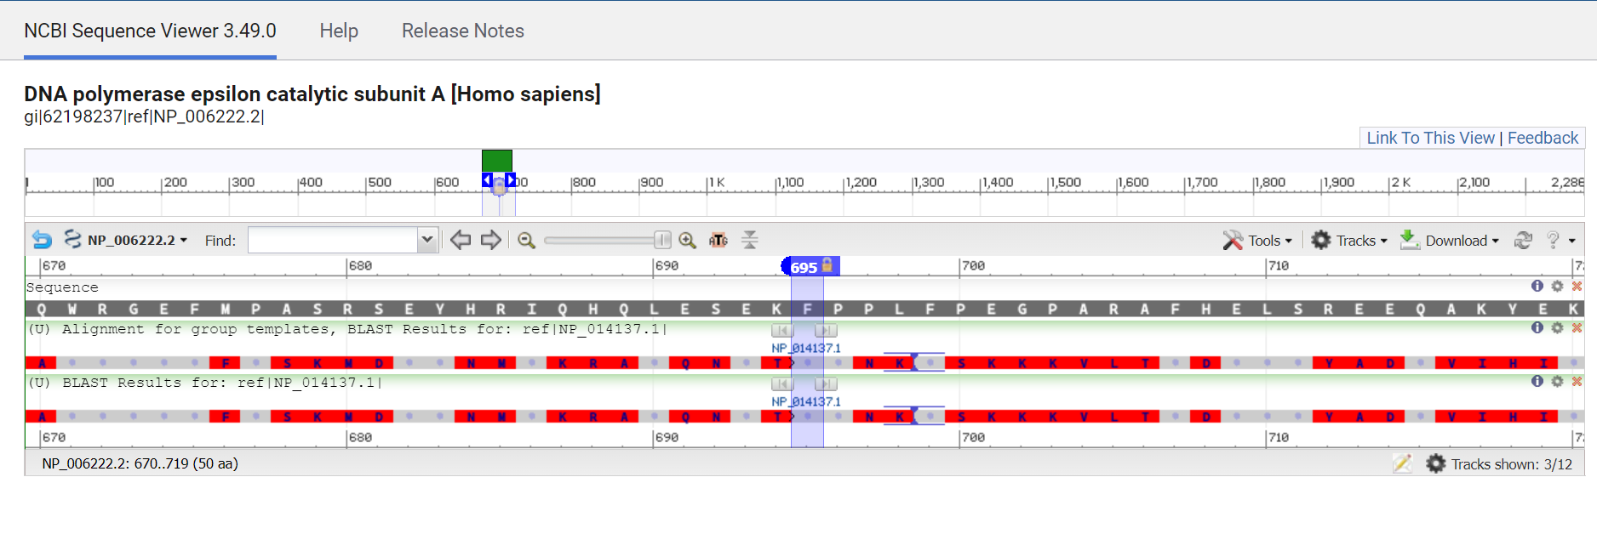
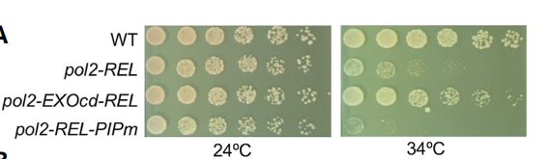

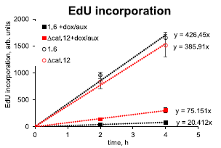
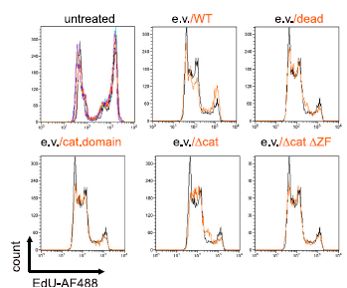
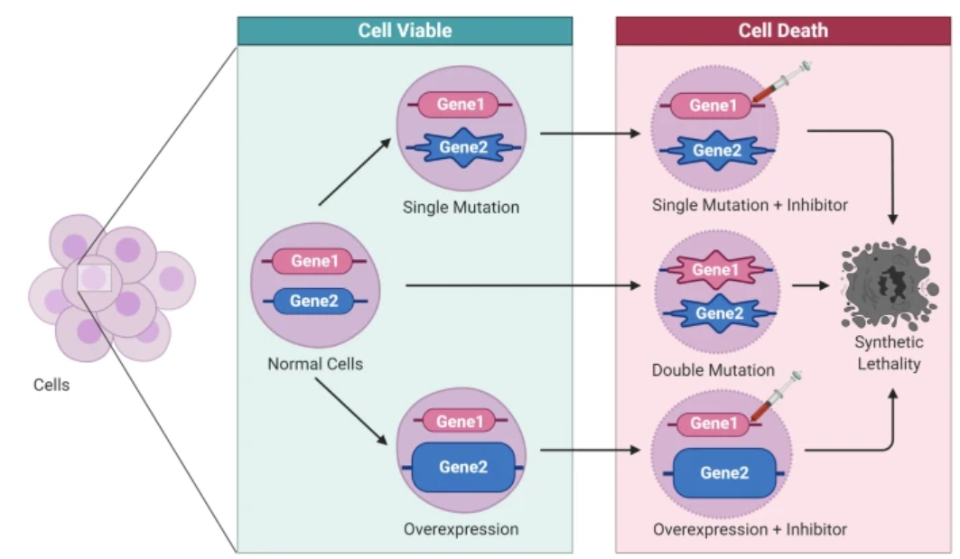
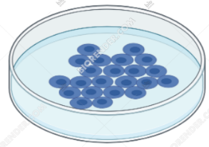
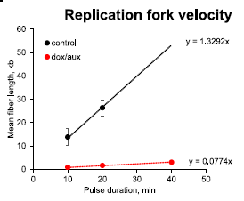
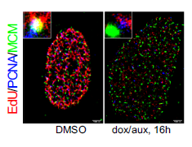
Functional Studies of POLE F695V in Experimental Model Systems
Yeast as model organism
Mutagenesis of Pol2 in the nucleotide corresponding to that of the human gene
Yeast-based
in vivo functional assays
Pol2 yeast ortholog of hPOLE
Human POLE
Growth assays
Drug sensitivity (HU, DNA damaging
agents, etc.)
Yeast Pol2
Meng et al. Nat. Comm. 2020
Meng et al. Genes & Dev. 2023
Giordano Liberi
U2OS cell line
human osteosarcoma
In vivo functional assays
Identification of synthetic lethal interactions
with CRISPR technology
+
Gene editing of POLE using CRISPR
Vipat et al. Nat. Comm. 2022
Francesco Nicassio
Notes:
The knowledge of individual genetic variants is not sufficient for determining the causality or predisposition to a particular disease without a clear picture of the impact of the genetic variants on the protein activity.
Even though computational methods are considered a valid tool in clinical practice for interpreting genetic variants [3], they
have limited predictive power [4–6]. This approach is not sufficient for explaining the complexity of human diseases because it focuses only on the protein without considering pathways and interactions inside the cell. The other approach is based on the use of model
organisms (MOs) such as yeast, worm, fly, zebrafish, and mouse.
The budding yeast Saccharomyces cerevisiae has been an excellent model system for the study of DNA replication.

Slide 9
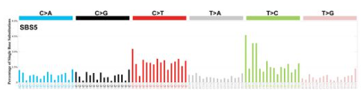

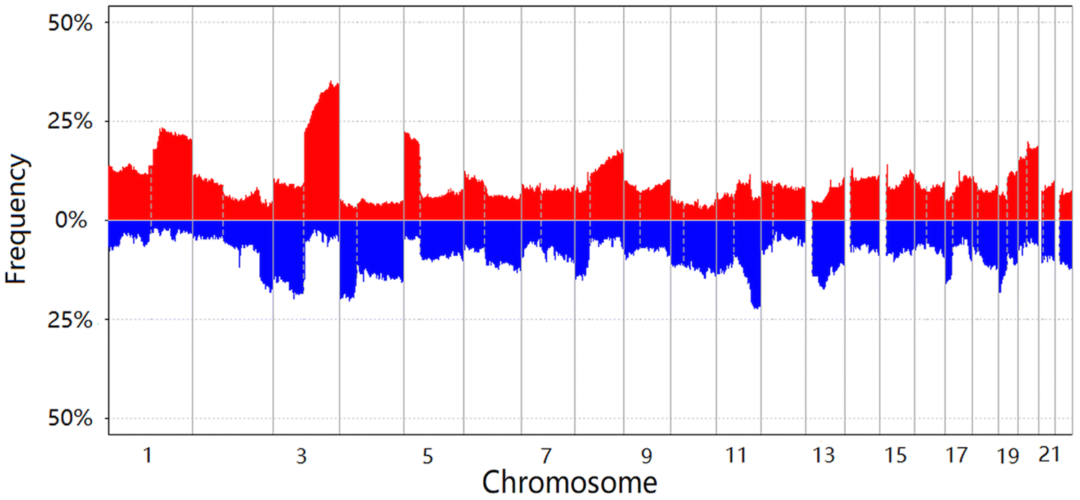
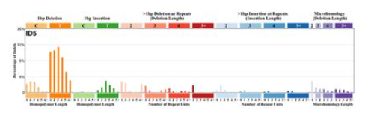
Characterization of Variants of Unknown Significance (VUS) in POLE
Clustering of variants in the 3 main different protein domains
Select POLE variants predicted
P/LP by AlphaMissense located in the 3 different domains (EXO, DNApolB and C-terminus)
In-depth analysis of mutational signatures
present in tumors with variants predicted P/LP
in POLE clustered in the 3 main protein domains

Slide 10
Functional Characterization of VUS Variants Identified in POLE
POLE:c.2083T>G pF695V
F695V is located within the DNA_pol_B domain of POLE
Biophysical-structural analyses and molecular dynamics structural predictions
Functional genomics using experimental eukaryotic model organisms

Slide 11

Recombinant POLE
PolE WT (1-1186) and F695V PolE mutant were expressed and purified in a recombinant form
Purified polE
Important issue! Polymerase and exonuclease activity always coexist. To favor polymerase over exonuclease activity, dNTPs are added at high concentrations.
However, at longer time points (20 min) exonuclease activity starts predominating.
Maximal primer
extension
Denaturing 15% TBE-UREA hand cast gel
Polymerase activity of the F695V mutant is slower than the activity of the WT enzyme
primer
Enzyme 10 nM
dNTPs 250 mM
MgCl2 5 Mm
Primer:template 100 nM
2-20 min @35 °C
Degradation
products
Notes:
Nel laboratorio di Genova diretto da Stefanoa Girotto, sono stati condotti degli esperimenti in vitro per valutare l’impatto funzionale delle mutazioni nel dominimo polimerasico della POLE. Come già riportato nel precedente meeting plenario si è espresso la subunità 1-1186 che include sia il dominio esonucleasico che il dominio polimerasico per la proteina wild-type e per il mutazante F695V, ovvero la mutazione trovata nel paziente che vi ha descritto precedentemente Manuela. Questa subunità è stata espresso e putificata e qui potete vedere I risultati del western-blot. Successivamente con I composti putificati sono stati condotti di saggi funzionali per vedere in primo luogo la capacità del mutante di portare a termine la polimeizzazione del DNA. Come potete vedere dal gel a sinistra l’attività polimerasica è presente sia nel WT che nel mutante, quindi la Perdita di funzionalità non è completa.
Andando però a valutare l lunghezza dei frammenti sintetizzati si nota una differenza fra I due casi: mediamente la lunghezza di frammenti nel mutante risulta più corta risptto alla WT.
L’attività polimerasica dl mutante è quindi più lenta rispetto alla WT.

Slide 12

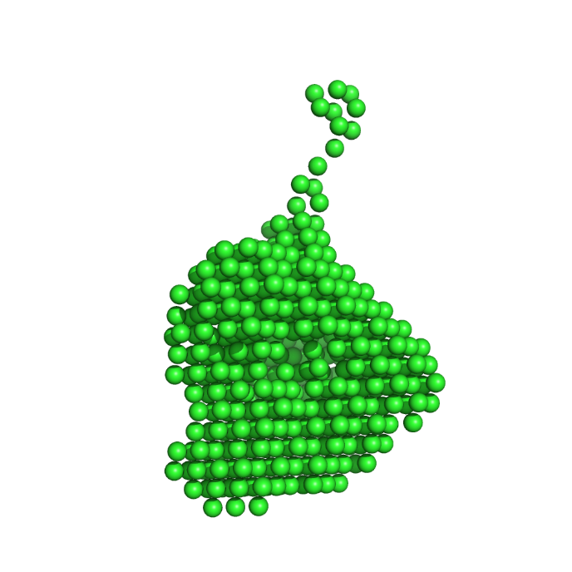
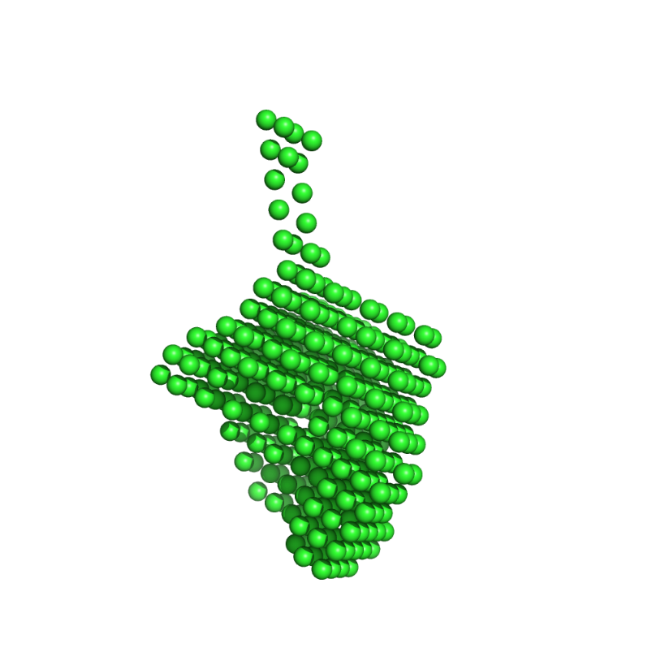
DNA Binding and structural information
Microscale Thermophoresis (MST) – DNA binding
Ab Initio Modelling (DAMMIN) –
SEC-SAXS -
DNA oligo: Cy5-polyT 30mer; 1 nM
buffer: 5 mM HEPES pH 7.8, 150 mM NaCl, 2.5% glycerol, 2 mM TCEP, 0.05% Tween-20
WT
F695V
Refine.cif
Both proteins have similar binding affinity for DNA
Slightly different shapes obtained by low resolution SAXS data
Modelling of SAXS data suggests that the mutant has a higher degree of flexibility compared to the WT
Notes:
Visto il rallentamento nell’attività di polimerizzazione, del mutante rispetto al WT, ci si è chiesti se questo fosse dovuto ad un binding meno efficace (?) con il DNA.
Per valutare questa eventualità si è quindi condotto un esperimento di microscale thermophoresis . Il quale però ha mostarto una simile affinità di binding fra WT e mutante.
Una ipotesi alternativa é che fosse la conformazione tridimensionale a rallentare l’attività polimerasica, si è quindi deciso di condurre degli esperimenti SAXS (Small Angles X-rays Scattering) appoggiandosi al laboratorio Diamond in UK per ottenere delle informazioni sulla struttura dei due composti. Dal dato SAXS è stato possibile tramite una modellizzazione ab-initio col software DAMMIN ricavare un set di cnformazioni bassa risoluzione compatibili con il dato sperimentale. Il risulatato ha evidenziato una leggera differenza fra i due composti. Il dato più interessante ottenuto da questa analisi è in realtà il maggior numero di conformazioni accettabili per il mutante che sono una indicazione di una maggiore flessibilità del mutante rispetto a WT.
Questo potrebbe rendere il mutante meno efficiente nell’attività di polimerizzazione.
A sostegno di questa ipotesi siamo andati a rinalizzare le simulazioni di dinamica molecolare presentate precedentement.

Slide 13
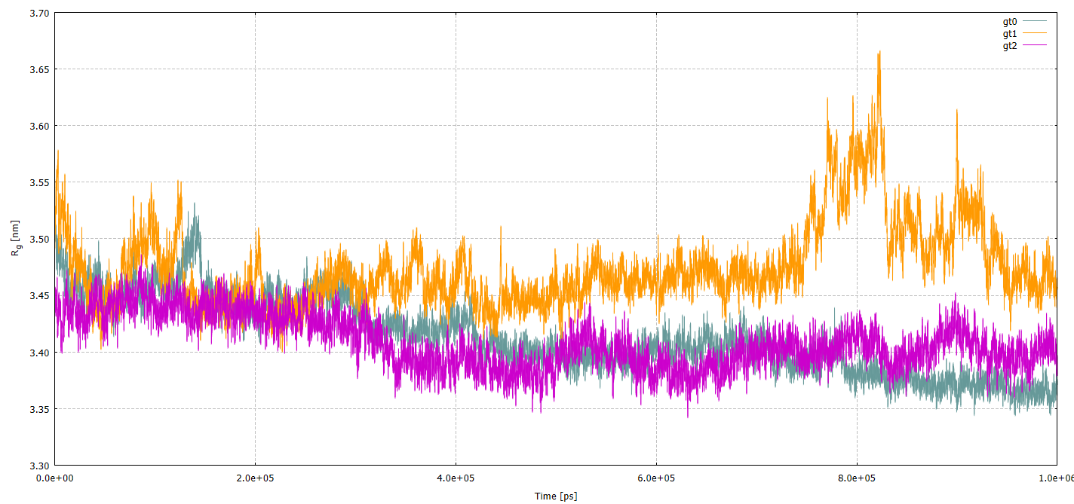
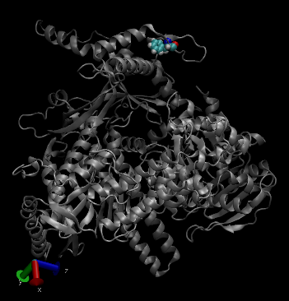
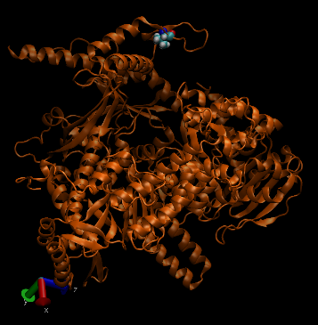
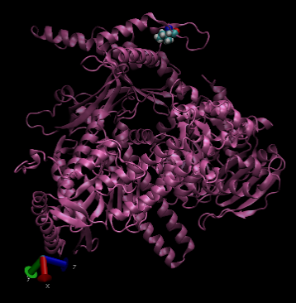
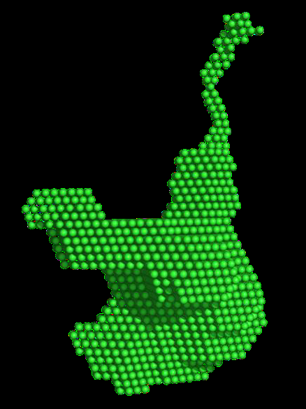
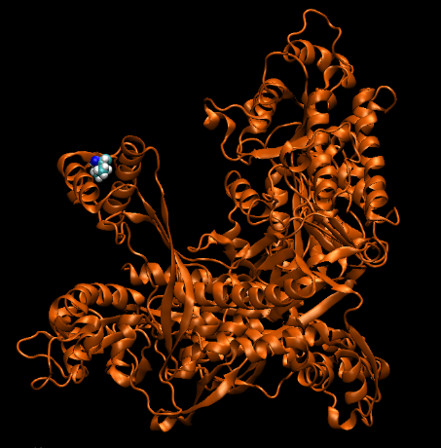
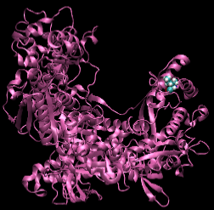
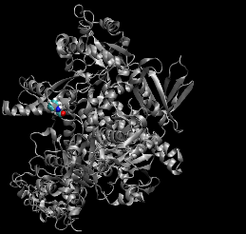
Radius of Gyration in POLE sub-unit MD simulation
SAXS
WT
pF695V
pF695I
SAXS
Notes:
In particolare dalla MD siamo andati ad estrarre informazioni sul RadiusOfGyration, una quantità che esprime la compattezza del compost e che è possibile ricvare anche dai dati SAXS
Le simulazioni analizzate sono tre WT, F695V e F695I.
Osservando l’andamento del RoG viene confermata una maggiore fluttuazione del WT F695V rispetto agli atri due composti, in particolare questo si nota intorno a 0.8us dove la curva rancione ha un picco che evidenzia un cambio di conformazione non presente nel WT né nel mutante F695I. Inoltre solo a titolo qualitative si sono riportate alcune delle configurazioni ottenute dal dato SAXS, che sono copmatibili con la conformazione assunta dal modello durante le simulazione MD in corripondenza del picco.
Complessivamente, seppur non una complete conferma, questi due dati puntano nella stessa direzione ovvero una maggiore flessibilità del mutante osservto nel pazientge isptto al WT.

Slide 14
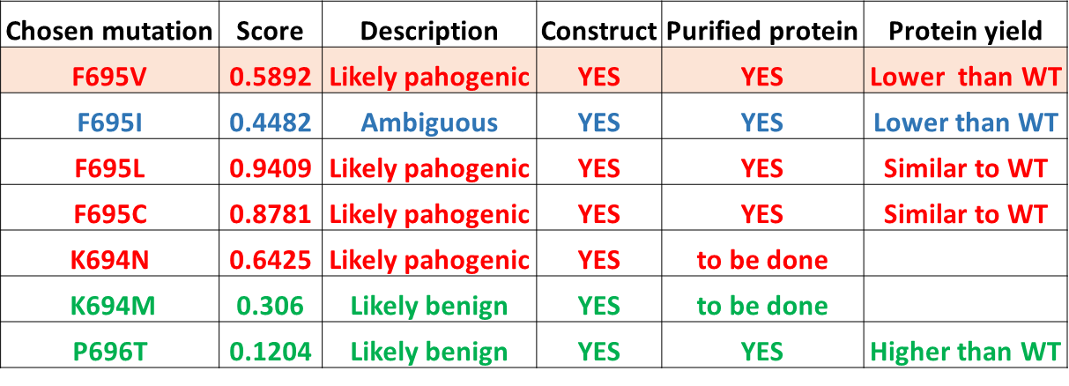
Analysis of Various POLE Variants
Expression and purification of additional variants of POLE in position 695, 694 and 696
F695I, F695L, F695C (the other 3 variants identified in this position).
F695I the only variant in this position predicted to be benign or likely benign
K694N and K694M two mutations at position K694 one that is predicted to be likely pathogenic and the other likely benign
P696T predicted benign or likely benign

Slide 15
BACK UP
SLIDES

Slide 16
Recombinant POLE
Polymerase activity of the F695V mutant is slower than the activity of the WT enzyme
Denaturing 15% TBE-UREA hand cast gel
PolE WT (1-1186) and F695V PolE mutant were expressed and purified in a recombinant form
Maximal primer
extension
Purified
polE
primer
Degradation
products
Important issue! Polymerase and exonuclease activity always coexist. To favor polymerase over exonuclease activity, dNTPs are added at high concentrations.
However, at longer time points (20 min) exonuclease activity starts predominating.
Enzyme 10 nM
dNTPs 250 μM
MgCl₂ 5 Mm
Primer:template 100 nM
2-20 min @35 °C

Slide 17
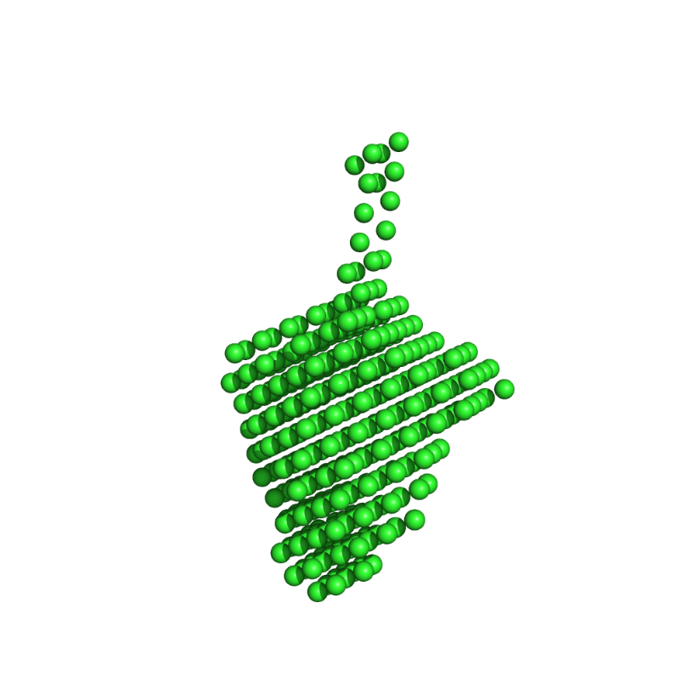
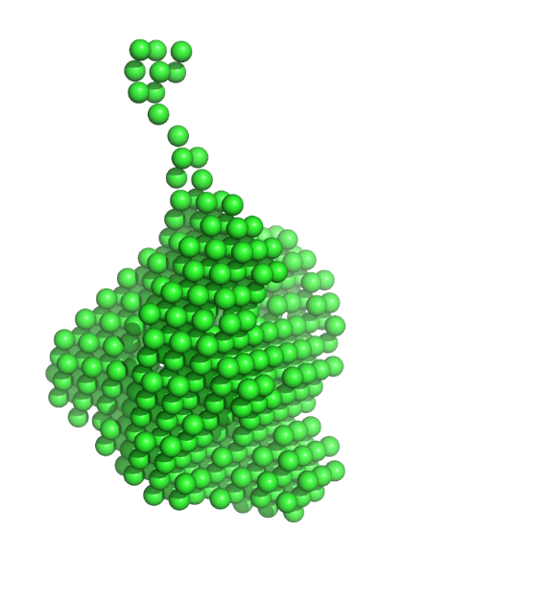
DNA Binding and structural information
Microscale Thermophoresis (MST) – DNA binding
Ab Initio Modelling (DAMMIN)
- SEC-SAXS -
DNA oligo: Cy5-polyT 30mer; 1 nM
buffer: 5 mM HEPES pH 7.8, 150 mM NaCl, 2.5% glycerol, 2 mM TCEP, 0.05% Tween-20
Refine.cif
WT
F695V
Both proteins have similar binding affinity for DNA, but slightly different shapes (low resolution SAXS data)
Modelling of SAXS data suggests that the mutant has a higher degree of flexibility compared to the WT

Slide 18
Radius of Gyration in POLE sub-unit MD simulation
SAXS
WT
pF695V
pF695I
SAXS

Slide 19
Analysis of Various POLE Variants
Expression and purification of additional variants of POLE in position 695, 694 and 696
F695I, F695L, F695C (the other 3 variants identified in this position).
F695I the only variant in this position predicted to be benign or likely benign
K694N and K694M two mutations at position K694 one that is predicted to be likely pathogenic and the other likely benign
P696T predicted benign or likely benign

Slide 20

Pathogenicity prediction - DeepMind
AlphaMissense
POLE position F695
chr12 132668446 A T hg38 Q07864 ENST00000320574.9 F695I 0.4482 ambiguous
chr12 132668446 A G hg38 Q07864 ENST00000320574.9 F695L 0.9409 likely_pathogenic
chr12 132668446 A C hg38 Q07864 ENST00000320574.9 F695V 0.5892 likely_pathogenic
chr12 132668445 A C hg38 Q07864 ENST00000320574.9 F695C 0.8781 likely_pathogenic
Other aa change in the same position:
chr12 132668445 A G hg38 Q07864 ENST00000320574.9 F695S 0.9507 likely_pathogenic
chr12 132668445 A T hg38 Q07864 ENST00000320574.9 F695Y 0.4903 ambiguous
Changes in positions close to 695:
chr12 132668447 C G hg38 Q07864 ENST00000320574.9 K694N 0.6425 likely_pathogenic chr12 132668447 C A hg38 Q07864 ENST00000320574.9 K694N 0.6425 likely_pathogenic
chr12 132668448 T C hg38 Q07864 ENST00000320574.9 K694R 0.0831 likely_benign
chr12 132668448 T A hg38 Q07864 ENST00000320574.9 K694M 0.306 likely_benign
chr12 132668448 T G hg38 Q07864 ENST00000320574.9 K694T 0.261 likely_benign
chr12 132668449 T G hg38 Q07864 ENST00000320574.9 K694Q 0.1897 likely_benign
chr12 132668449 T C hg38 Q07864 ENST00000320574.9 K694E 0.4669 ambiguous
chr12 132668442 G C hg38 Q07864 ENST00000320574.9 P696R 0.2167 likely_benign
chr12 132668442 G T hg38 Q07864 ENST00000320574.9 P696H 0.1927 likely_benign
chr12 132668442 G A hg38 Q07864 ENST00000320574.9 P696L 0.1067 likely_benign
chr12 132668443 G C hg38 Q07864 ENST00000320574.9 P696A 0.085 likely_benign
chr12 132668443 G A hg38 Q07864 ENST00000320574.9 P696S 0.1101 likely_benign
chr12 132668443 G T hg38 Q07864 ENST00000320574.9 P696T 0.1204 likely_benign

Slide 21
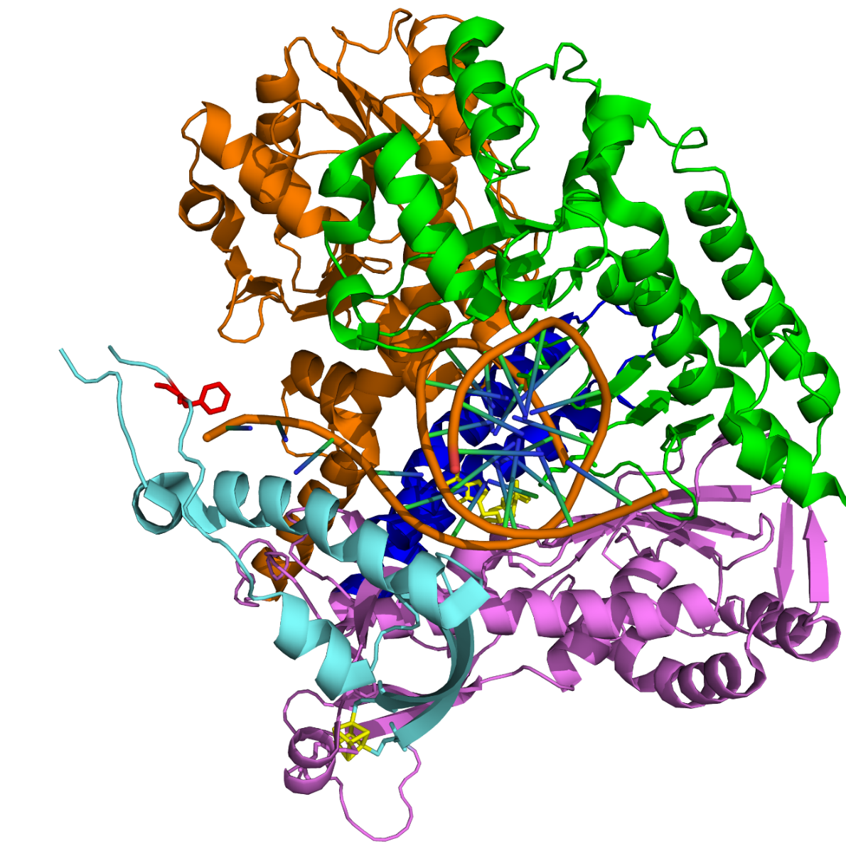
POLE Variant
N-terminal catalytic domain (NTD, 1-1186 aa)
Exonuclease
Thumb
Fingers
F695
[4Fe-4S]
Palm
PDB ID: 6QIB
Can F695V mutation affect PolE catalytic activity?
F695 is located in the Palm domain, at the base of the P-domain
Notes:
La variante sta in un dominio mobile alla base del P-domain.
Qusto cluster è stato scoperto da poco e senza questo non si riesce a caricare il DNA. Il dubbio è che sia funzionale all’aperture e chiusura della porta.

Slide 22
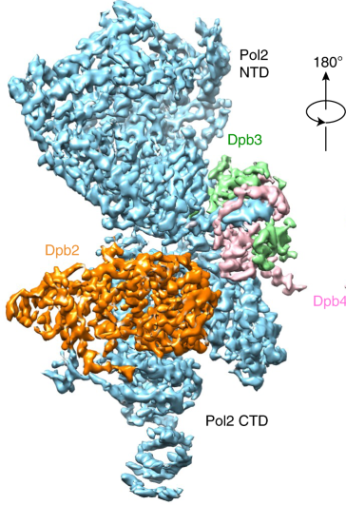
Characterization of POLE Variant
Human polymerase epsilon (2286 aa) plays a major role in leading strand synthesis during genome duplication and in nucleotide and base excision repair.
N-terminal catalytic domain (NTD, 1-1186 aa)
Exonuclease
Thumb
PolE catalytic domain
63% sequence identity between yeast and human
Fingers
F695
[4Fe-4S]
Palm
PDB ID: 6QIB
S. cerevisiae PolE
PDB ID: 6WJV
Nat Commun, 2020
F695 is located in the Palm domain, at the base of the P-domain
Notes:
C’è la struttura 3D CRIOEM di lievito. Alpha fold predice quella umana. Ma alpha fold non la predice legata al DNA.

Slide 23
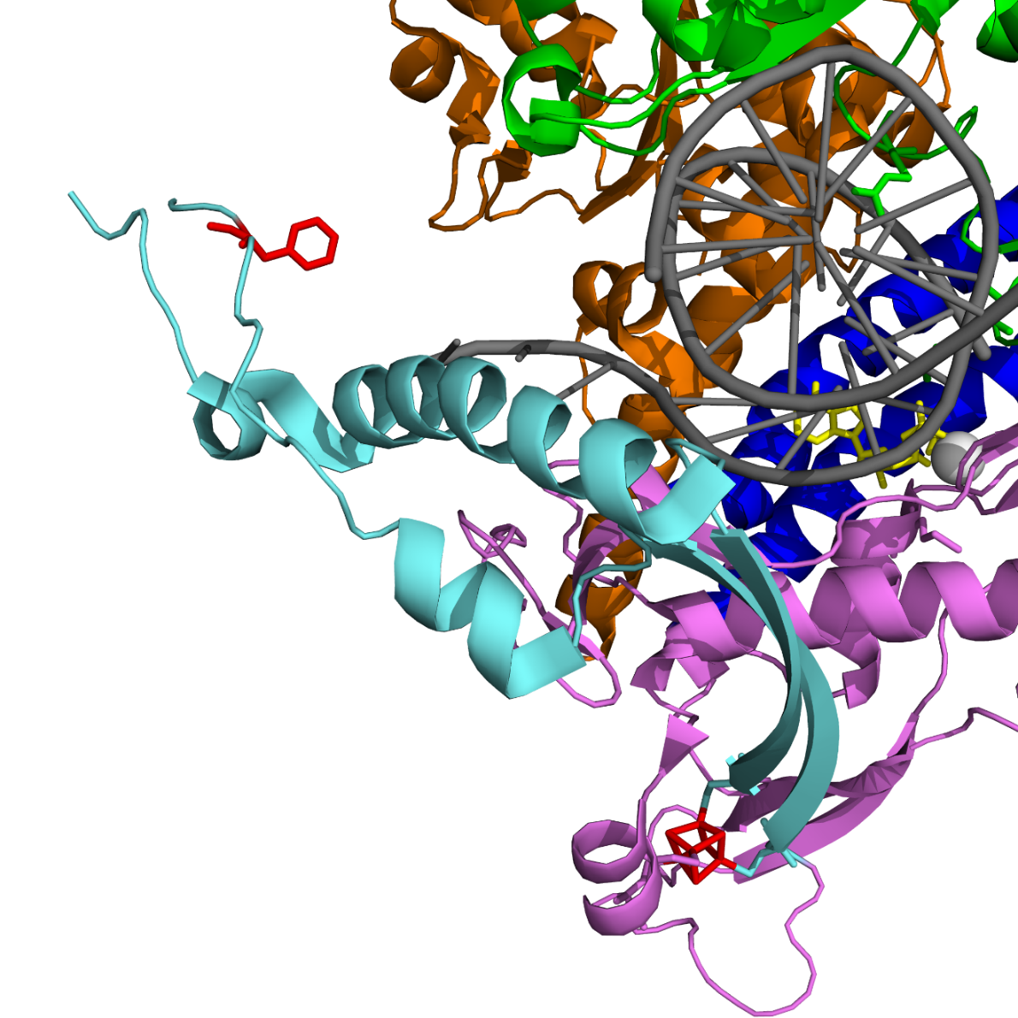
Characterization of POLE Variant
Exonuclease
Thumb
The [4Fe-4S] cluster regulates the conformation of the P-domain, which like a gatekeeper controls access to a DNA-binding cleft for a template: primer
Lisova A.E. eta al. Sci. Reports, 2022
F695
Fingers
P-domain
Can F695V mutation affect PolE catalytic activity?
Palm
[4Fe-4S]
PDB ID: 6QIB
Notes:
Classico PALM finger domain tipico delle polimerasi.
Il cluster Fe-S sembra che regoli il P-domain che controlla l’accesso del primer del DNA. Se c’è una mutazione all’apice del P-domain allora forse questo influire nell’ingresso del primer alla cleft del DNA.

