Slide 1

Spoke 8
In Silico Medicine & Omics Data
DRUG-TARGET studies and DRUG REPURPOSING
June 24th, 2024

Slide 2
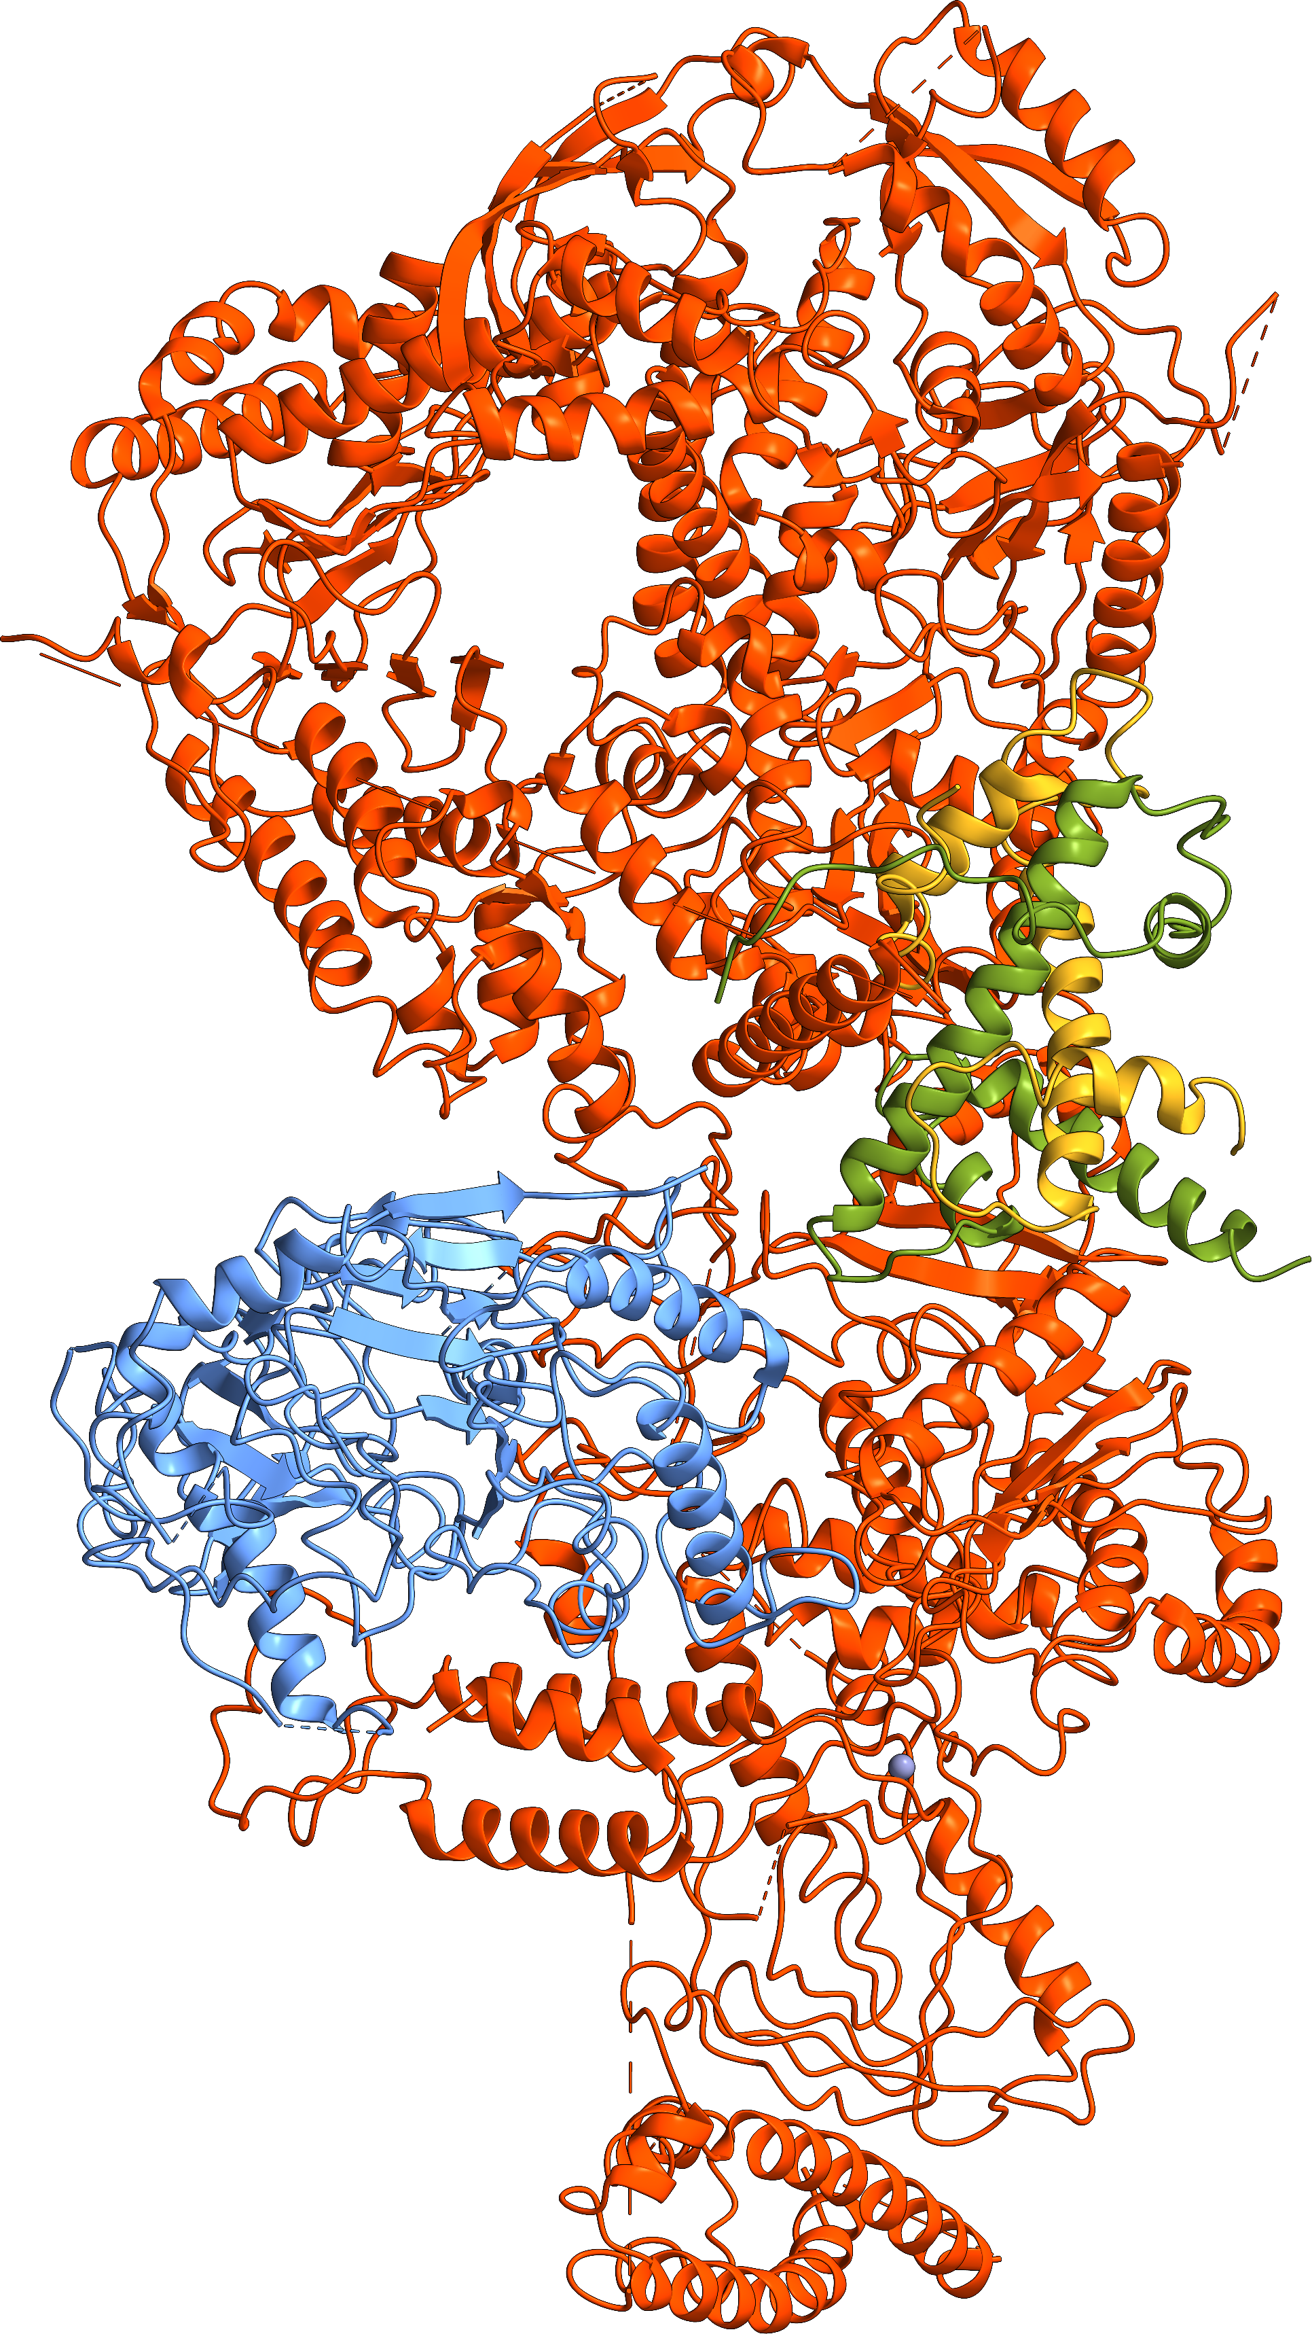
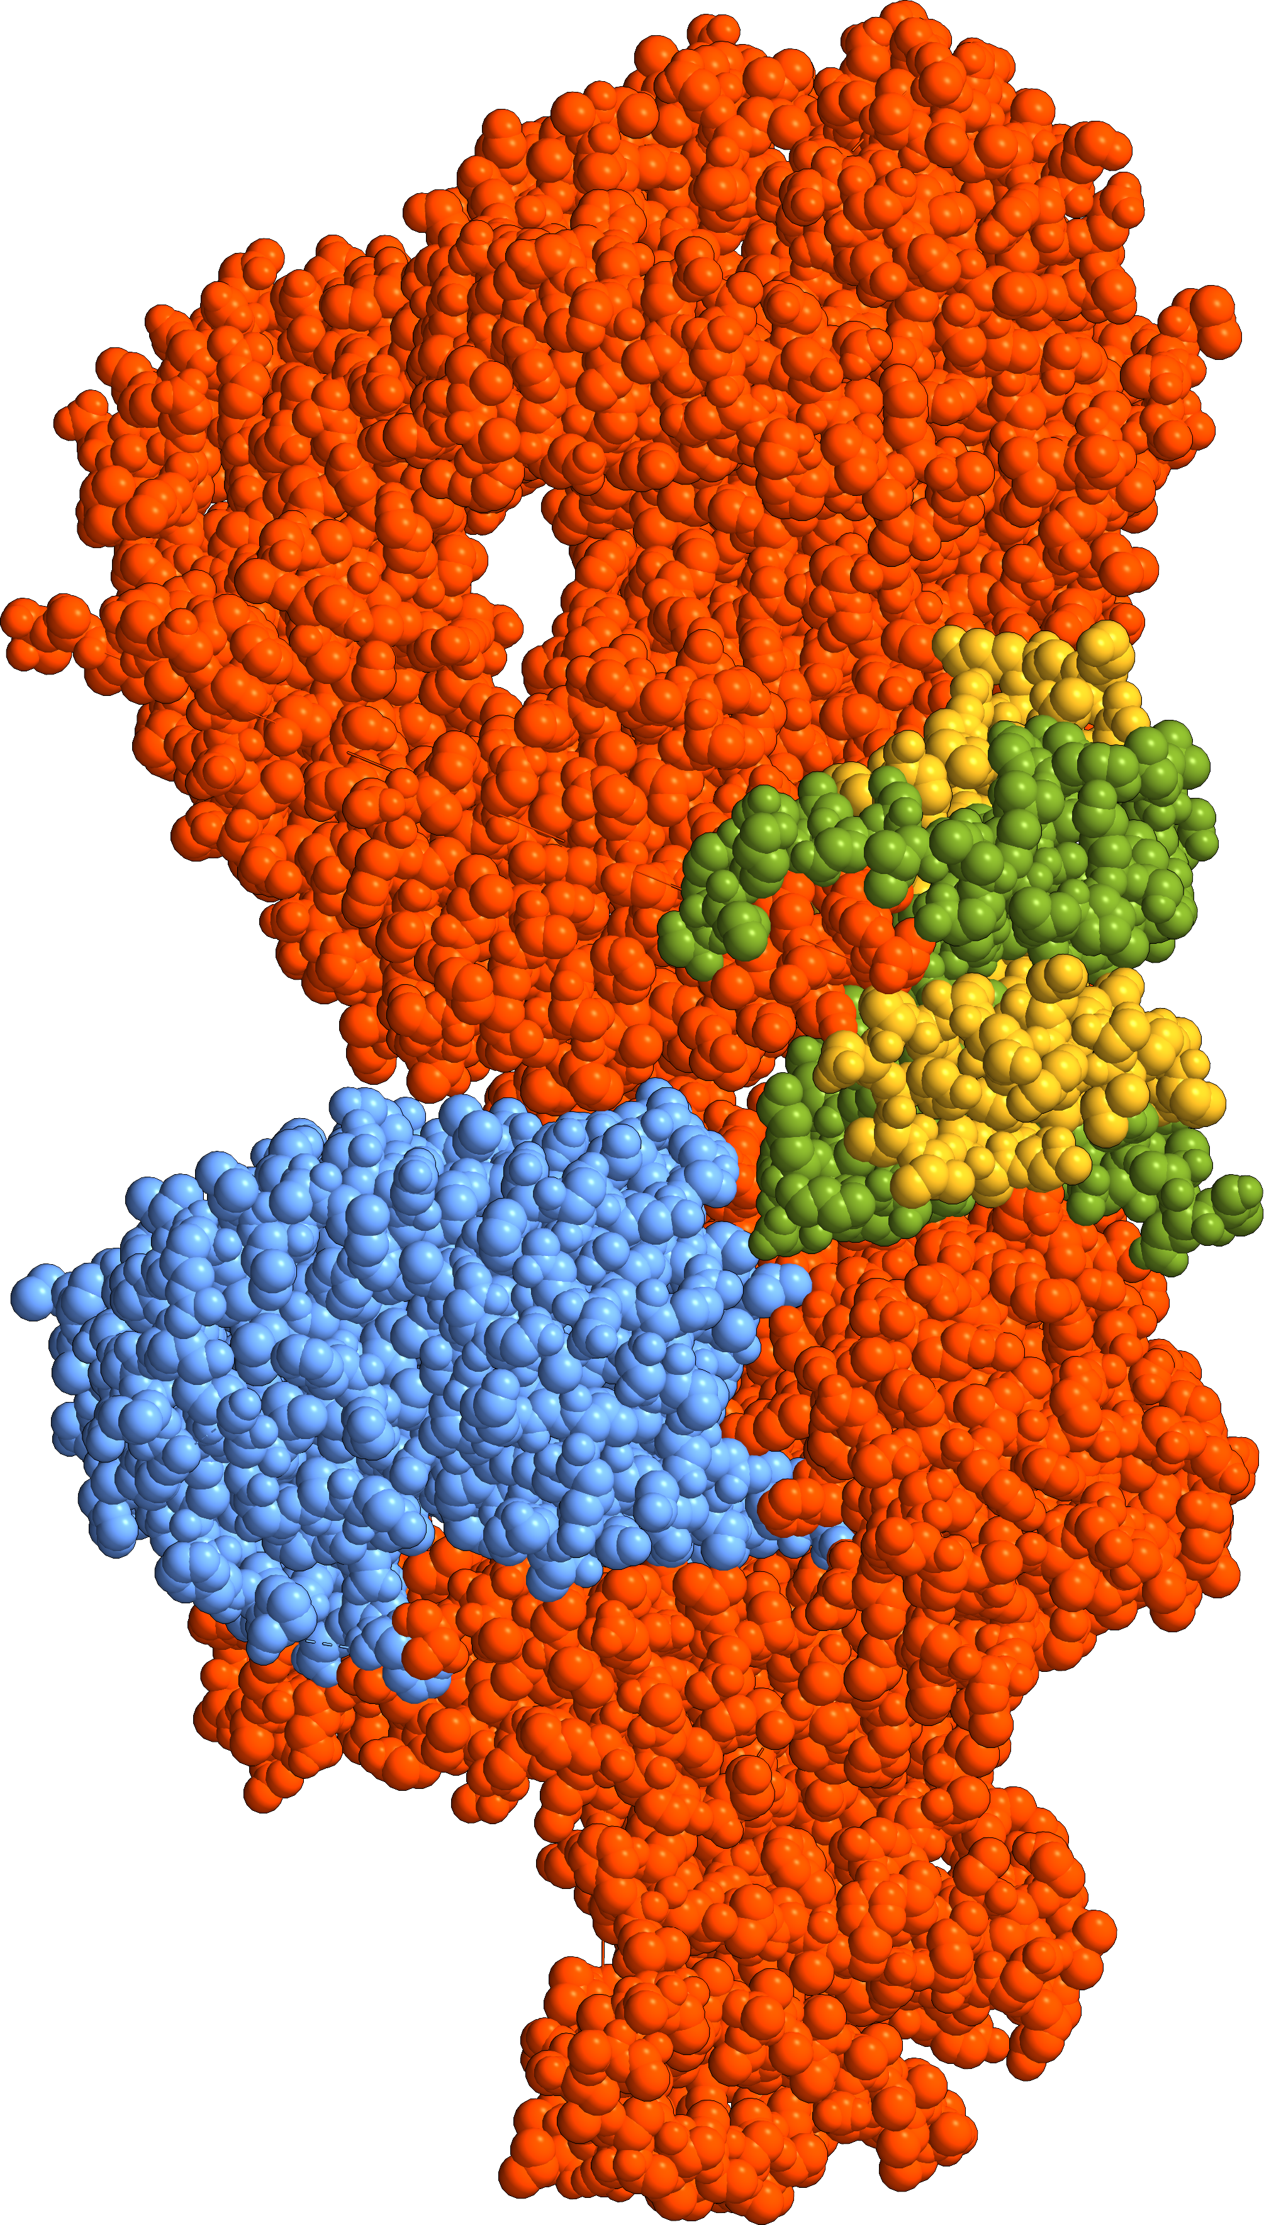
Pol2
Catalytic
Subunit
(PolE)
DNA polymerase epsilon (PolE)
is an enzyme essential for DNA replication.
Deficiencies and mutations
in PolE cause severe developmental abnormalities and cancers.
Paradoxically, the catalytic domain of yeast PolE catalytic subunit
is dispensable for survival, and
its non-catalytic essential function
is linked with replicative helicase (CMG) assembly.
PolE
subunit D
(PolE4)
DNA cavity
PolE
subunit B
(PolE2)
PolE
subunit C
(PolE3)
Zn²⁺
Saccharomyces cerevisiae PolE
PDB id: 6WJV (3.5 Å resolution, CryoEM)

Slide 3
PolE Mutations

Slide 4
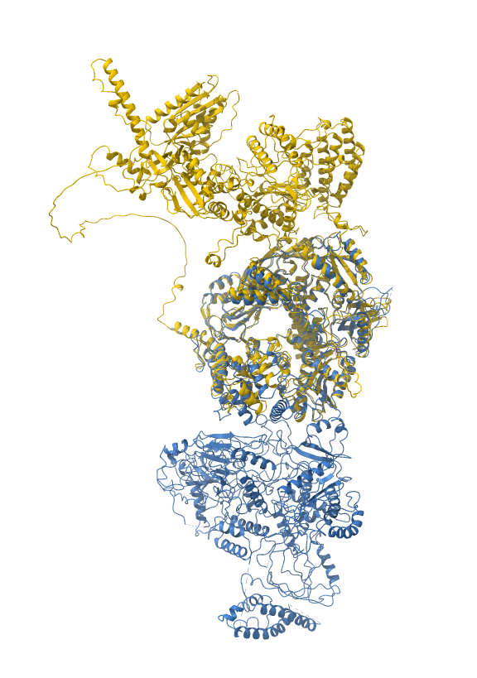
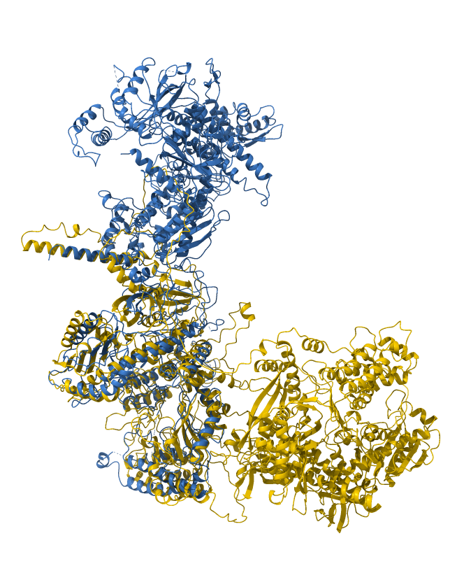
AlphaFold vs. CryoEM
AF-Q07864-F1
6WJV
Catalytic subdomain
(NTD)
AF-Q07864-F1
CTD
6WJV

Slide 5
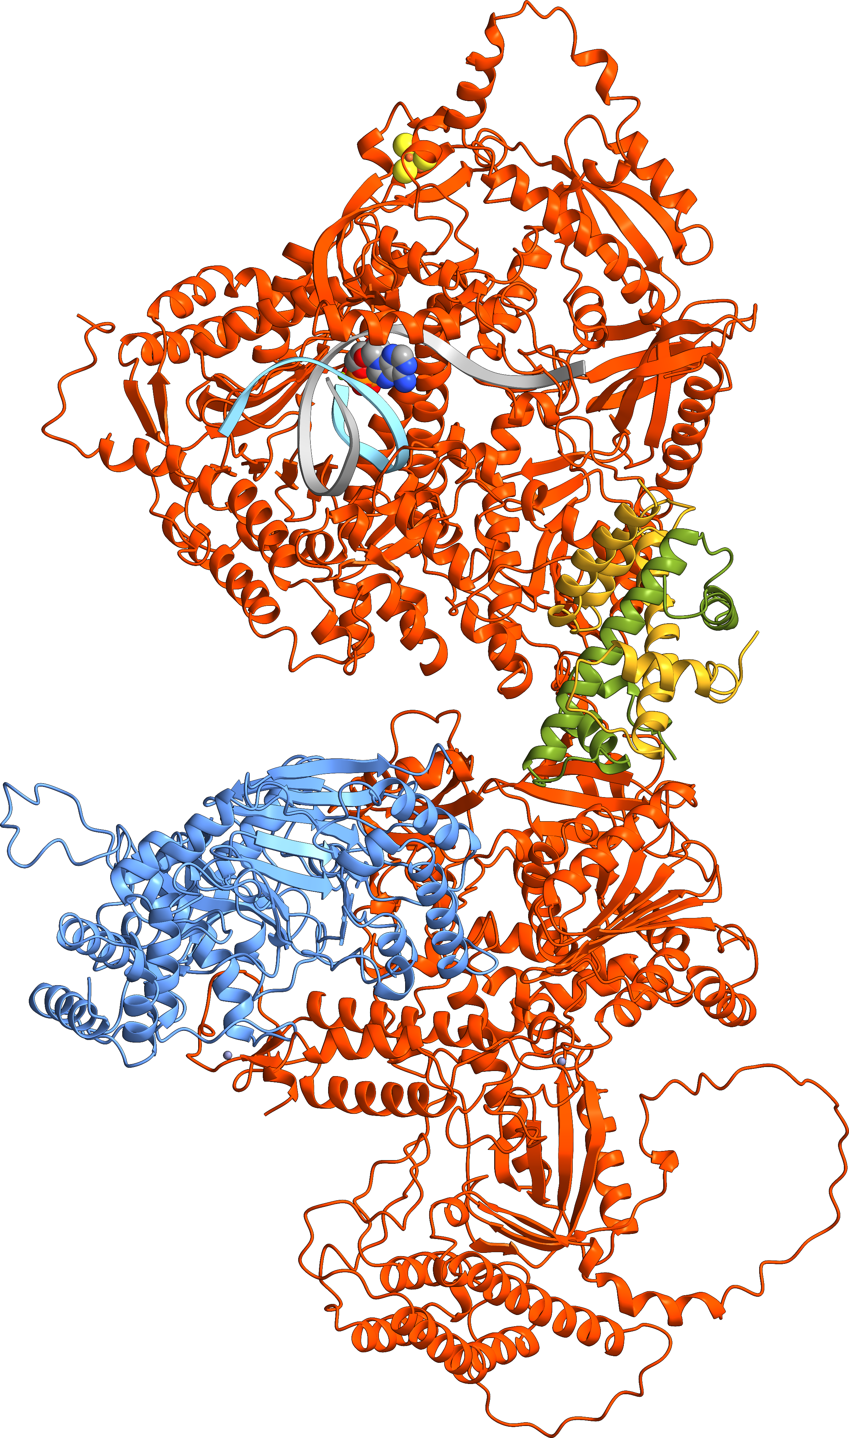
Available templates
7PLO (H. sapiens, 2.80 Å, CryoEM)​
  DNA polymerase epsilon catalytic subunit A (gene POLE)
  DNA polymerase epsilon subunit 2 (gene POLE2)
5VBN (H. sapiens, 2.35 Å, X-ray)​
  DNA polymerase epsilon catalytic subunit A (gene POLE)
  DNA polymerase epsilon subunit 2 (gene POLE2)
  2 Zn²⁺
4QCL (H. sapiens, 2.20 Å, X-ray)
  Mg²⁺
6QIB (S. cerevisiae, 2.80 Å, X-ray)
  DNA polymerase epsilon catalytic subunit A (gene POL2)
  [4Fe-4S]
6WJV (S. cerevisiae, 3.50 Å, CryoEM)
  Protein quaternary structure (subunits C and D)
4M8O (S. cerevisiae,​ 2.20 Å, X-ray)​
  DNA polymerase epsilon catalytic subunit A (gene POL2)
  Primer and template DNA
  dATP / Mg²⁺
[4Fe-4S]
dATP:2Mg²⁺
DNA
Zn²⁺
Zn²⁺

Slide 6
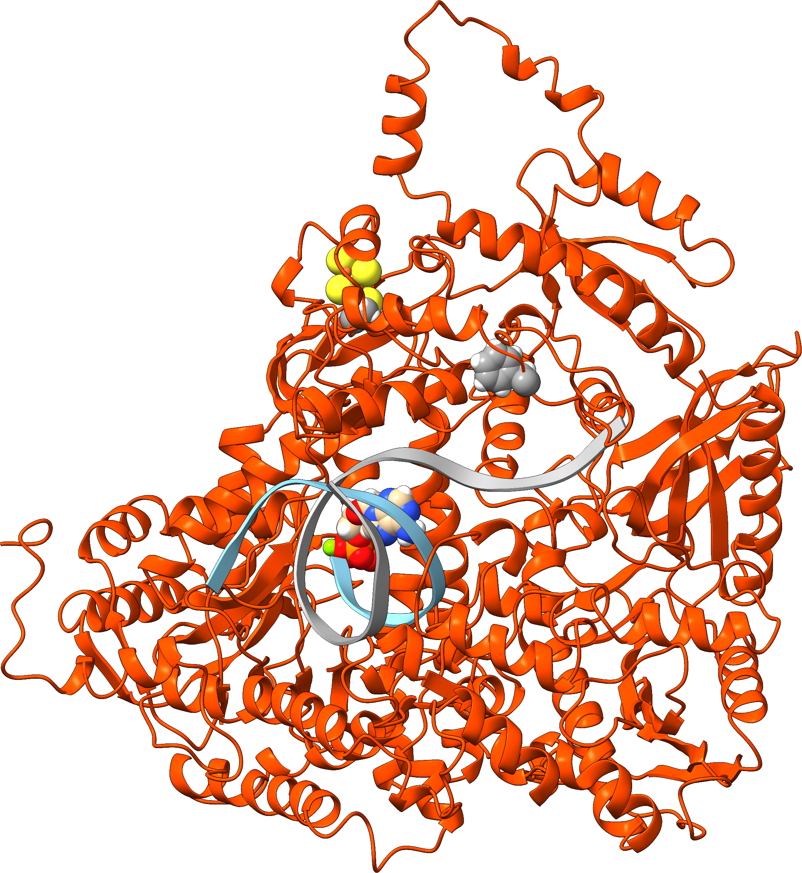
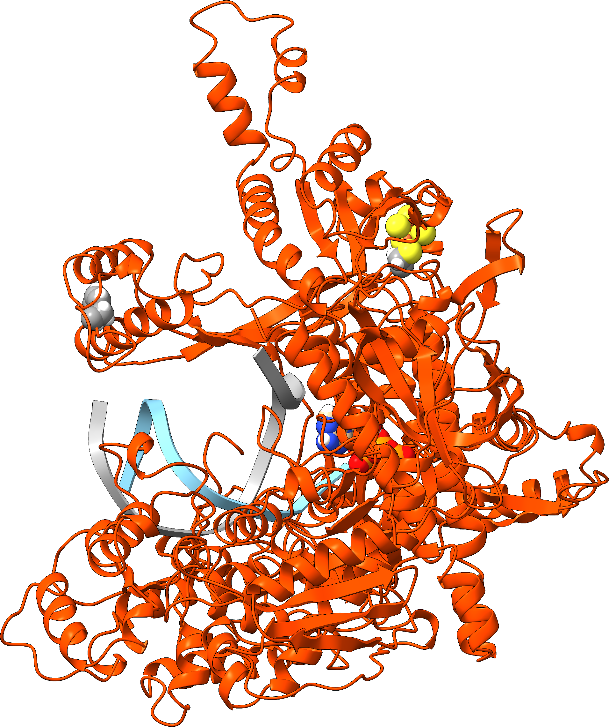

WT PolE catalytic domain model structure
F695
[4Fe-4S]
[4Fe-4S]
dATP:2Mg²⁺
F695
DNA
dATP:2Mg²⁺
DNA

Slide 7
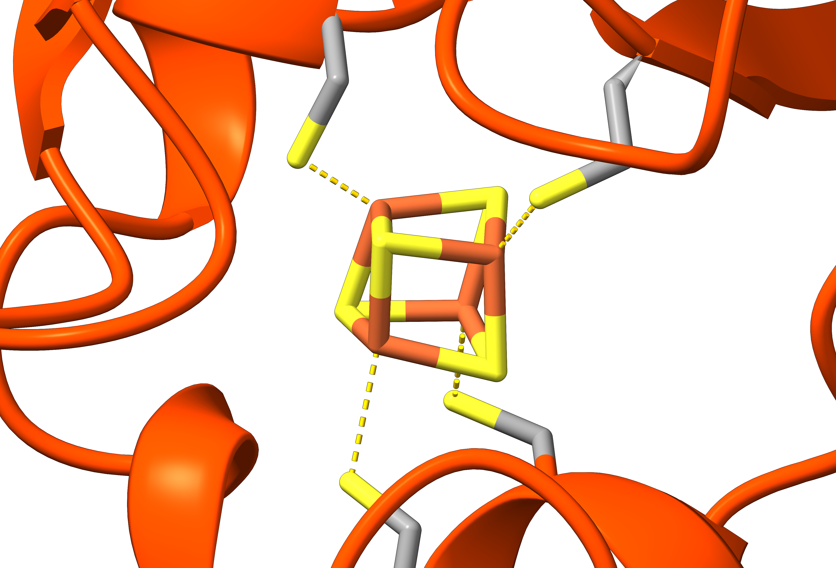
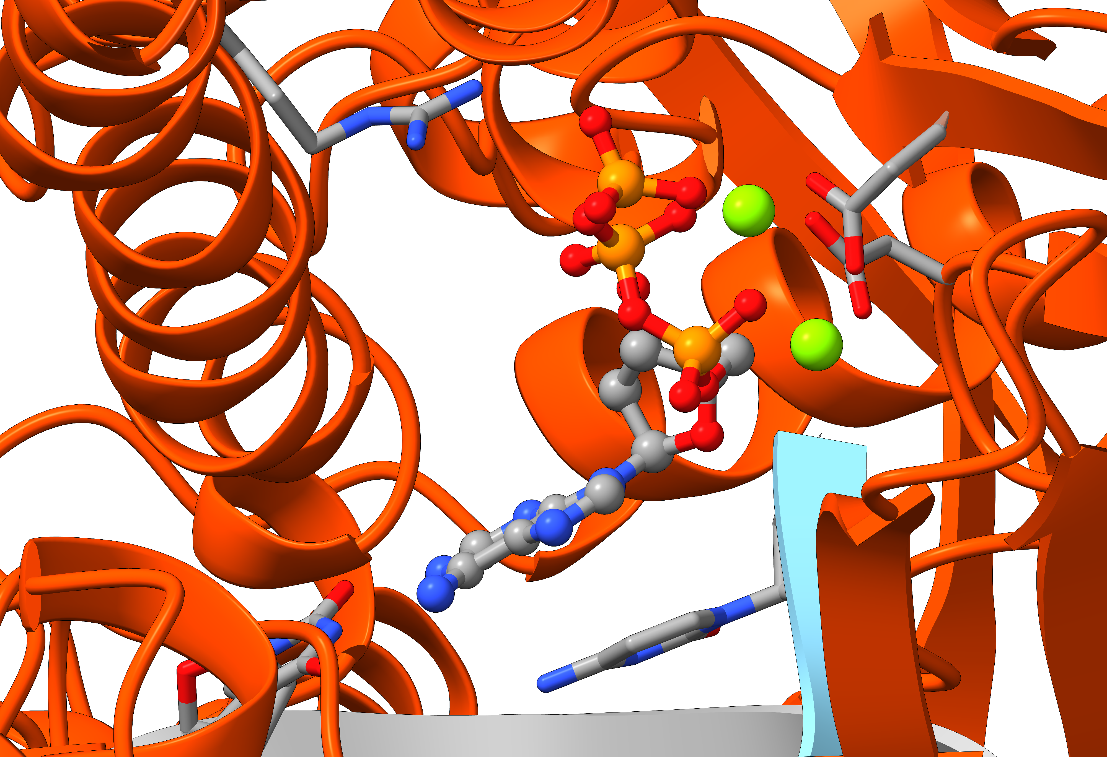
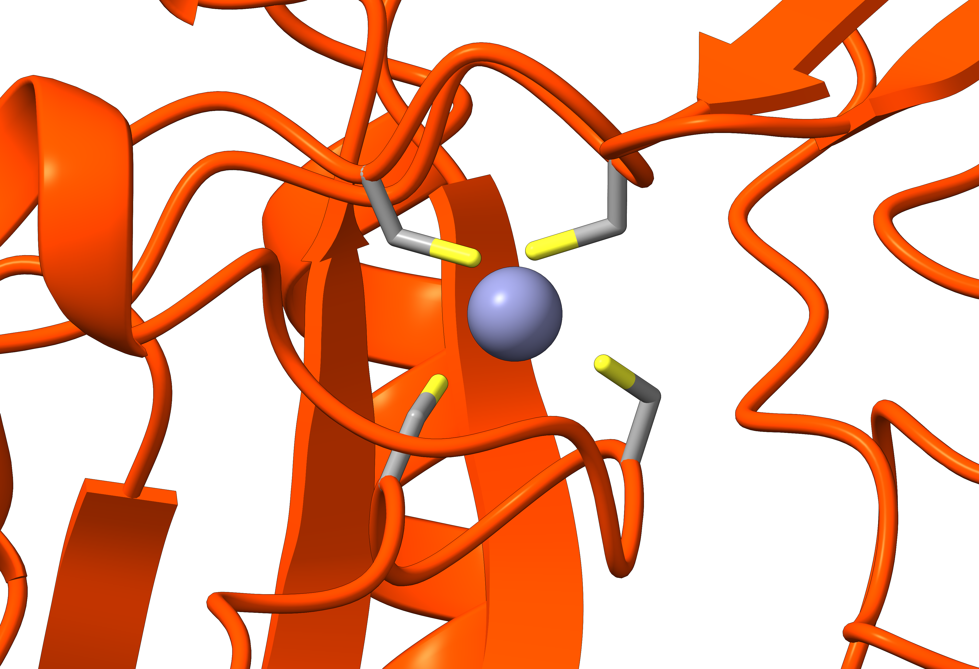
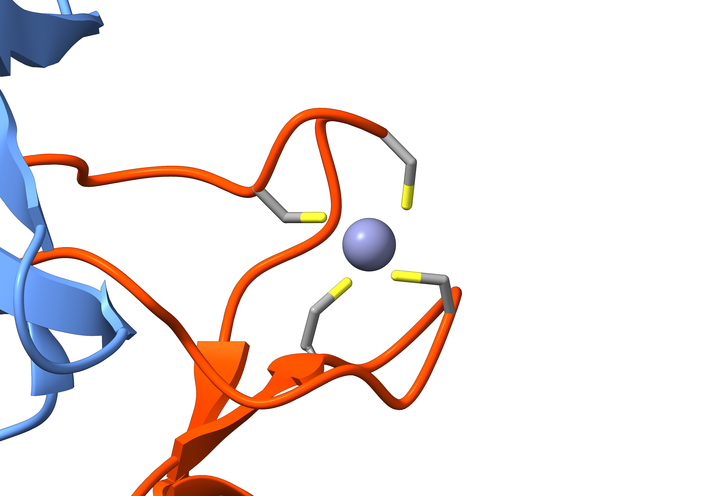
Mg²⁺
D626
C663
R765
C747
D862
[4Fe-4S]
dATP
Mg²⁺
C651
Thy
C654
Cyt
C2161
C2238
C2158
C2236
Zn²⁺
Zn²⁺
C2190
C2224
C2221
C2187

Slide 8
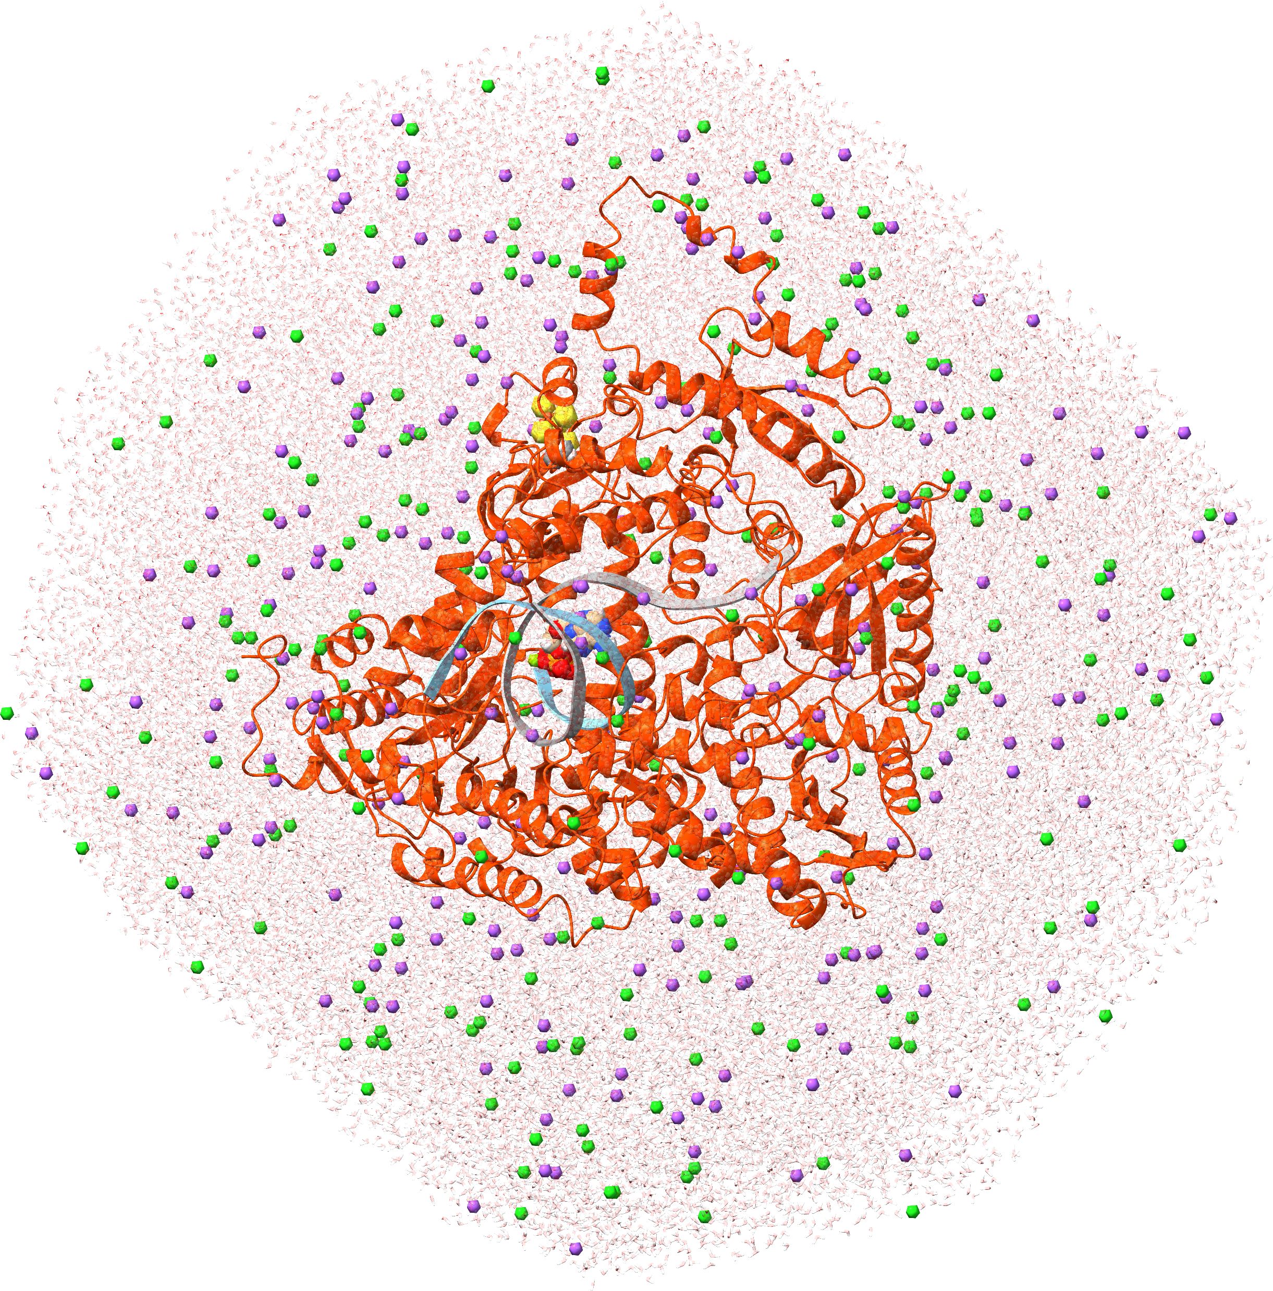
MD simulations on the human PolE catalytic subdomain
WT and F595V, F695I and F695L mutants
Force field: AMBER ff14sb-OL15 and TIP3P water
[4Fe-4S] cluster, dATP and Mg²⁺ ions:
state-of-the-art parameters
Physiological ionic strength: 200 mM NaCl
Box: truncated octahedron
NPT ensemble
Software: GROMACS 2023
Total atoms: ca. 187,000
Simulation time: 1 µs/system
CPU/GPU hours: Leonardo (ISCRA C)

Slide 9
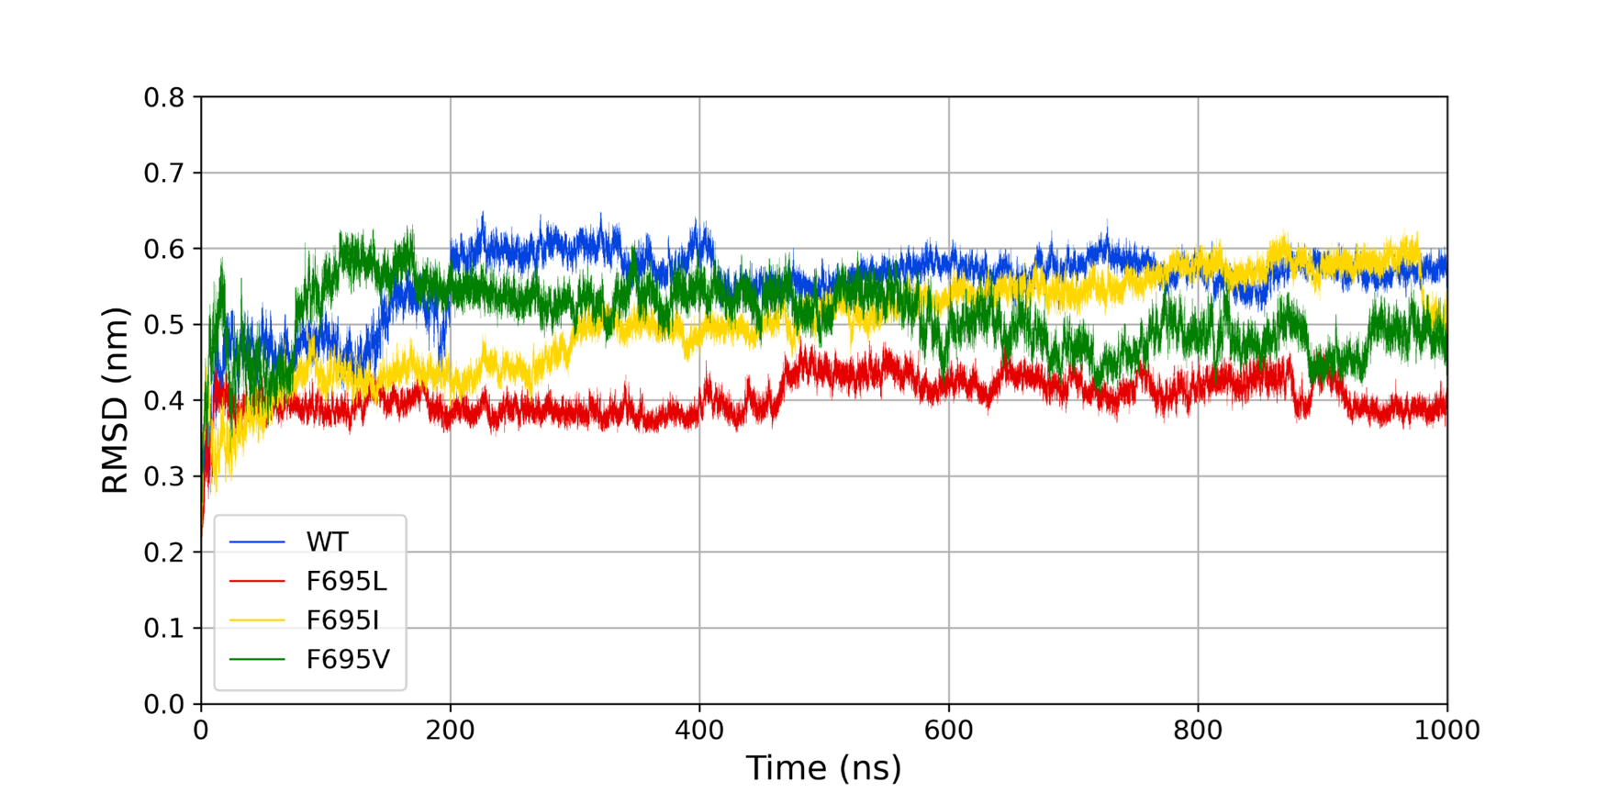
MD simulations on the human PolE catalytic subdomain

Slide 10
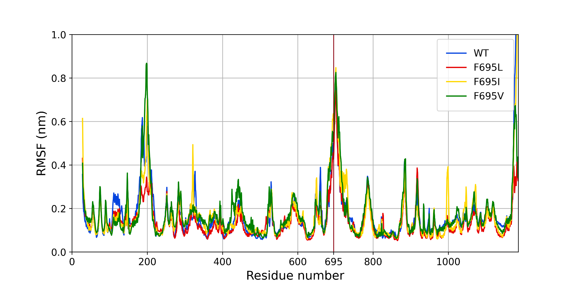
MD simulations on the human PolE catalytic subdomain

Slide 11
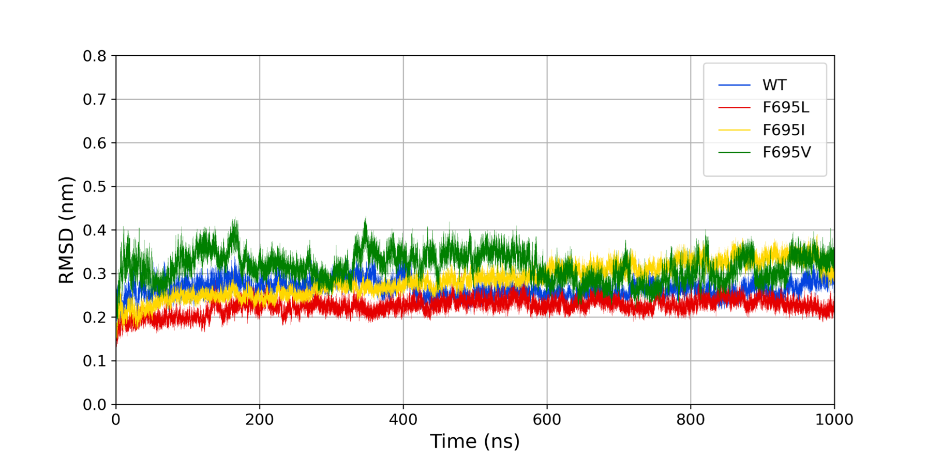
MD simulations on the human PolE catalytic subdomain
(Δ 28-33, 169-218, 678-735, 774-800, 1153-1186)

Slide 12
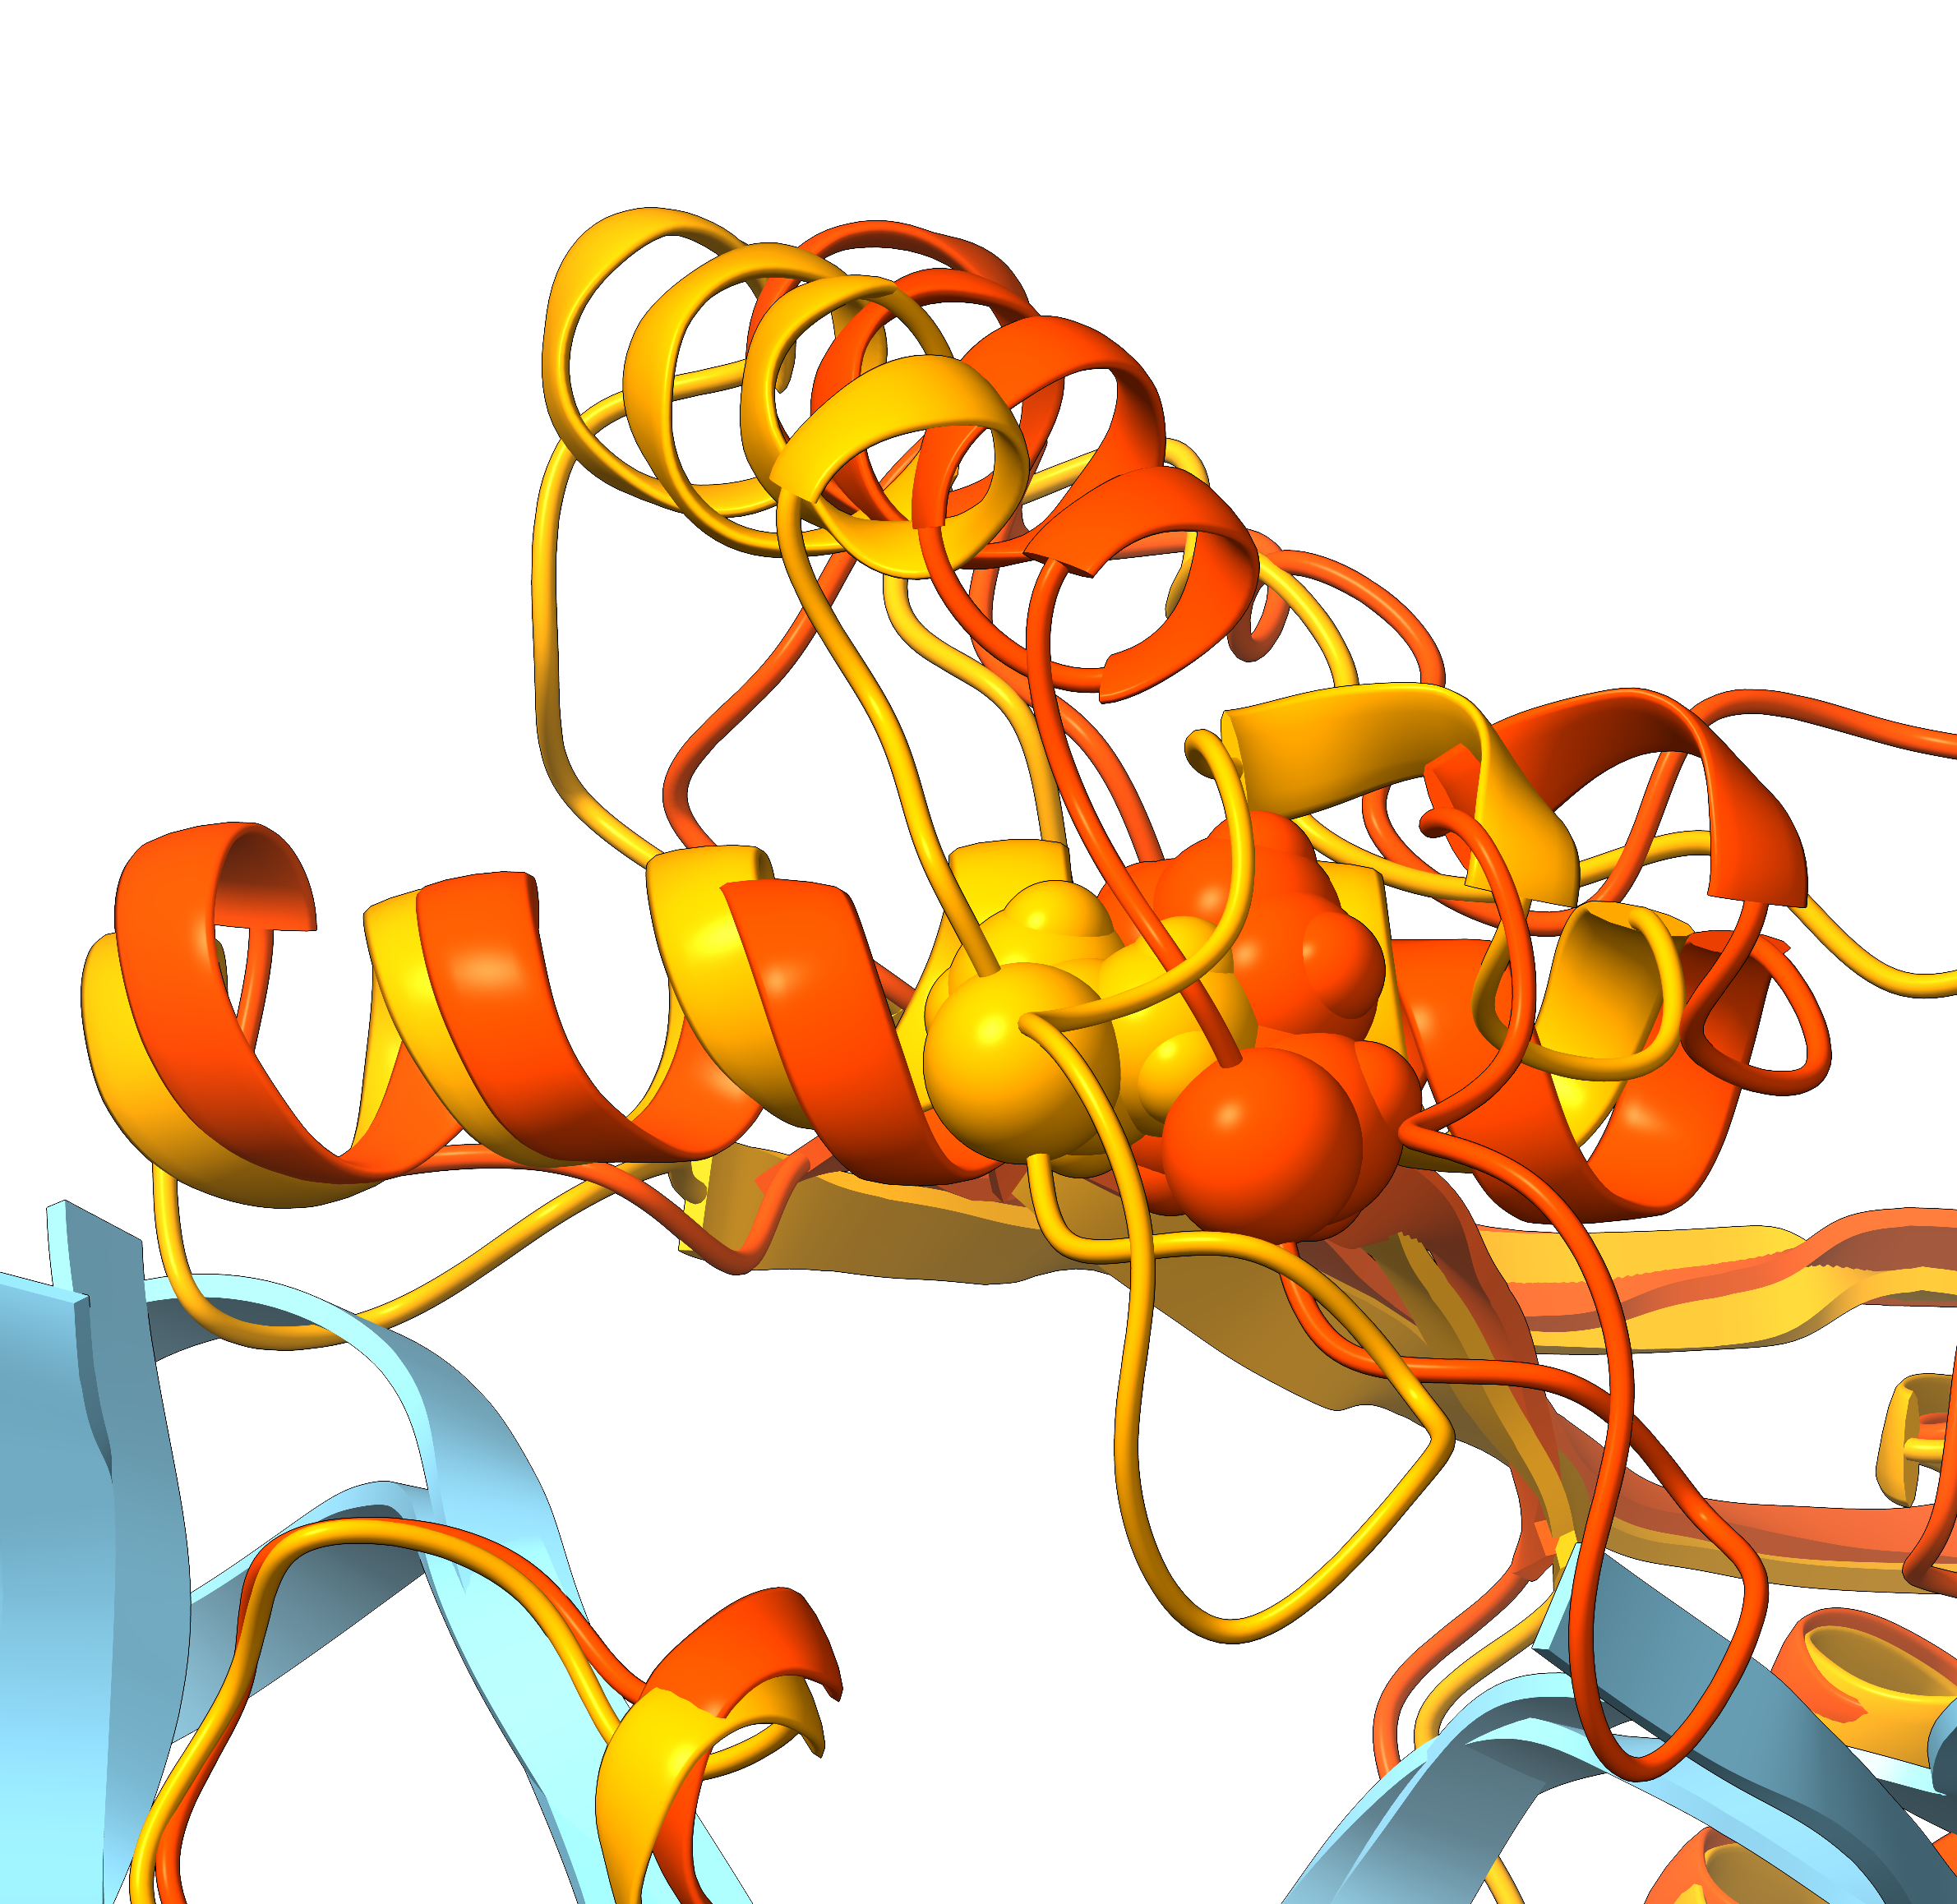
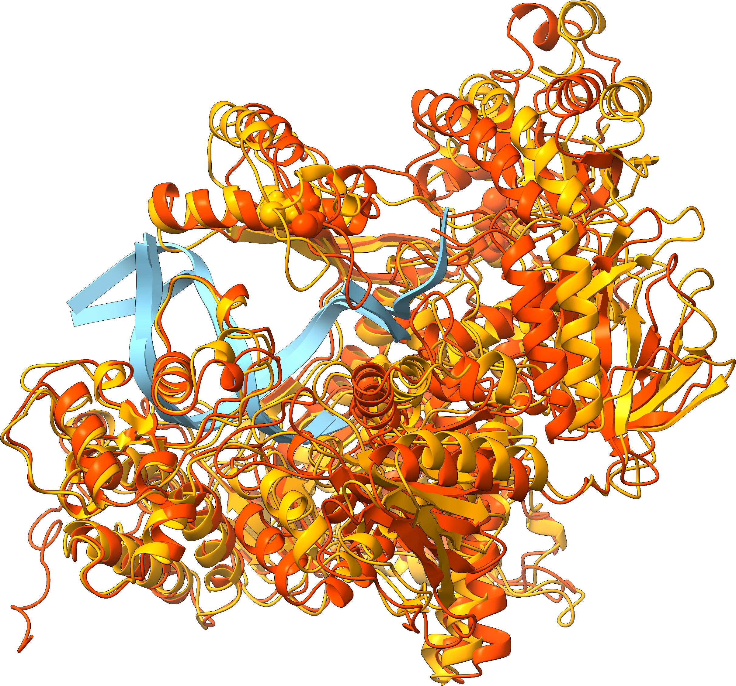
Cluster analysis
F695
F695V

Slide 13
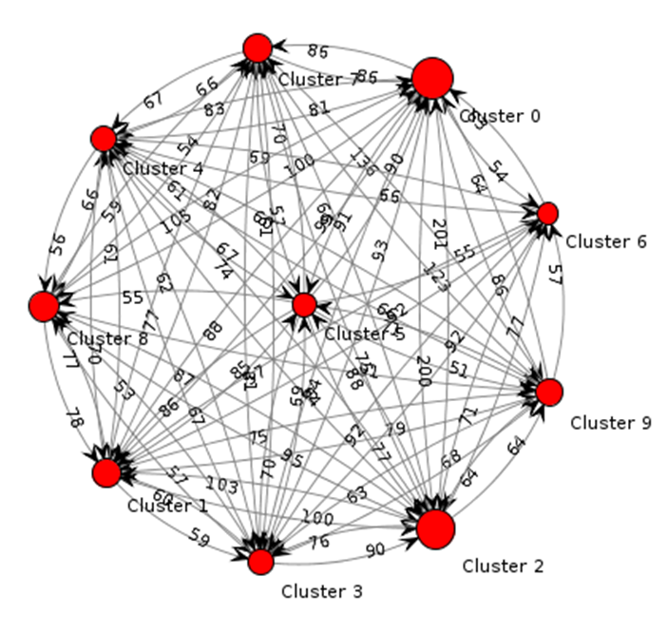
SBVS WORKFLOW (UniTO)
MD
  New simulations (1 µs) of the complete domain
  Clustering (WT – F695V) (10 clusters)
Pocket tracking
Pocket identification (WT – F695V) (BiKi)
Pocket comparison in WT and F695V (volume and n. residues)
Pocket selection for the first cluster (pocket 11)
Pocket selection for the first cluster (pocket 9) (ongoing)
Same analyses are ongoing for second and third clusters
SBVS
IFD
ChEMBL and DrugBank libraries SBVS (Glide)
Molecular Docking and induced fit (ongoing)
Clustering diagram (BiKi)

Slide 14
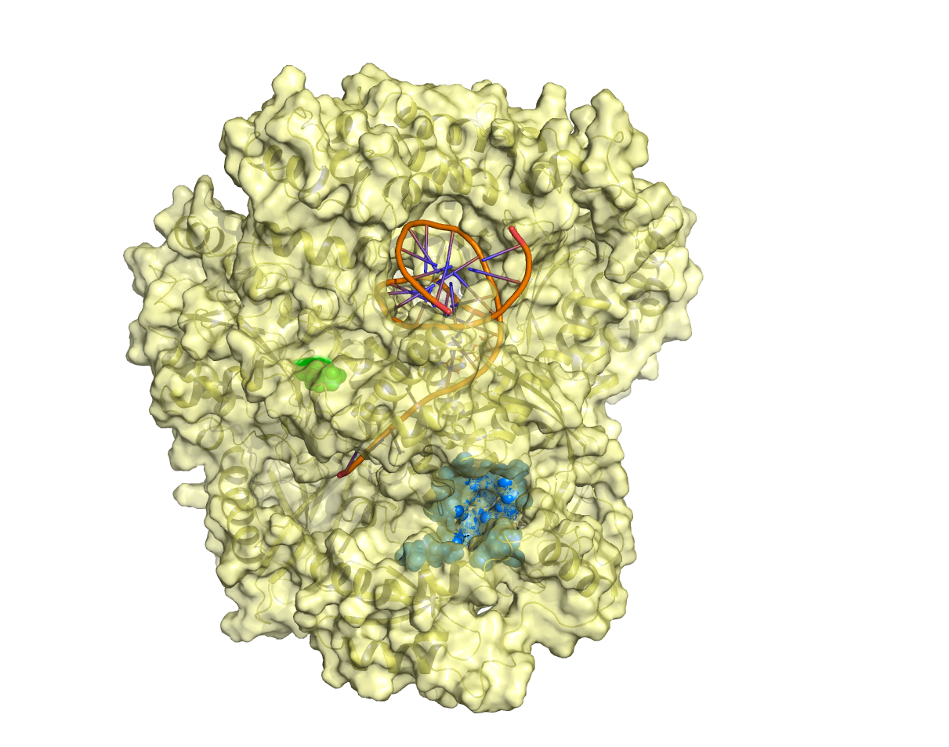
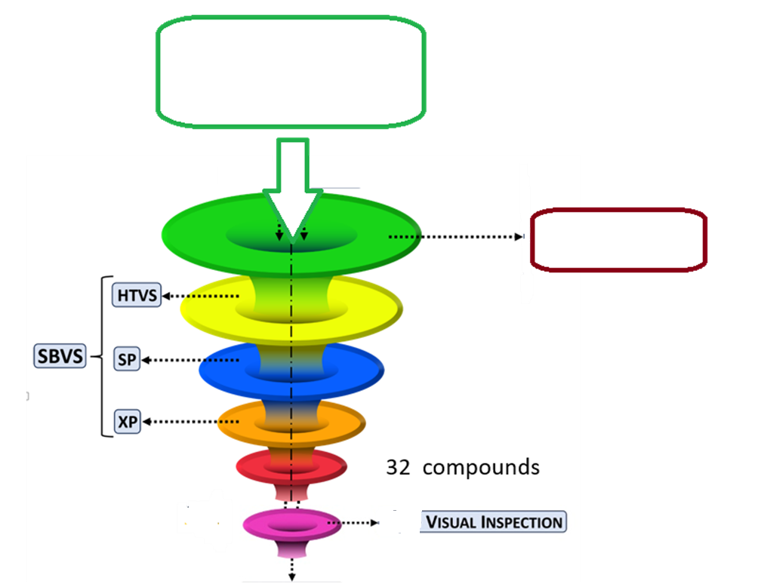
Pocket and SBVS pipeline (UniTO)
DrugBank + ChEMBL approved drugs
DRUGBANK: 2623 cpds
ChEMBL: 2476 cpds
F695V
Filter:
O number ≤8
Selected pocket
average volume 140 A³
11 compounds

Slide 15
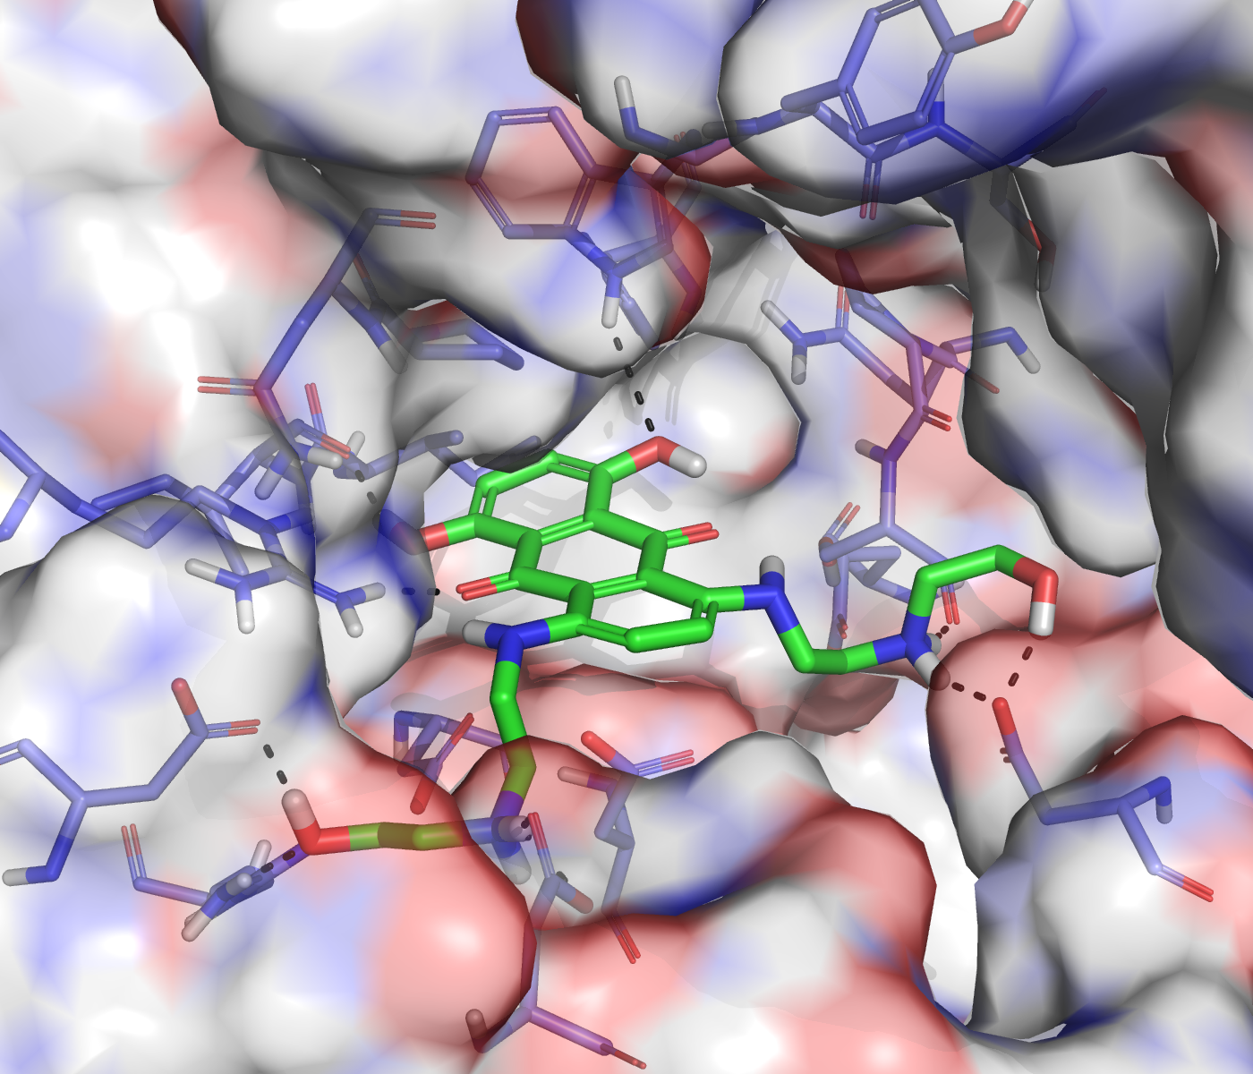
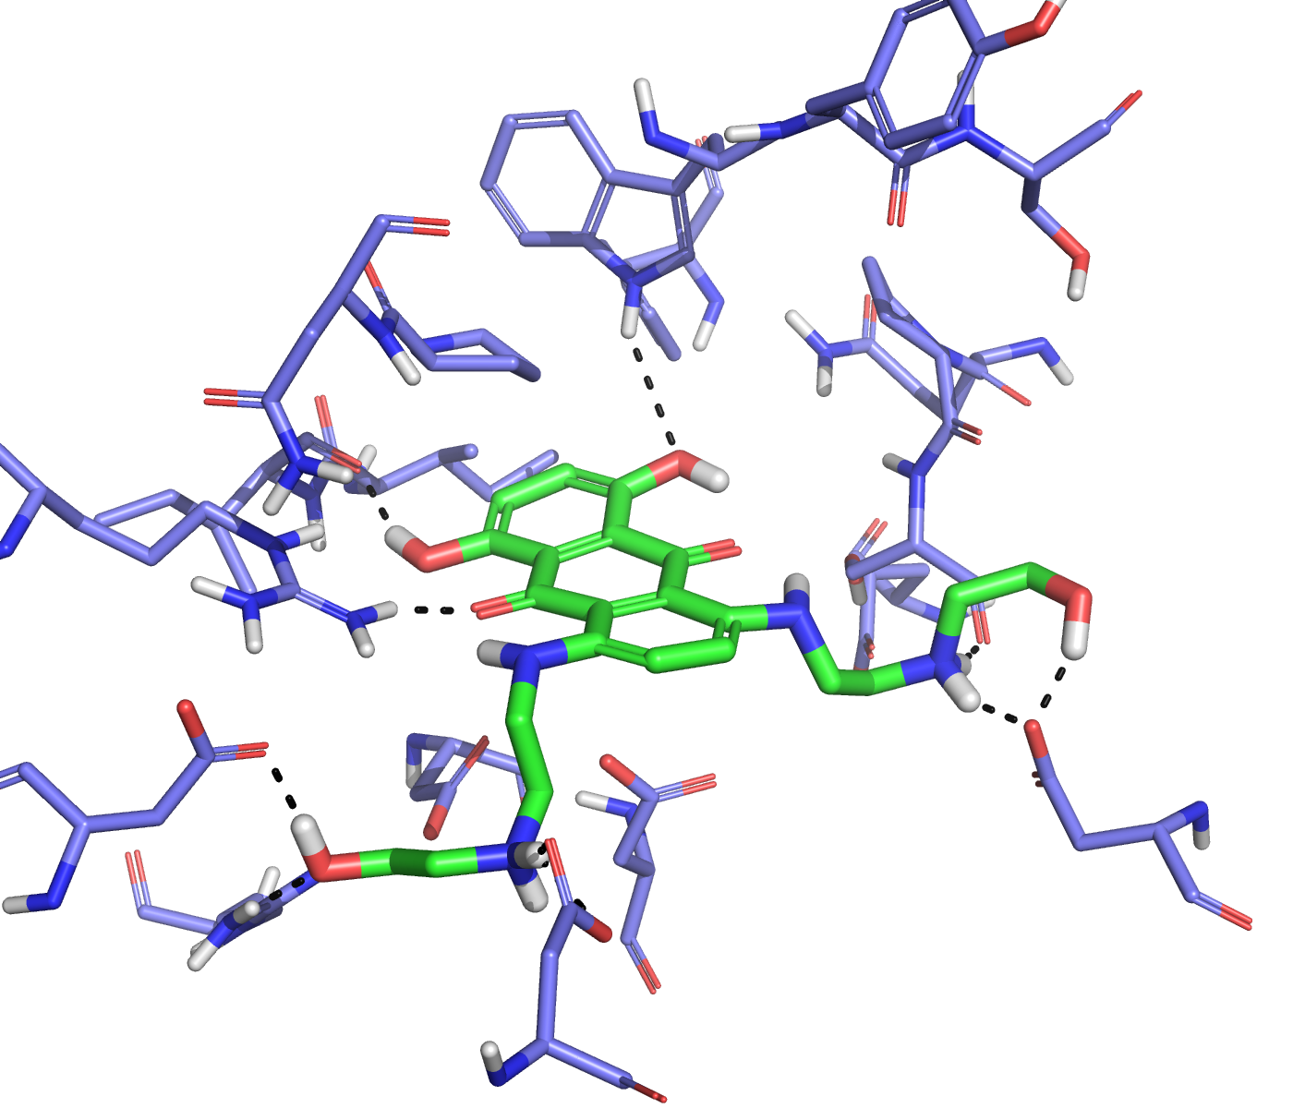
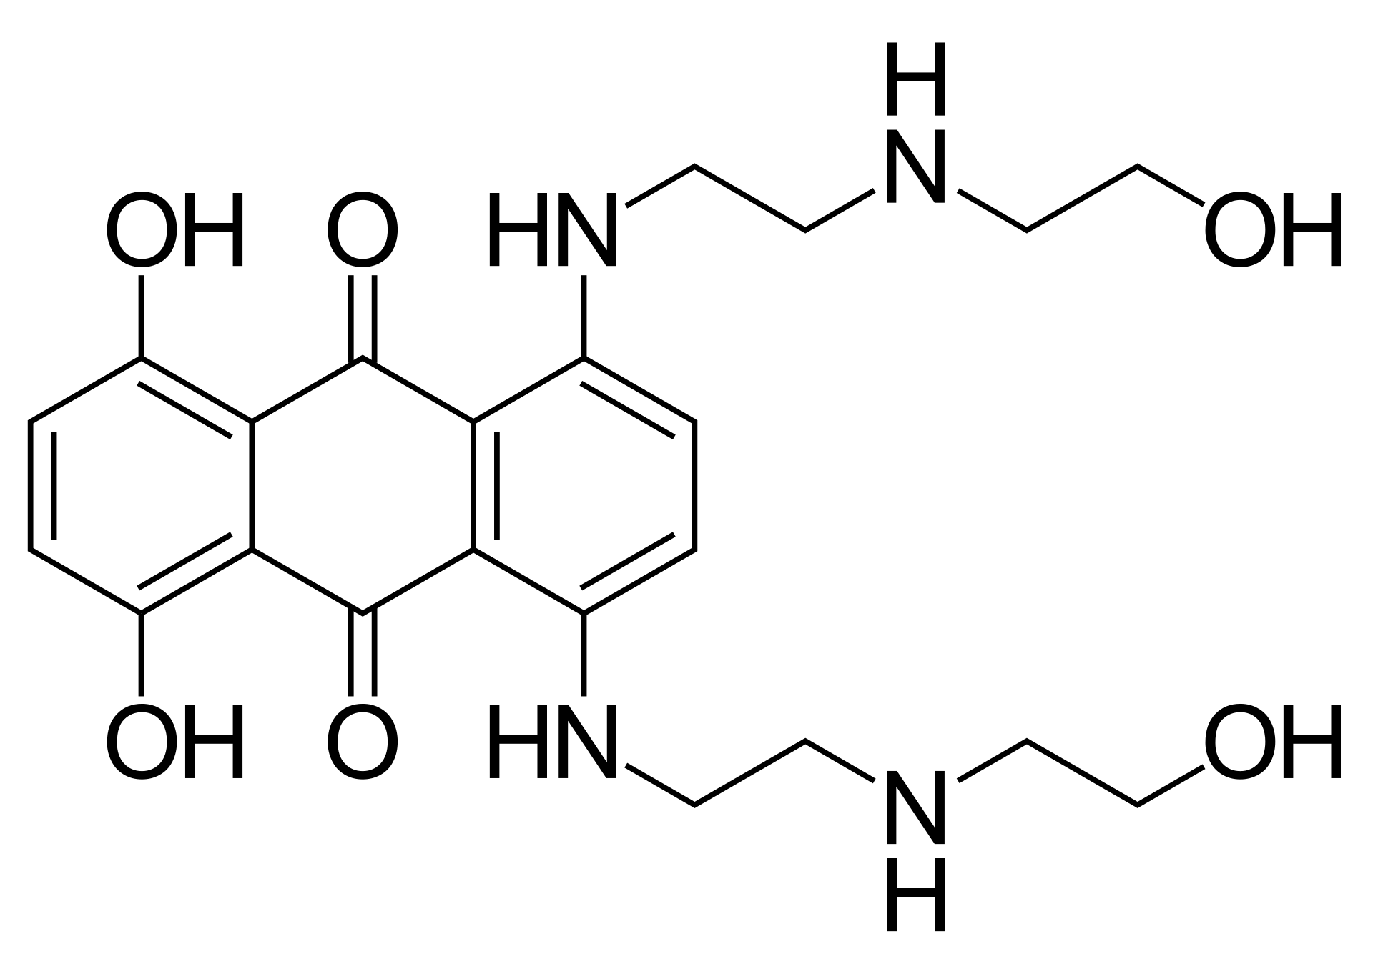
Mitoxantrone:
Acute myeloid leukemia
Acute lymphoblastic leukemia
Prostate cancer (combination with prednisone)
Multiple sclerosis
Type II topoisomerase inhibitor
(DNA intercalator)

Slide 16
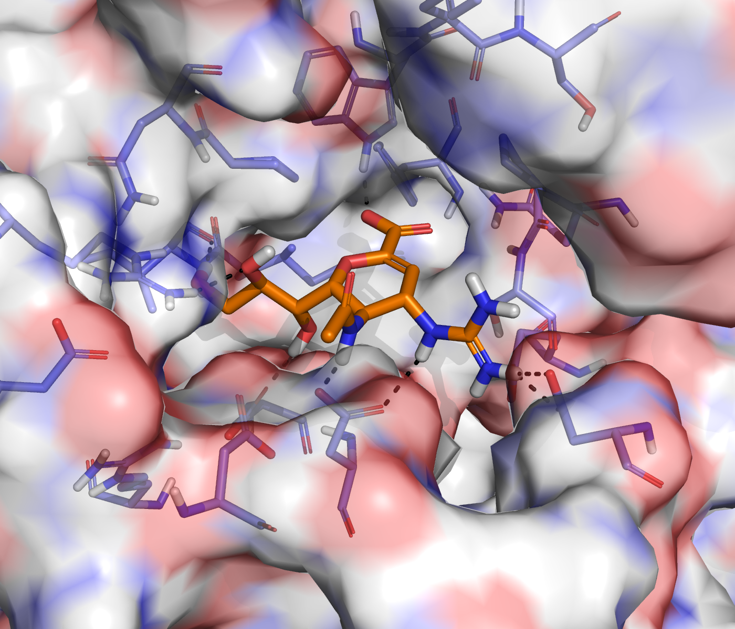
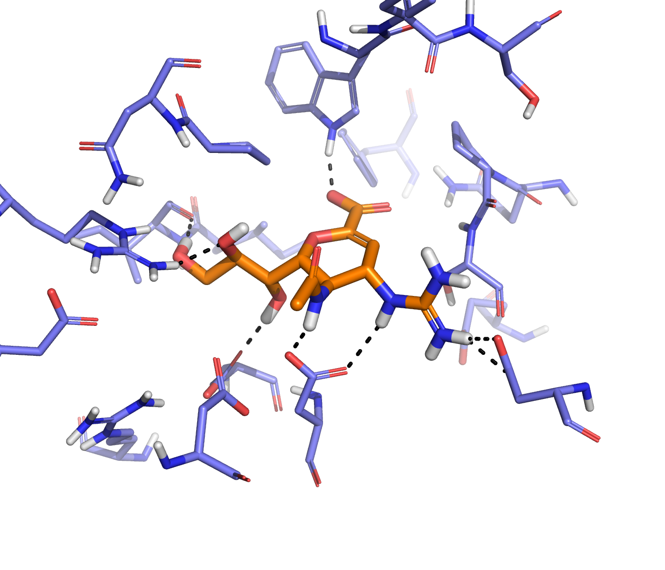
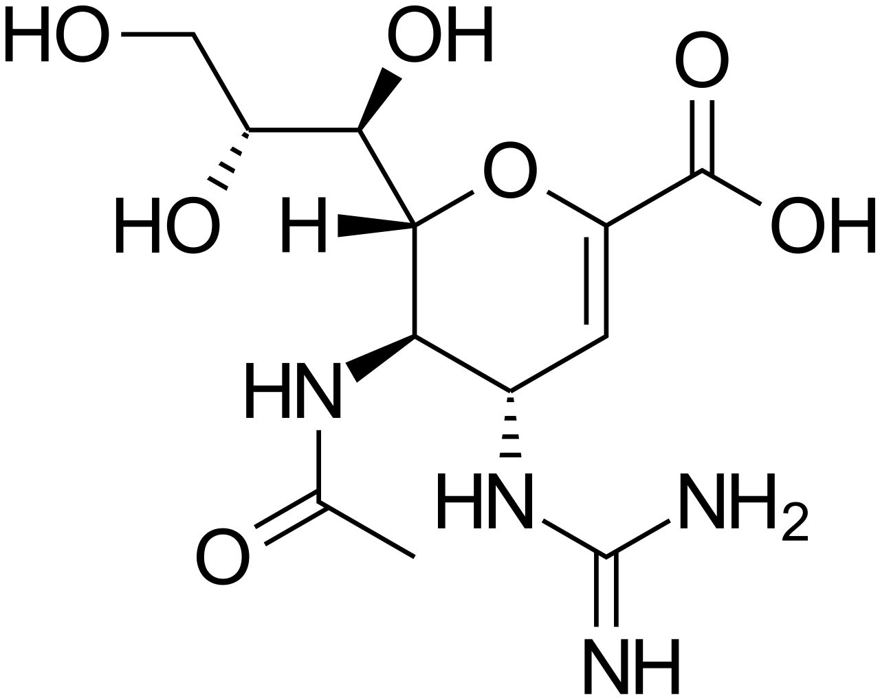
Zanamivir:
Infections caused by influenza A and B viruses
Neuraminidase inhibitor

Slide 17
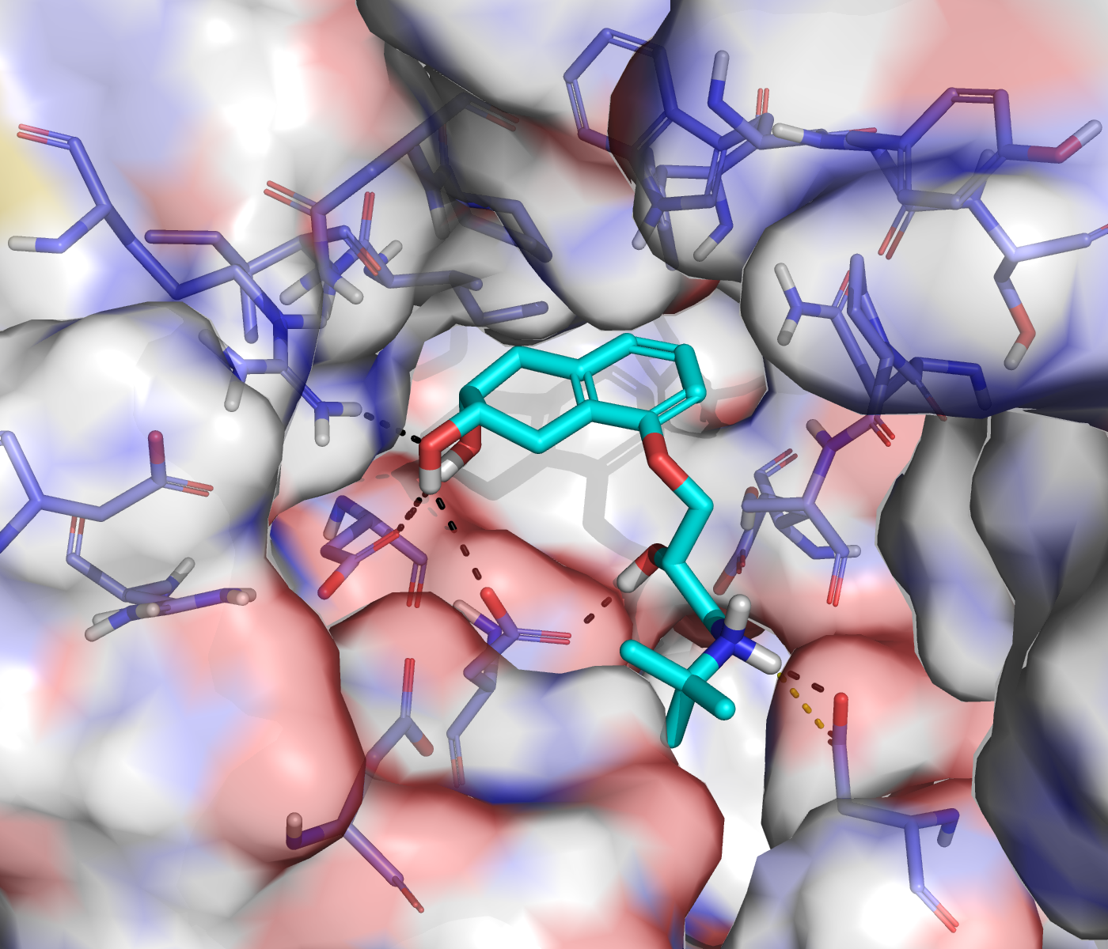
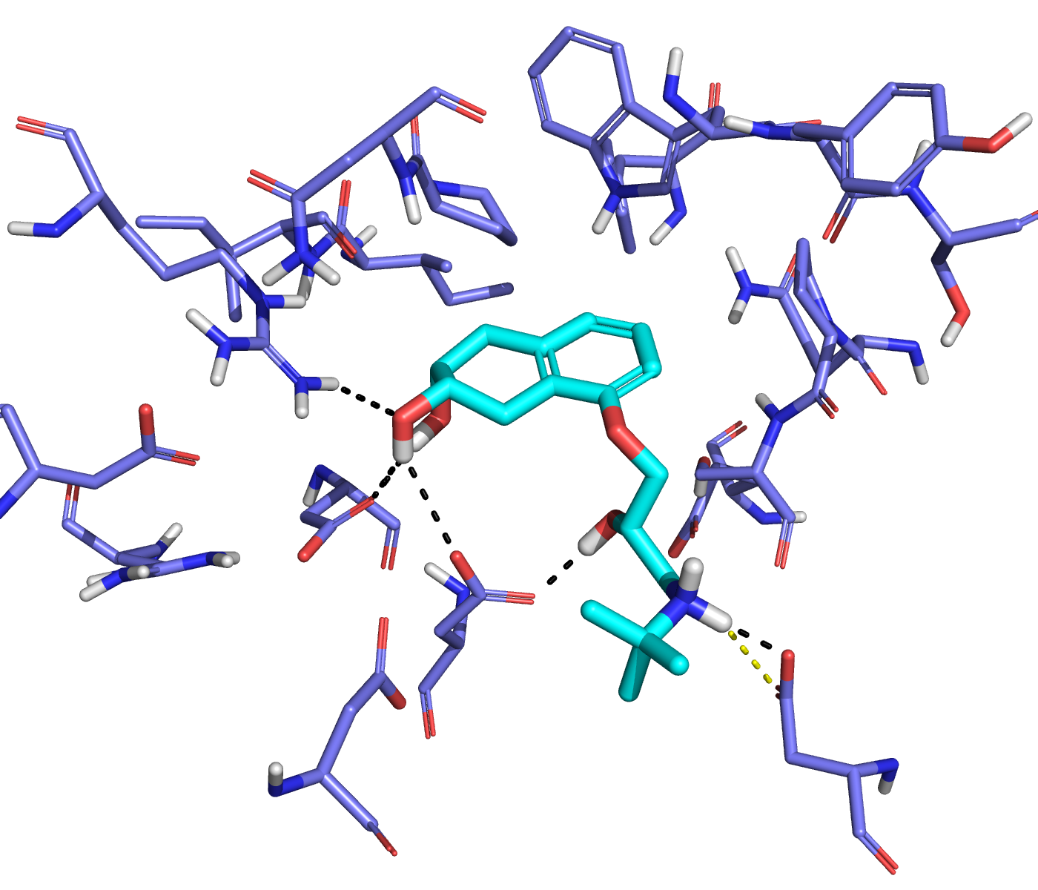
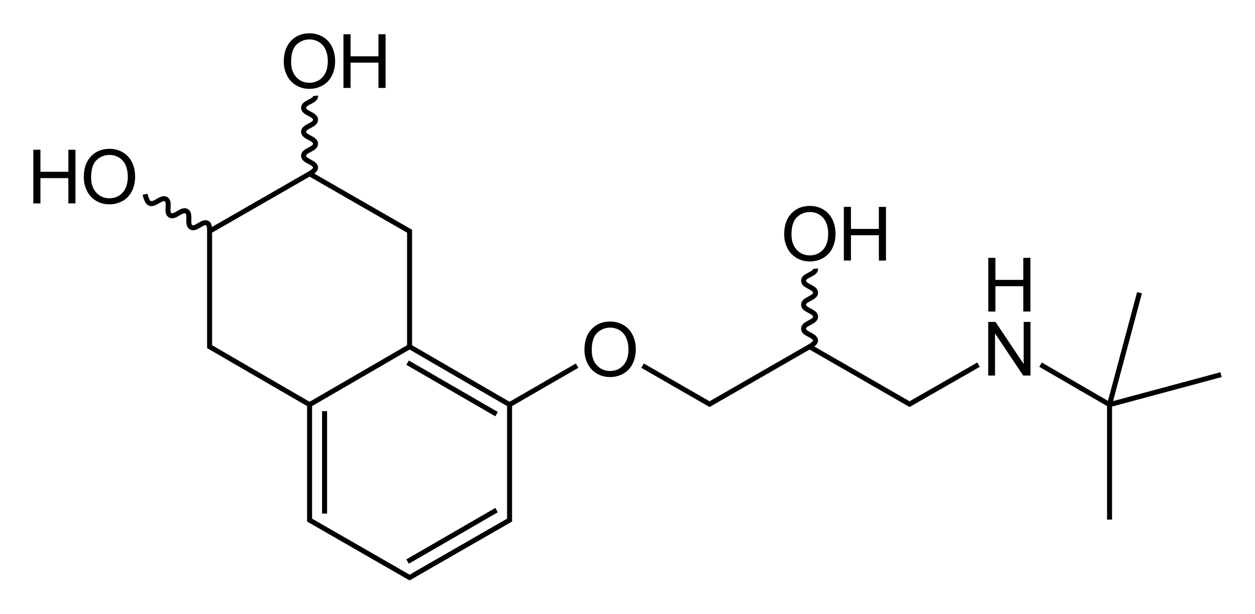
Nadolol:
Hypertension
Angina pectoris
Atrial fibrillation
Beta blocker

Slide 18
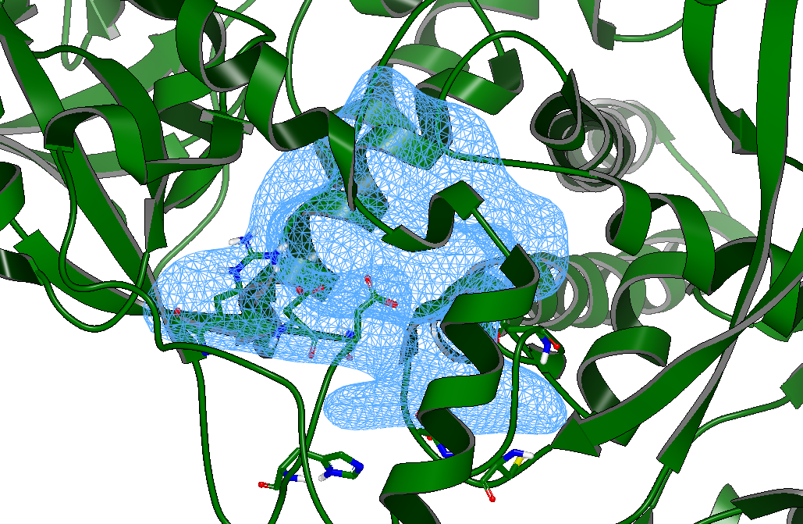
SBVS UniBO (OpenEye + DrugBank Approved)
OpenEye FixpKa
pH = 7.4
OpenEye Omega (pose mode)
Max conformers: 200/800
Molecules processed: 2588
OpenEye MakeReceptor
Pockets: 9 and 11
Volume box: 2445 Å
OpenEye FRED
Dock resolution: High
Docked molecules: 1821
ARG150
ASP140
ASP750
ASP138
ASP647
HIS144
CYS651

Slide 19
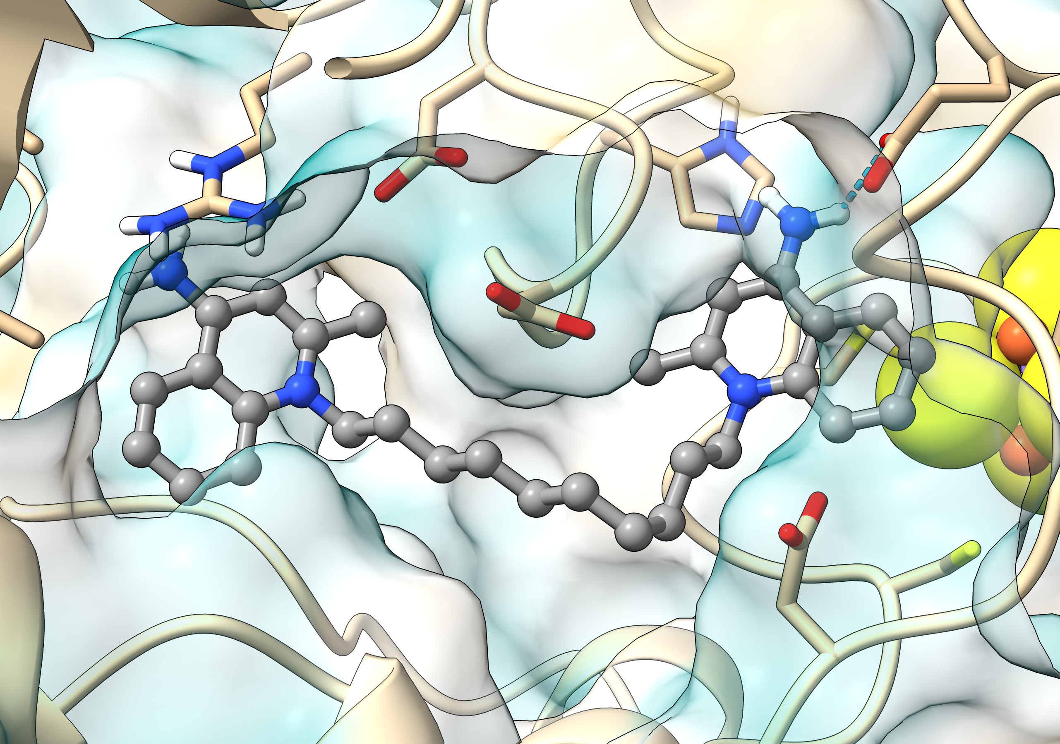
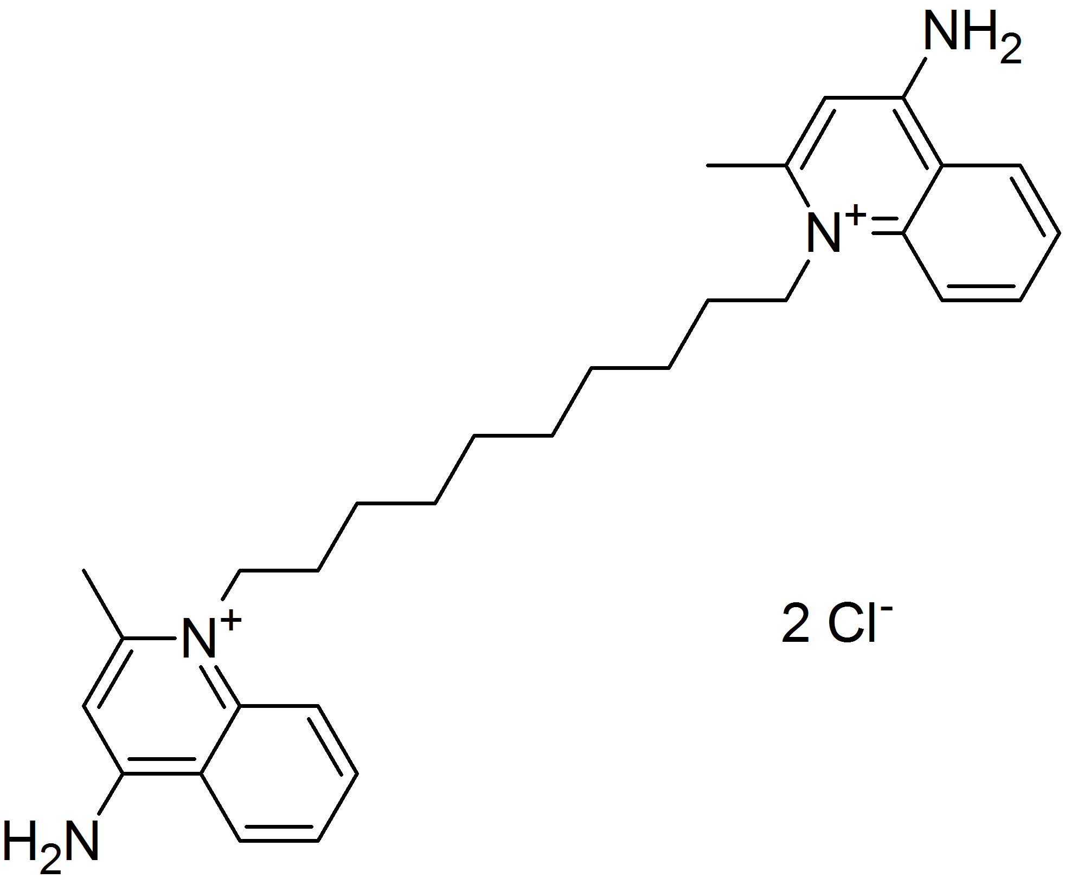
SBVS UniBO (OpenEye)
Dequalinium
Infections of the mouth and throat
Vaginal candidiasis
HIS144
ASP750
ARG150
ASP138
ASP140
Dequalinium
CYS651
ASP647
Antimicrobial agent

Slide 20
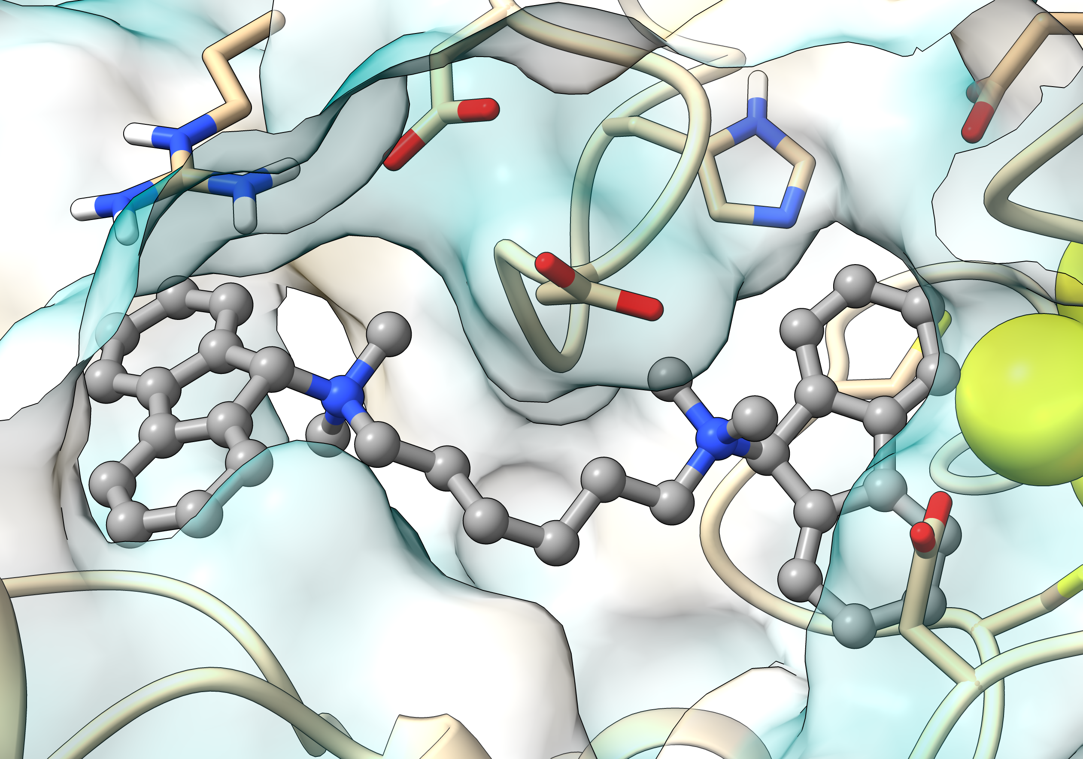
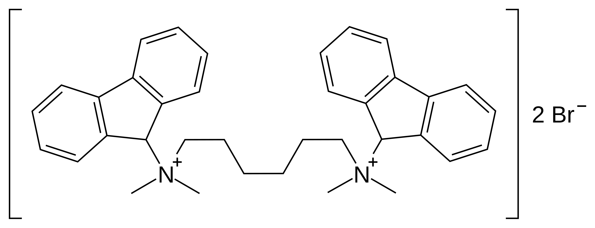
SBVS UniBO (OpenEye)
Hexafluronium
Muscle relxant
ARG150
HIS144
ASP138
ASP750
ASP140
CYS651
Hexafluronium
ASP647
Plasma cholinesterase non-competitive reversible inhibitor

Slide 21
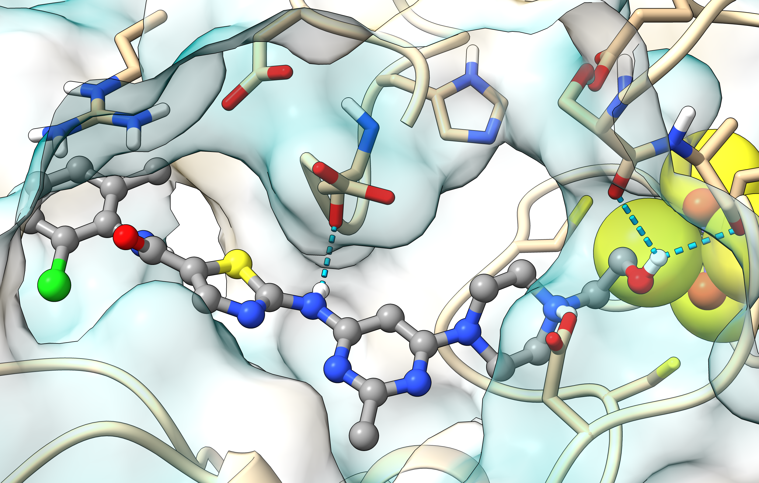
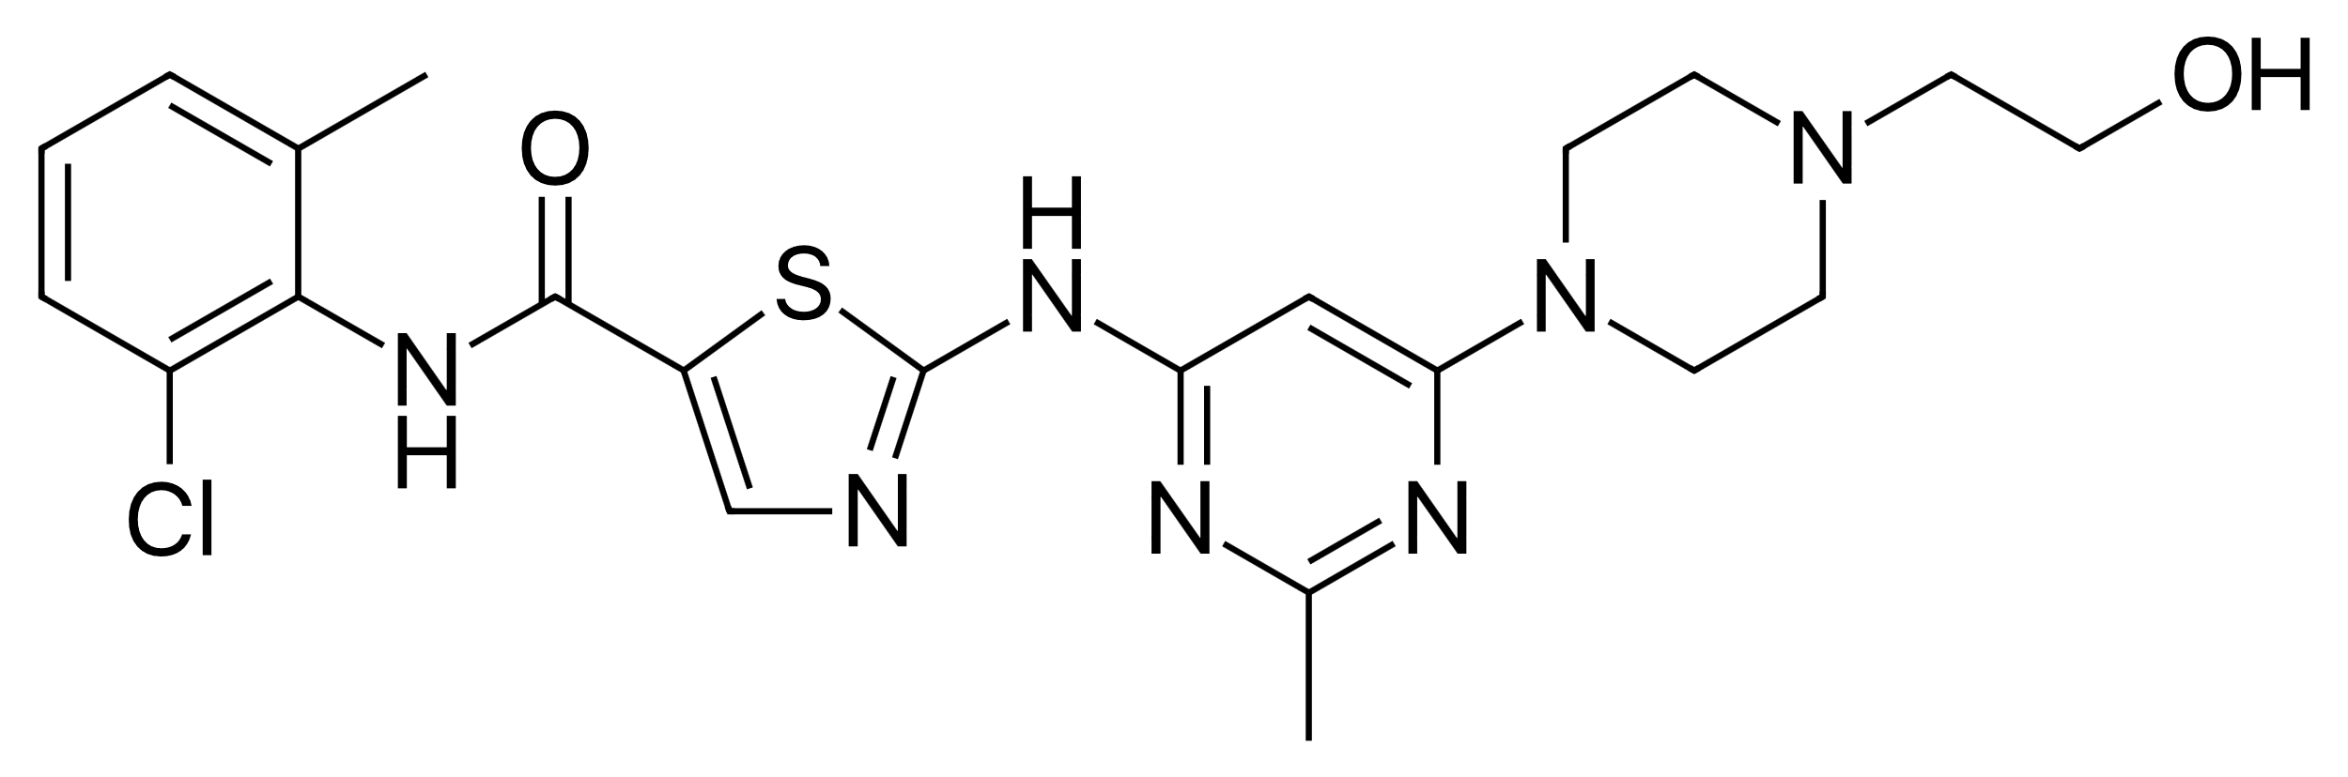
SBVS UniBO (OpenEye)
Dasatinib
Philadelphia chromosome-positive acute lymphoblastic leukemia
Chronic myeloid leukemia
ARG150
HIS144
ASP138
ASP750
ASP140
ASP647
Dasatinib
CYS651
ATP-competitive tyrosine kinase inhibitor

Slide 22
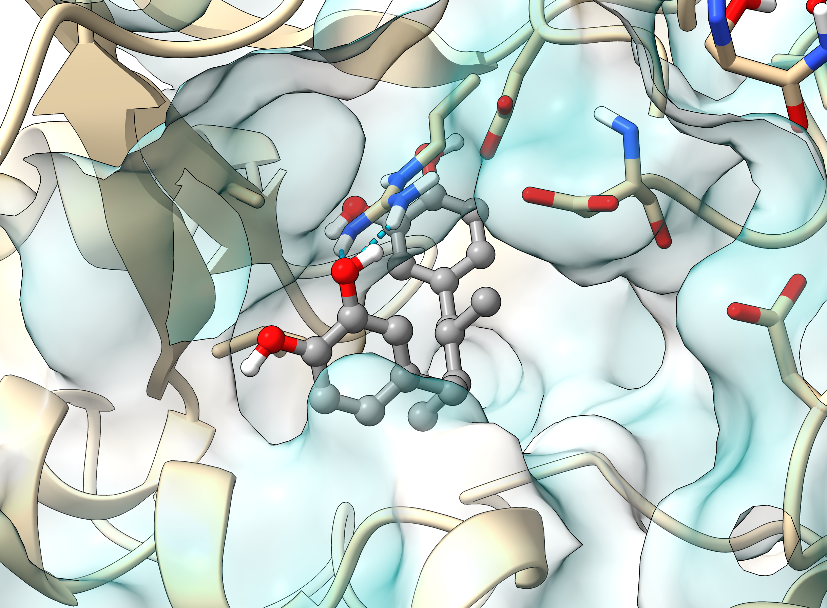
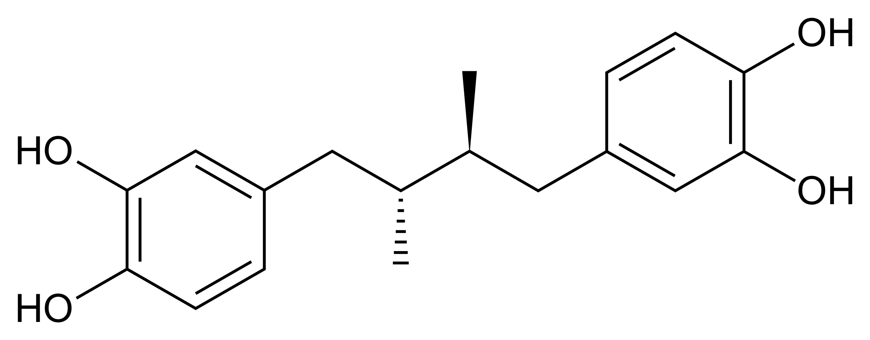
SBVS UniBO (OpenEye)
Masoprocol
Actinic keratoses
Antineoplastic agent
ASP138
ARG150
ASP140
ASP647
Masoprocol
Lipoxygenase inhibitor

Slide 23
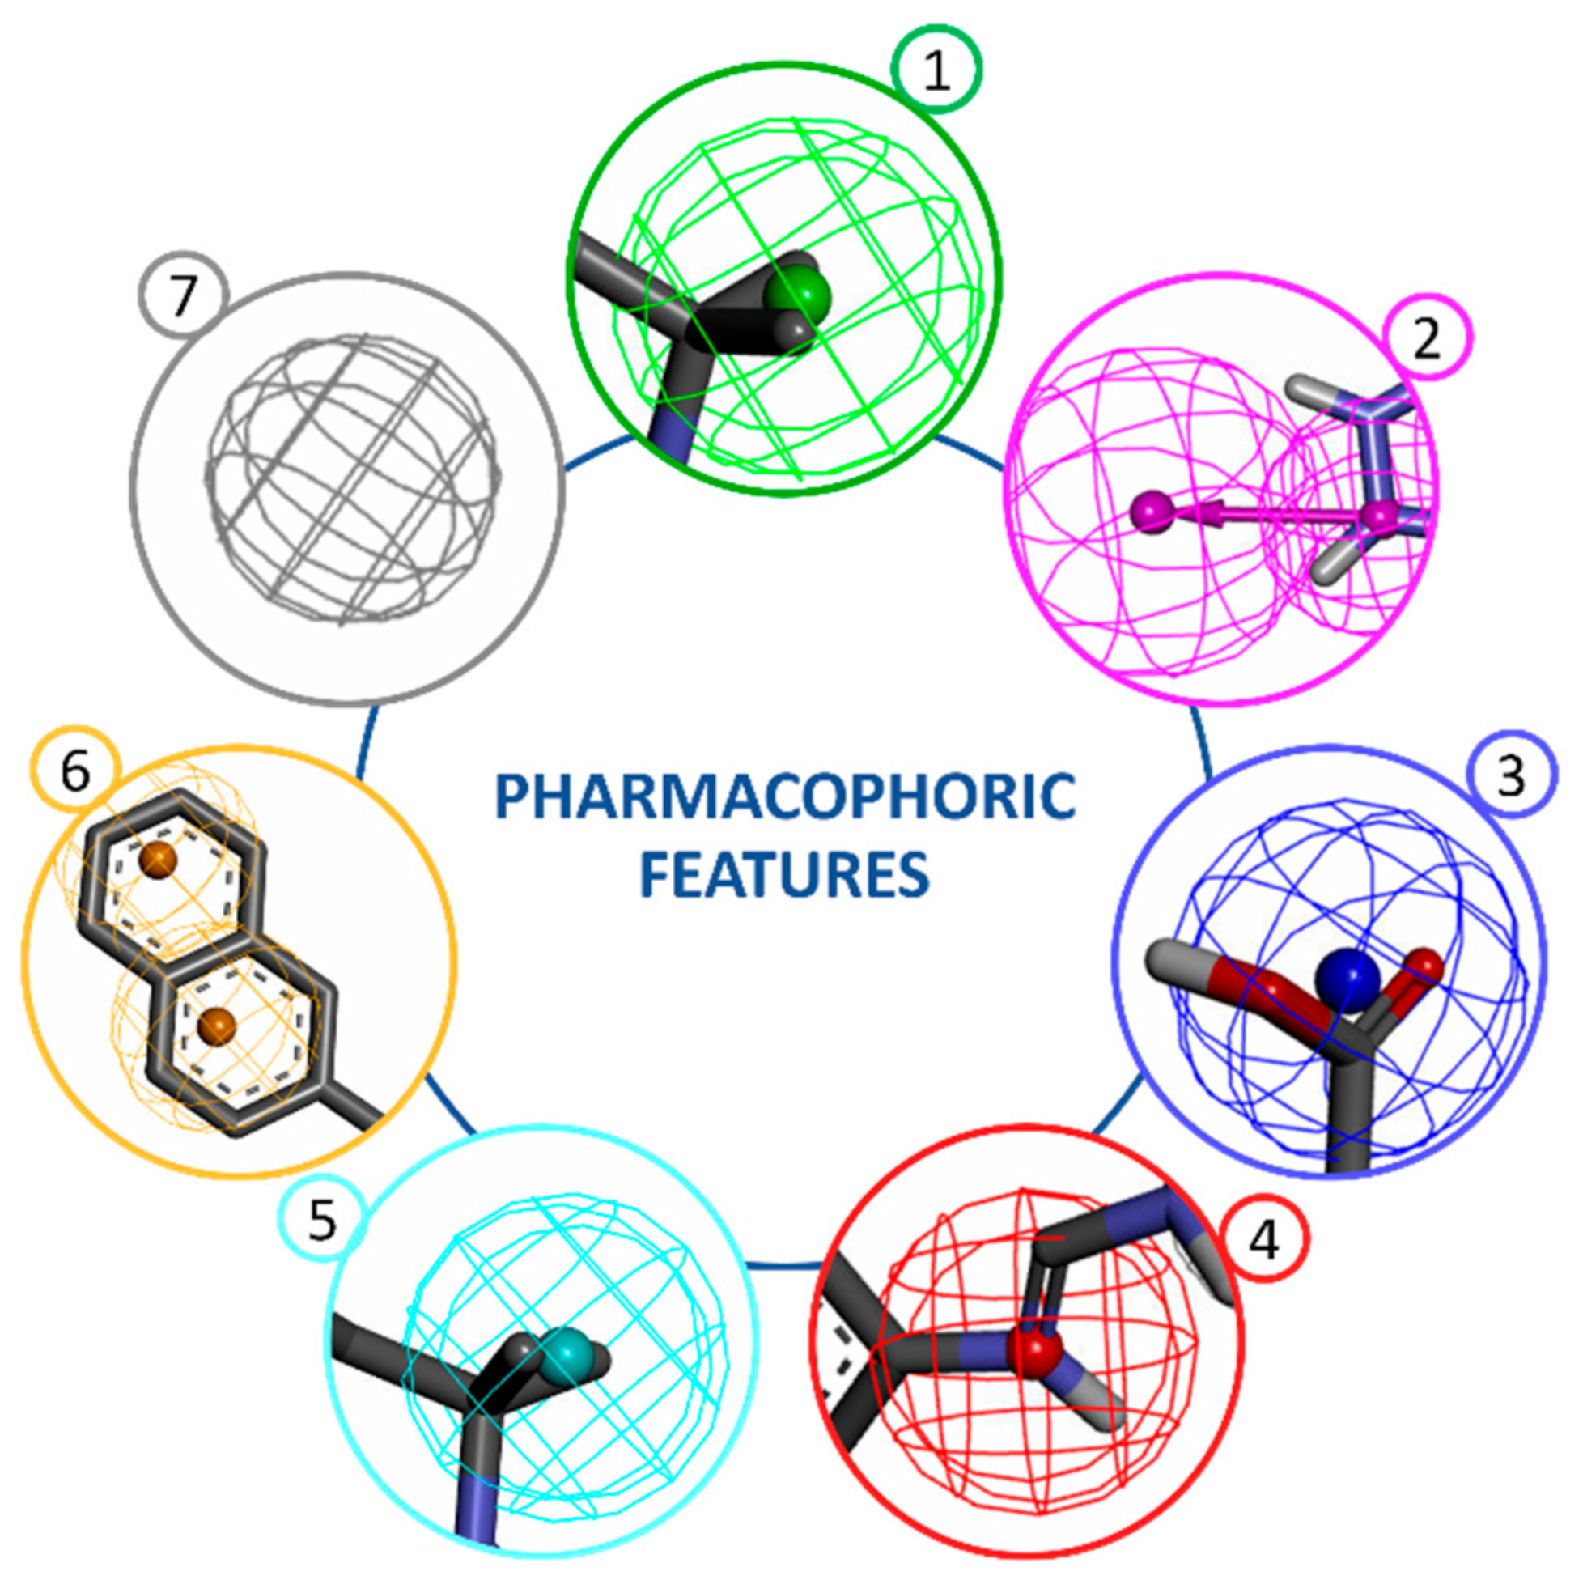
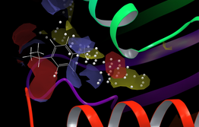


CN – HPC Spoke 8 – WP6 Drug-target studies and drug repurposing
Task 6.2 – Drug repurposing studies using novel target and the FDA-approved drug database
Approach
on novel targets
(PolE)
PDB
AlphaFold2
Modelling
Target 3D structure
BS mapping with
probe molecules
and pharmacophore generation
Structure-based/
biophysics-based
VS
Potential binding sites (BS)
identification/characterization
Identification of leads close to clinical application, production, and market
Pharmacophore-based VS

Slide 24
In progress…
PolE catalytic subdomain
Pocket selection for the first cluster (pocket 9)
Pocket analyses for the second and third clusters
Molecular Docking and induced fit
MD simulations on the most promising PolE/ligand complexes
MM_GBSA and other analyses
PolE/PolE2/PolE3/PolE4 complex
MD simulations on the whole PolE/PolE2/PolE3/PolE4 complex
Comparison between MD simulations on the PolE catalytic subdomain
and the PolE/PolE2/PolE3/PolE4 complex

