Slide 1
CN-HPC Spoke 8 plenary meeting
WP5 - Updates
Benchmarking CPU- and GPU-optimized
ML workflows on TCGA omics data
Jun 24, 2024
Marco Chierici
joint work with
Andrea Zen & Walter Endrizzi
Fondazione Bruno Kessler
chierici@fbk.eu
www.fbk.eu

Slide 2
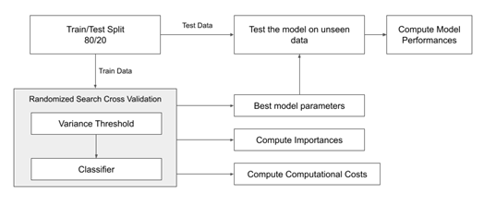
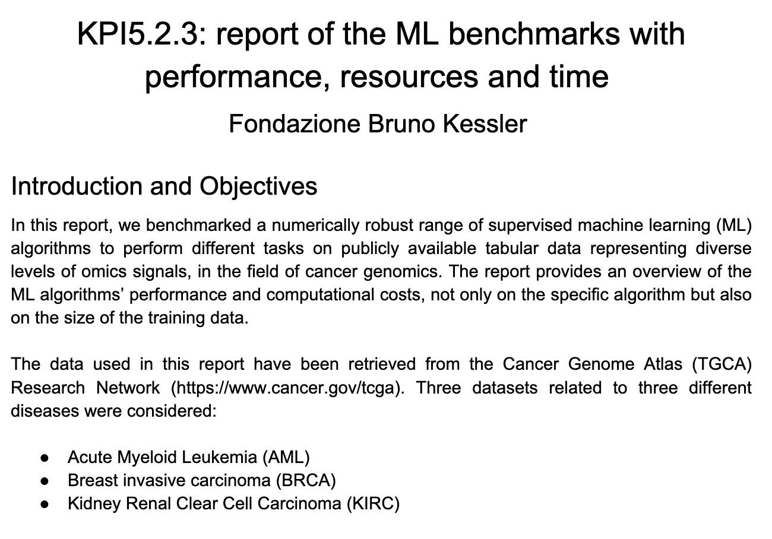
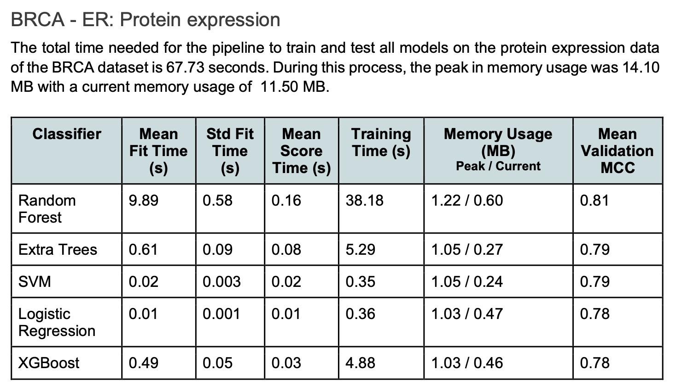
previous work
march 2024

Slide 3


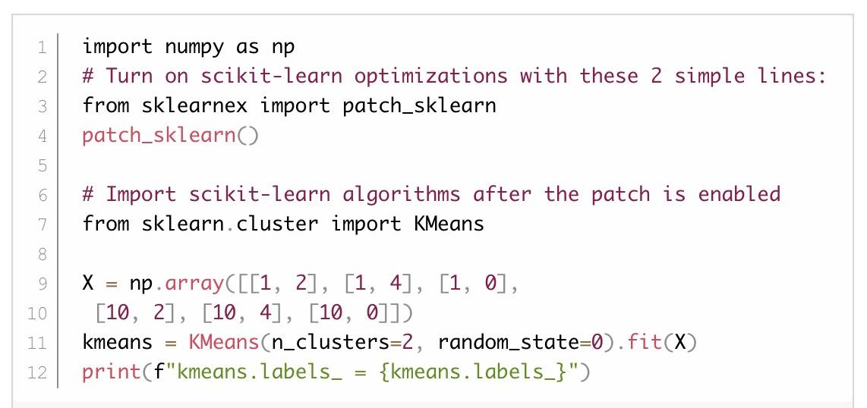

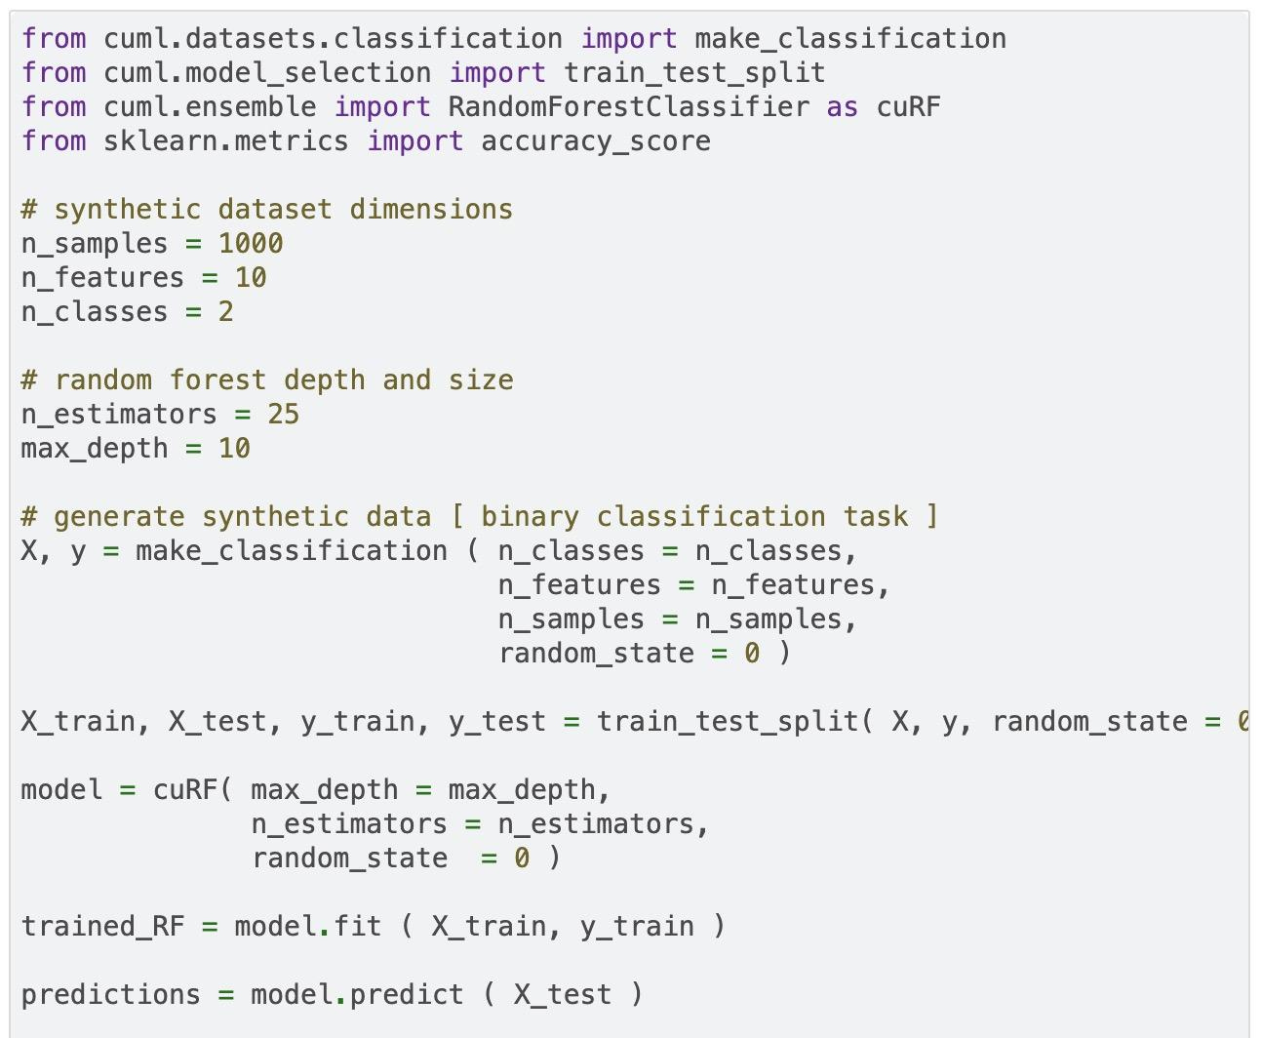

benchmark framework
Data
TCGA-BRCA gene expression
(381 patients, 17814 predictors)
Tools
Python & scikit-learn
Intel® extensions for scikit-learn
(CPU: single vs multicore on i7-1370P)
RAPIDS cuML Random Forest implementation (GPU)
XGBoost native implementation (GPU)
work in progress!
Notes:
Intel extensions:
Speed up scikit-learn (sklearn) algorithms by replacing existing estimators with mathematically-equivalent accelerated versions.

Slide 4
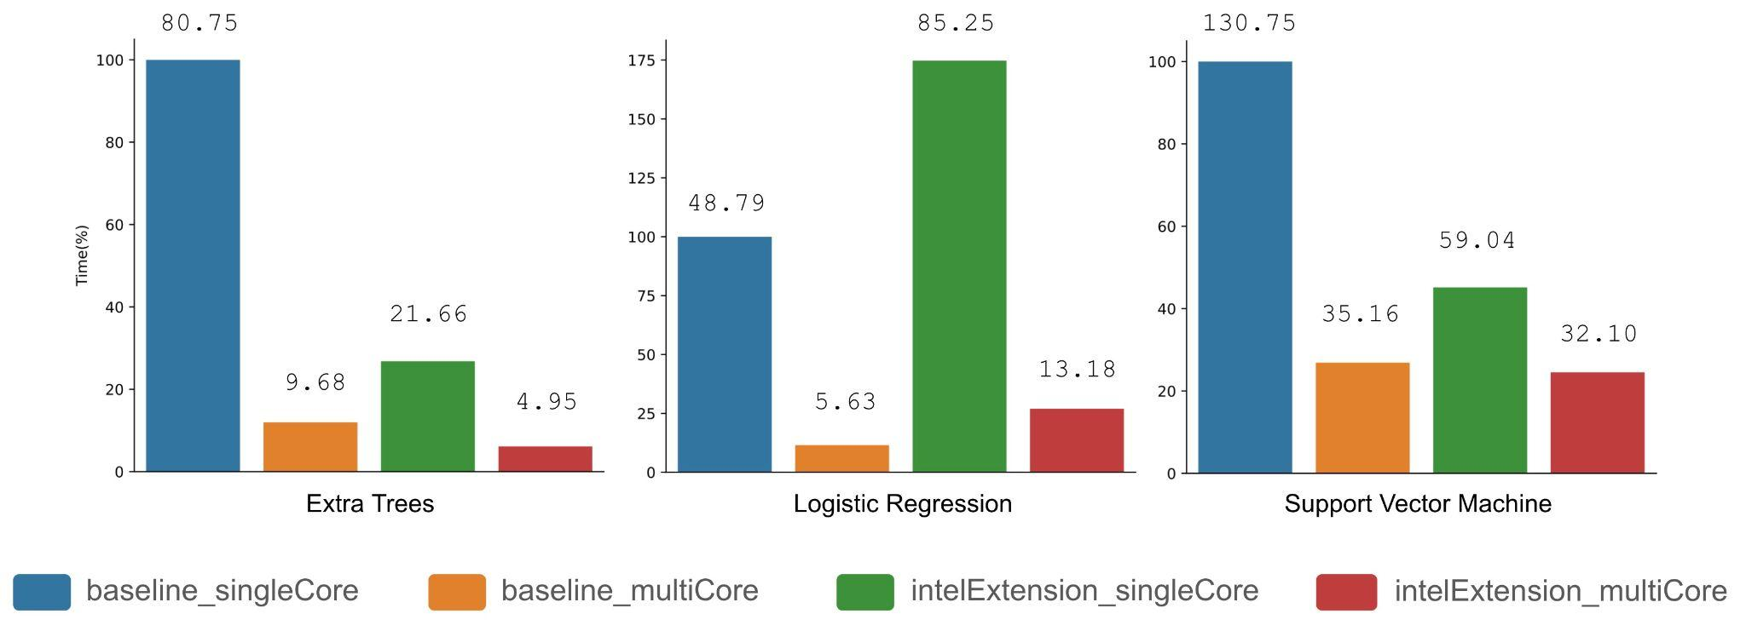
results
CPU (non-optimized vs optimized)
Scikit-learn on single vs multicore CPU:
non-optimized (baseline) vs optimized (Intel Extensions), Intel i7-1370P
numbers are overall training times in seconds

Slide 5
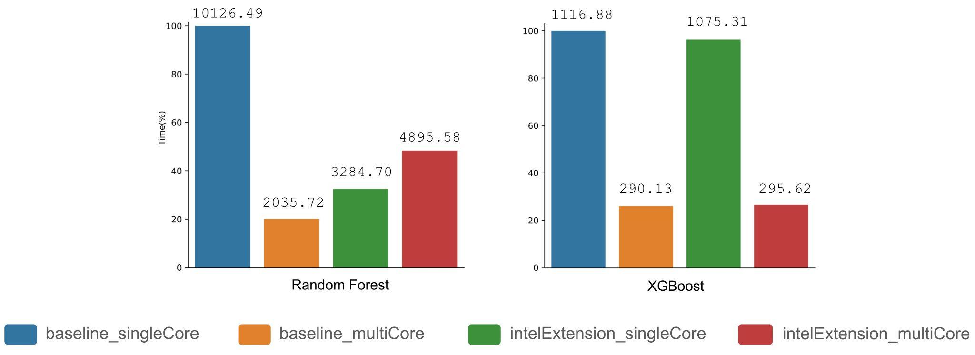
results
CPU (non-optimized vs optimized)
Scikit-learn on single vs multicore CPU:
non-optimized (baseline) vs optimized (Intel Extensions), Intel i7-1370P
numbers are overall training times in seconds

Slide 6
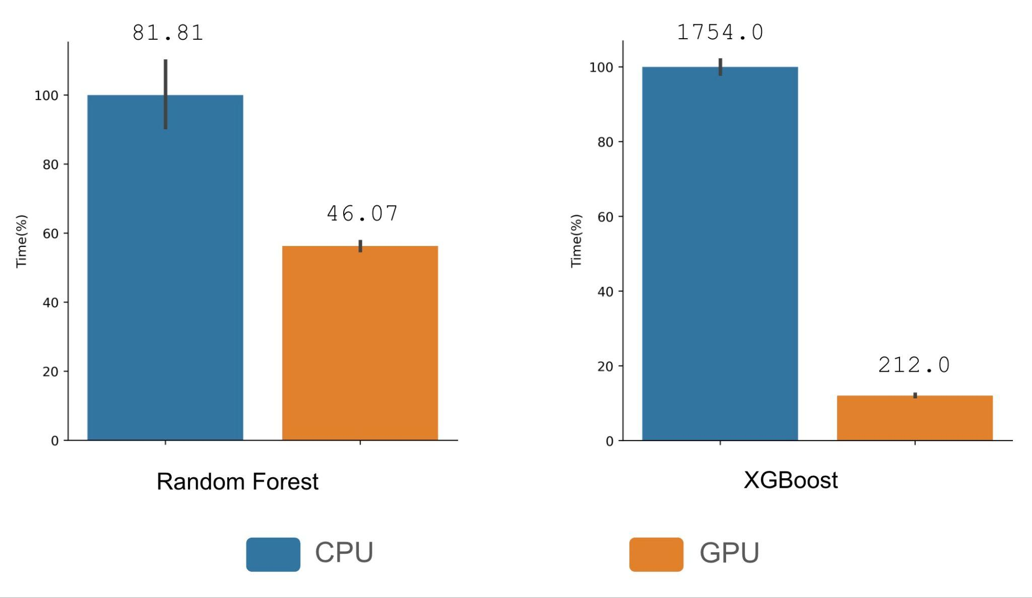
results
CPU vs GPU
Random Forest and XGBoost:
CPU vs GPU (Google Colab)
numbers are overall training times in seconds
Notes:
Colab T4 GPU

Slide 7
discussion
CPU: scikit-learn’s multicore implementations are the fastest
  even compared to Intel® extensions
GPU implementations (cuML and native XGBoost) are faster than CPU, but need finer assessment
Ongoing & future work:
benchmark environment (e.g. VMs, dedicated server, HPC)
additional data sets

Slide 8

thank you / grazie !

