Slide 1
CN-HPC Spoke 8 plenary meeting
WP5 - Updates
Enhancing ML models
by synthetic omics data:
recent advancements in generative AI
for medical tabular data
Jun 24, 2024
Marco Chierici
joint work with
Silvia Menchetti & Giuseppe Jurman
Fondazione Bruno Kessler
chierici@fbk.eu
www.fbk.eu

Slide 2
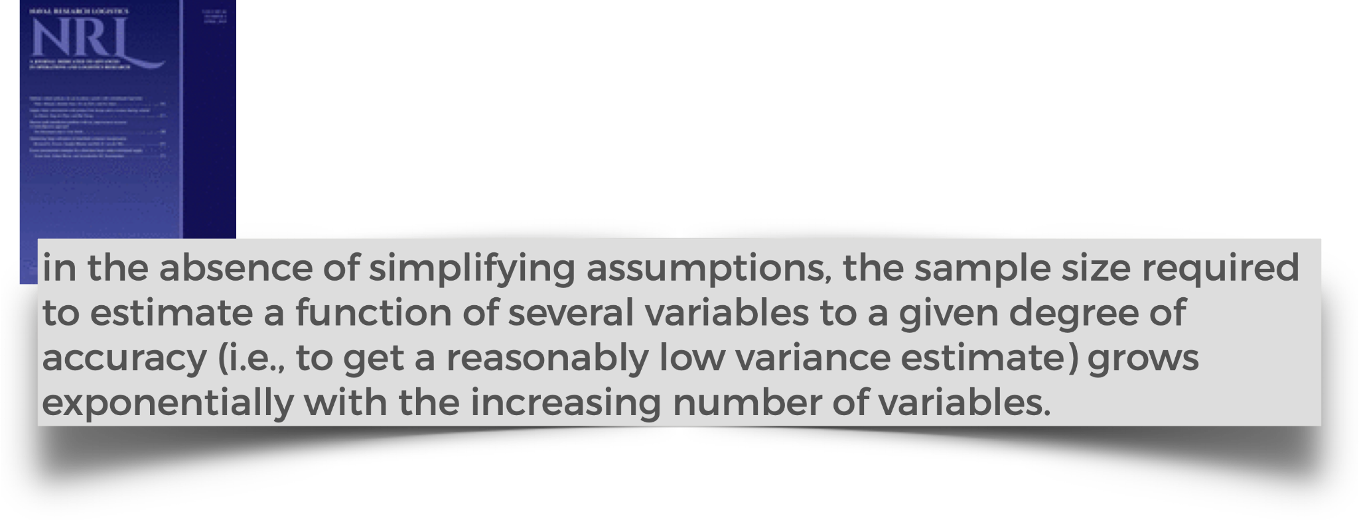
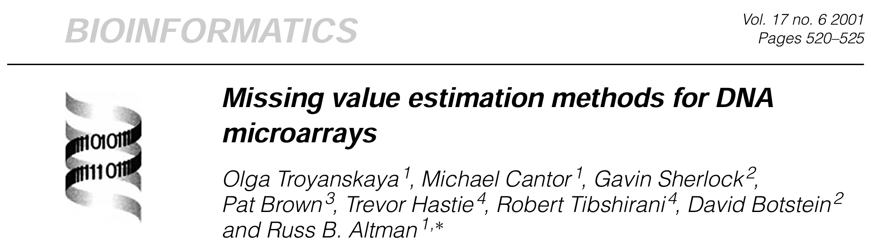
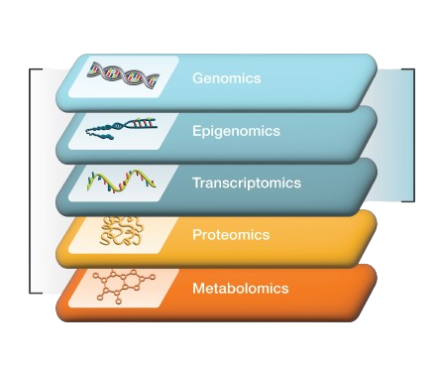
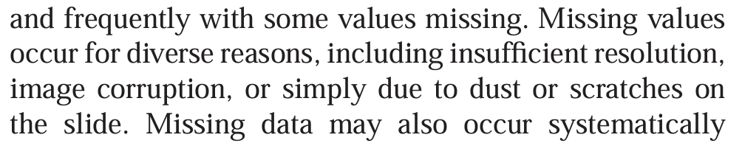
omics issues
dataset shift
the curse of dimensionality, aka
the hughes phenomenon
sparsity (p >> n)
adaptive control processes: a guided tour, 1961
missing data
multiple levels

Slide 3
synthetic data
in omics
imputation
augmentation
integration

Slide 4
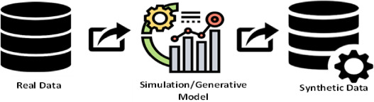

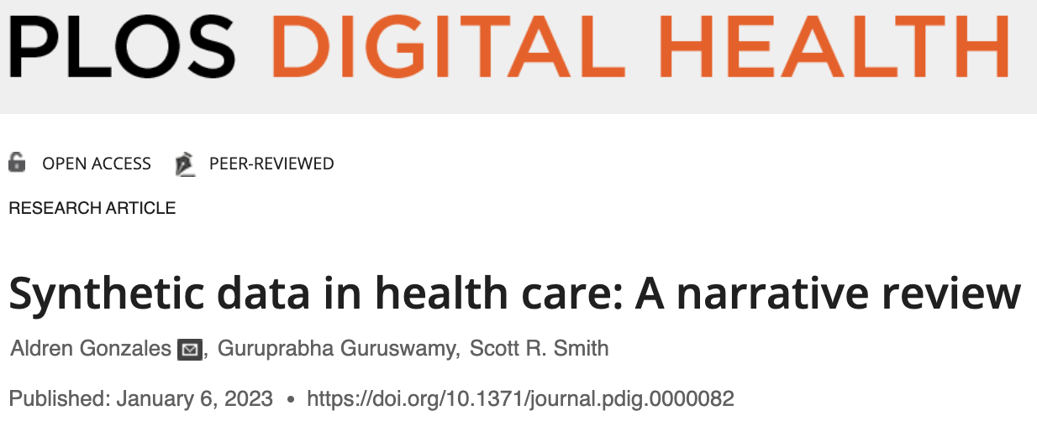
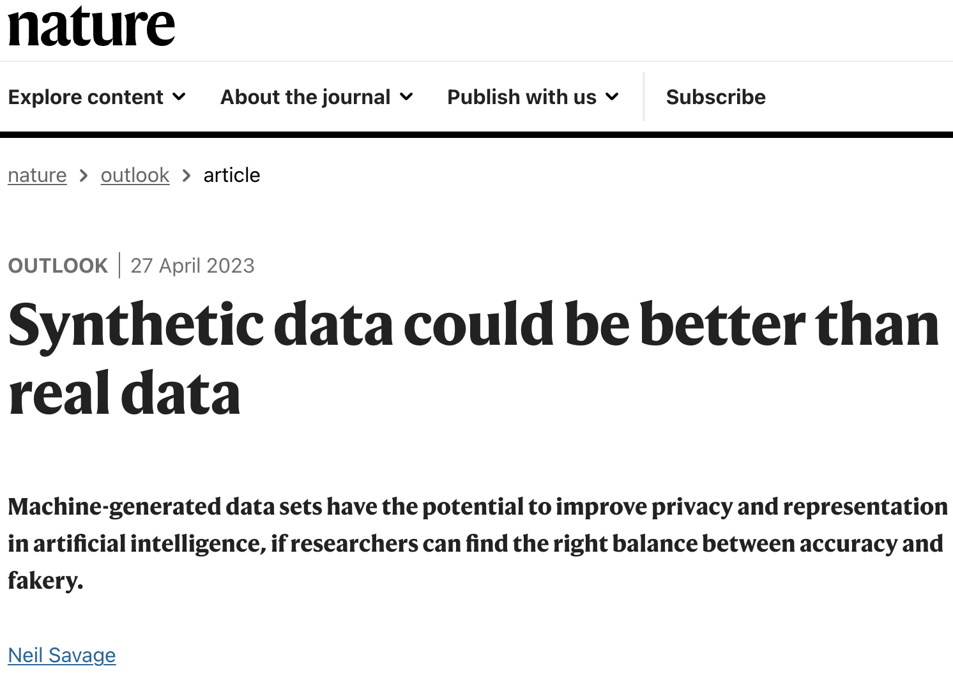
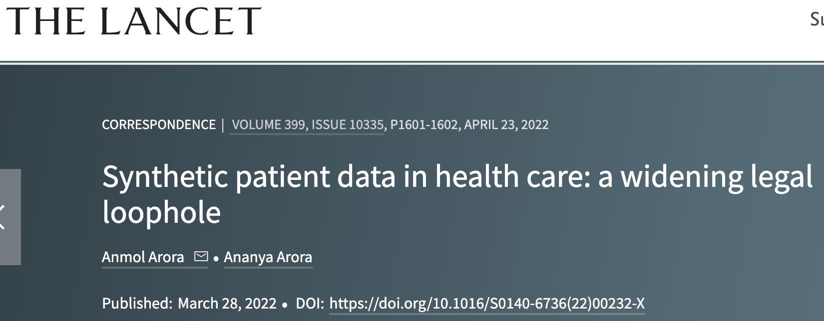
synthetic data: ai as a generator engine
definition & use
"microdata records created by statistically modeling original data and then using those models to generate new data values that reproduce the original data’s statistical properties"
improve model training performance
dealing with privacy issues
enhancing the dataset structure/diversity
providing an educational alternative

Slide 5
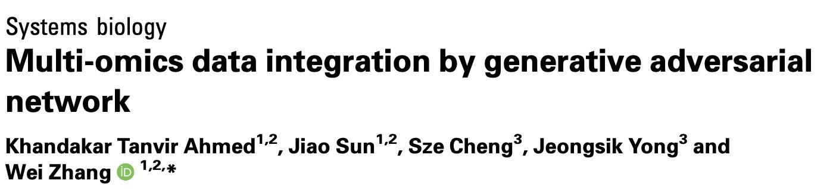
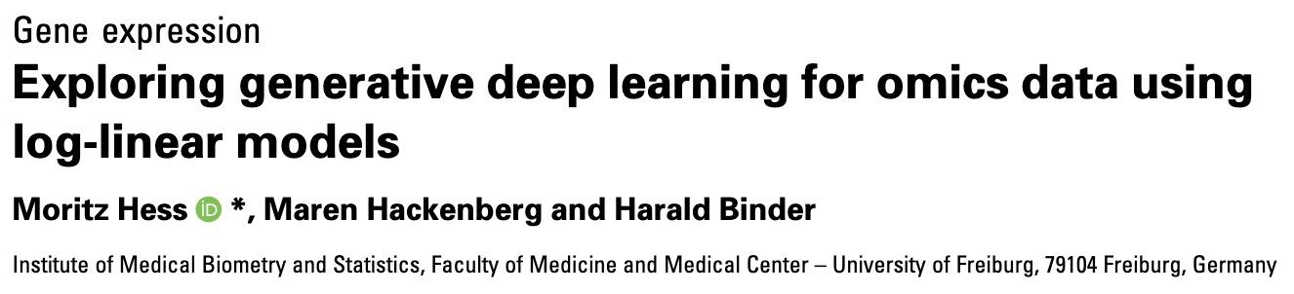
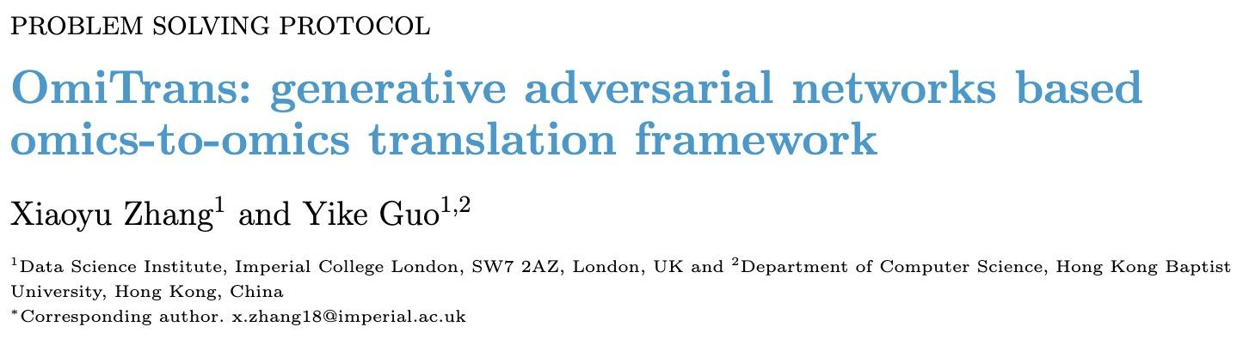
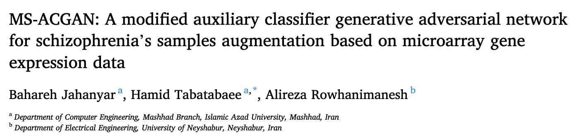
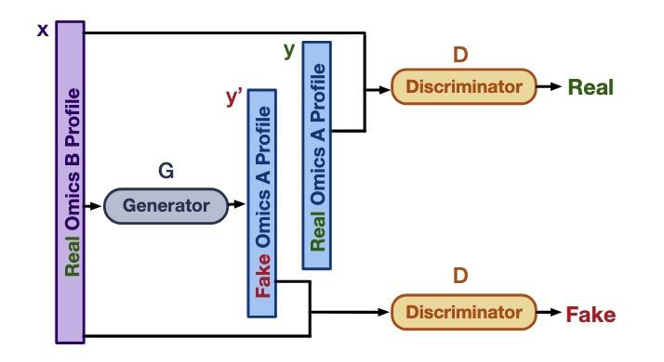
generative ai for…
filling gaps (feats & samples)
multiomics integration
Bioinformatics, 2021
bioinformatics, 2020
IEEE Int C Bioinform, 2022
computers in biology and medicine, 2023
generative-based data augmentation provides a significant boost in classification performance
Notes:
by providing a generative model for the latent and observed variables, deep generative models can generate synthetic observations, which allow us to assess the uncertainty in the learned representations.
omitrans: can reconstruct gene expr data from DNA meth

Slide 6
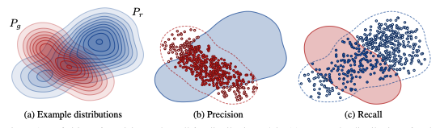
evaluation
unsupervised: distribution
frechet distance - the similarity between true and generated data based on the last hidden layer of an MLP trained to discriminate tissue types.
precision/recall - the distance between true and fake distributions considering the intrinsic dimensionality of their support.
f1-score: the harmonic mean between precision and recall measures.
adversarial accuracy: 1-nn accuracy discriminating true from generated data
correlation score: distance between the correlation matrices of true and generated data using pearson correlation scores.
Notes:
Frechet inception distance (2017). 2-Wasserstein distance between multi-variate Gaussians fitted to data embedded into a feature space.
https://en.wikipedia.org/wiki/Fr%C3%A9chet_inception_distance
https://en.wikipedia.org/wiki/Wasserstein_metric
Precision, Recall, F1 score: used to quantify the degree of overfitting in GANs, often over toy datasets
Adversarial Accuracy. Computes the classification accuracies achieved by the two classifiers, one trained on real data and another on generated data, on a labeled validation set

Slide 7
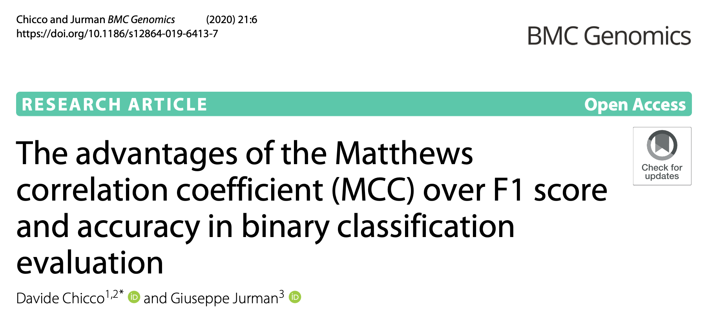
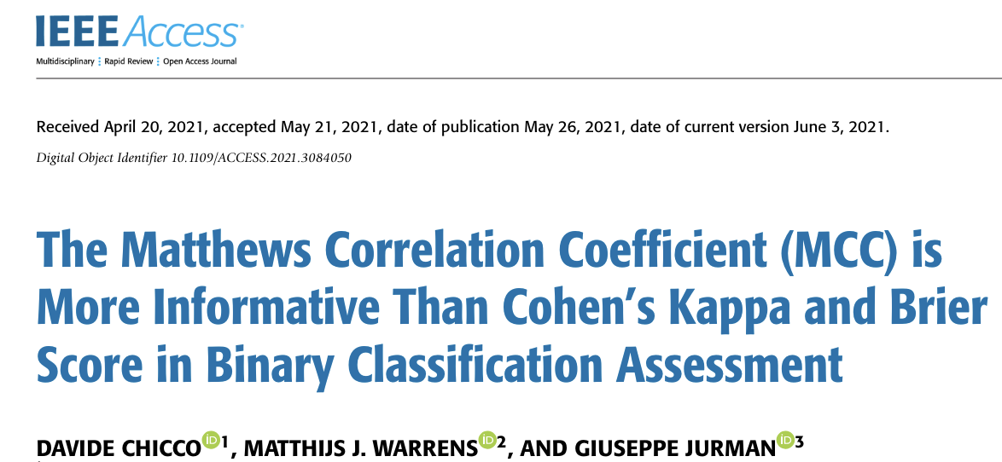
evaluation
supervised: effectiveness
strategy
metrics
reverse validation
compute the performance of a classifier trained only on generated data
data augmentation
compute the performance of a classifier trained on n true samples and k generated samples
accuracy
f1-score
brier score
…
mcc

Slide 8
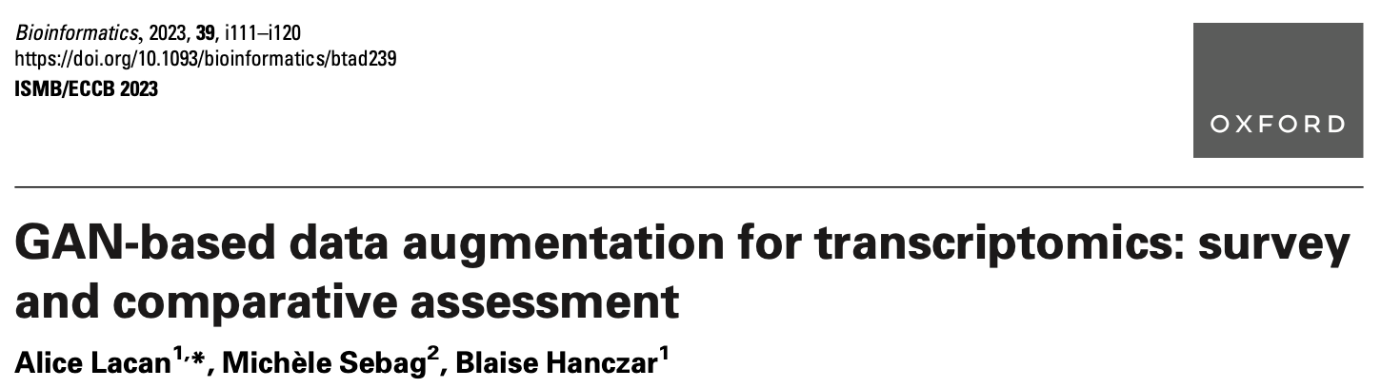
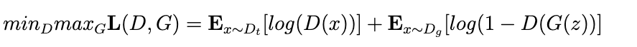
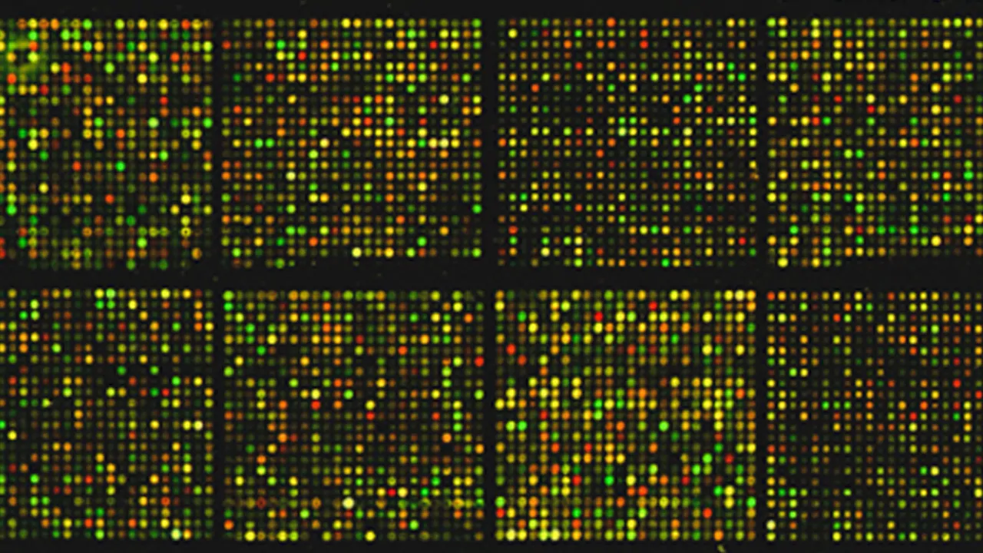


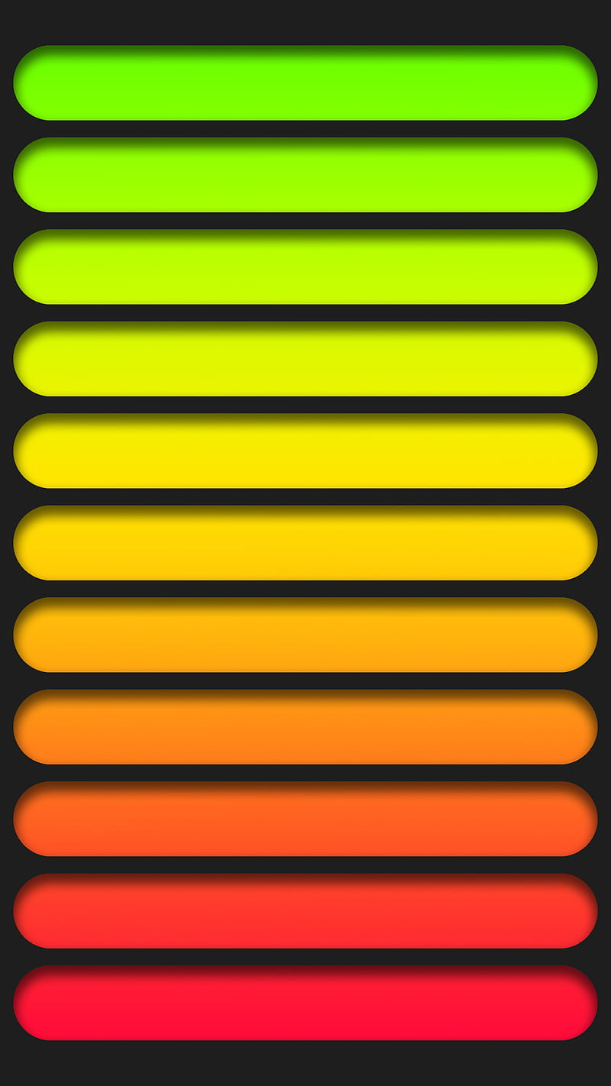


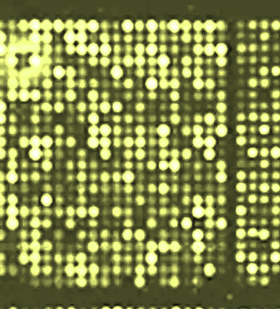
enriching the model
gan variations
basic gan
“generator”
“discriminator”
Notes:
G and D are trained simultaneously but with opposing goals. G aims to produce realistic data samples to fool D, while D aims to distinguish between real and generated samples.
GAN training typically unstable due to the adversarial nature. When G finds an output that successfully fools D, it may start to overemphasize it, neglecting other parts of the data distribution.
Ideally, training should lead to Nash equilibrium (G produces a wide variety of realistic samples, and D cannot distinguish between real and fake).
It is difficult to reach this equilibrium and imbalances can lead to “mode collapse” = lack of diversity in generated data; poor generalization of the entire data distribution.
Mitigation of mode collapse: regularization (adding noise to the input of D; dropout); minibatch D (evaluate multiple samples at once so to detect lack of diversity in G output); Wasserstein GANs, WGAN-GP

Slide 9
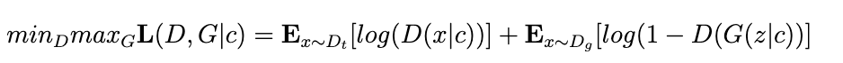

enriching the model
gan variations
conditional gan
covariates
Notes:
they allow the model to conditionally generate samples based on additional information. For example, if we want to generate a cat face given a dog picture, we could use a conditional GAN.
GANs can be trivially extended to conditional GANs by providing the labels to both the generator and the discriminator.

Slide 10

enriching the model
gan variations
wasserstein gan gradient penalty
d( , )
“critic”
(discriminator)
covariates
Notes:
Wasserstein distance (WD) to evaluate the diff. between real and generated data distribs
Discriminator = “critic”. Its loss function ~ Wasserstein distance.
G aims to minimize WD; C aims to maximize WD.
Weights of C are clipped to a small fixed range, thus enforcing the Lipschitz constraint and preventing C from becoming too powerful
WGAN-GP: gradient penalty, instead of weight clipping, enforces the Lipschitz constraint (GP term added to C’s loss function) -> gradient norm of C’s output w.r.t its input is close to 1
Better empirical performance, higher quality generated samples

Slide 11

enriching the model
gan variations
attention layered wasserstein gan gradient penalty
d( , )
gene interactions
(high correlation or PPI)
covariates
Notes:
Self-attention layer polishes G output accounting for dependencies among the features (genes).
Attention module: genes with high correlations and/or high protein-protein interactions

Slide 12

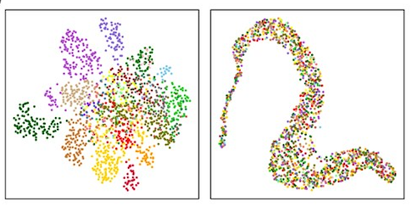
comparative evaluation
on tcga
9749 samples
20 531 gene expression level
6499, 1625, 1625 train/validation/test
33 cancer types
24 tissue types
unsupervised (umap)
true
synth
gan

Slide 13
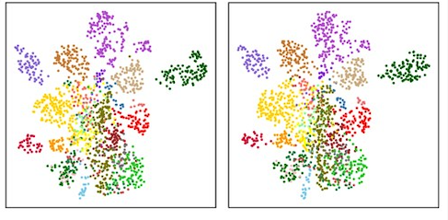
comparative evaluation
on tcga
9749 samples
20 531 gene expression level
6499, 1625, 1625 train/validation/test
33 cancer types
24 tissue types
unsupervised (umap)
true
synth
attgan

Slide 14
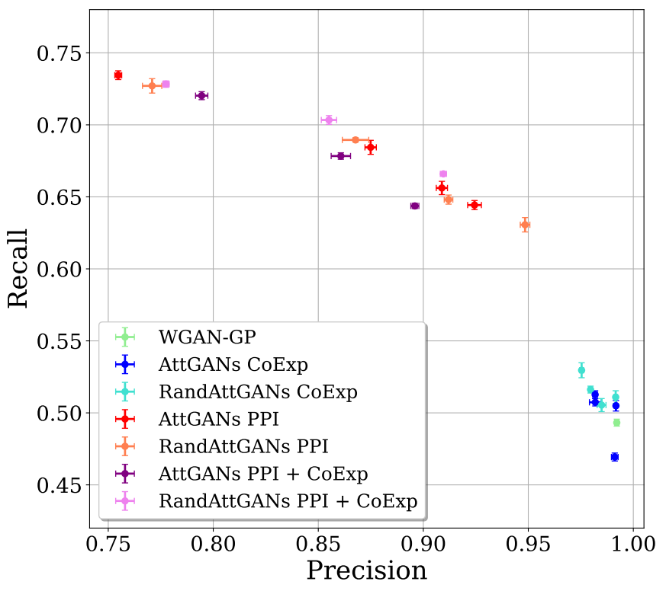
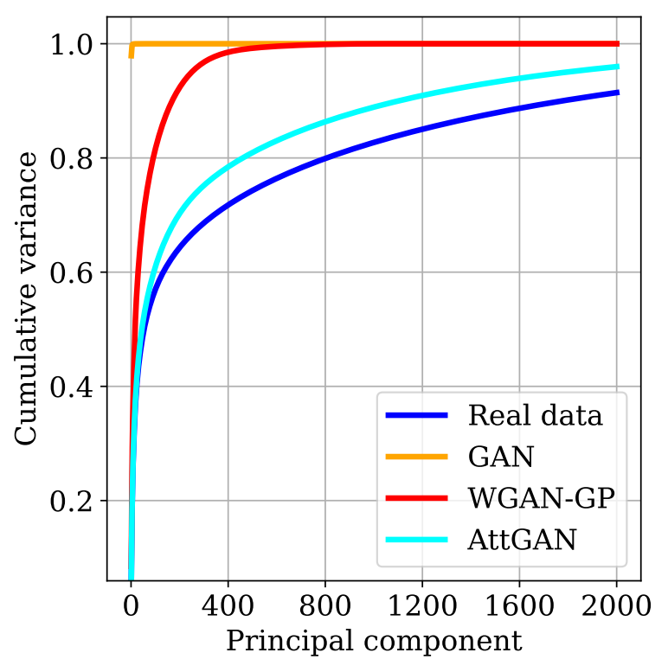
comparative evaluation
on tcga
9749 samples
20 531 gene expression level
6499, 1625, 1625 train/validation/test
33 cancer types
24 tissue types
unsupervised (precision/recall & pca)
attgan
more diverse data & more info preserved

Slide 15
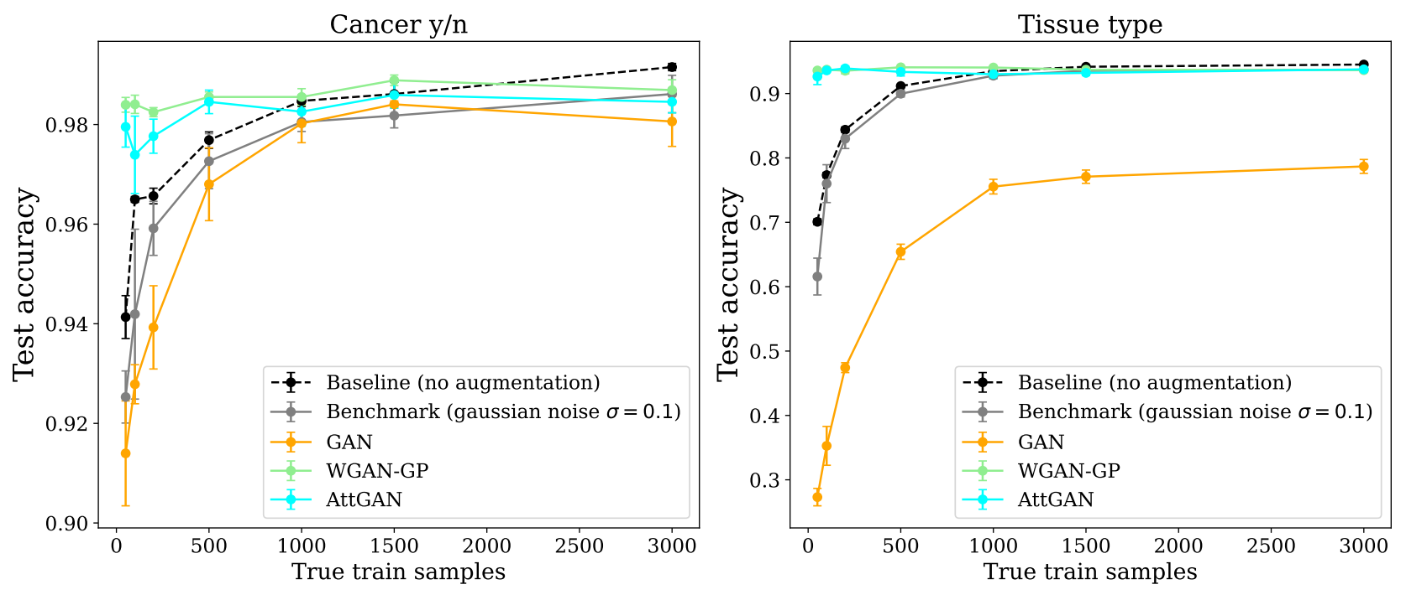
comparative evaluation
on tcga
9749 samples
20 531 gene expression level
6499, 1625, 1625 train/validation/test
33 cancer types
24 tissue types
supervised (accuracy: binary/multiclass)
8K synthetic
samples

Slide 16
comparative evaluation
take home message
9749 samples
20 531 gene expression level
6499, 1625, 1625 train/validation/test
33 cancer types
24 tissue types
significant gain in classification performance
attgan best in preserving data representation
not necessarily translating in better performance
benefits of data augmentation depend on the amount of true samples
limited impact of domain knowledge

Slide 17

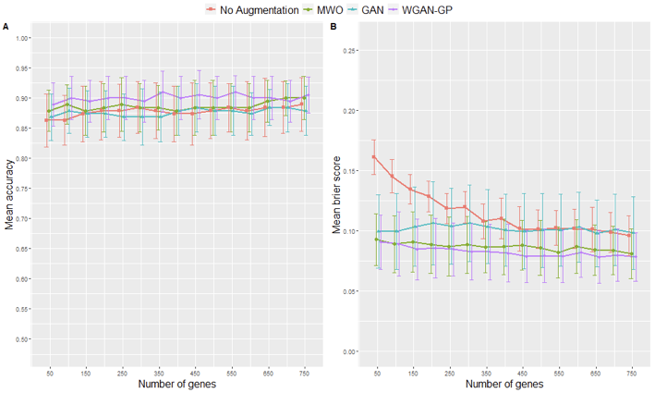
scaling down
on smaller datasets
273 samples [88 non-infectious + 115 viral + 70 bacterial]
22,277 genes
5 fold-cv on increasing number of top-genes
augmentation still working with a more limited gain

Slide 18
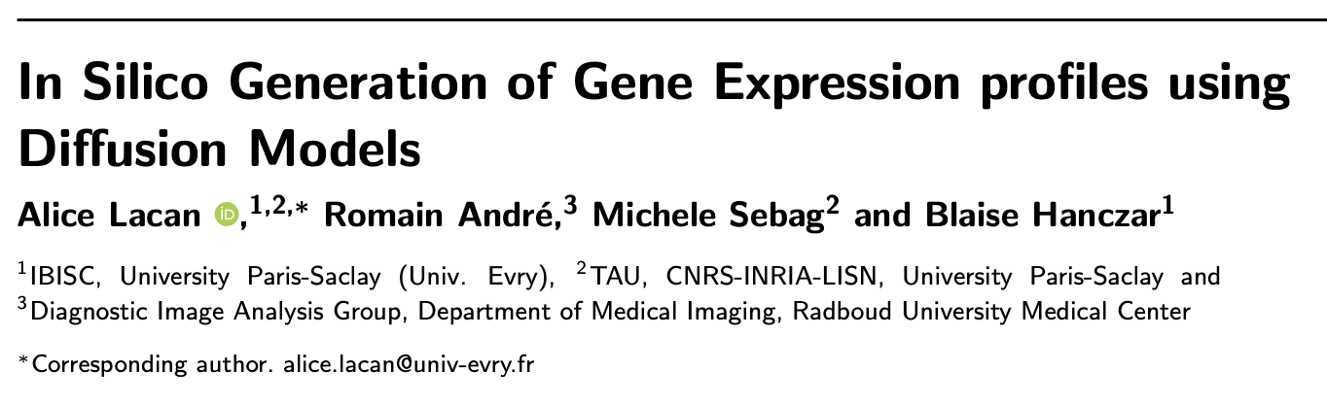
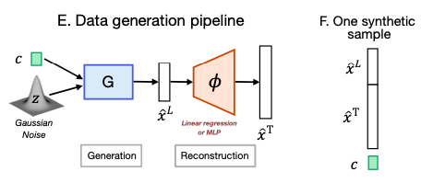
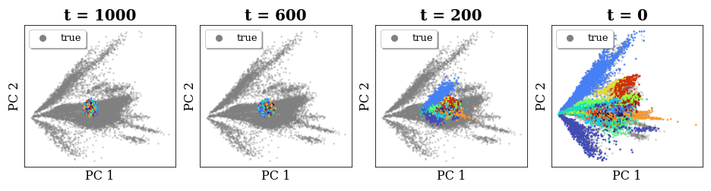

the new kid on the block
stable diffusion
9,796 – 2,448 – 5,000 train-validation-test samples
974 landmark genes
17,717 target genes,
26 tissues types
Notes:
DDPM (probabilistic, Ho et al 2020), DDIM (implicit, Song et al 2021) = state of the art DMs
The diffusion trajectories over the 1,000 diffusion steps show that synthetic data are initially grouped in the center of the image (t = 1, 000) and gradually spread across true data points (in grey) when t goes to 0, nicely grouping together the tissue-related clusters.

Slide 19
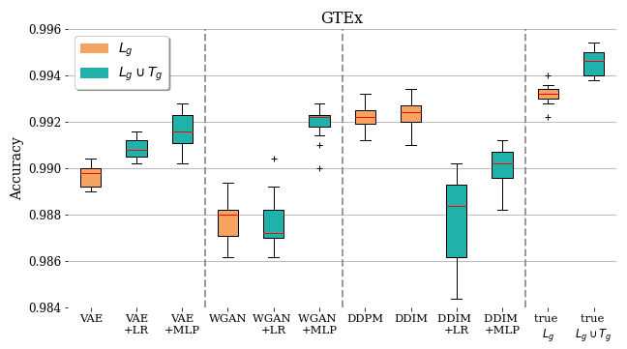
the new kid on the block
stable diffusion
stable diffusion models
competitive performance
easier, stabler & faster convergence
driven by covariates and domain knowledge
better filling of the representation space
larger size
9,796 – 2,448 – 5,000 train-validation-test samples
974 landmark genes
17,717 target genes,
26 tissues types

Slide 20
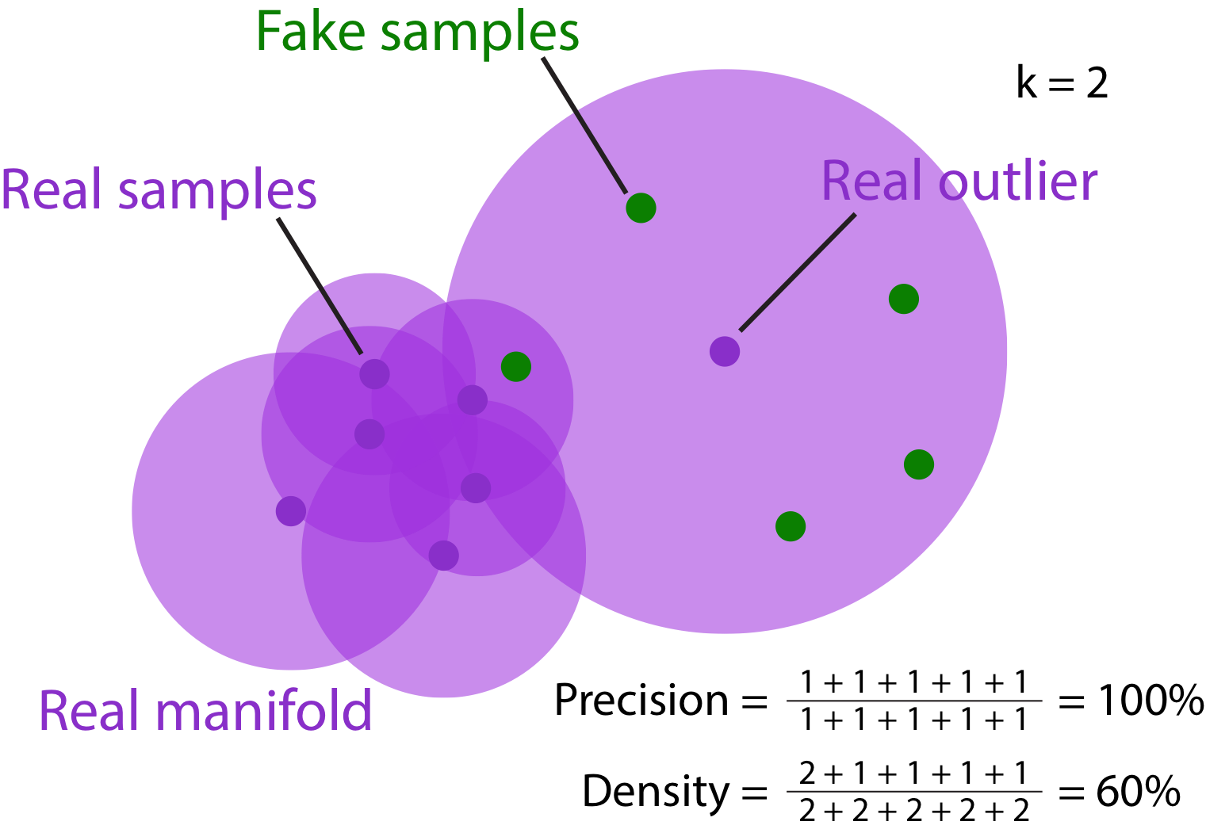
ongoing & future work
better/improved metrics to evaluate fidelity and diversity of generated data
  variants of precision/recall (Kynkäänniemi et al., 2019)
  density and coverage (Naeem et al., 2020)
data generation “stress test”
diffusion models vs. GANs

Slide 21

thank you / grazie !

