Slide 1
Genomic Insights into Pancreatic Cancer of an Italian Patient Cohort
24th June 2024
Federica Furia

Slide 2
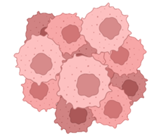
Pilot study: retrospective cohort of patients with pancreatic cancer
Summary of the analysed cohort of patients
N=58 (biobanked paired healthy/tumor pancreatic tissues)
Retrospective cohort
of PDAC patients
58 healthy tissues
58 tumor tissues
N=58
Analyzed samples
(short-read WGS
- 100X coverage)
PDAC: Pancreatic Ductal Adenocarcinoma

Slide 3
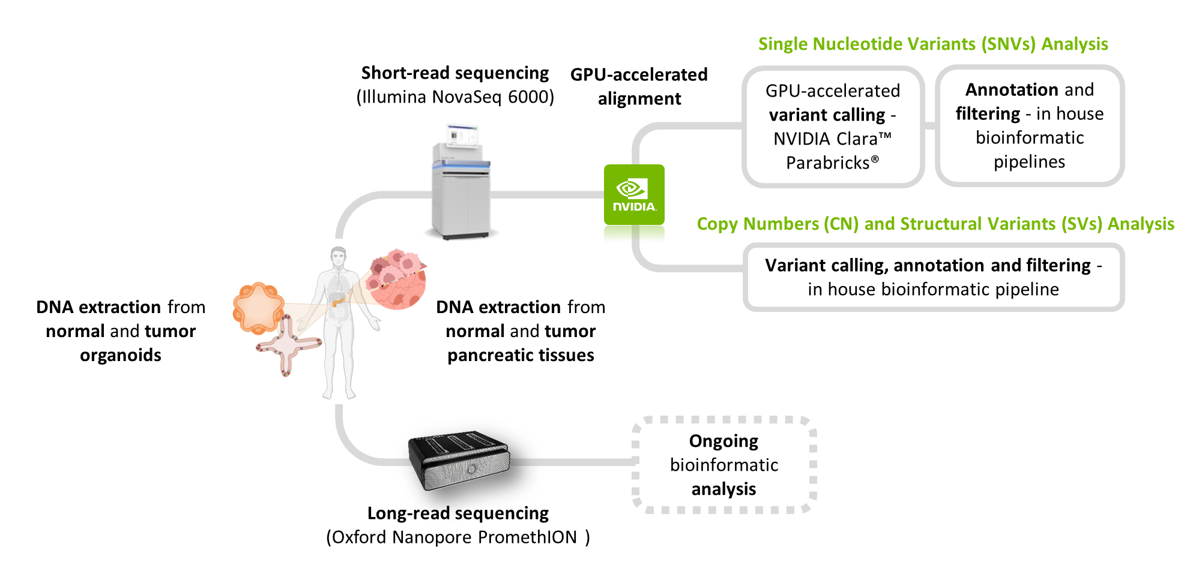
Schematic overview of the experimental workflow
Germline and somatic analysis using bioinformatic pipelines implemented in the CMP3VdA center

Slide 4
Quality controls on PDAC genomic data
Quality controls implemented on genomic data
TN and TT matches – BAM matcher
For 58/58 of the PDAC TN - TT matches the tool concluded:
“Bam files are from the same source”
Tumor purity – Facets
10 samples NA
48 samples have tumor purity (range: 0.15 – 0.76)
Tot= 58 samples
Sex analysis - CNVkit
30 female
28 male
To check according to clinical data
Tot= 58 patients
TN: Normal Tissue
TT: Tumor Tissue

Slide 5
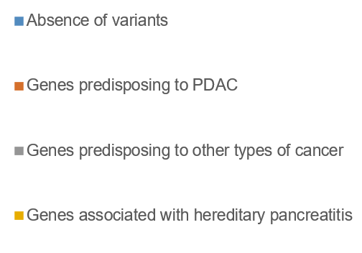
Germline Analysis of SNVs in HRC-PDAC Retrospective Cohort
Germline predisposing single nucleotide variants
BRCA2:c.8303_8304delTT (LP, AD)
CHEK2:c.1427C>T (LP, ?)
ATM:c.4396C>T (P, AD)
ATM:c.9047_9057delAACTGAAAGGA (P, LP, AD)
MLH1:c.50A>T (VUS/LP, AD/AR)
MSR1:c.818-1G>A (LP, ?)
RNASEL:c.793G>T (P, AD)
USP8:c.3037C>T (LP, ?)
LZTR1: c.2063G>A (LP, AD)
POLG:c.2243G>C (P, ?)
CTNND1:c.-214+1G>A (LP, AD)
CFTR:c.350G>A (P/LP, AD)
21% of patients (12/58) show germline P/LP variants in genes predisposing to PDAC, other types of cancer and hereditary pancreatitis

Slide 6
Germline Analysis of SNVs in HRC-PDAC Retrospective Cohort
Germline predisposing single nucleotide variants
RECESSIVE GENES PREDISPOSING TO OTHER TYPES OF CANCER
BUB1B:c.948_966delCAGGTCCTTGGAACACAGG (P,AR)
SLX4: c.1163+1G>A (LP, AR)
ERCC3:c.325C>T (P, AR)
MUTYH:c.1356_1358delGGA (P/LP, AR)
FANCM:c.5423-5427delCTCTT (LP, AR)
FANCM:c.5791C>T (P, AR)
CTC1:c.2016G>A (LP,AR)
RECESSIVE GENES PREDISPOSING TO OTHER DISEASES
STXBP2:c.1247-1G>C (P, AR)
CANT1:c.278delT (P, AR)
BRCA2:c.8303_8304delTT (LP, AD)
CHEK2:c.1427C>T (LP, ?)
ATM:c.4396C>T (P, AD)
ATM:c.9047_9057delAACTGAAAGGA (P, LP, AD)
MLH1:c.50A>T (VUS/LP, AD/AR)
MSR1:c.818-1G>A (LP, ?)
RNASEL:c.793G>T (P, AD)
USP8:c.3037C>T (LP, ?)
LZTR1: c.2063G>A (LP, AD)
POLG:c.2243G>C (P, ?)
CTNND1:c.-214+1G>A (LP, AD)
CFTR:c.350G>A (P/LP, AD)
21% of patients (12/58) show germline P/LP variants in genes predisposing to PDAC, other types of cancer and hereditary pancreatitis

Slide 7
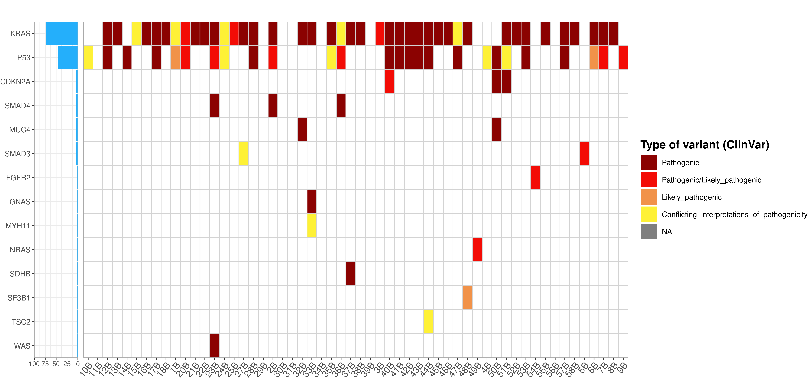
Somatic Analysis of SNVs in HRC-PDAC Retrospective Cohort
Somatic variant analysis – Tumor genomic landscape of somatic variants
*
*
*
* TMB-H: ≥ 10 mutazioni/Mb
(Barroso-Sousa et al, Annals of Oncology, 2020;O'Meara and Tolaney, Oncotarget, 2021)
Note: only P/LP and CI of P variants according to Clinvar
Mutational landscape on 56 samples (2 excluded: not adequate)

Slide 8
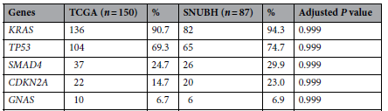
Somatic Analysis of SNVs in HRC-PDAC Retrospective Cohort
Somatic variants analysis - Percentage of mutations identified in key pancreatic cancer genes in the PDAC cohort
Percentage of mutations identified in key pancreatic cancer genes in the HRC-PDAC cohort
Frequency of PDAC patients reported in TCGA and Korean cohorts
73.21%
55.36%
46.43%
21.43%
21.43%
8.93%
8.93%
1.79%
5.36%
5.36%
1.79%
Jung K. et al. Scientific Reports (2022) 12:20937
Note: 56 PDAC patients in total – Genomic alterations include P/LP and CI of P SNVs and copy number variations (CNV) gain or loss.

Slide 9
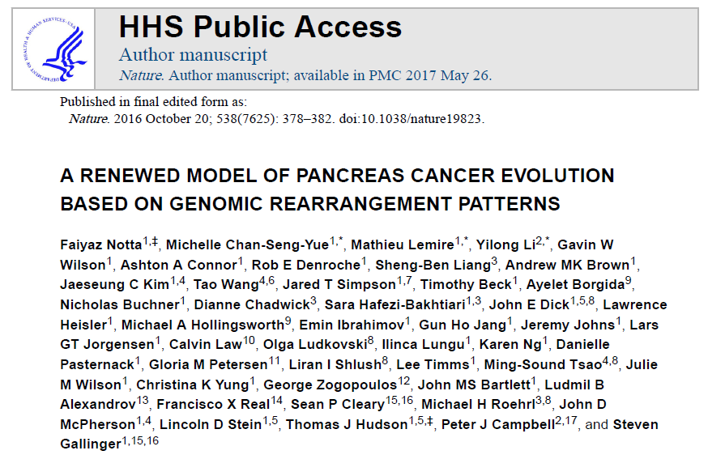
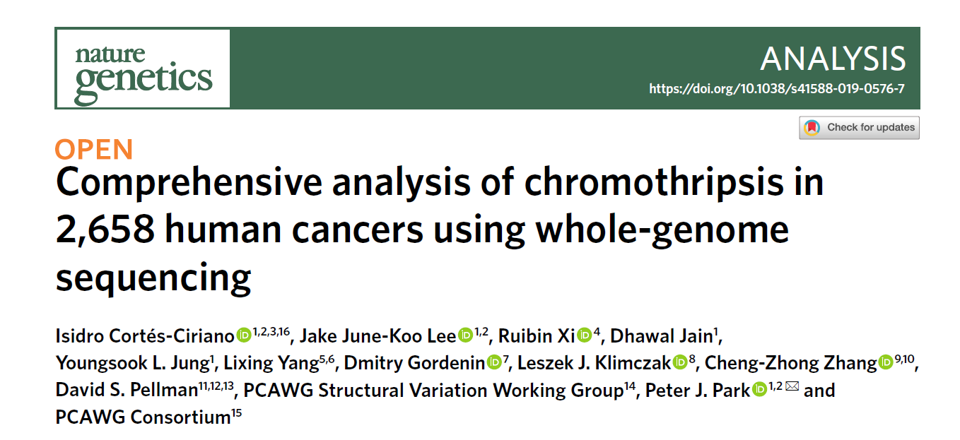
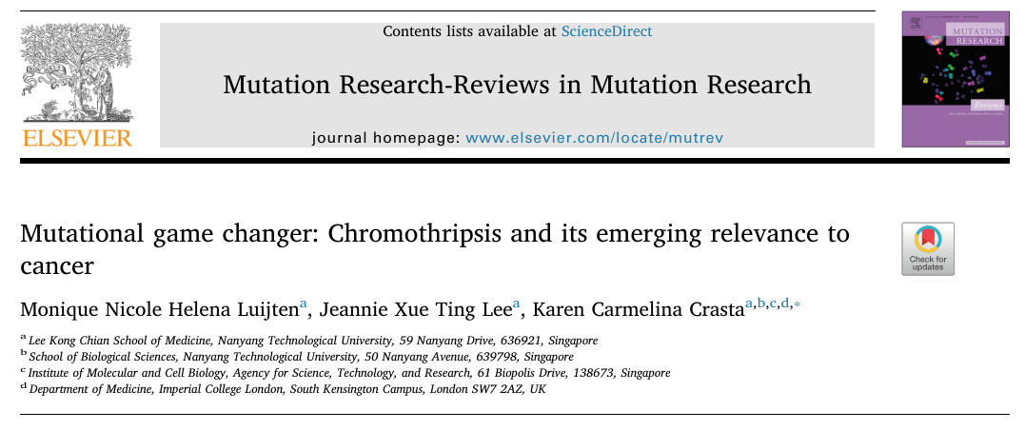
Chromothripsis analysis in HRC-PDAC Retrospective Cohort
58 PANCREATIC
DUCTAL
ADENOCARCINOMAS
Number of high-confidence chromothripsis events in PDAC cohort = 48/58 (82.7%) but the percentage of chromothripsis events according to the litterature seems to be lower

Slide 10
Chromothripsis analysis in HRC-PDAC Retrospective Cohort
58 PANCREATIC
DUCTAL
ADENOCARCINOMAS
Number of high-confidence chromothripsis events in PDAC cohort = 48/58 (82.7%) but the percentage of chromothripsis events according to the litterature seems to be lower

Slide 11
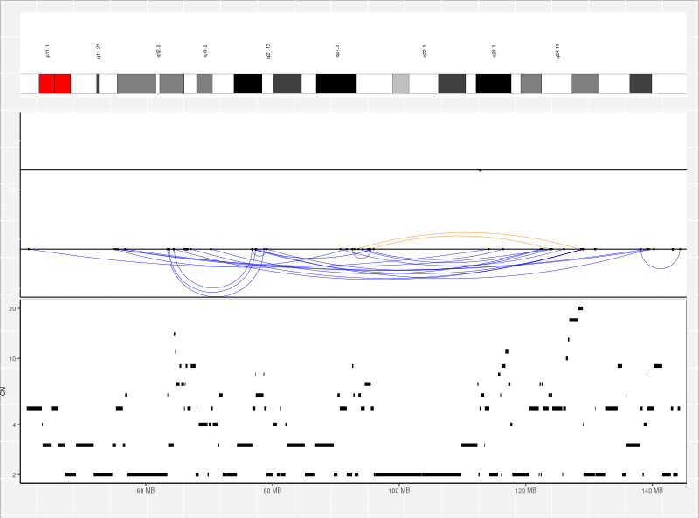
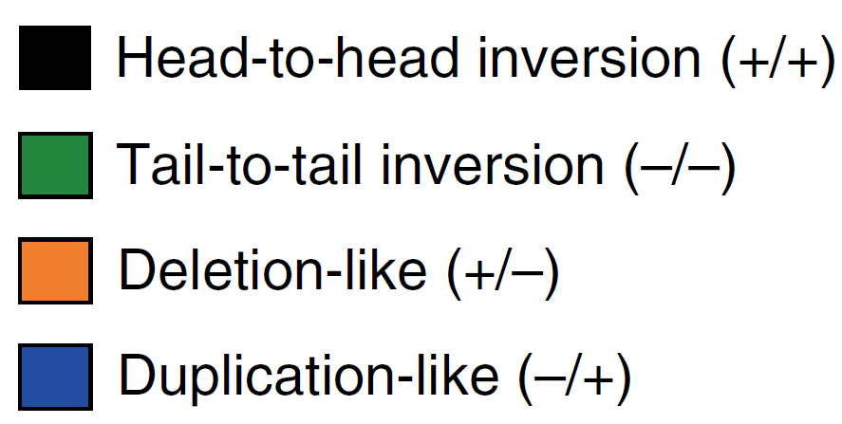
Example of chromothripsis event in HRC-PDAC Retrospective Cohort
1 PANCREATIC
DUCTAL
ADENOCARCINOMA
Chromothripsis event on chr. 8
Oncogene MYC affected
Patient: 57A_57B
Ploidy status: 3.18
Samples | Tumor Purity - Facets | N. of high-confidence chromothripsis events | N. of high-confidence chromothripsis events - post improvements
57A_57B | 0.37 | 14 | 2
Clusters of interleaved SVs
Oscillating CN patterns

Slide 12
Conclusions and future directions
Deeper analysis of Structural Variants (SVs) and chromothripsis re-analysis on 58 PDAC samples after bioinformatic pipelines improvements
Mutational signatures analysis
Identification of lnRNAs in deleted or amplified genomic regions
Data sharing with Humanitas researchers in order to compare results and bioinformatic pipelines
Meta-analysis using TCGA and/or PCAWG genomic data

Slide 13
Thank you for the attention
Federica Furia

