Slide 1
Dissecting tumor transcriptional heterogeneity using single-cell RNA-seq data.
raffaele.calogero@unito.it

Slide 2
Benchmark experiments
BE1:
  A single cell RNAseq benchmark experiment embedding “controlled” cancer heterogeneity
BE2:
  Generating surrogate tumor-tissues for spatial transcriptomics benchmarking
BE3:
  A benchmark experiment devoted to the validation of cell to cell crosstalk tools.

Slide 3
Benchmark experiments
BE1:
  A single cell RNAseq benchmark experiment embedding “controlled” cancer heterogeneity (Arigoni et al. Sci. Data 2024)
BE3:
  A benchmark experiment devoted to the validation of cell-to-cell crosstalk tools. (In progress)
BE2:
  Generating surrogate tumor-tissues for spatial transcriptomics benchmarking

Slide 4
BE1
A single cell RNAseq benchmark experiment embedding “controlled” cancer heterogeneity (Completed)

Slide 5
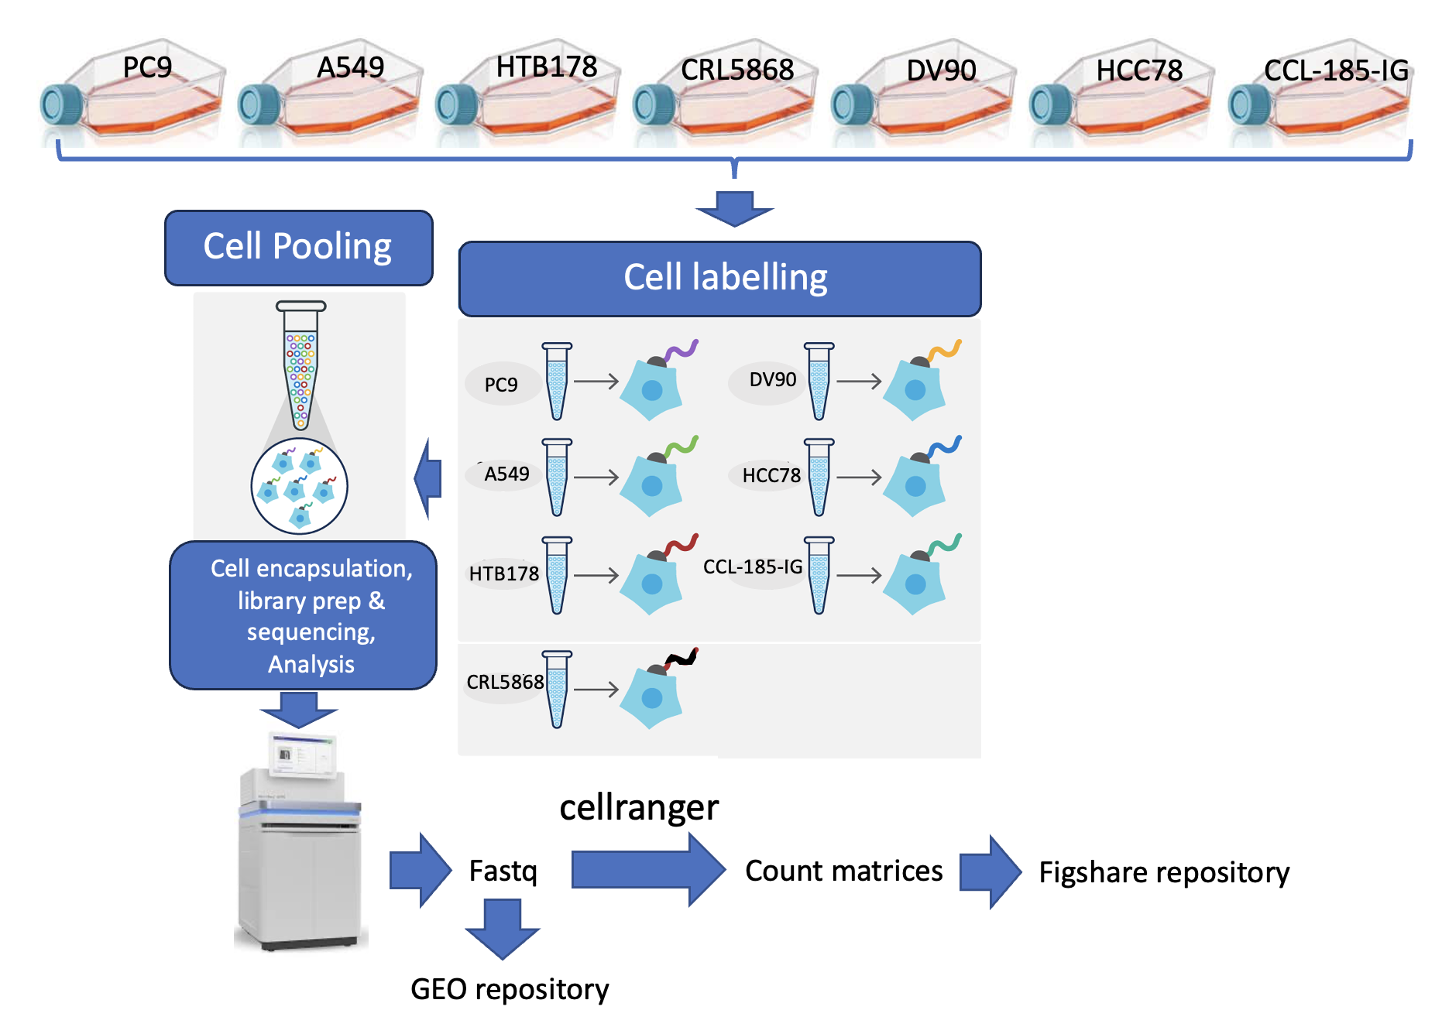
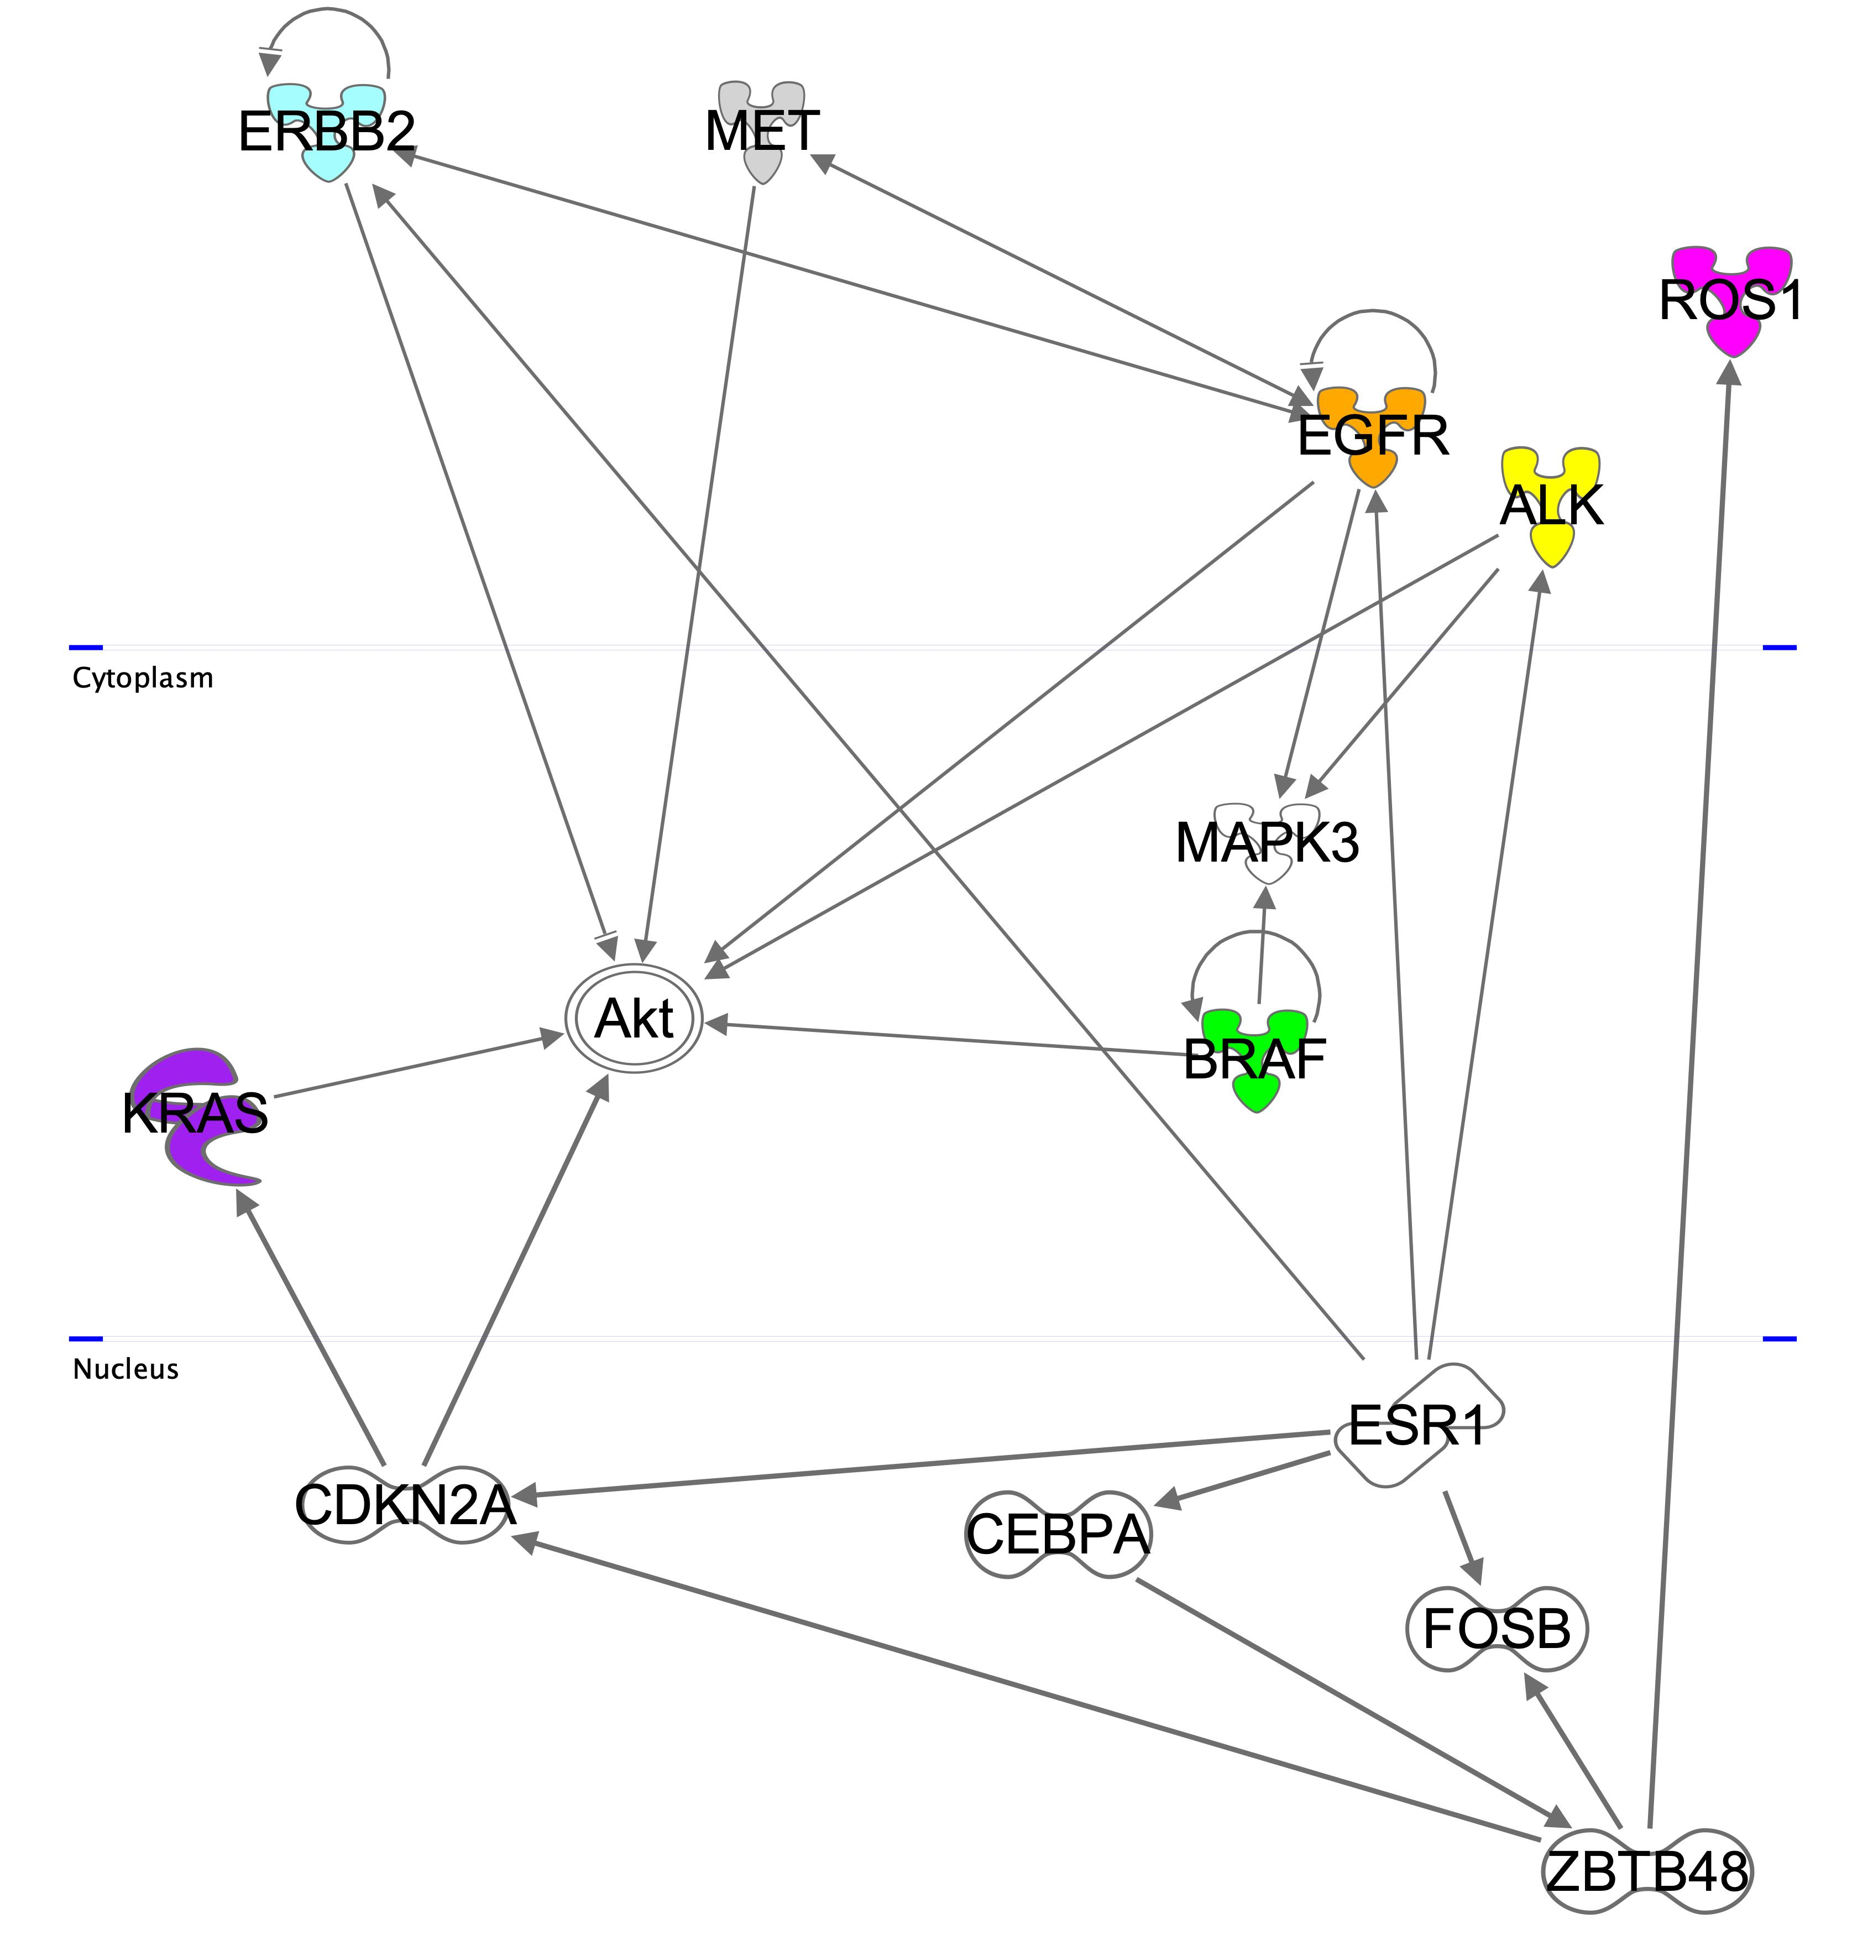
A
B
Plasma membrane
HTB178
DV90
HCC78
PC9
CCL-185-IG
Cytoplasm
A549
CRL5868
Nucleus

Slide 6
A
B
C
80
80
CCL-185-IG
CRL5868
80
40
A549
40
% of mitochondrial counts
40
0
0
0
0
20
40
0
20
40
0
20
40
% of ribosomal counts
% of ribosomal counts
F
% of ribosomal counts
D
DV90
E
HCC78
HTB178
80
60
30
40
20
40
% of mitochondrial counts
20
10
0
0
0
0
20
40
0
20
40
0
20
40
% of ribosomal counts
% of ribosomal counts
% of ribosomal counts
G
PC9
30
20
% of mitochondrial counts
10
0
0
20
40
% of ribosomal counts
Notes:
Fig. 2:” A) A549, B) CCL-185-IG, C) CRL5868, D) DV90, E) HCC78, F) HTB178, G) PC9

Slide 7
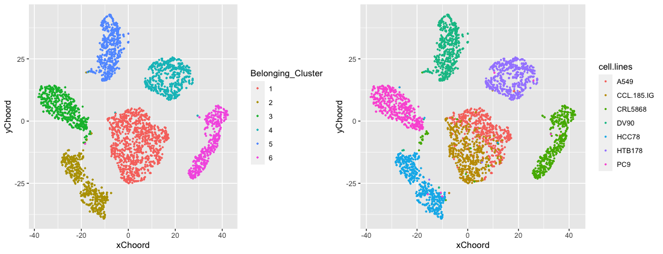
A
B
5
DV90
4
HTB178
3
PC9
CCL185IG
1
6
CRL5868
A549
2
HCC78
C
(PBLK)
CRL5868 (CCLE)
PC9 (PBLK)
PC9 (CCLE)
CRL5868 (PBLK)
DV90 (CCLE)
A549 (CCLE)
DV90 (PBLK)
HTB178 (CCLE)
HTB178 (PBLK)
HCC78 (CCLE)
HCC78 (PBLK)
A549
CCL-185-IG
Notes:
Fig. 3: BE1.500, 500 cells randomly selected from each of the seven cell lines experiment were combined in a unique dataset and clustered using Louvain modularity method. A) the clustering results are presented at a resolution of 0.1. B) cell lines association to the clusters. A549 and CCL-185-IG are syngeneic, and despite the expression of ALK in CCL-185-IG, this alone does not lead to the segregation of A549 and CCL-185-IG into distinct clusters. C) Hierarchical clustering of the clusters pseudo-bulks, generated by aggregating the expression levels of all cells within each cluster, and the bulk transcriptomes of the cell lines downloaded from Cancer Cell Lines Encyclopedia (CCLE). The clustering was done using the best 100 positively expressed markers depicted by COMET software for each cluster.

Slide 8
A
B
PC9 (PBLK)
PC9 (CCLE)
CRL5868 (PBLK)
PC9 (CCLE)
DV90 (PBLK)
CRL5868 (CCLE)
HTB178 (CCLE)
DV90 (CCLE)
HTB178 (PBLK)
HCC78 (PBLK)
A549 (CCLE)
HCC78 (CCLE)
A549/CCL-185-IG (PBLK)
H2228 (CCLE)
H838 (CCLE)
HCC827 (CCLE)
H1975 (CCLE)
H838 (Tian 2019)
H2228 (Tian 2019)
PC9 in vitro 3 dropseq (Aissa)
H1975 (Tian 2019)
HCC827 (Tian 2019)
PC9 (PBLK)
PC9 xenograft dropseq (Aissa)
A549 cls 2 (Tian 2019)
PC9 in vitro 2 dropseq (Aissa)
A549 cls 4 (Tian 2019)
PC9 in vitro 10X (Clark)
PC9 in vitro 10X (Aissa)
PC9 in vitro 1 dropseq (Aissa)
KRAS
KRAS
MET
BRAF
KRAS
EGFR
ROS1
EGFR
EGFR
EML4-ALK
ERBB2
EML4-ALK, KRAS
Notes:
Fig.4: Evaluating the similarity among the BE1-500 pseudo-bulk, previously published pseudo-bulk generated for lung cancer single cell data and CCLE cell line bulk transcription profiling. A) Tian et al. 2019 [ref]. This dataset includes: H2228 (PTPN3 KO [Jung et al (2012)], EML4-ALK Fusion [Isozaki et al (2015)]), H1975 (EGFR L858R and T790M mutations [Zhao et al. 2015]), A549 (KRAS p.G12S, growth and proliferation [Yoon et al. (2010)], H838 (KRASp.G12D [[Wang et al. (2019)]) and HCC827 (EGFR L858R mutation [Juchum et al. (2015)]) cell lines. B) pseudo-bulk data derived from scRNA-seq published by Aissa et al. (2021) GSM3972657, SM4494347, GSM3972651, GSM4869650 and Clark et al. (2023) GSM3972674 and GSM6106787.
,

Slide 9
A
B
Plasma membrane
HTB178
DV90
HCC78
PC9
PC9 (PBLK)
PC9 (CCLE)
CRL5868 (PBLK)
DV90 (PBLK)
CRL5868 (CCLE)
HTB178 (CCLE)
DV90 (CCLE)
HTB178 (PBLK)
HCC78 (PBLK)
A549 (CCLE)
HCC78 (CCLE)
Cytoplasm
A549/CCL-185-IG (PBLK)
H2228 (CCLE)
H838 (CCLE)
HCC827 (CCLE)
H1975 (CCLE)
H838 (Tian 2019)
H2228 (Tian 2019)
CCL-185-IG
H1975 (Tian 2019)
HCC827 (Tian 2019)
A549
A549 cls 2 (Tian 2019)
A549 cls 4 (Tian 2019)
CRL5868
Nucleus
KRAS
KRAS
MET
BRAF
KRAS
EGFR
ROS1
EGFR
EGFR
EML4-ALK
ERBB2
EML4-ALK, KRAS
Notes:
Fig.4: Evaluating the similarity among the BE1-500 pseudo-bulk, previously published pseudo-bulk generated for lung cancer single cell data and CCLE cell line bulk transcription profiling. A) Tian et al. 2019 [ref]. This dataset includes: H2228 (PTPN3 KO [Jung et al (2012)], EML4-ALK Fusion [Isozaki et al (2015)]), H1975 (EGFR L858R and T790M mutations [Zhao et al. 2015]), A549 (KRAS p.G12S, growth and proliferation [Yoon et al. (2010)], H838 (KRASp.G12D [[Wang et al. (2019)]) and HCC827 (EGFR L858R mutation [Juchum et al. (2015)]) cell lines. B) pseudo-bulk data derived from scRNA-seq published by Aissa et al. (2021) GSM3972657, SM4494347, GSM3972651, GSM4869650 and Clark et al. (2023) GSM3972674 and GSM6106787.
,

Slide 10
EGRF

Slide 11
BRAF

Slide 12
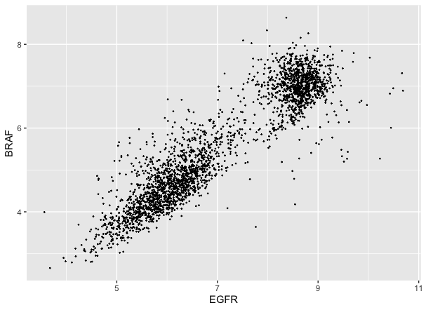
EGFR/BRAF (CRL5868)

Slide 13
KRAS

Slide 14
ALK

Slide 15
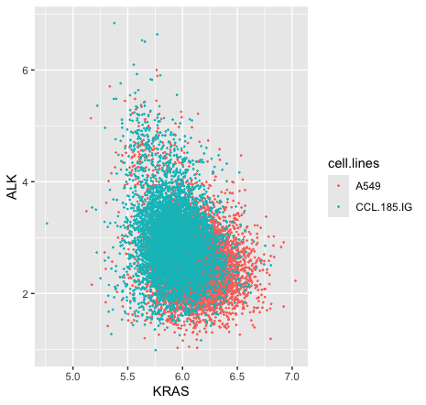
KRAS/ALK (A549, CCL185)

Slide 16
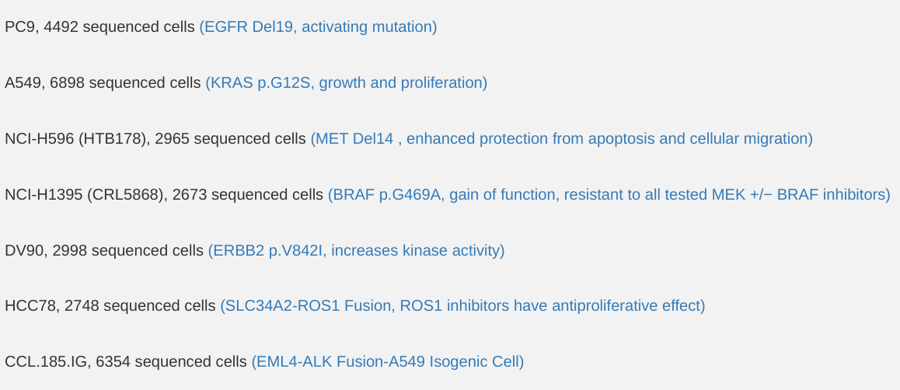
A test classifier
Train 60%
Test 40%

Slide 17
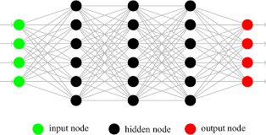
Results
We have enough Information at RNA-seq level
to discriminate those subpopulation
PC9 ➙ 99 %
A549 ➙ 99%
HTB178 ➙ 95%
CRL568 ➙ 94 %
DV90 ➙ 99 %
HCC78 ➙ 93 %
CCL185 ➙ 97 %
128
64
32
7
Genes expression

Slide 18
Searching for an approach able to discriminate between A549 and CCL185
Clustering approach tested:
  Seurat (Louvain modularity)
    fail
  Scanpy (Leiden algorithm)
    fail
  Sharp (Meta-clustering)
    fail
On going collaboration with Infolife CINI laboratory to setup a massive comparison of different clustering tools.

Slide 19
Searching for an approach able to discriminate between A549 and CCL185
Dimensionality reduction:
  Depicting bi-modal and multi-modal genes.
    fail
  Sparsely connected autoencoders (Alessandri et al. npj systems biology and applications 2021)
    In progress
Coexpression
  Double clustering through distribution analysis (Pernice et al. Bioinformactics 2023)
    In progress

Slide 20
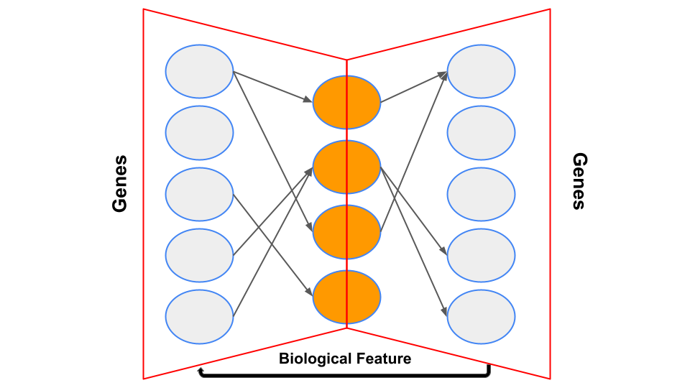
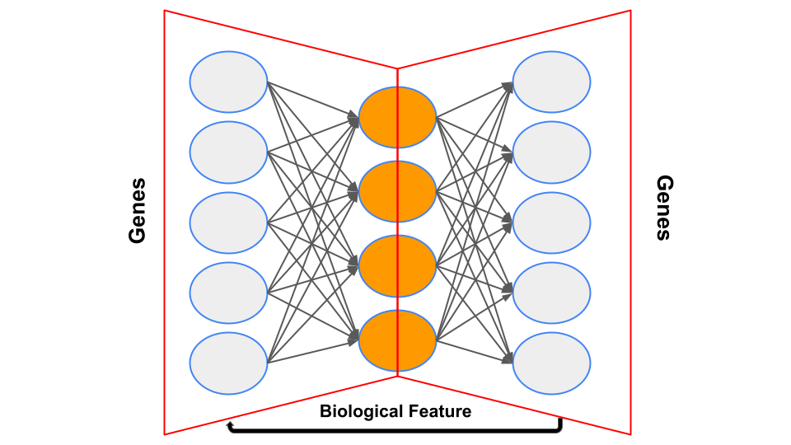
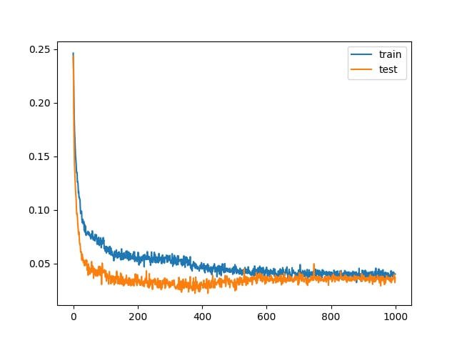
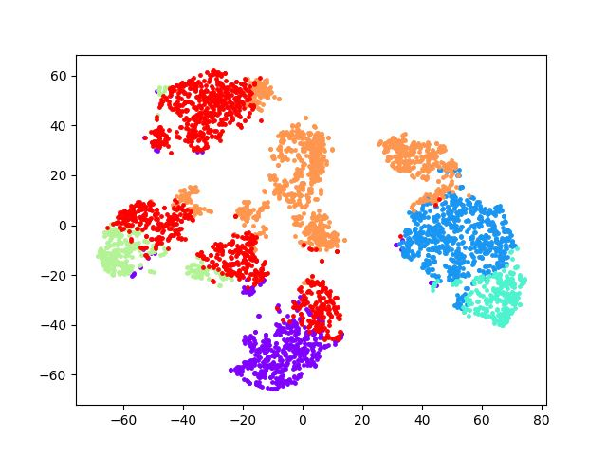
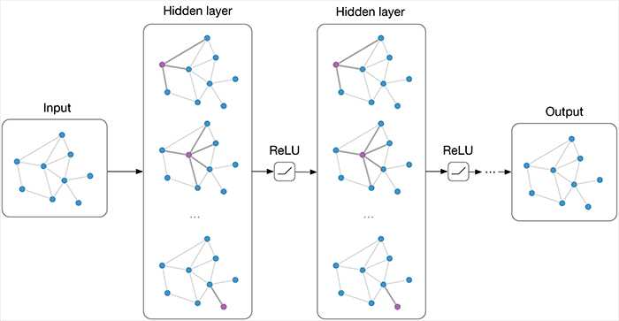

Sparsely-connected Autoencoder
Genes expression
https://www.gsea-msigdb.org/gsea/msigdb/human/genesets.jsp?collection=C6
Notes:
We are exploring a second approach using partially connected autoencoders. Autoencoders are a deep learning technique for dimensionality reduction. Unlike fully connected autoencoders, ours are sparsely connected. This means the connections are determined by a network based on biological information we want to investigate.
For instance, if analyzing transcription factors, the inputs are genes, the latent space represents transcription factors, and the connections are pre-determined based on known interactions between these factors and genes. This method is extendable to any biological information, such as microRNA or pathways. Currently, we are focusing on a new database of cancer-related pathways and genes. Here, each latent factor represents a specific cancer type, with connections based on known interactions between that cancer and various genes.
A significant bias in this analysis stems from the lack of connections rather than the connections themselves. To address this, after training the model to convergence, we save the weights, freeze the model, create a fully connected autoencoder, and continue training. This way, if the initially provided connections are sufficient, the model should not further converge. If new connections enhance the model, it indicates some previously unconsidered interactions.
We are also working on identifying important connections for our dataset, but this aspect is still in progress.

Slide 21
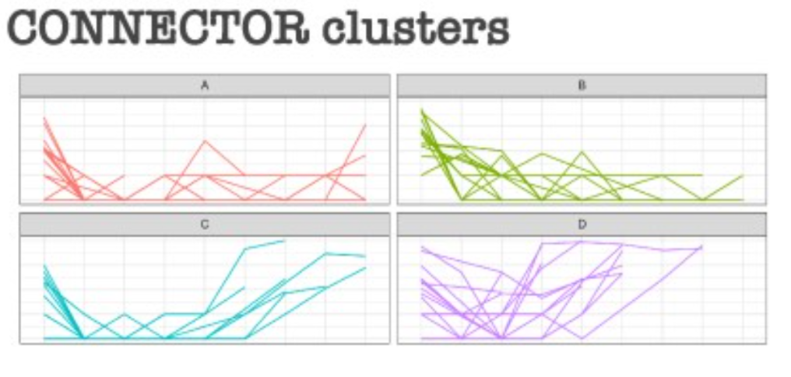
Double clustering through distribution analysis
Cluster genes
Filter cells
SIMLR Clustering
SIMLR
Clusters comparison
Ramazzotti D, Wang B, De Sano L (2024). SIMLR: Single-cell Interpretation via Multi-kernel LeaRning (SIMLR). R package version 1.30.0, https://github.com/BatzoglouLabSU/SIMLR.
Notes:
We are developing a clustering method focused on gene distributions for single-cell analysis. The main challenge in single-cell analysis is determining how granular to go to identify subpopulations. Our approach resembles an endogram, where we descend to the smallest possible subpopulations. We achieve this by examining gene distributions using a tool called Connector. This tool clusters genes based on their distribution curves.
The process involves:
Clustering genes with similar distribution curves using Connector.
Using these gene clusters to further cluster cells based on the genes in each cluster.
The expectation is to identify groups with significant distributions, while others may have normal distributions, likely representing housekeeping genes. This double clustering method involves:
Initial clustering by Connector based on gene distribution curves.
Secondary clustering of cells within these groups using k-means, analyzed through various configurations.
we utilize SIMLR for second clustering algorithm, despite its slower performance, it is way more precise.

Slide 22
BE3
  A benchmark experiment devoted to the validation of cell-to-cell crosstalk tools.
  (In progress)

Slide 23
State of the art
Identifying cellular cross-talk activity is one of the hot topics in single cell omics technologies.
Many tools, predicting how cells can transmit information to each other, have been developed in recent years.
One of the critical issues of this type of tools is the lack of datasets that can be used to evaluate their functional performance.
For this reason, we decided to build a specific benchmark dataset to validate this type of bioinformatics tools.

Slide 24
Experiment structure
Three cell line experiments:
  PC9 (lung cancer EGFR mutated) cultured alone
  DV90 (lung cancer ERBB2 over-expressed) cultured alone
  PC9/DV90 co-colture

Slide 25
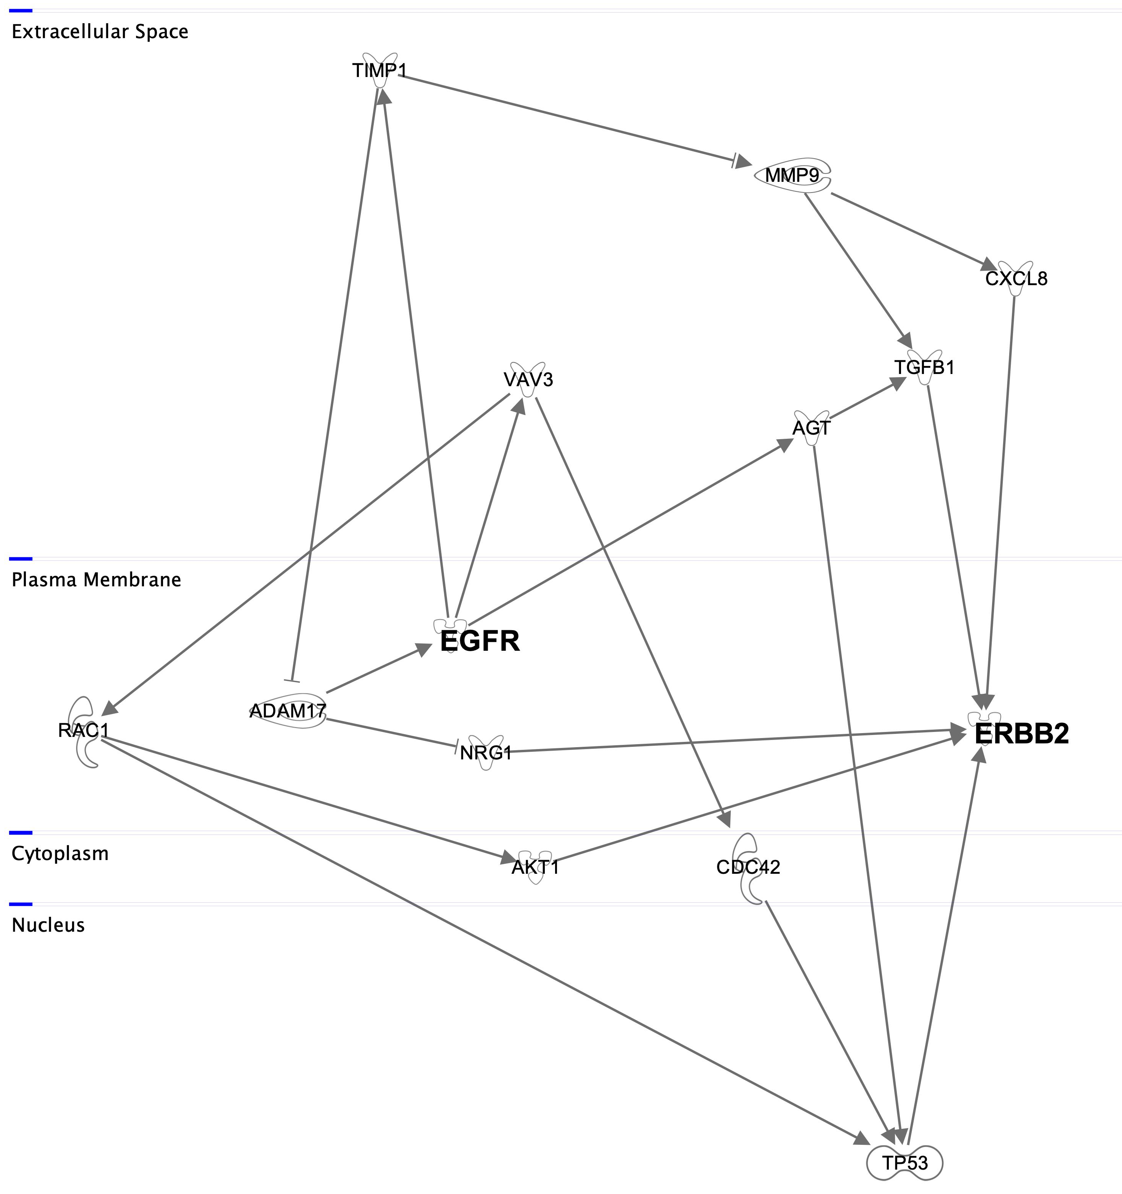
Extracellular space
Plasma membrane
(PC9)
(DV90)
Cytoplasm
Nucleus

Slide 26
Experiment structure
Three cell line experiments:
  PC9 (lung cancer EGFR mutated) cultured alone
  DV90 (lung cancer ERBB2 over-expressed) cultured alone
  PC9/DV90 co-colture
snRNAseq/snATACseq (10XGenomics platform)
Bulk-RNAseq/miRNAseq (intracellular and secreted microvesicles)
Bulk- phospho-proteomics and protein differential expression analysis (1400 proteins Sciomics service)

Slide 27










raffaele.calogero@unito.it

